Slide 1
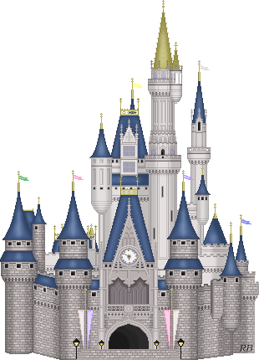
The Holy War

Slide 2
The Holy War
Made By King Shaddai Upon Diabolus for the Regaining of the Metropolis of the World
Or
The Losing and Taking Again of the Town of Mansoul

Slide 3
Class Format
Segment | Time
Review the week’s assignment | 10 minutes
Class discussion | 15 minutes
Specific lesson on theme from the week’s assignment | 10 minutes

Slide 4
Week 1
Beginning
to Opening of the gates to Diabolus

Slide 5
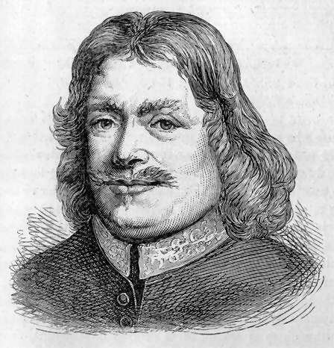
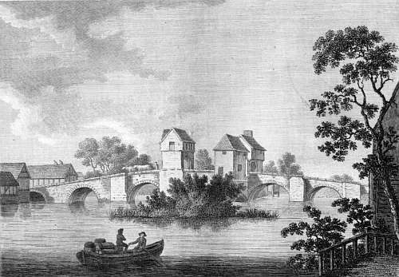
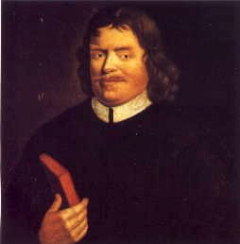
Introduction
John Bunyan (1628-1688)
Written sometime during the first six years of his incarceration in Bedford Prison.

Slide 6
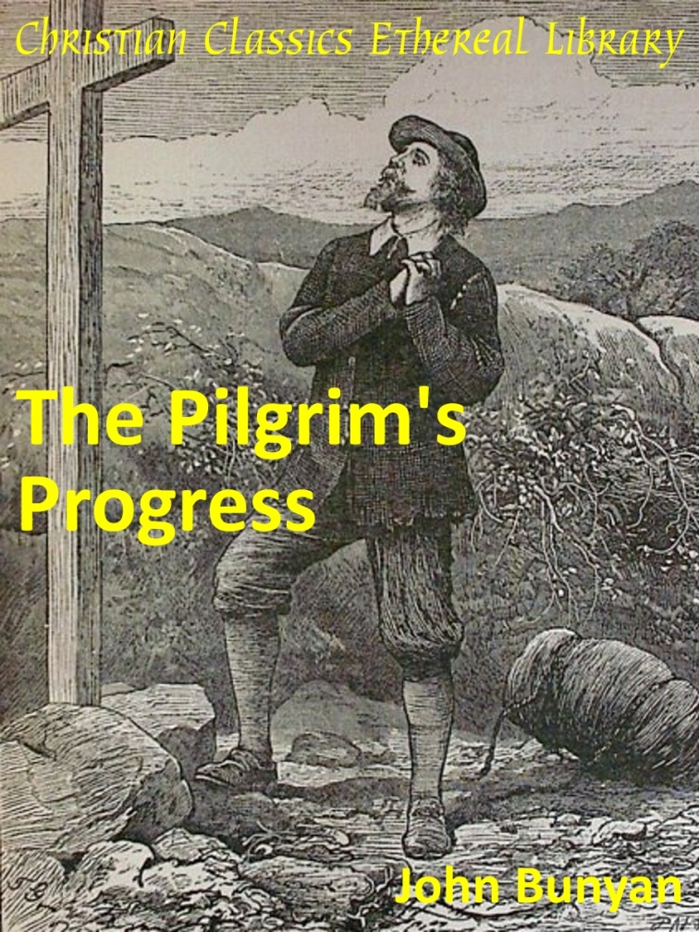
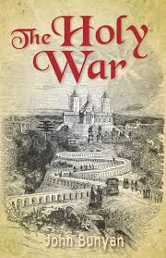
Pilgrim’s Progress vs The Holy War
How are these two works similar?
How are they different?

Slide 7
Setting
Like Pilgrim’s Progress, setting and story told from the perspective of one recounting events that have already taken place.
But same story is occurring constantly in the lives of believers.
Bunyan employs his wealth of military experience (terminology and strategy)

Slide 8
Goals
To gain a greater understanding of the spiritual warfare in which we are engaged.
To develop a greater awareness of the methods employed by Satan.
To deepen our appreciation for the grace of God in saving sinners.
To learn more about ourselves through empathizing with Mansoul (Mansoul = me)

Slide 9
Key Questions
What primary Bible passages come to your mind as you read this assignment?
To what degree does the story accurately depict Bible teaching?

Slide 10
Synopsis
2 Introductory Poems
“To the Reader” (summary)
“An Advertisement to the Reader” (defense of authorship)

Slide 11
To the Reader:
When men, let them make what they will their own,
Till they know this, are to themselves unknown.
…
For my part, I myself was in the town, …

Slide 12
To the Reader:
Mansoul, the desire of both princes was:
One keep his gain would, t'other gain his loss.

Slide 13
To the Reader:
Mansoul! her mighty wars, they did portend
Her weal or woe, and that world without end:
Wherefore she must be more concern'd than they
Whose fears begin, and end the selfsame day;
…
With those, which, if a Christian, thou wilt see
Not small, but things of greatest moment be.

Slide 14
Synopsis
2 Introductory Poems
“To the Reader” (summary)
“An Advertisement to the Reader” (defense of authorship)
In my travels… (Bunyan’s conversion and call to preach)
Description of town of Mansoul in the continent of Universe

Slide 15
Mansoul
“There is not its equal under the whole heaven.”
Lies between two worlds
Built and founded by Shaddai
For His own delight
The pinnacle of His creation
Intended to have dominion over all
Entered through one of 5 gates:
Ear, Eye, Mouth, Nose, Feel
Was perpetually defendable
Had well-built walls
Had abundant provisions
Could not be penetrated except by consent
Operated under the best law
Had Shaddai’s constant attention

Slide 16
Synopsis
2 Introductory Poems
“To the Reader” (summary)
“An Advertisement to the Reader” (defense of authorship)
In my travels… (Bunyan’s conversion and call to preach)
Description of town of Mansoul in the continent of Universe
Built by Shaddai
Enjoyed great privileges
Pinnacle of His creation
5 gates (Ear-gate, Eye-gate, Mouth-gate, Nose-gate, Feel-gate)
Prior assault of Diabolus
Diabolonians interest in Mansoul

Slide 17
Character Sketches: Main Forces
Shaddai
A Hebrew title frequently used of God the Father in the OT
Translated “Almighty”
Communicates His All-sufficiency
Comes from the Hebrew word for breast – nourishment
Rightful owner of Mansoul
Diabolus
King of the Blacks (Dark world)
Great and mighty, but poor and beggarly prince
Greek and Latin name for the Devil
Signifies the Accuser or Slanderer
The head of the whole company of fallen spirits
Mansoulians
Natives of Mansoul
Parts of the inner man
Diabolonians
Intruders, often residing for extended time in Mansoul
Elements of the flesh that reside in every believer (even after salvation)

Slide 18
Synopsis
2 Introductory Poems
“To the Reader” (summary)
“An Advertisement to the Reader” (defense of authorship)
In my travels… (Bunyan’s conversion and call to preach)
Description of town of Mansoul in the continent of Universe
Built by Shaddai
Enjoyed great privileges
Pinnacle of His creation
5 gates (Ear-gate, Eye-gate, Mouth-gate, Nose-gate, Feel-gate)
Prior assault of Diabolus
Diabolonians interest in Mansoul
Council of war

Slide 19
Character Sketches: War Council
Diabolus – The Greek and Latin name for the Devil (Accuser or Slanderer).
Alecto – Fierce being, one of the Furies (heathen gods),
Tisiphone – Another Fury of the lake (sister of Alecto). Associated with torment and suffering.
Apollyon – Destroyer
Beelzebub – Lord of Flies / Filth
Lucifer – The Morning Star
Ill-pause – Orator in difficult speeches
Legion – named of those demonizing the man in Mark 5:9

Slide 20
Synopsis
2 Introductory Poems
“To the Reader” (summary)
“An Advertisement to the Reader” (defense of authorship)
In my travels… (Bunyan’s conversion and call to preach)
Description of town of Mansoul in the continent of Universe
Built by Shaddai
Enjoyed great privileges
Pinnacle of His creation
5 gates (Ear-gate, Eye-gate, Mouth-gate, Nose-gate, Feel-gate)
Prior assault of Diabolus
Diabolonians interest in Mansoul
Council of war
“Assault” at Ear-gate
Death of Captain Resistance and Lord Innocency
Opening of Ear-gate and Eye-gate

Slide 21
Character Sketches: Leaders of Mansoul
The leaders of the town represent the facets of the inner man most immediately involved in responding to sin:
Lord Will-be-will – Emphasizes the role of the will in relenting or resisting
Lord-Mayor Mr. Understanding – Involved in understanding of truth
Mr. Recorder – Memory but particularly Conscience
Captain Resistance
Only man of war in the town
Resistance to sin
Lord Innocent
Innocence before sin entered
When they eat the fruit, he dies.

Slide 22
Application

Slide 23
The Holy War

