Slide 1
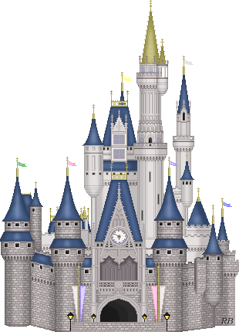
The Holy War

Slide 2
Week 5
The captains resolve for battle
to A fight within the town

Slide 3
Goals
To gain a greater understanding of the spiritual warfare in which we are engaged.
To develop a greater awareness of the methods employed by Satan.
To deepen our appreciation for the grace of God in saving sinners.
To learn more about ourselves through empathizing with Mansoul (Mansoul = me)

Slide 4
Key Questions
What primary Bible passages come to your mind as you read this assignment?
To what degree does the story accurately depict Bible teaching?

Slide 5
Synopsis
The captains battle long against Mansoul then retreat and employ other tactics that are effective in causing a mutiny against Diabolus within the town.

Slide 6
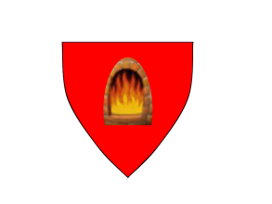
The 4 Captains
Captain | Color | Scutcheon | Significance | Place
Boanerges | Black |  |  | First
Conviction | Pale |  |  | Middle
Judgment | Red |  |  | Middle
Execution | Red |  |  | Last
Awakened preaching of the Word with boldness
Exposure to offenses against
the Law of God
Terror produced in an informed conscience
Finality of the penalty of rejection

Slide 7
The Assault Begins
What significant cry marks the beginning of the assault by Shaddai’s army?
“YE MUST BE BORN AGAIN”
(from John 3 - Jesus with Nicodemus)
What is the significance of the cry?
It clearly states the conditions of surrender
The necessity (“Ye must”)
The nature (“be born again”)

Slide 8
Defense of the Town
What were the names of the two guns that were positioned above Ear-gate and trained on Shaddai’s men?
High-mind
Heady
What do these guns signify?
The men of the city “trusted much” in themselves, rather than in the words from Shaddai.
These represent man’s pride in himself and his own way.
These guns were forged in Diabolus’ foundry by Mr. Puff-up.
Should the Gospel messenger be afraid of these?
What do the battering rams of Shaddai’s army signify?
The forceful thrusts of the Word of God

Slide 9
New Recruits
As the captains had travelled across the land to the town of Mansoul, they met “three young fellows that had a mind to go for soldiers”
Mr. Tradition
Mr. Human-Wisdom
Mr. Man’s-Invention
What happened to these 3 during the battle?
“They did not so much live by religion as by the fates of fortune”
These represent elements of human effort and reliance
They are poor substitutes for true spiritual power or a relationship with God.
In the heat of the battle they will prove unreliable.
When they “change sides” to join Diabolus, they are finally wearing the correct uniform.

Slide 10
Exploits of the Town
What “exploits” did the town make against the armies of Shaddai?
Protected ear-gate
Captured the 3 men
Caused great expense and much loss
Forced a retreat to a winter camp (less intense interaction)

Slide 11
Exploits of the Captains
What exploits did the armies of Shaddai make against the town?
Bravely attempted to open ear-gate with slings and battering rams
Destroyed the roof of Mayor Incredulity so that he was “more open” than before
Hit Lord Willbewill with a sling and almost killed him
Killed 6 aldermen with one shot (Swearing, Whoring, Fury, Stand-to-Lies, Drunkenness, Cheating) (quote p. 31)
“Dismounted” the 2 great guns and “laid them flat”
What is significant about each of the above gains in relation to the Word of God at work chipping away at man’s stubborn resistance to God’s calling?

Slide 12
3 Summons
Summons 1: Words of peace
Summons 2: A little more roughly
Summons 3: Yet more roughly
Then what happens?
Lord Willbewill calls for a parley
He says the townsmen can come to agreement with the captains under certain conditions
Describe the conditions

Slide 13
Conditions
We want to:
Retain our old leadership
Retain all aspects of our present rebellion without penalty
Retain our former practices engaged in under Diabolus
Have veto power over any new authority
Basically:
“We will surrender to you if we can do it without surrendering.”

Slide 14
Responses
What is Boanerges’ response?
He was initially glad but then his gladness was turned to sorrow
He said the captains reject the terms “with the highest disdain”
He insists that they trust Shaddai to make the terms for them (quote p. 34)
What is the towns response?
Incredulity: “I, for my part, will never yield to so unlimited a proposition.”
His speech “undid all, and threw flat to the ground their hopes of an accord.”

Slide 15
Mutiny
Diabolus is happy with incredulity yet all is not well for Diabolus in the town
Mr. Recorder (Conscience) begins to sound like his old self again
He and the old mayor Lord Understanding begin to agitate the people
They rush upon Incredulity’s house and try to tear it down
The people in the town are now split between Diabolus and Shaddai
The tumult comes to blows
Mr. Benumbing almost takes out Mr. Conscience
Mr. Rashhead has his brains beaten out by Mr. Mind
Mr. Prejudice is “kicked and tumbled about in the dirt” and his crown is cracked
Mr. Anything has one of his legs broken

Slide 16
Change in Willbewil
How does it end?
Lord Willbewill is indifferent to the mutinee
He actually smiles to see Mr. Prejudice kicked about

Slide 17
Application

Slide 18
The Holy War

