Slide 1

1

Slide 2

Who is God the Father?
Blessed be the God and Father of our Lord Jesus Christ, the Father of mercies and God of all comfort (NASB; II Cor. 1:3).
We have seen and testify that the Father has sent the Son to be the Savior of the World (NASB; 1 John 4:14).
For God so loved the world, that he gave his only begotten Son, that whosoever believeth in him should not perish, but have everlasting life (KJV; John 3:16).
But as many as received Him, to them He gave the right to
become children of God, even to those who believe in His name (NASB; John 1:12).
14

Slide 3

God the Father is the eternal Father of our Lord Jesus Christ, Who so loved the world that He gave His only begotten Son, that by faith we might become His little children (1 John 2:1, 12; 5:20-21) and He our heavenly Father.

Slide 4
Who is God the Son?
. . . and we saw His glory, glory as of the only begotten
from the Father, full of grace and truth. (NASB; John 1:14 ).
And He is the radiance of His glory and the exact
representation of His nature . . . (NASB; Heb. 1:3).
And the Word became flesh, and dwelt among us . . .
(NASB; John 1:14).
. . . Christ according to the flesh, who is over all, God blessed forever. Amen (NASB; Rom. 9:5).
For in Him all the fullness of Deity dwells in bodily form
(NASB; Col. 2:9).
15

Slide 5
God the Son is “the only begotten from the Father,” “the radiance of His glory and the exact representation of His nature,” Who, being the eternal Son of God, became man, and so was, and continues to be, God and man in two distinct natures, and one person, forever
(Westminster Shorter Catechism, Q. 21)

Slide 6
Who is God the Holy Spirit?
How much more will the blood of Christ, who through
the eternal Spirit offered Himself without blemish to God,
cleanse your conscience from dead works to serve the
living God (NASB; Heb. 9:14)?
When the Helper comes, whom I will send to you from
the Father [see John 14:26], that is the Spirit of truth
who proceeds from the Father, He will testify about Me
(NASB John 15:26).
. . . baptizing them in the name of the Father and the Son
and the Holy Spirit (NASB; Matt. 28:19).
John 14:16; Rom. 8:15-17
16

Slide 7
God the Holy Spirit is the eternal Spirit proceeding from the Father, sent by the Father and the Son, but of one and the same essence, majesty and glory with both; and given me, to make me by a true faith, partaker of Christ and all His benefits, that He may comfort me and abide with me forever.
(Belgic Confession (1561), Article 11; Heidelberg Catechism (1563), Q. 53)

Slide 8
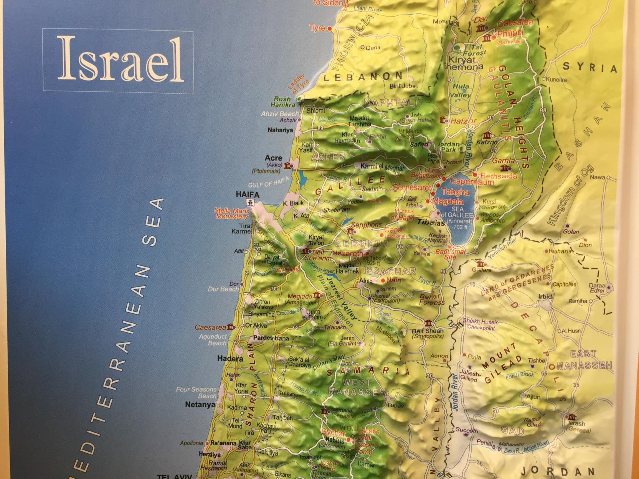

Slide 9
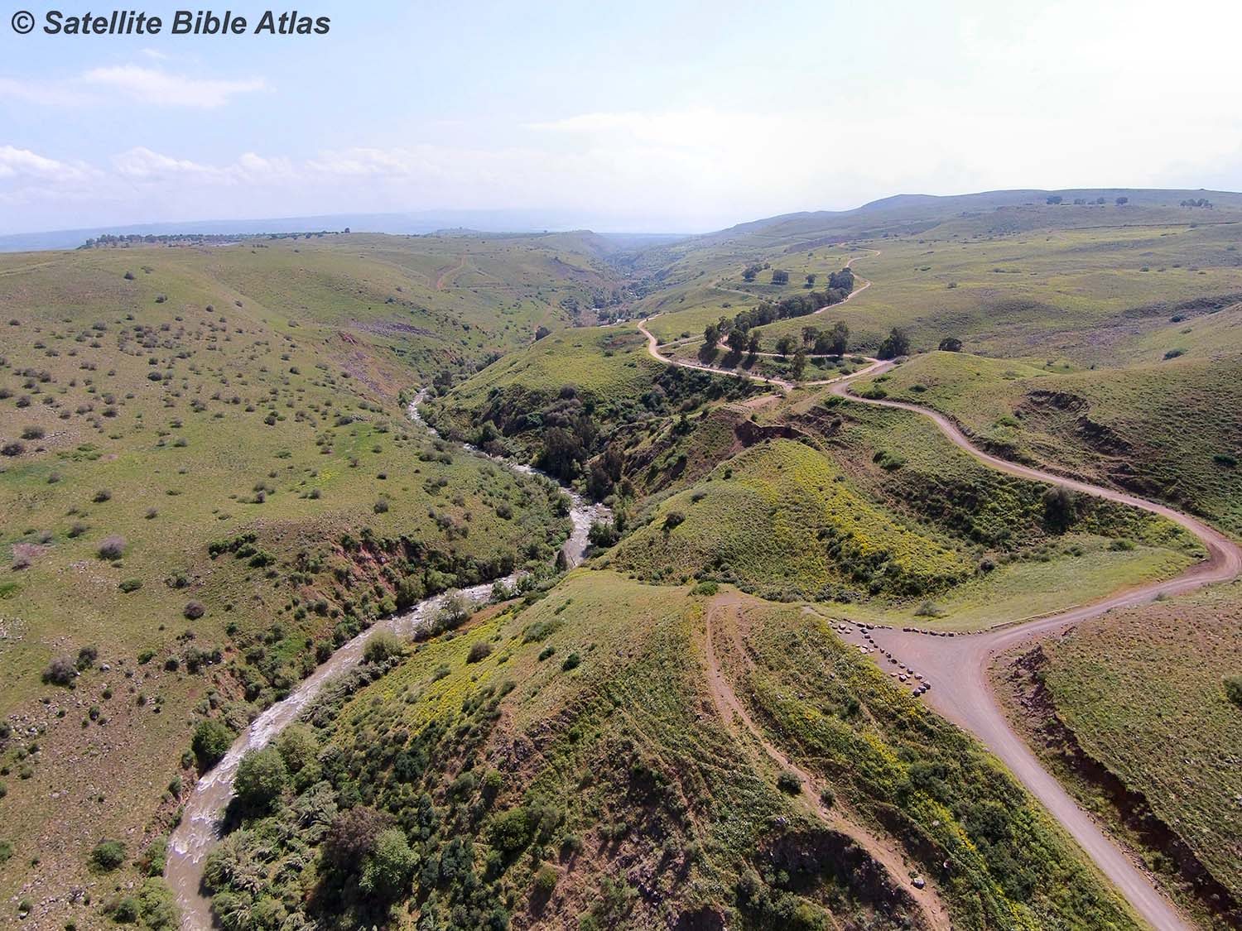

Slide 10
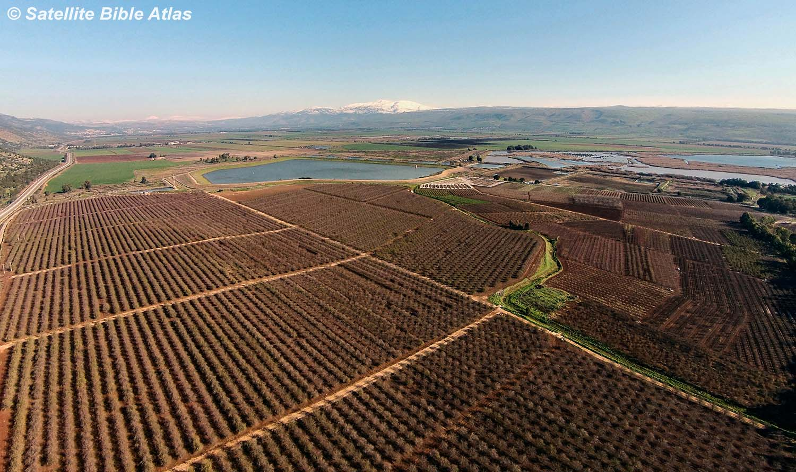

Slide 11
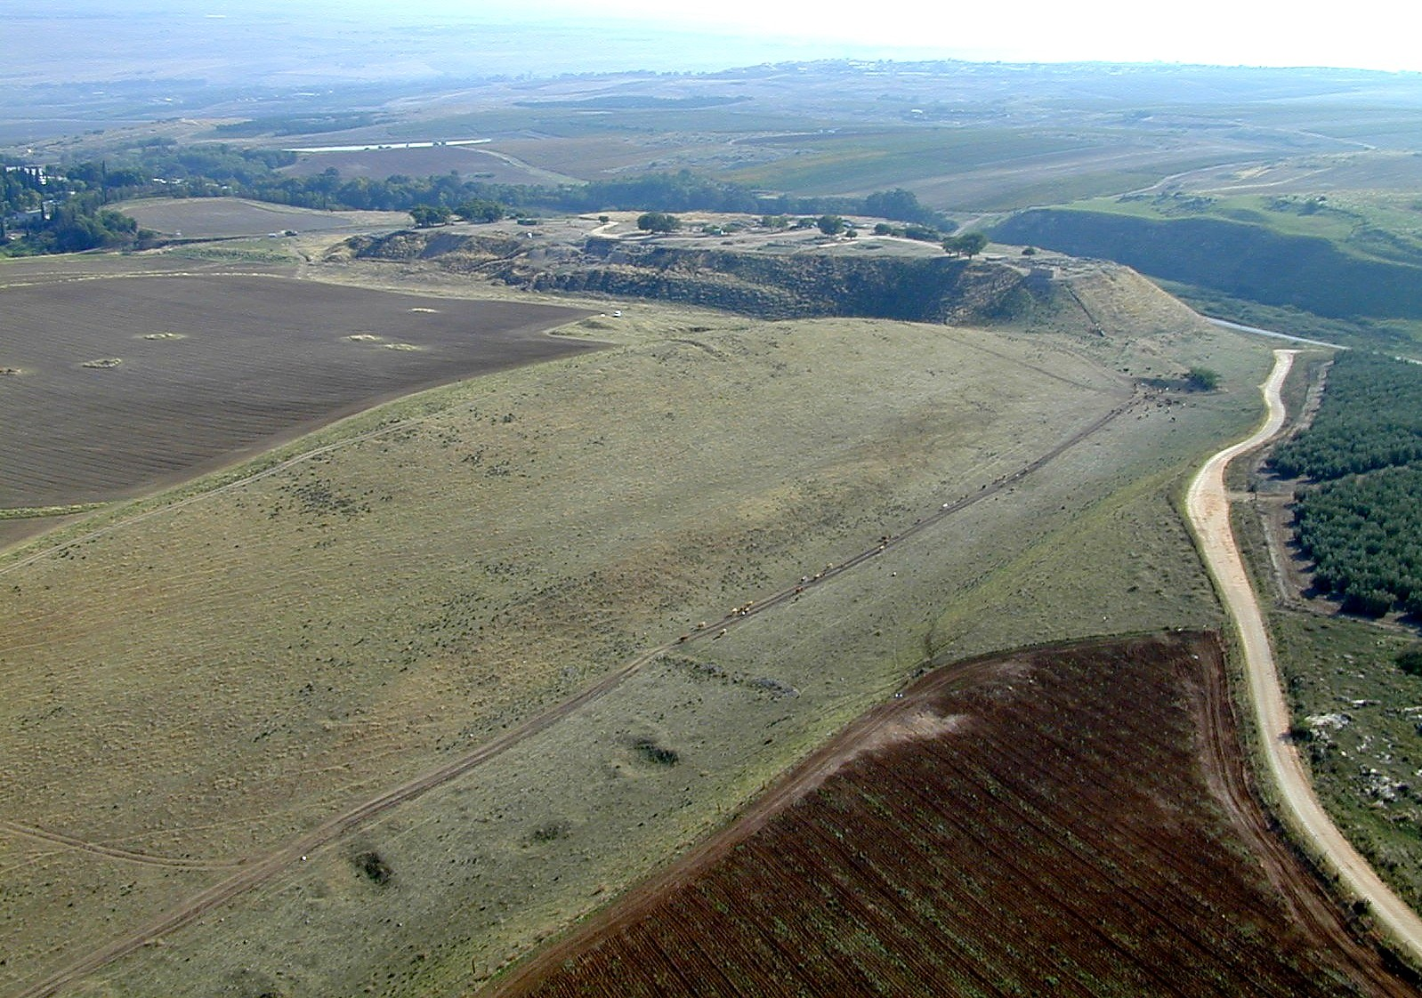

Slide 12
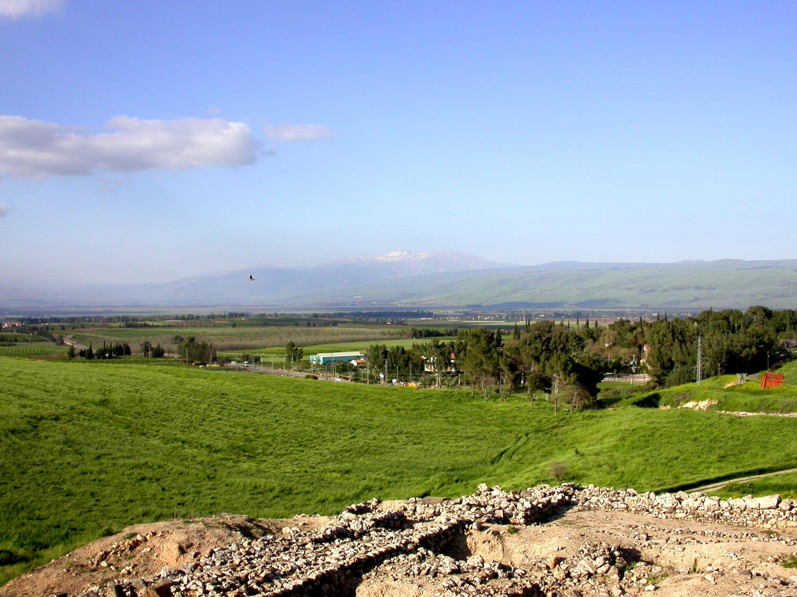

Slide 13
Joshua conquered (Joshua 11).

Slide 14
Joshua conquered (Joshua 11).
Jabin, king of Canaan, reigned in Hazor in the time of the Judges. His military commander was Sisera. They oppressed Israel 20 years (Judges 4).

Slide 15
Joshua conquered (Joshua 11).
Jabin, king of Canaan, reigned in Hazor in the time of the Judges. His military
commander was Sisera. They oppressed
Israel 20 years (Judges 4).
Solomon fortified Hazor, Megiddo, and
Gezer (I Kings 9).

Slide 16
Then Joshua turned back at that time, and captured Hazor and struck its king with the sword; for Hazor formerly was the head of all these kingdoms.
Joshua 11:10

Slide 17
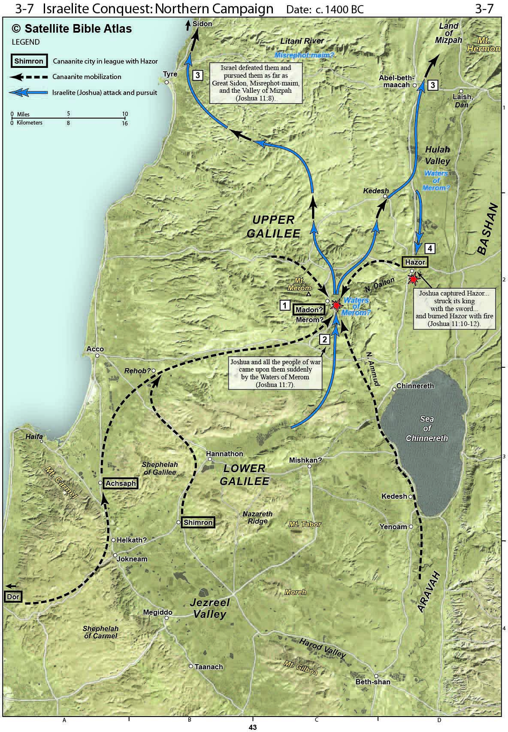

Slide 18
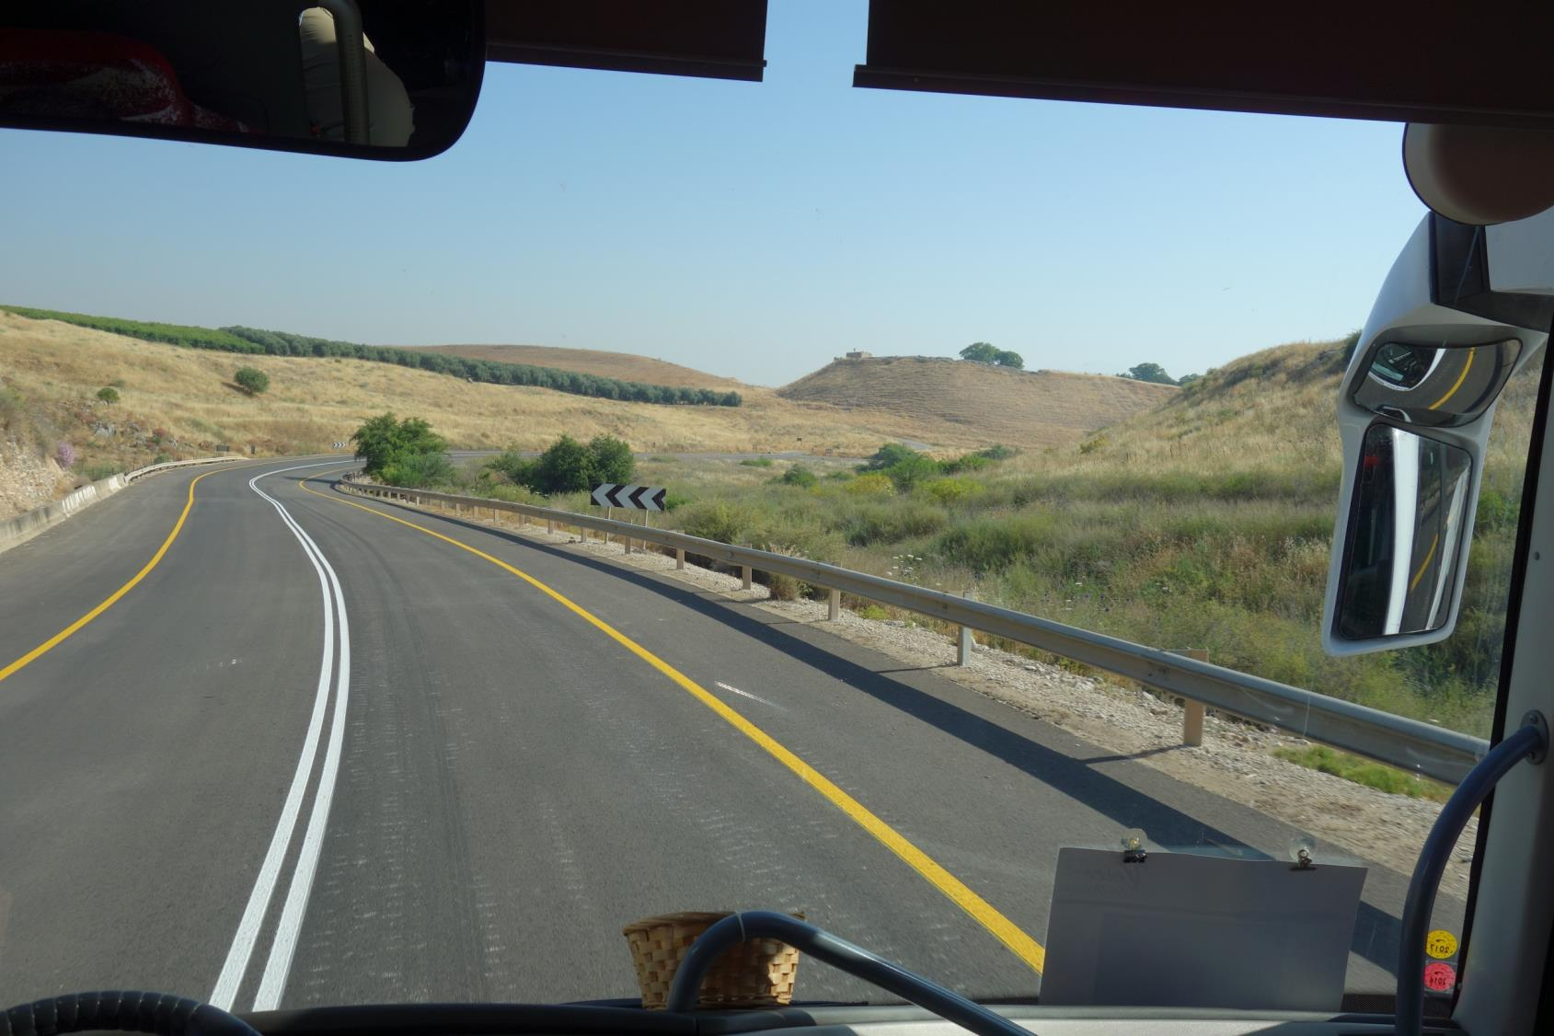

Slide 19
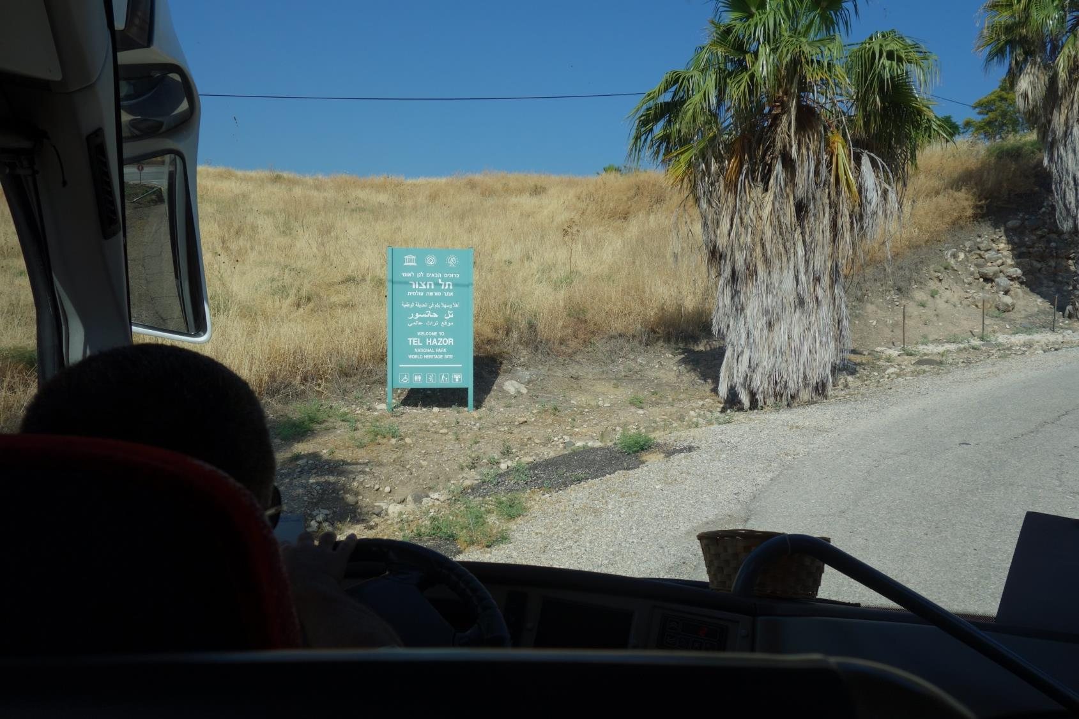

Slide 20
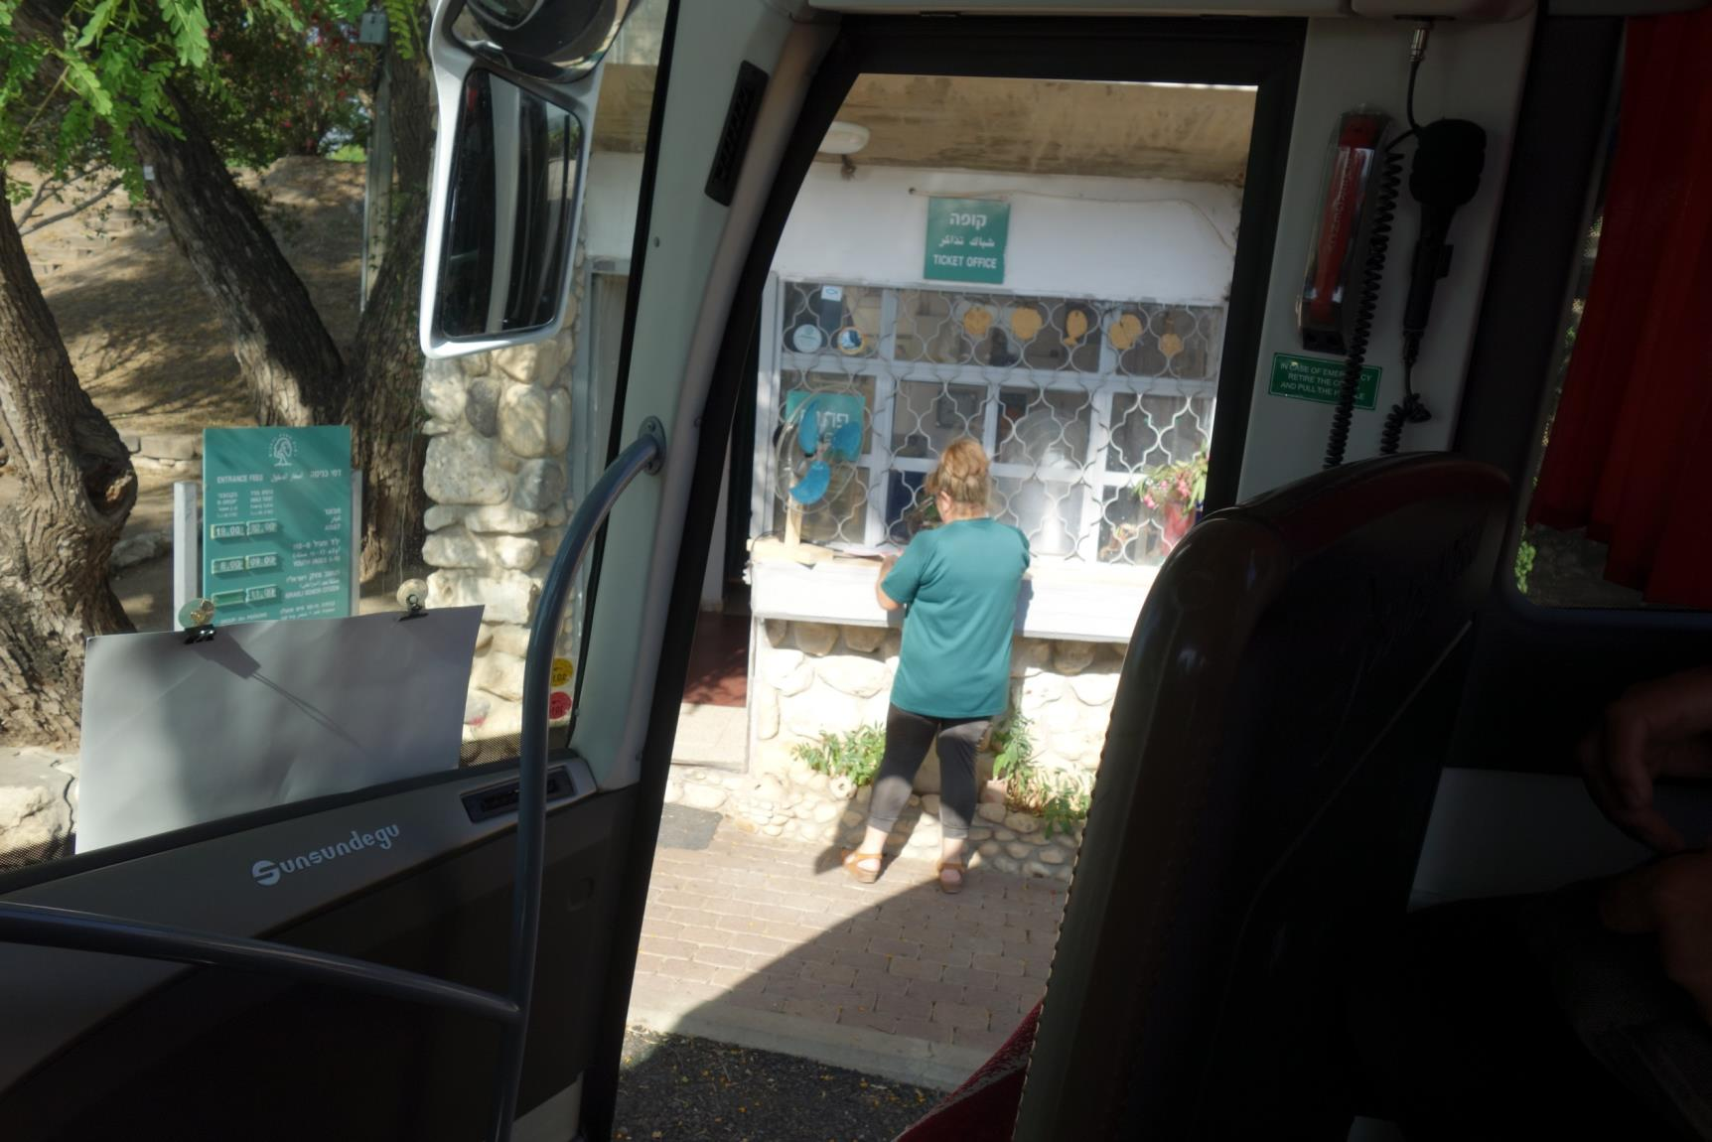

Slide 21
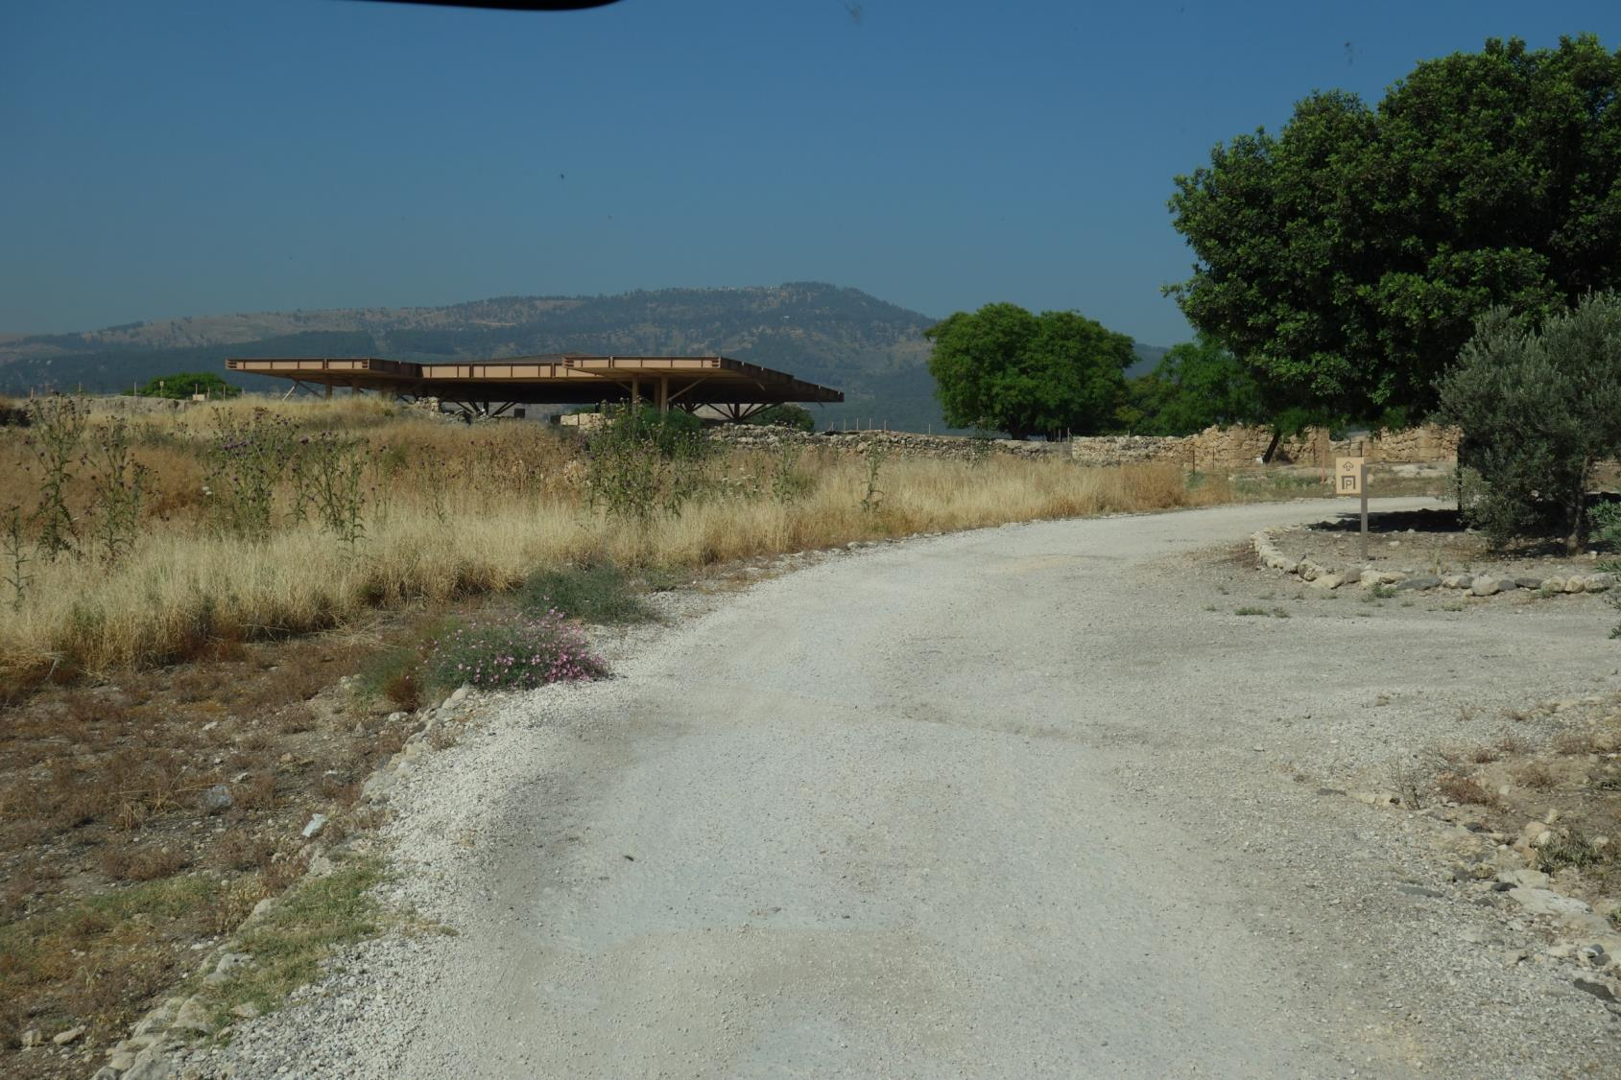

Slide 22
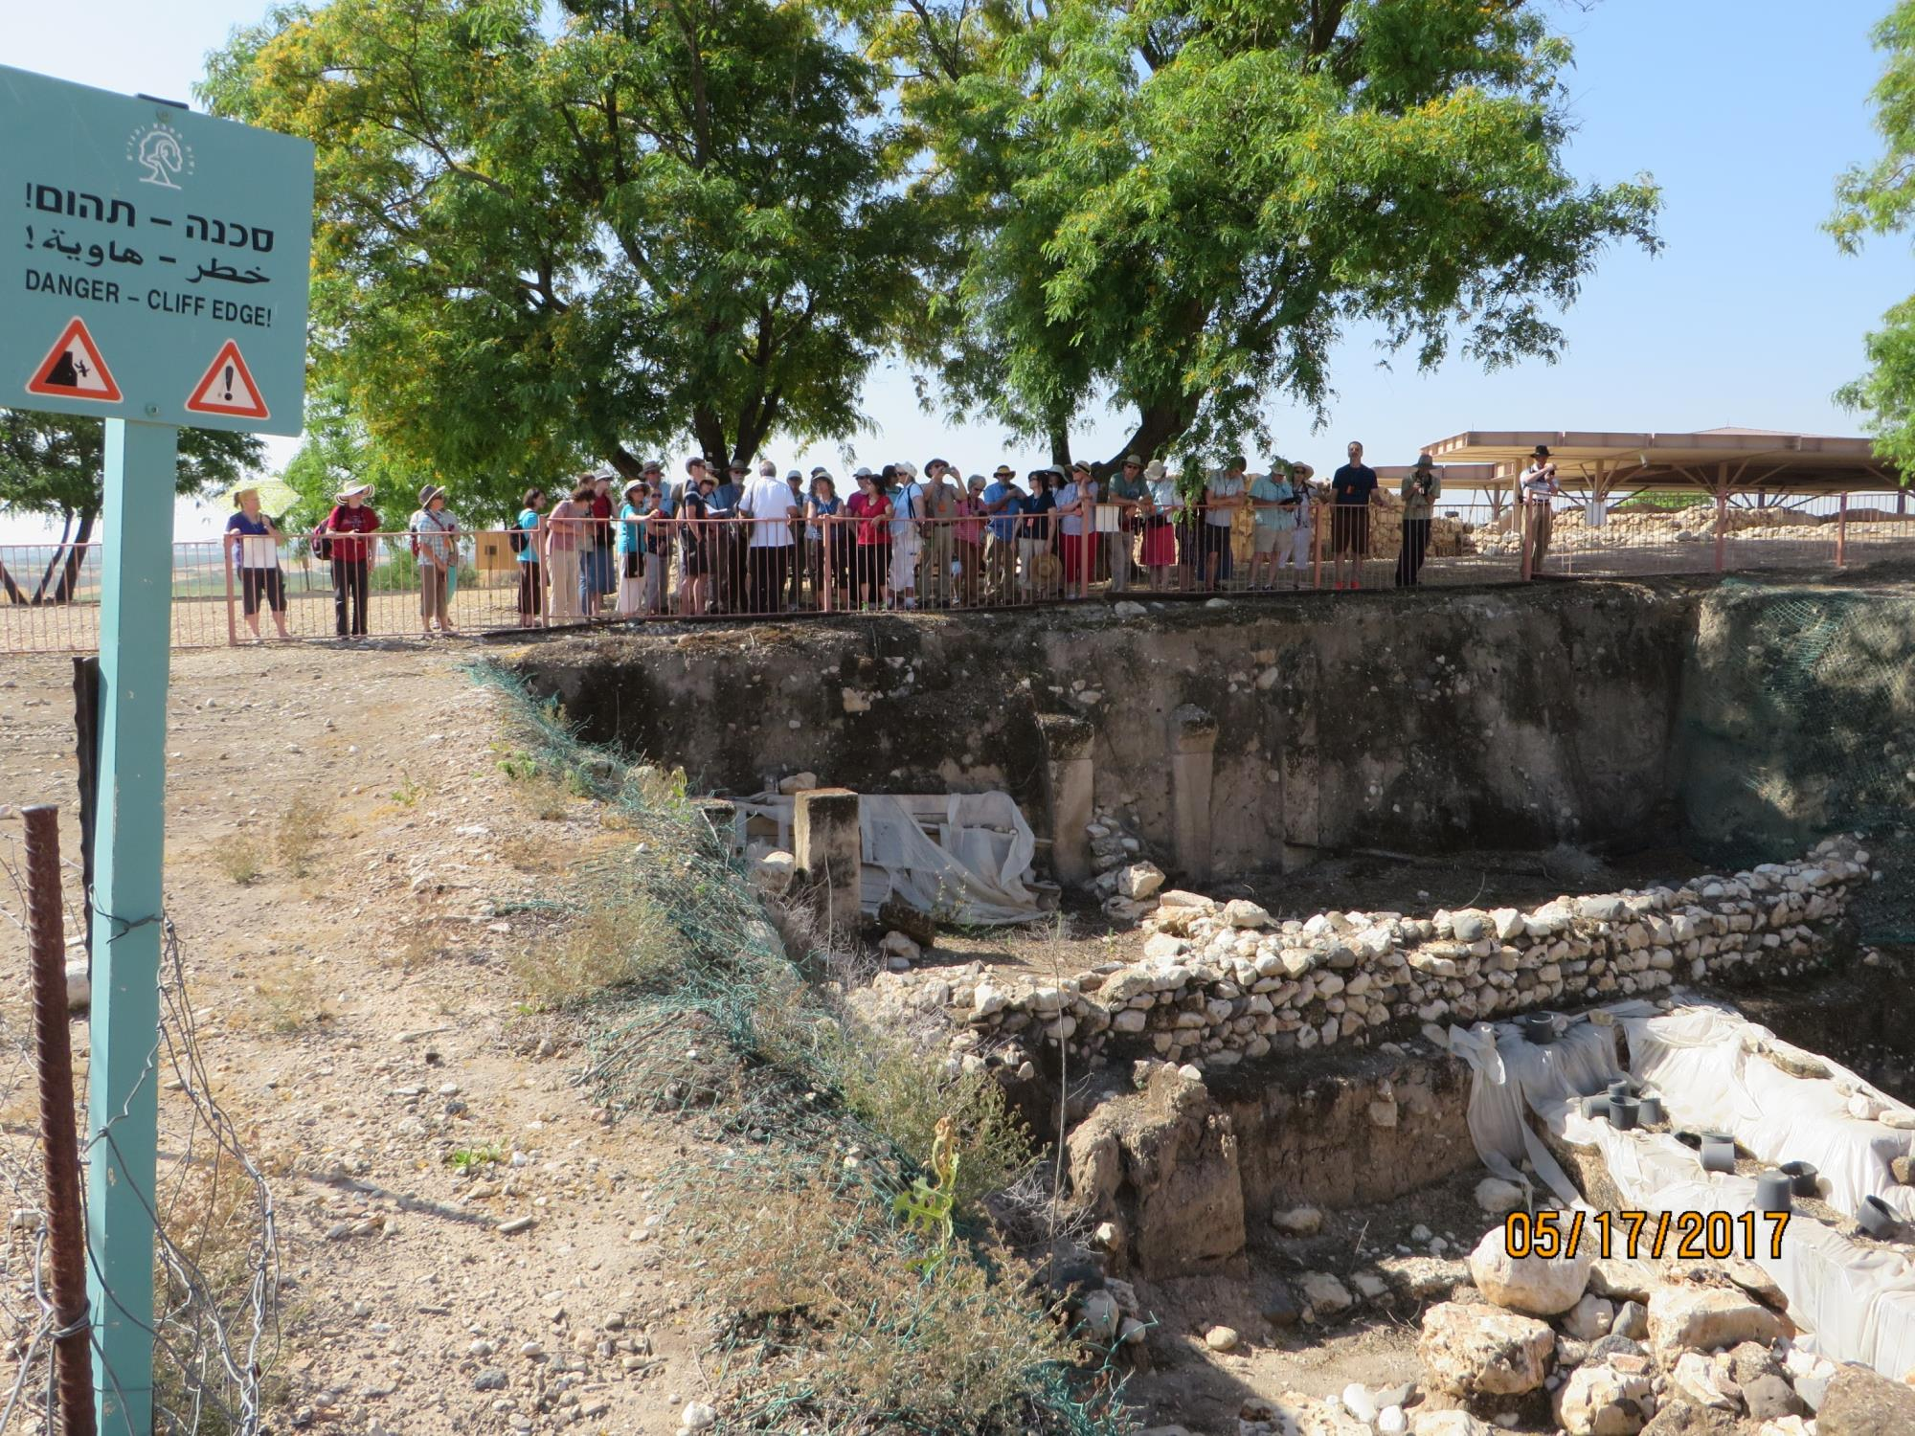

Slide 23
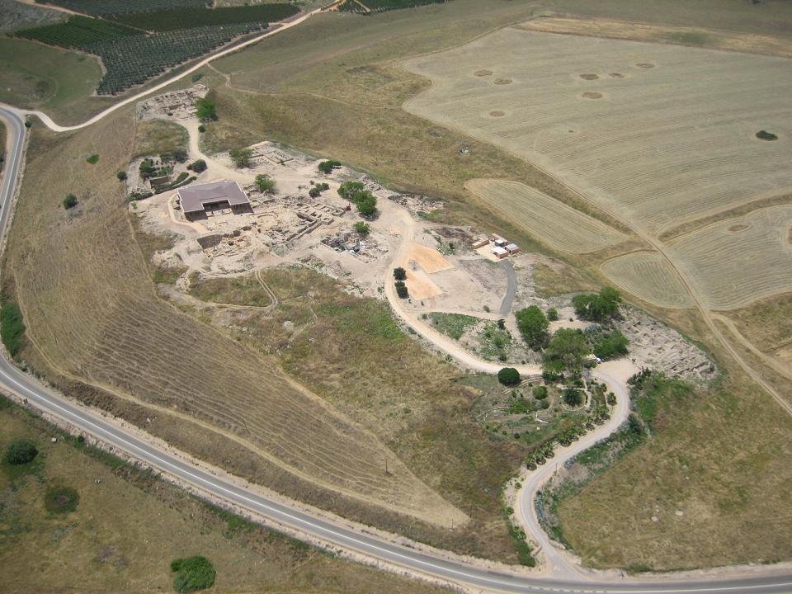

Slide 24
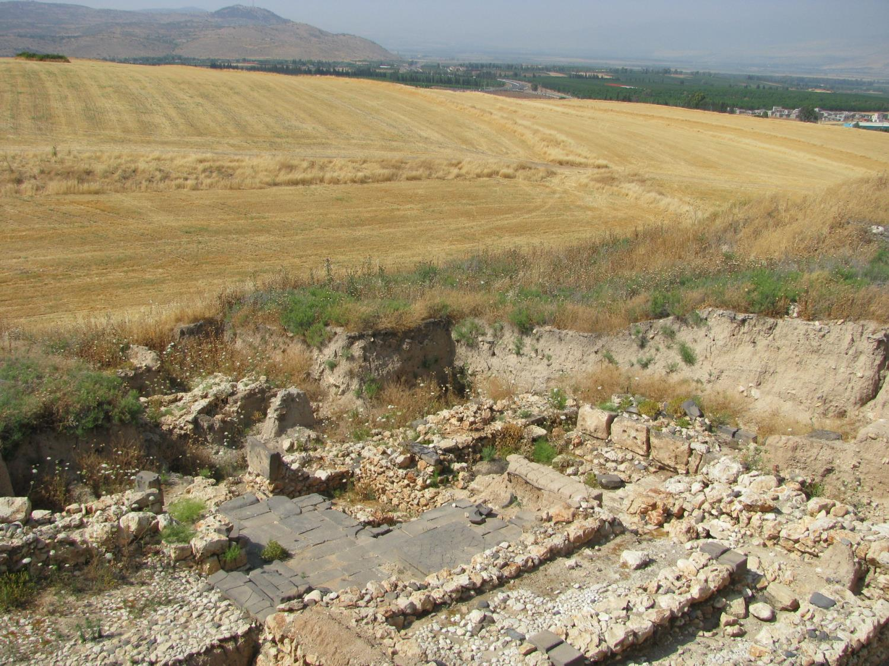
The Hazor expedition headed by Yigal Yadin in the mid-1950s was the most important dig undertaken by Israel in its early years of statehood. Tel Hazor is the largest archaeological site in northern Israel, featuring an upper tell of 30 acres and a lower city of more than 175 acres.^{[1]}

Slide 25
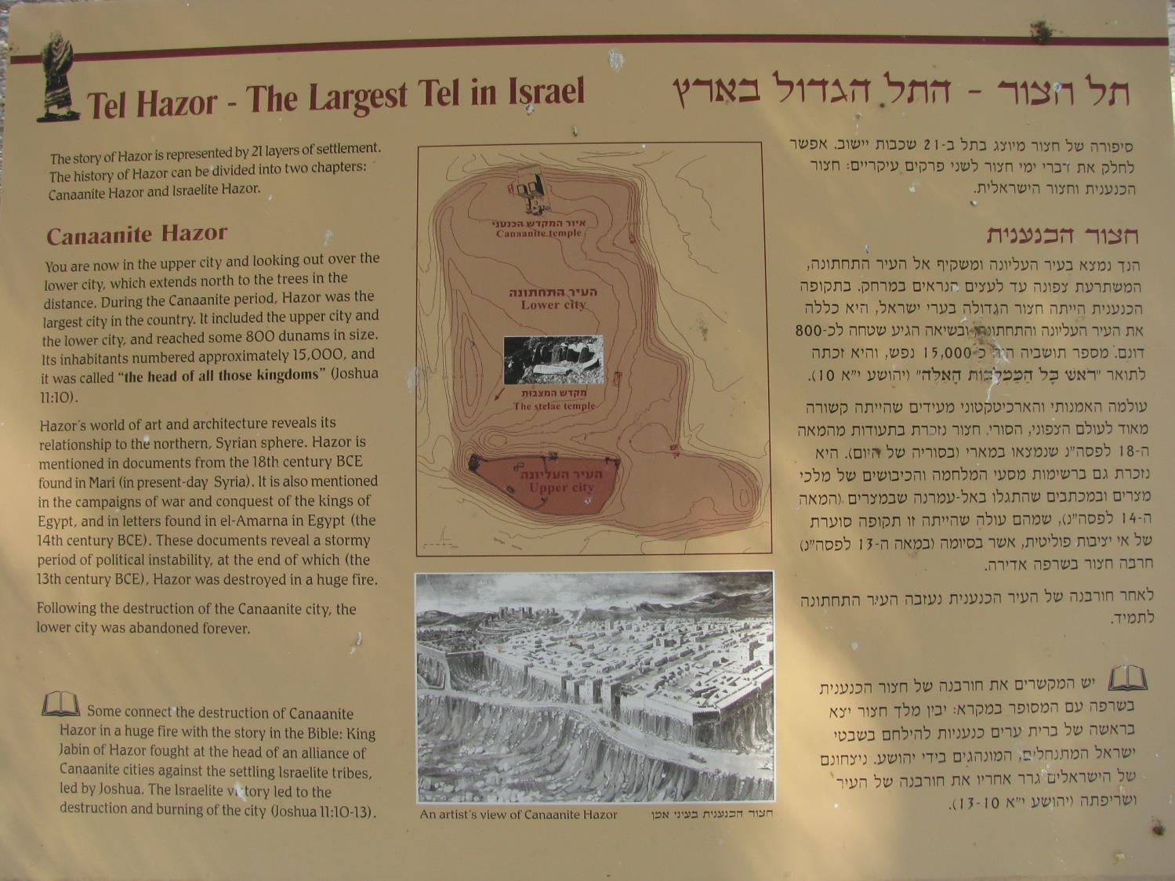

Slide 27
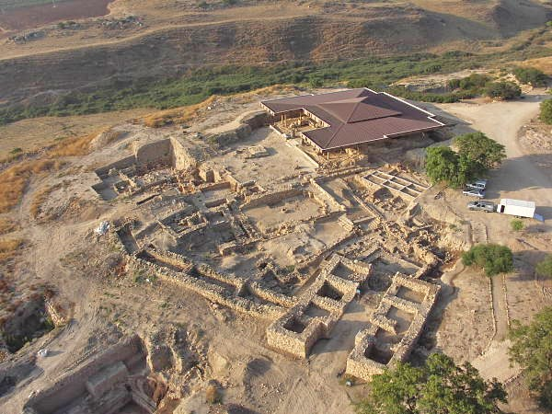

Slide 28
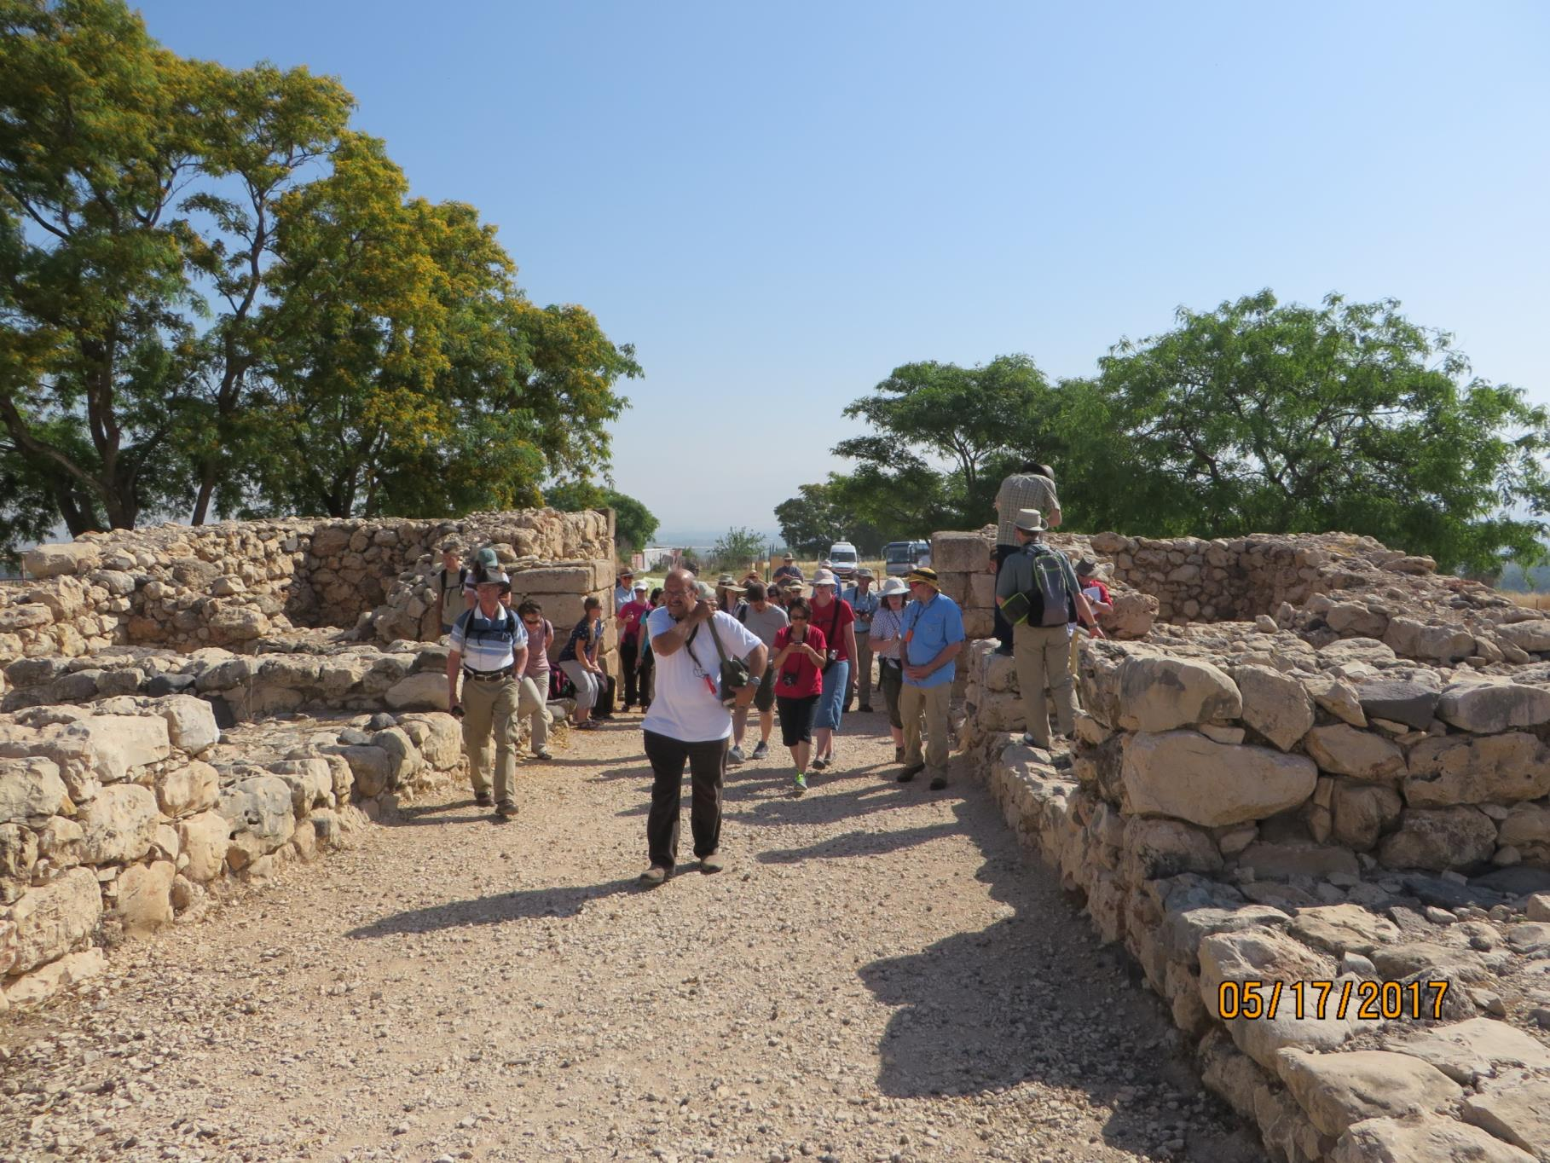

Slide 29
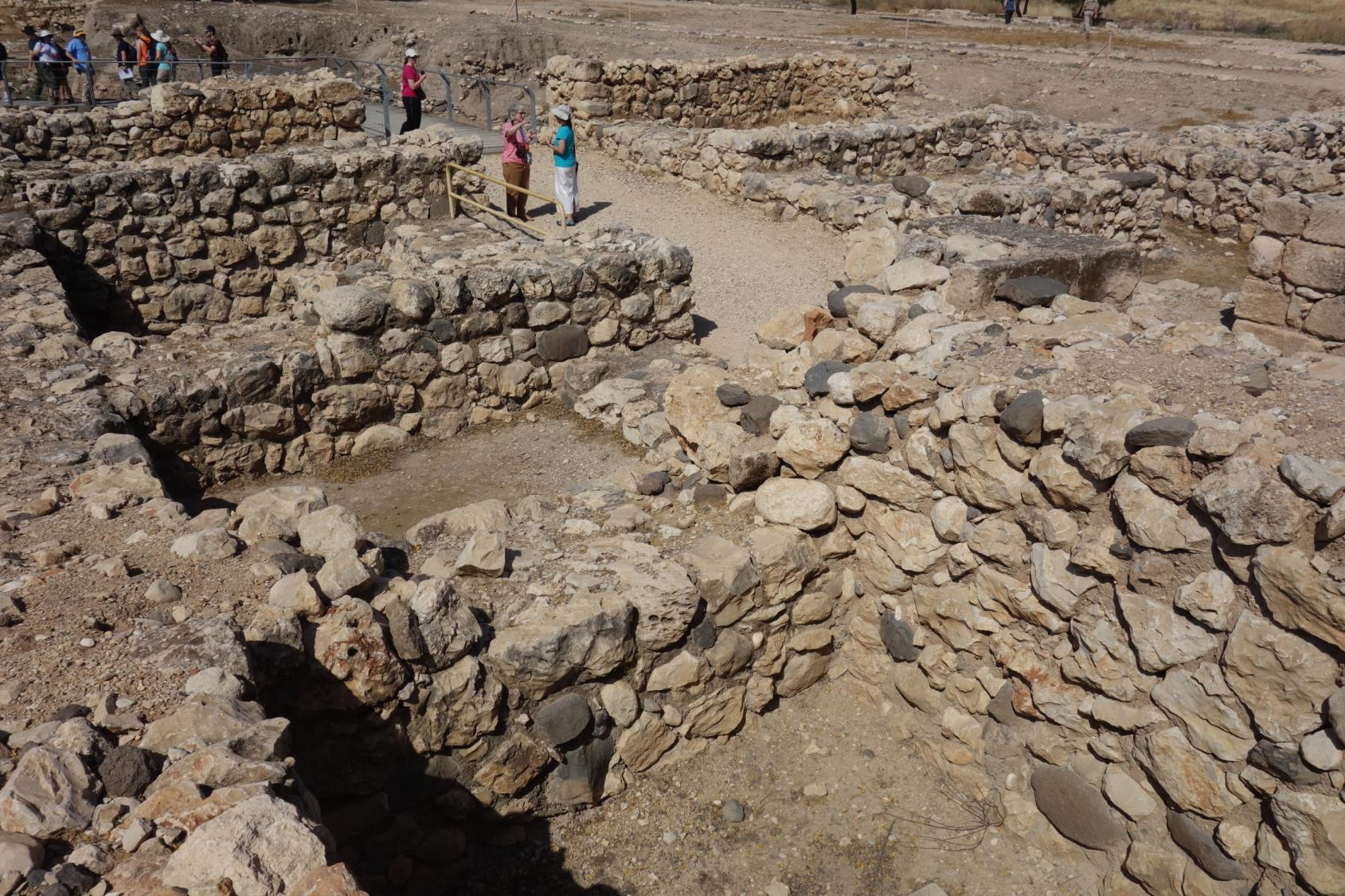

Slide 30
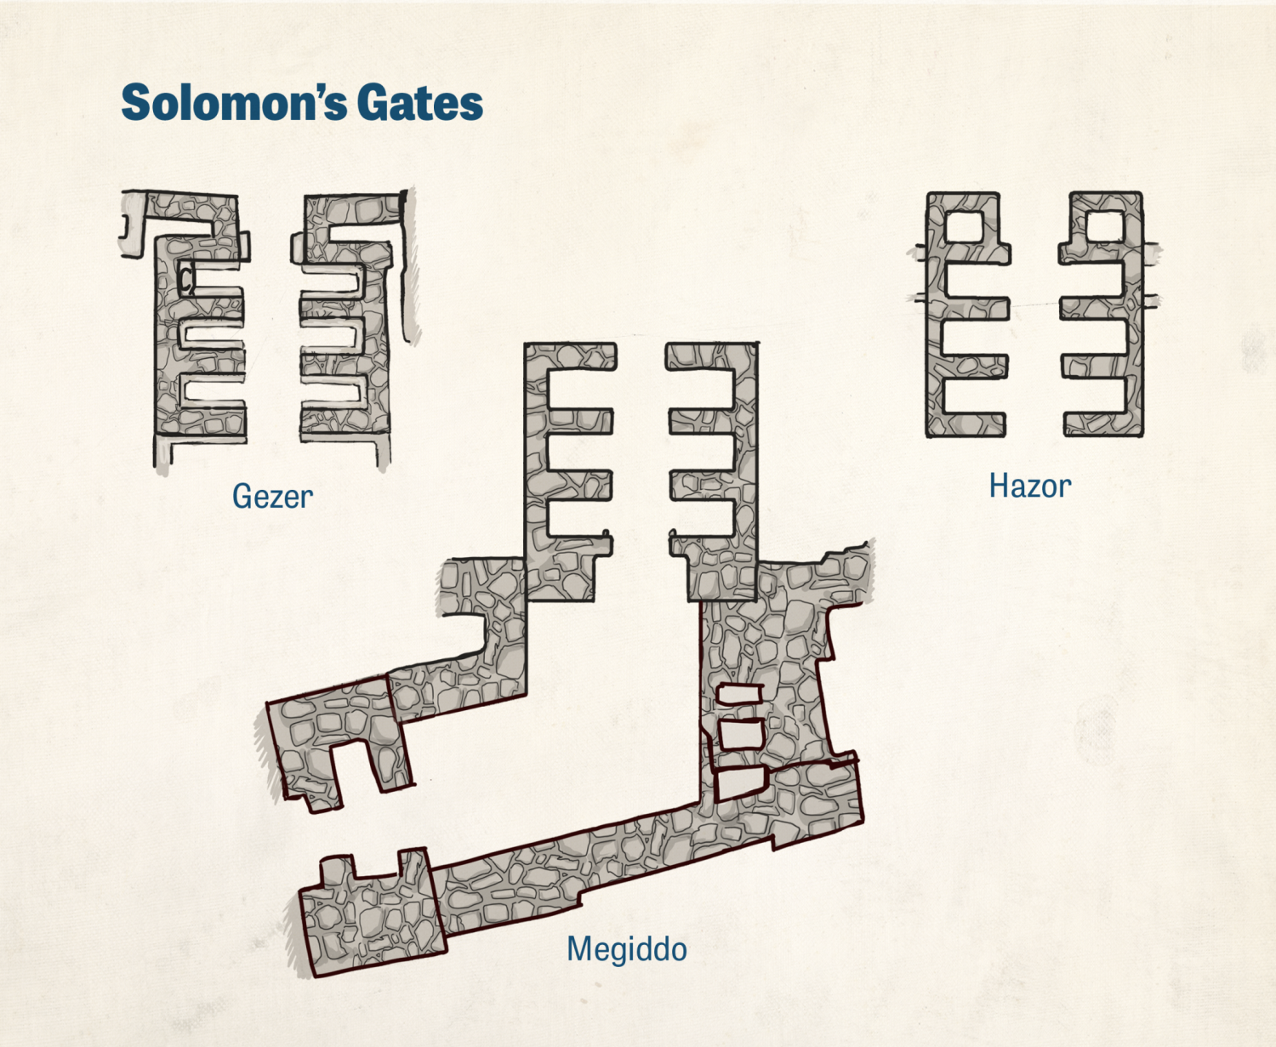

Slide 31
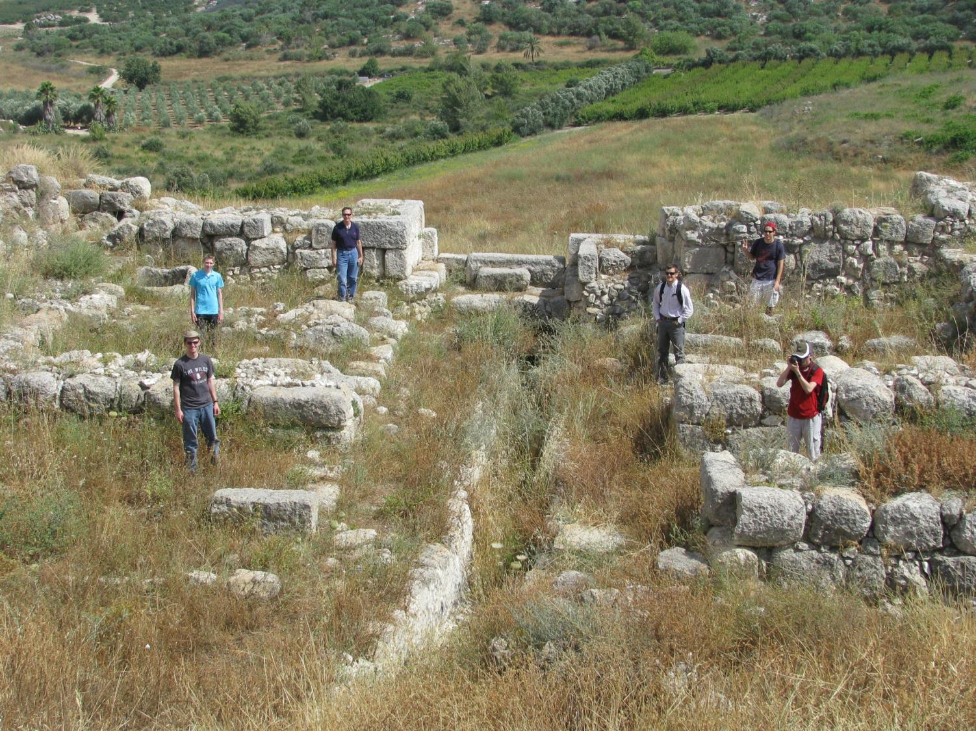

Slide 32
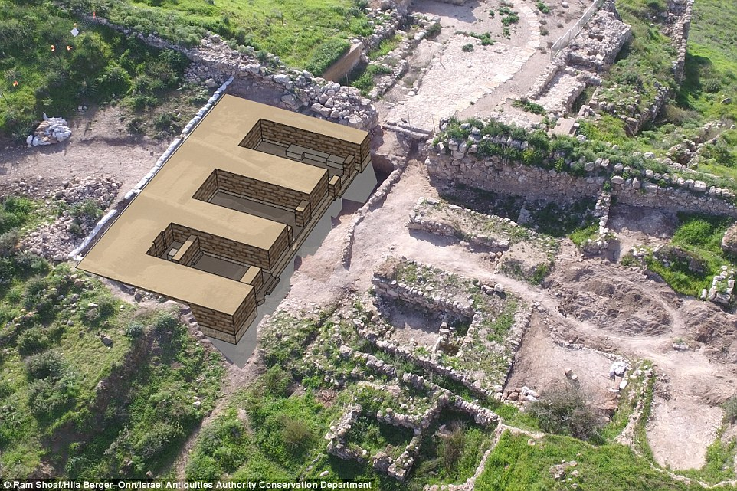

Slide 34
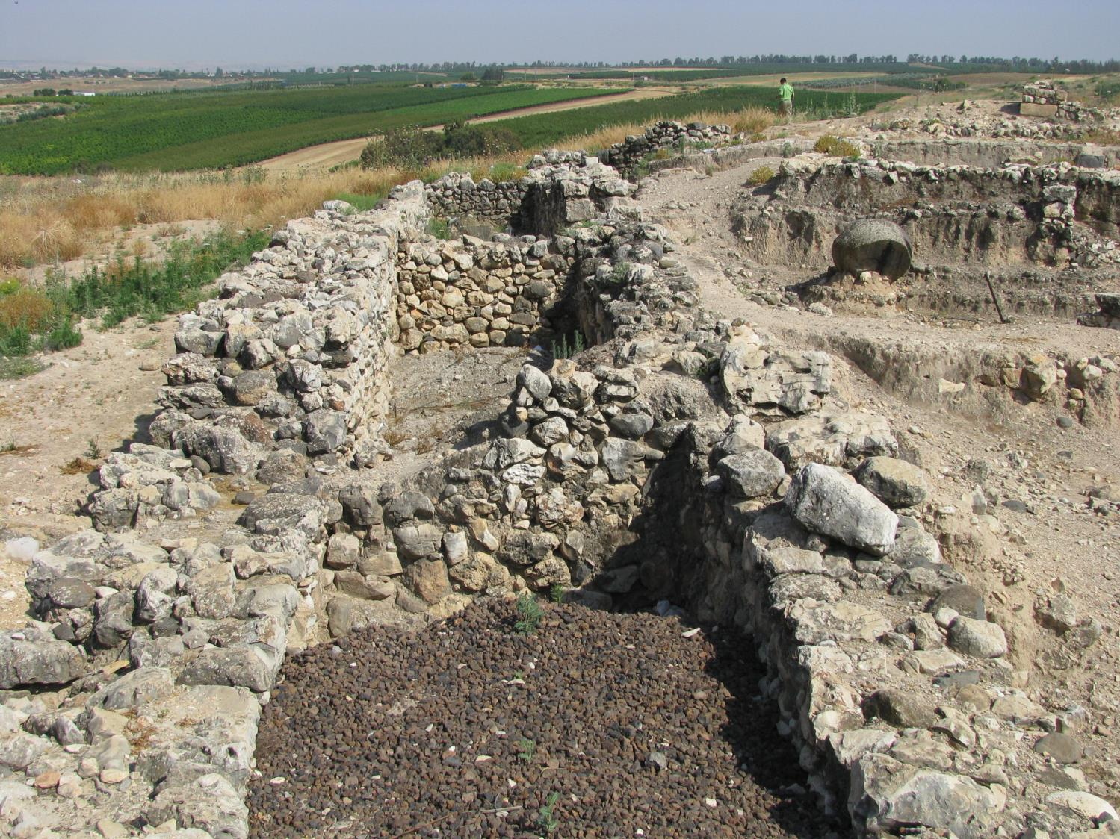

Slide 35
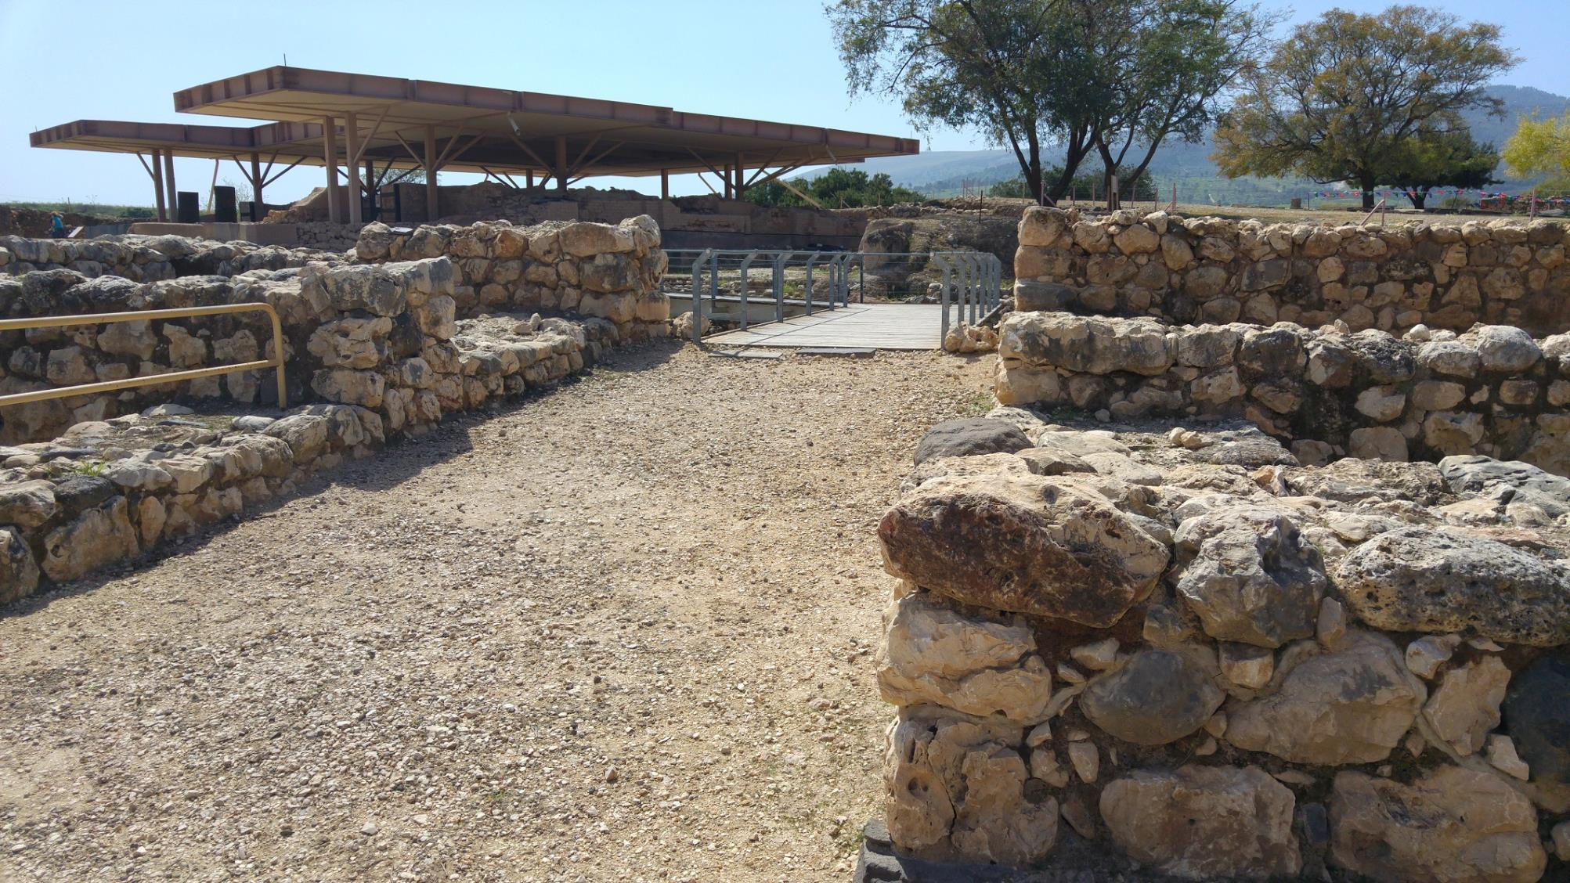

Slide 36
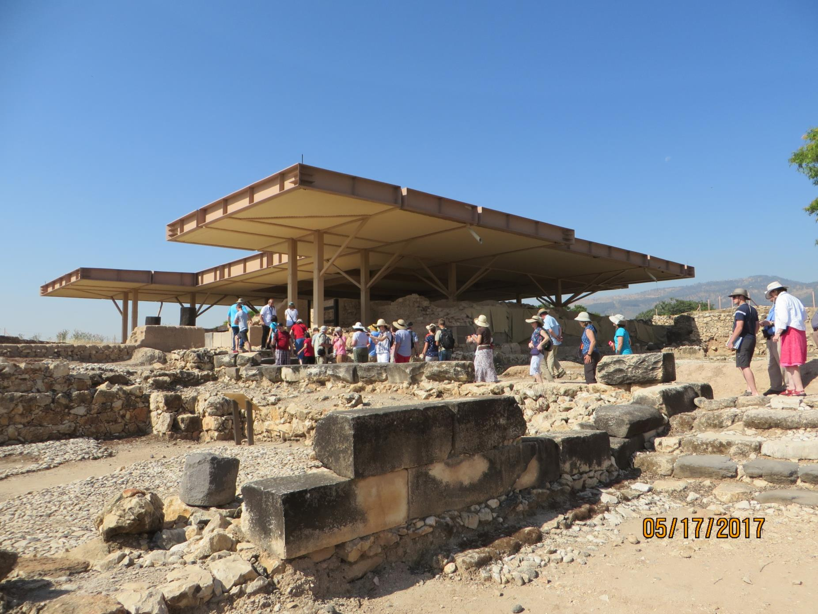

Slide 37
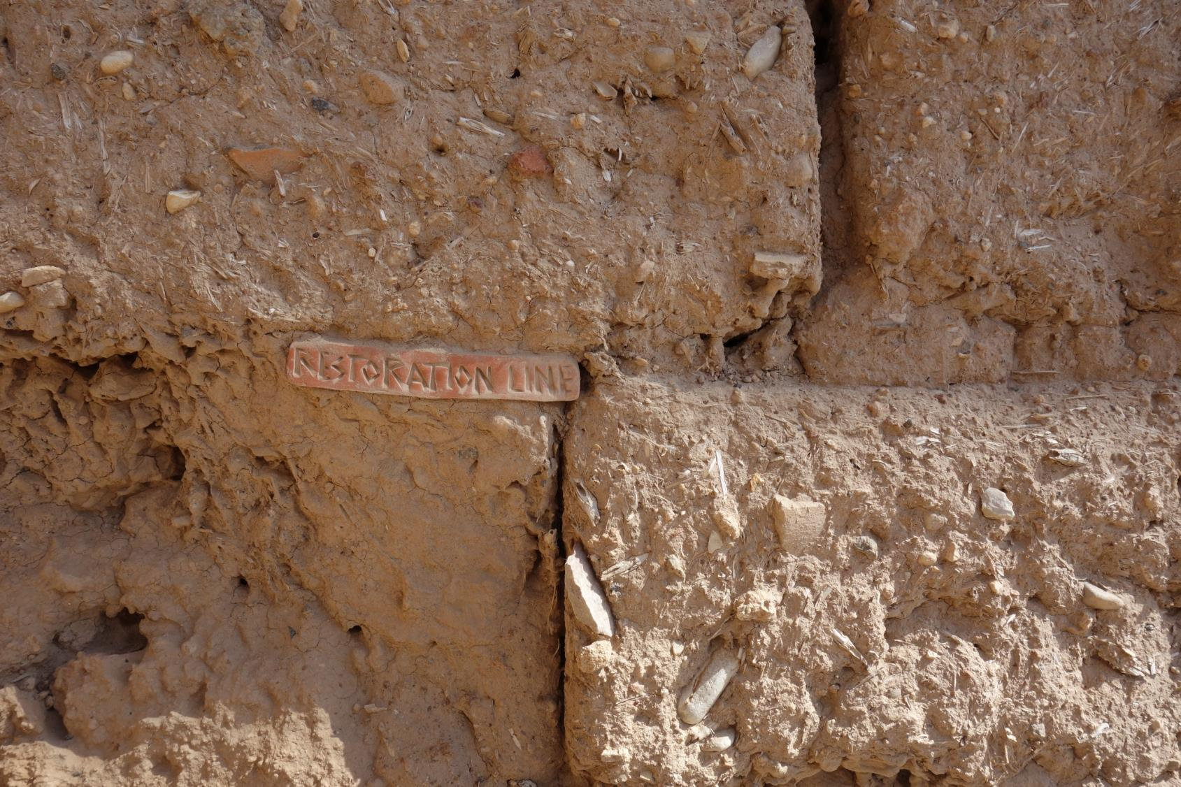

Slide 38
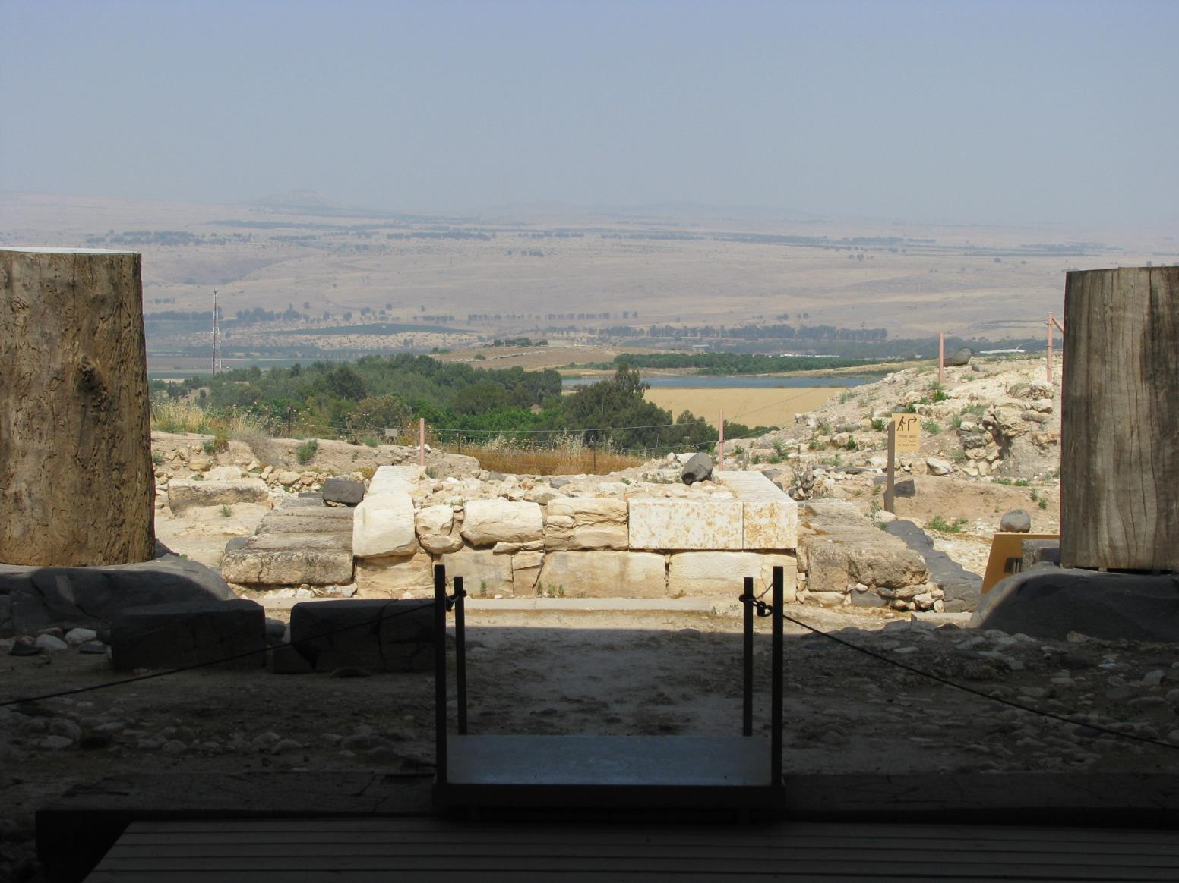

Slide 39
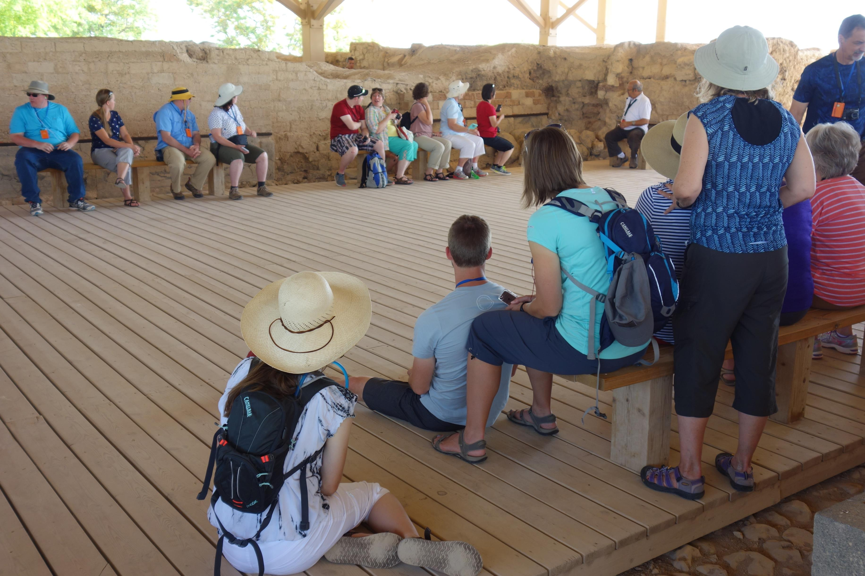

Slide 40
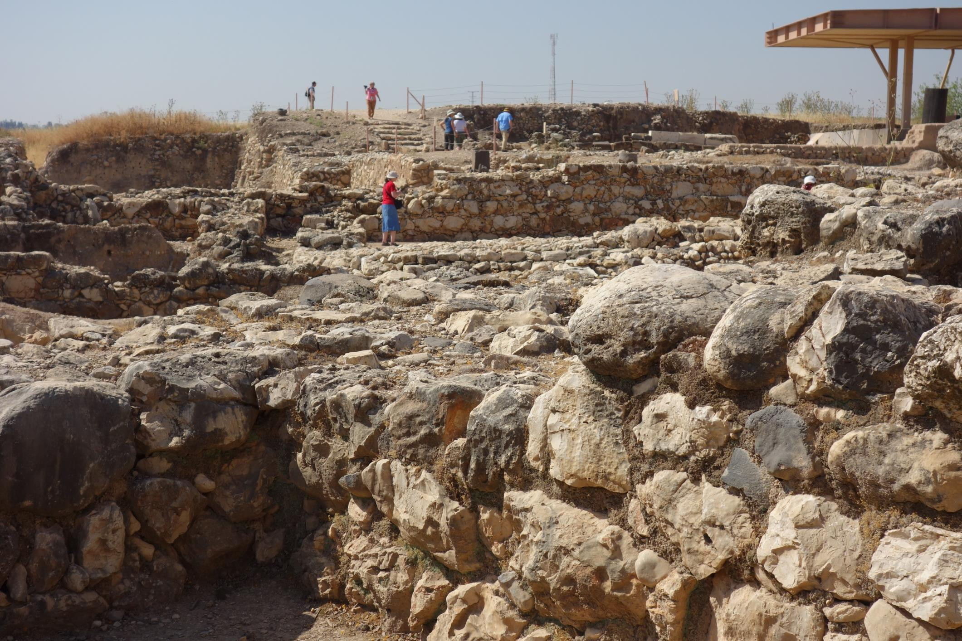

Slide 41
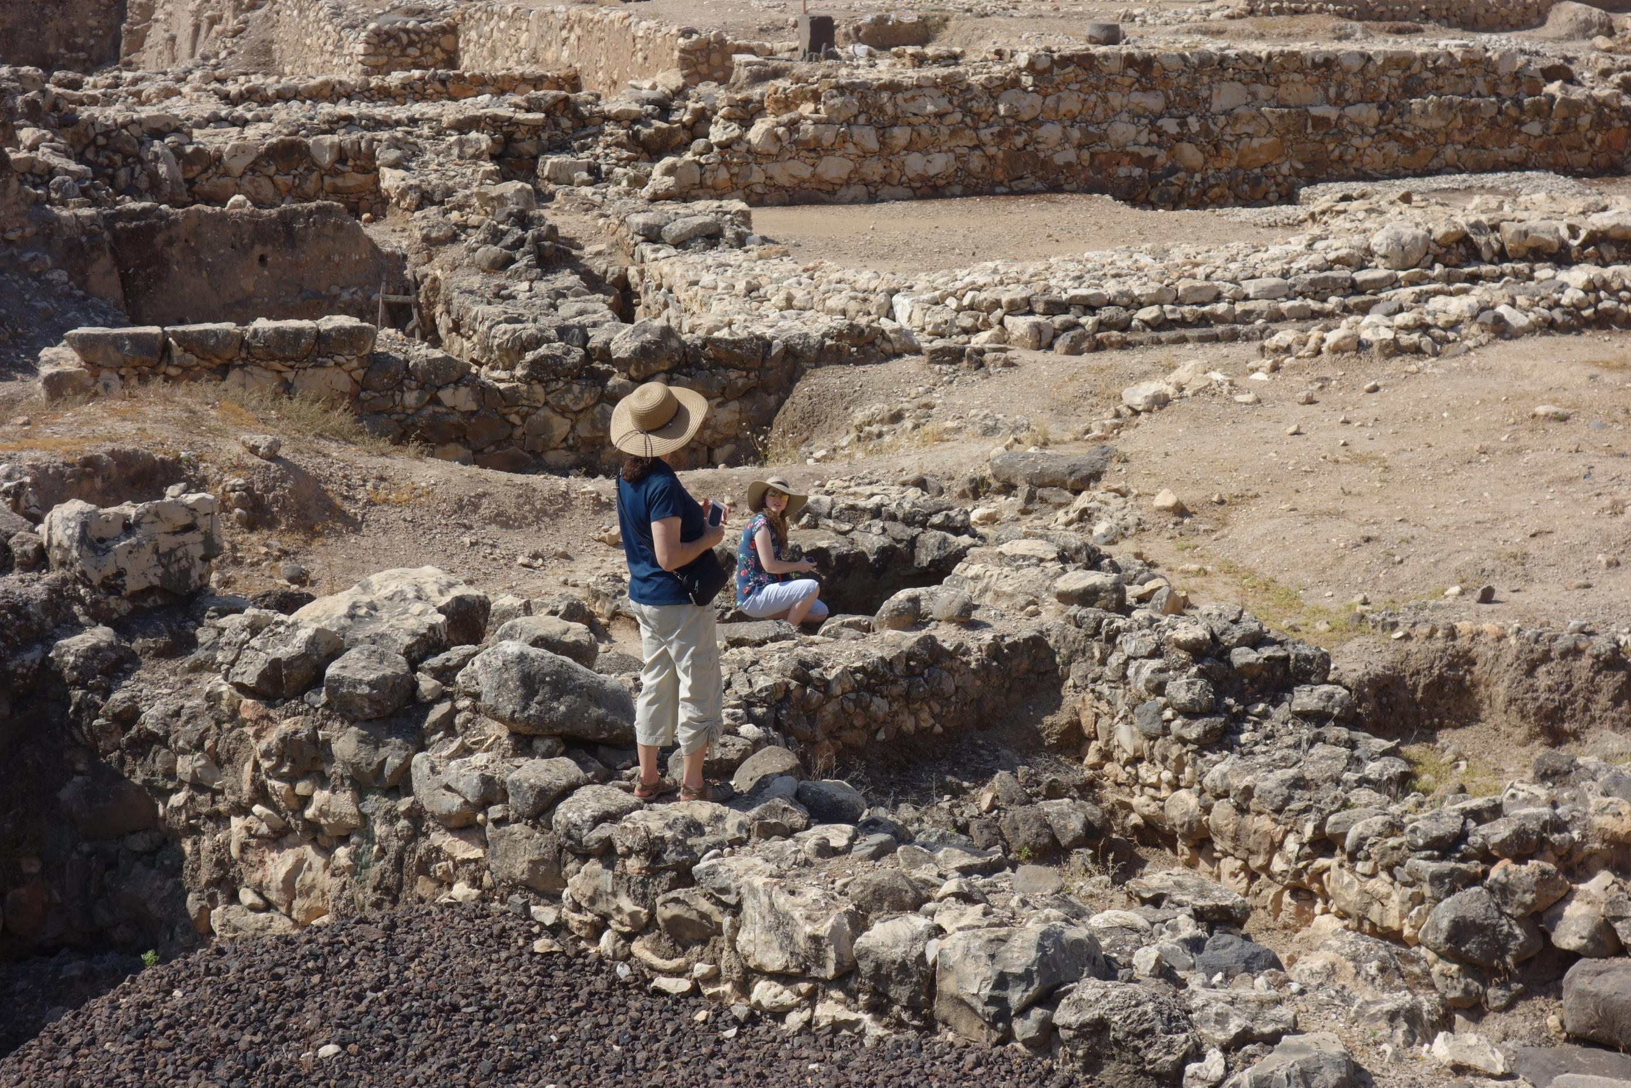

Slide 42
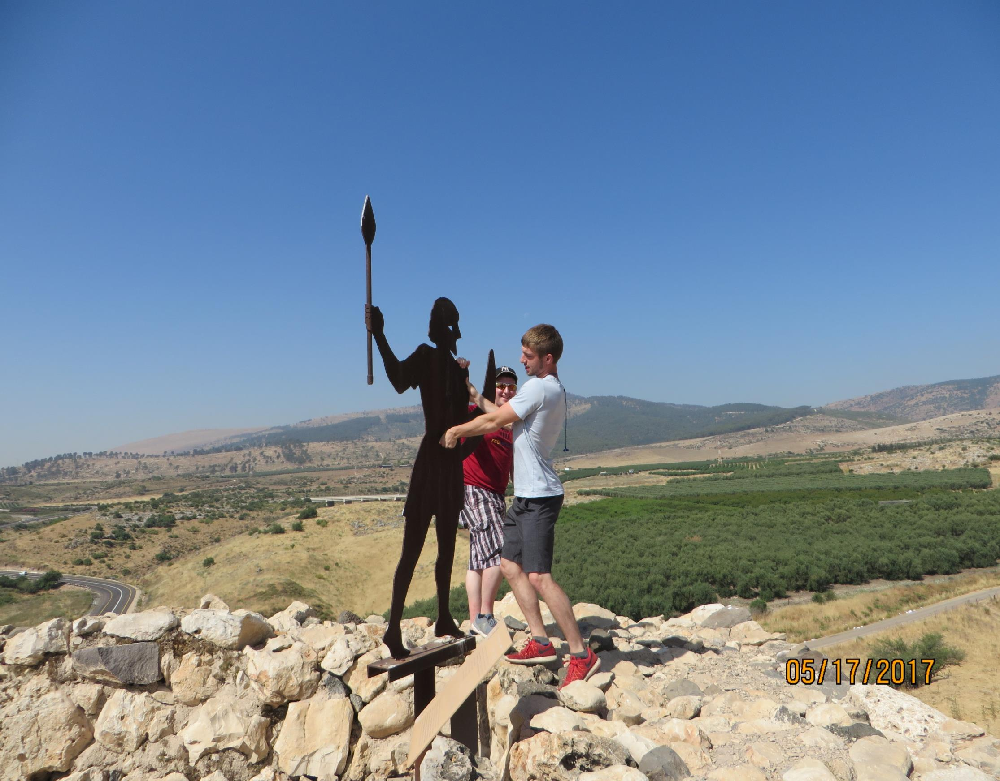

Slide 43
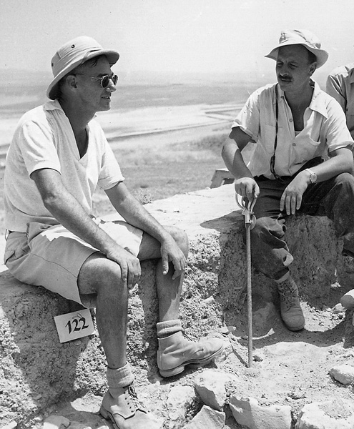
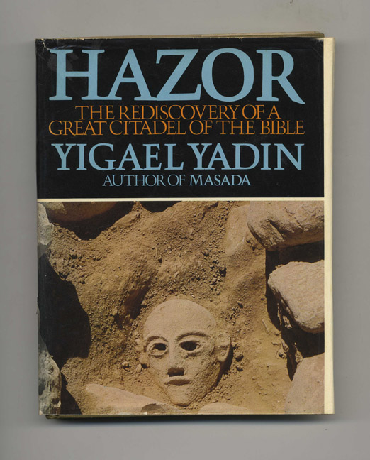
The Hazor expedition headed by Yigal Yadin in the mid-1950s was the most important dig undertaken by Israel in its early years of statehood. He is here at Hazor with Yohanan Aharoni in Sept., 1956. He told a friend, I am going to excavate Hazor. I must know about Joshua. I must know if he really conquered it.

Slide 44
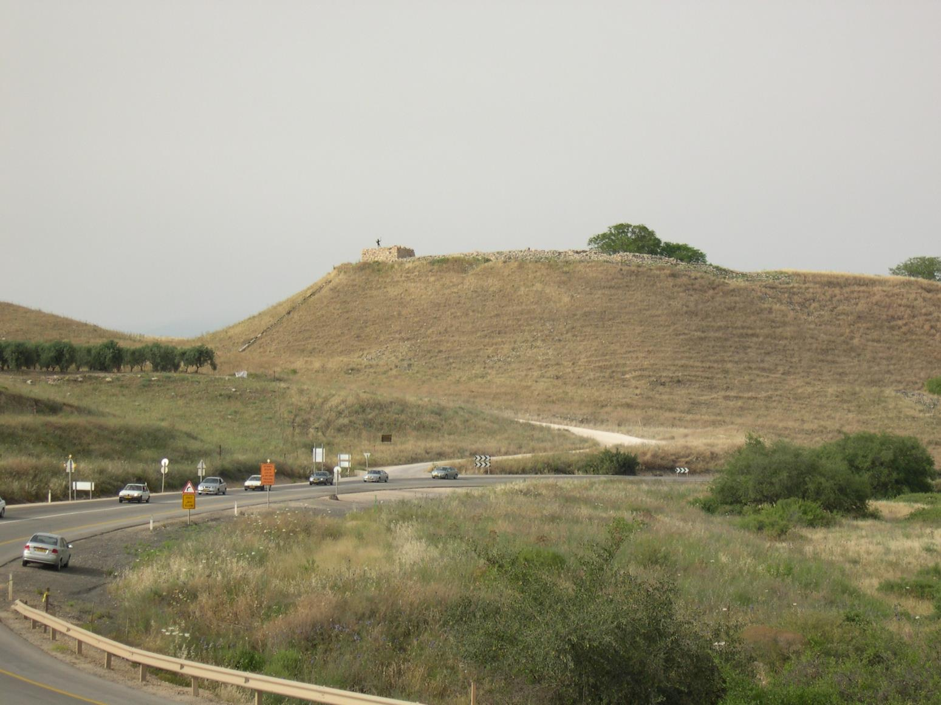

Slide 45
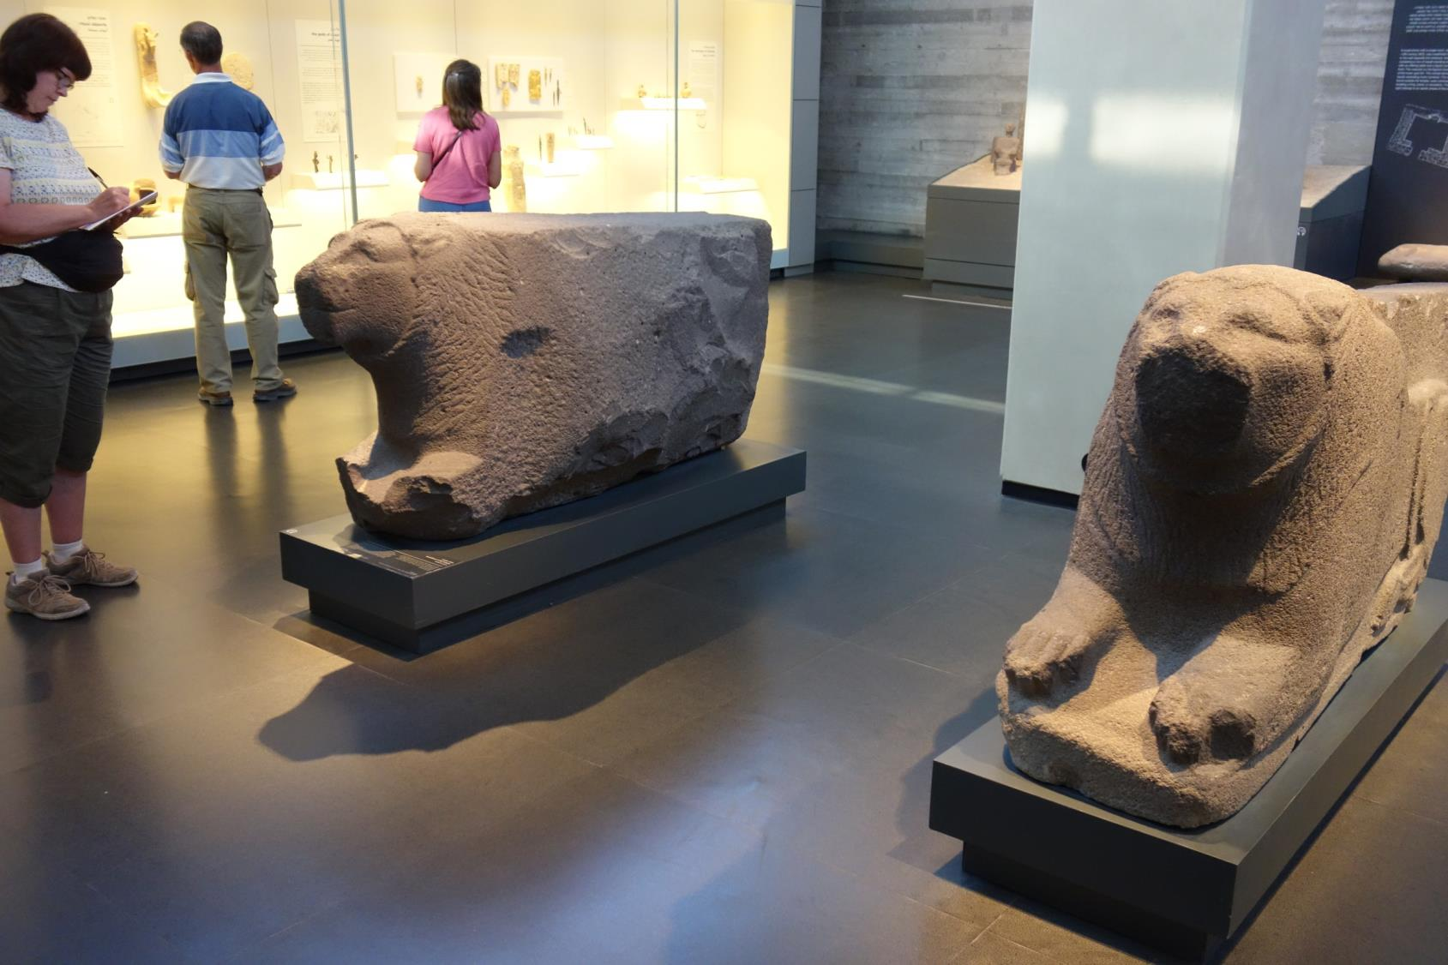

Slide 46
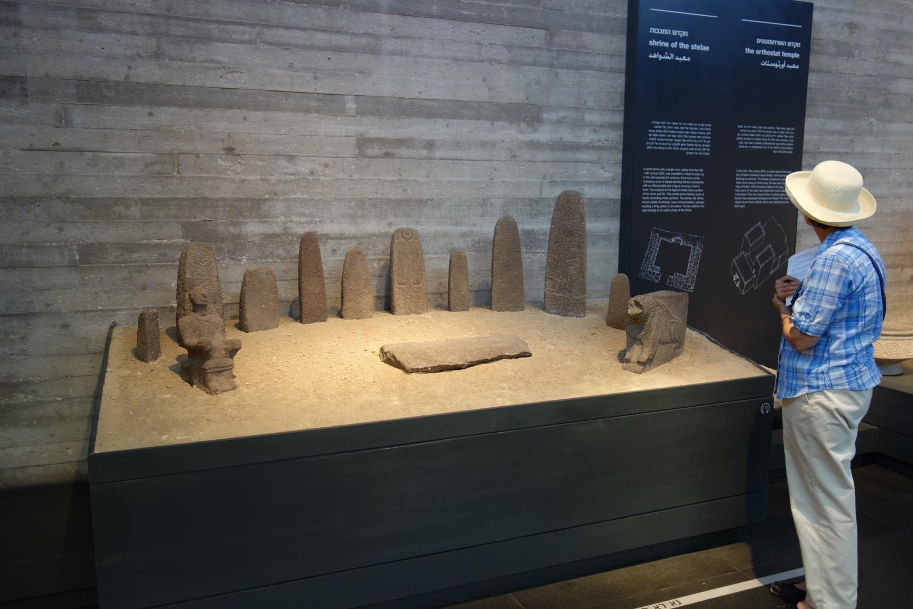

Slide 47
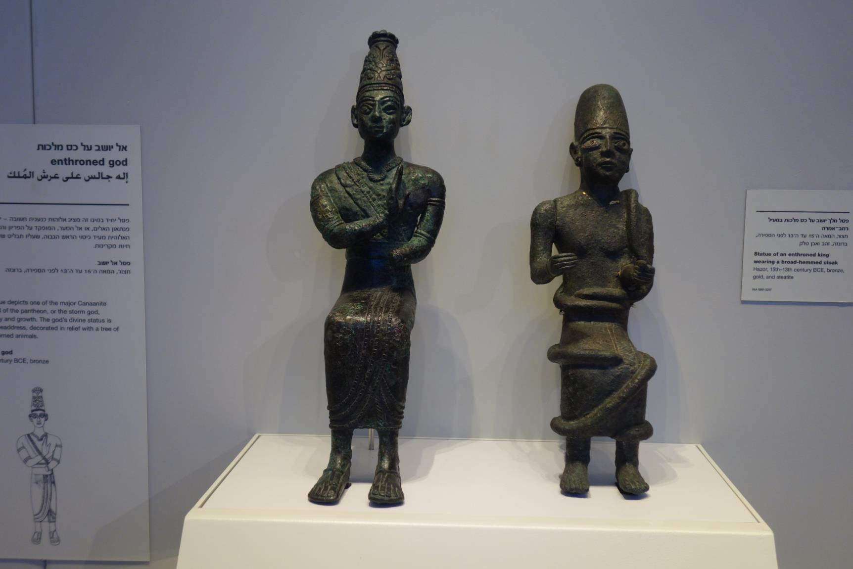

Slide 48
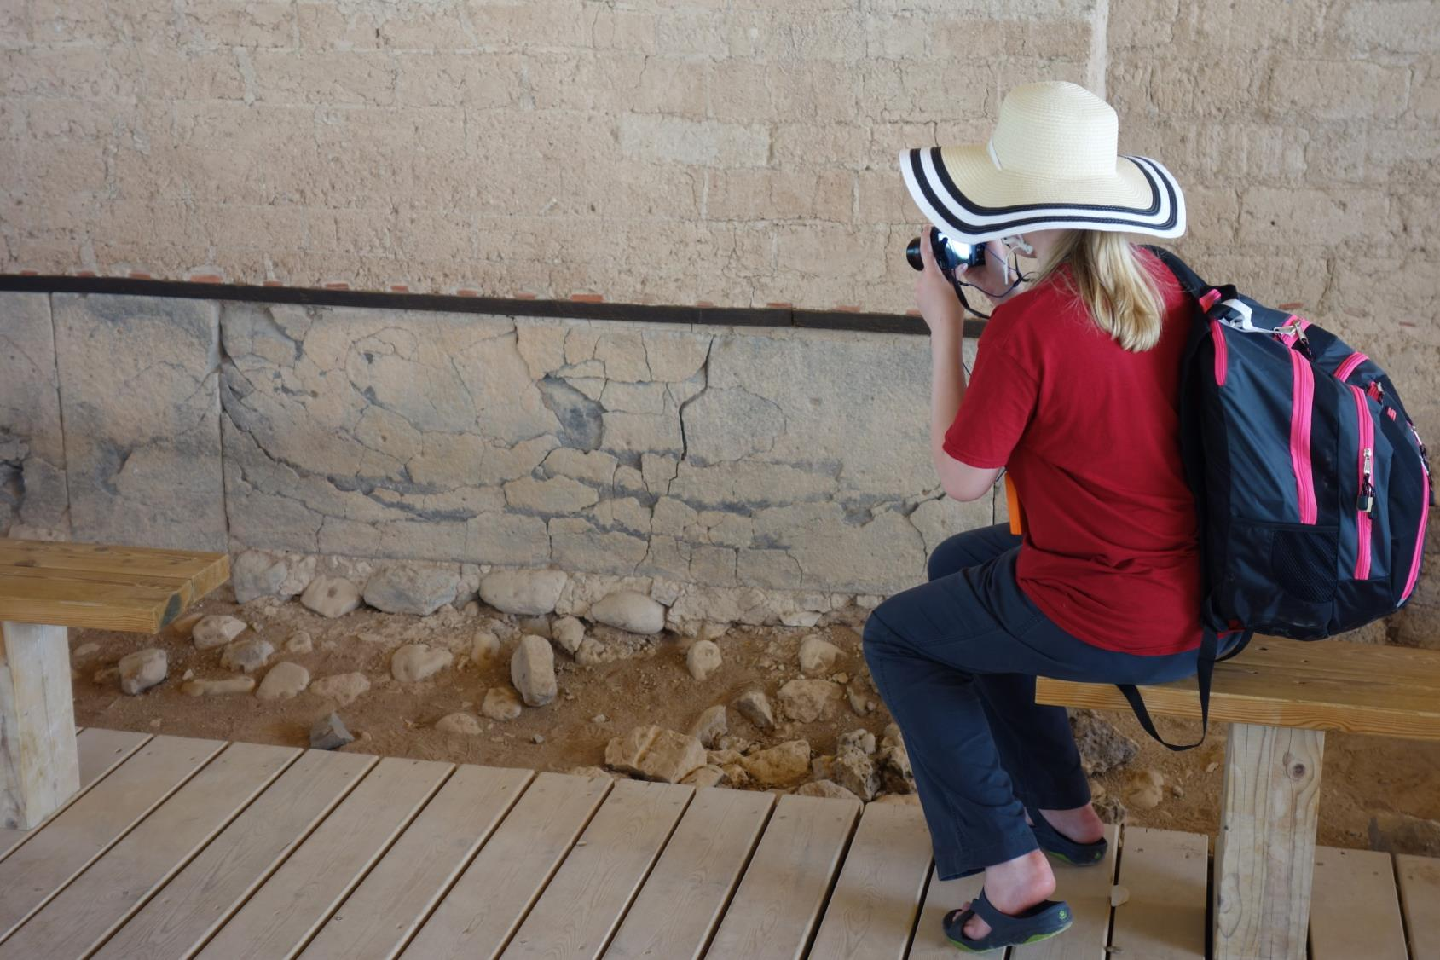

Slide 49
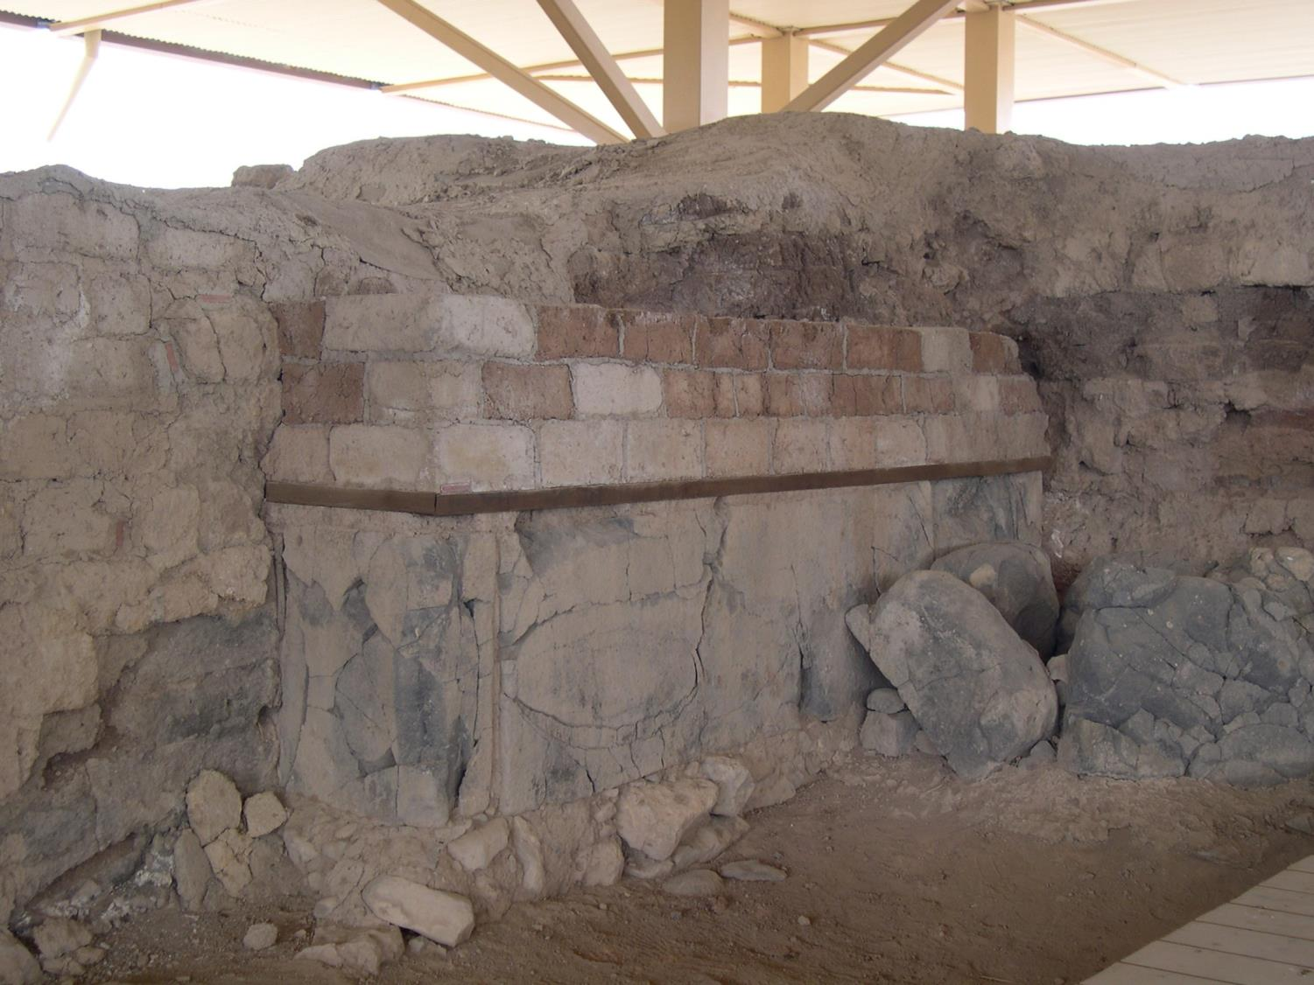

Slide 50
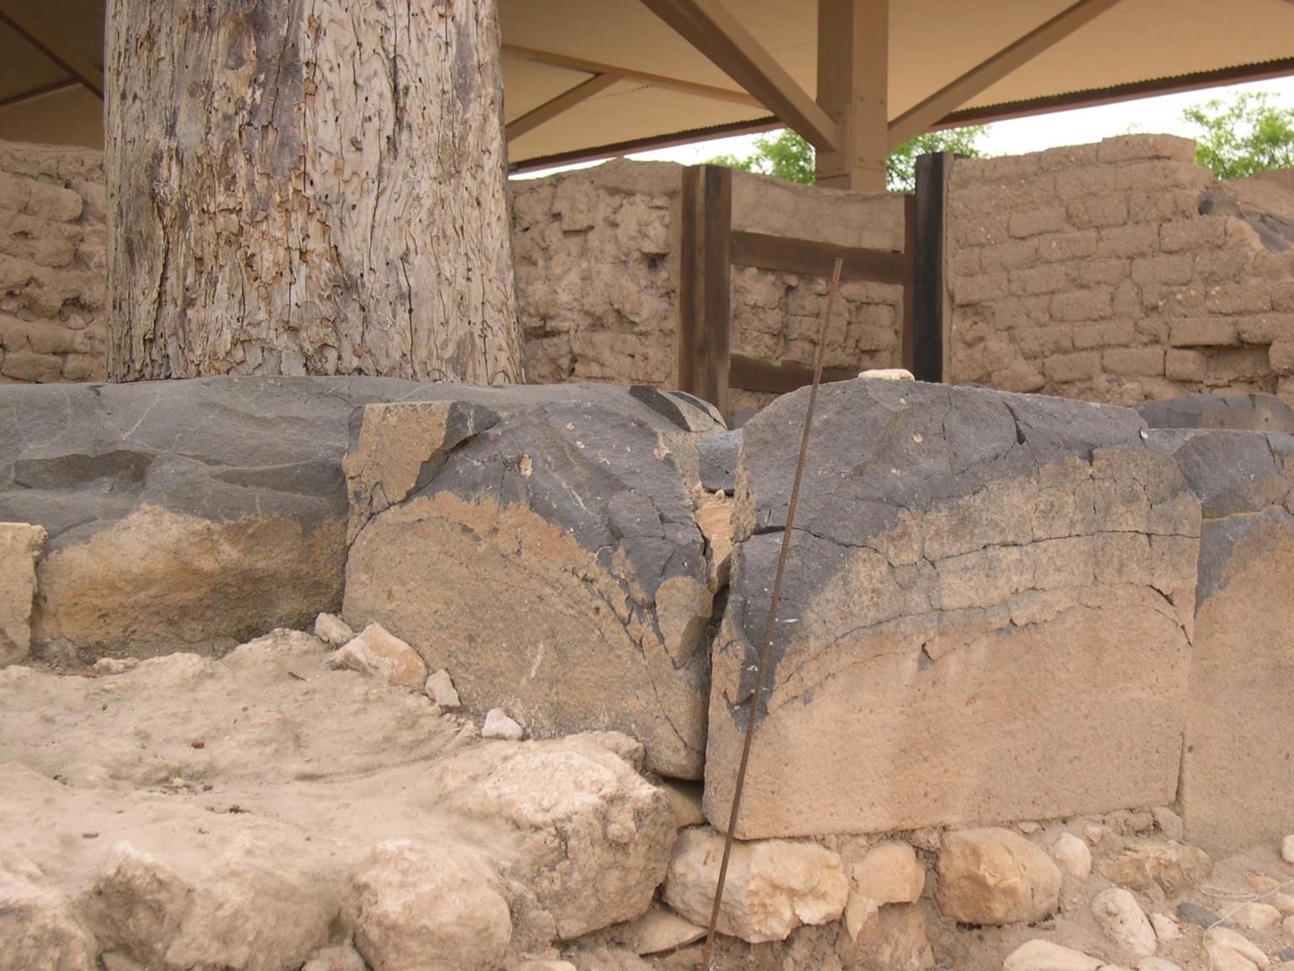

Slide 51
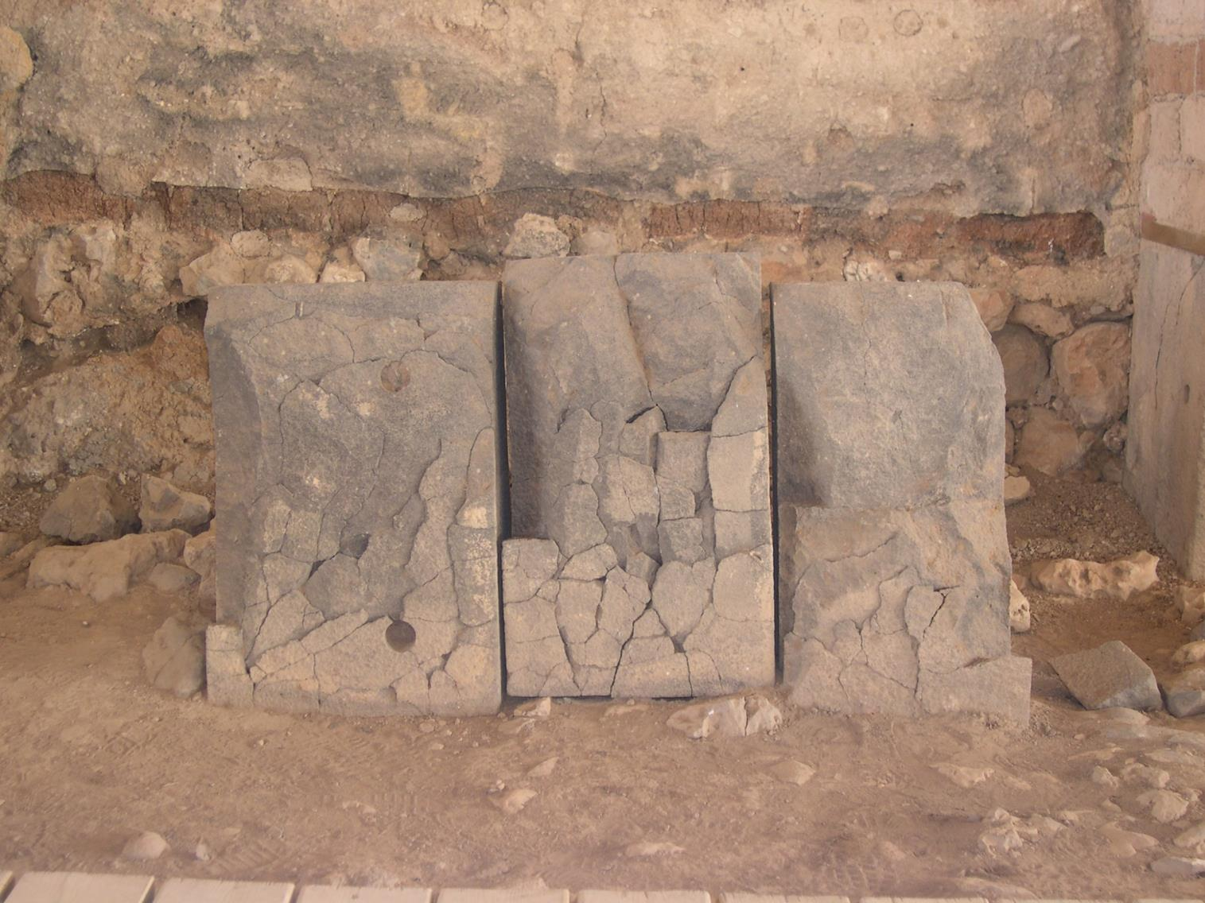

Slide 52
Joshua 1:10-13

Slide 53
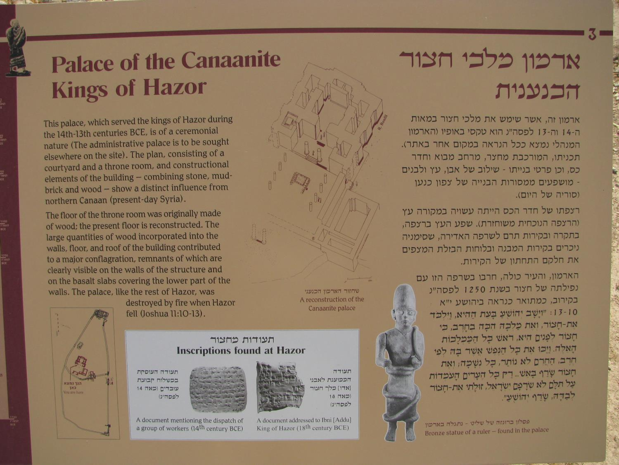

Slide 54
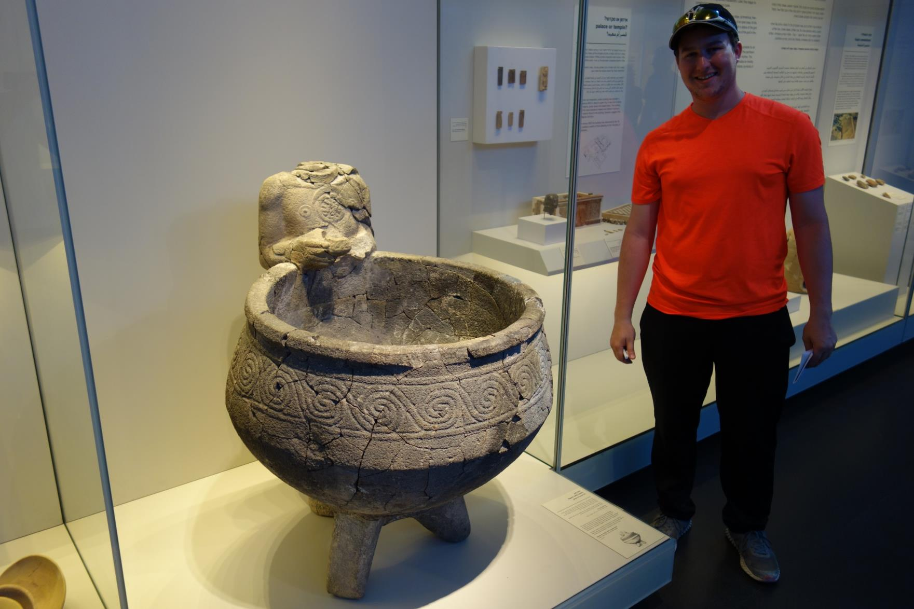

Slide 55
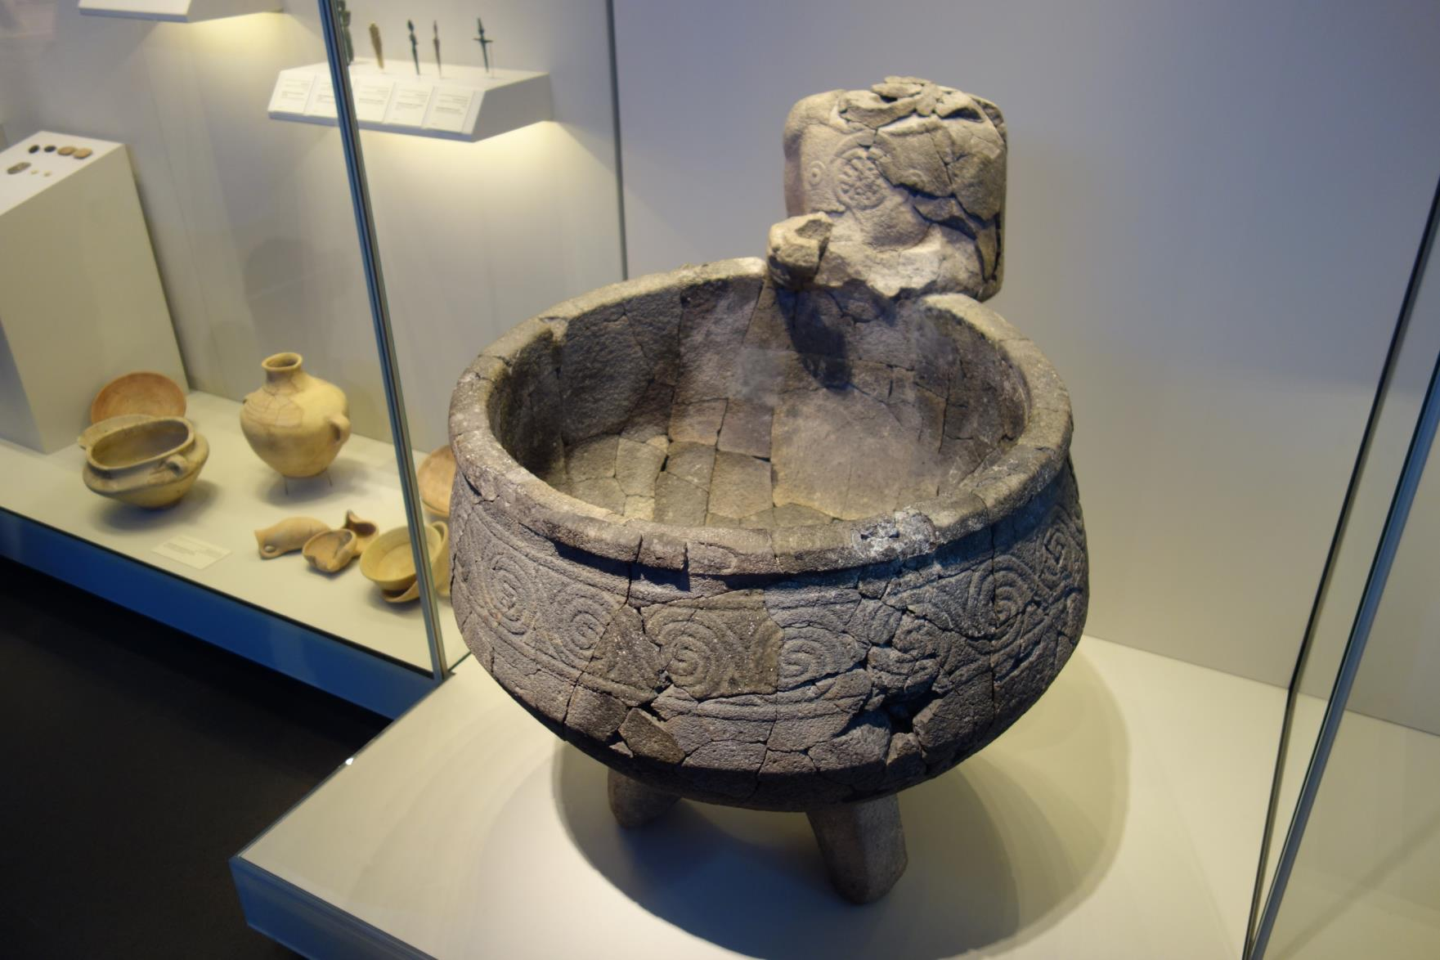

Slide 57
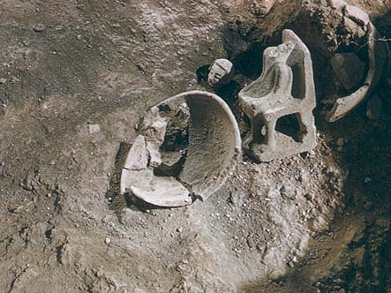

Slide 58
How many Gods are there?
The LORD our God is one LORD (KJV; Deut. 6:4).
“You are My witnesses,” declares the LORD, “And My servant whom I have chosen, so that you may know and believe Me and understand that I am He. Before Me there was no God formed, and there will be none after Me. I, even I, am the LORD, and there is no savior besides Me” (NASB; Is. 43:10-11).
“Turn to Me and be saved, all the ends of the earth;
For I am God, and there is no other. I have sworn by Myself, the word has gone forth from My mouth in righteousness and will not turn back, that to Me every knee will bow, every tongue will swear allegiance” (NASB; Is. 45:22-23).
12

Slide 59
We all believe with the heart, and confess with the mouth, that there is only one
living and true God. And we detest the
multitude of gods, because it is expressly
written, “The LORD our God is one LORD”
(KJV; Deut. 6:4), and, “There is no other God besides Me” (NASB; Is. 45:21).
(Belgic Confession (1561) Article 1; Second Helvetic
Confession III. 2. (1566))

