Slide 1

In what way can we obtain the gracious provisions of God’s covenants?
For there is one God, and one mediator between God and men, the man Christ Jesus (KJV; I Tim. 2:5).
. . . the great God and our Saviour Jesus Christ; who gave himself for us, that he might redeem us from all iniquity, and purify unto himself a peculiar people, zealous of good works (KJV; Tit. 2:13b-14).
For this reason He is the mediator of a new covenant, so that, since a death has taken place for the redemption of the transgressions that were committed under the first covenant, those who have been called may receive the promise of the eternal inheritance (NASB; Heb. 9:15).
36

Slide 2
The one way, the only way that we can
obtain the gracious provisions of God’s
covenants is through the Redeemer,
the Lord Jesus Christ.

Slide 3
What offices does Jesus Christ execute as our Redeemer?
Moses said, “THE LORD GOD WILL RAISE UP FOR YOU A PROPHET LIKE ME FROM YOUR BRETHREN; TO HIM YOU SHALL GIVE HEED to everything He says to you. And it will be that every soul that does not heed that prophet shall be utterly destroyed from among the people” (NASB; Acts 3:22-23).
Just as He says also in another passage, YOU ARE A PRIEST FOREVER ACCORDING TO THE ORDER OF MELCHIZEDEK” (NASB; Heb. 5:6).
He who sits in the heavens laughs, the Lord scoffs at them. Then He
will speak to them in His anger. . . “But as for Me, I have installed My King upon Zion, My holy mountain” (NASB; Psalm 2:4-5a, 6).
37

Slide 4
Jesus Christ executes as our Redeemer
the offices of prophet, priest and king,
in both His humiliation and His exaltation.
(Adapted from Westminster Shorter Catechism, Q. 23)

Slide 5
How does Christ execute the office of a prophet?
God, after He spoke long ago to the fathers in the prophets in many portions and many ways, in these last days has spoken to us in His Son . . . (NASB; Heb. 1:1-2a).
No one has seen God at any time; the only begotten God who is in the bosom of the Father, He has explained Him
(NASB; John 1:18).
. . . all things that I have heard from My Father I have made known to you (NASB; John 15:15b).
John 16:7-15
38

Slide 6
Christ executes the office of a prophet in revealing to us, by His Word and Spirit,
the will of God for our salvation.
(Westminster Shorter Catechism, Q. 24)

Slide 7
How does Christ execute the office of a priest?
Therefore, He had to be made like His brethren in all things, so that He might become a merciful and faithful high priest in things pertaining to God, to make propitiation for the sins of the people (NASB; Heb. 2:17).
But He, having offered one sacrifice for sins for all time, SAT DOWN AT THE RIGHT HAND OF GOD (NASB; Heb. 10:12).
But Jesus. . . because He continues forever, holds His priesthood permanently. Therefore He is able also to save forever those who draw near to God through Him, since He always lives to make intercession for them (NASB; Heb. 7:24-25).
39

Slide 8
Christ executes the office of a priest in offering up Himself as the once-for-all sacrifice to satisfy Divine justice and to reconcile us to God, and in making continual intercession for us.
(adapted from Westminster Shorter Catechism, Q. 25)

Slide 9
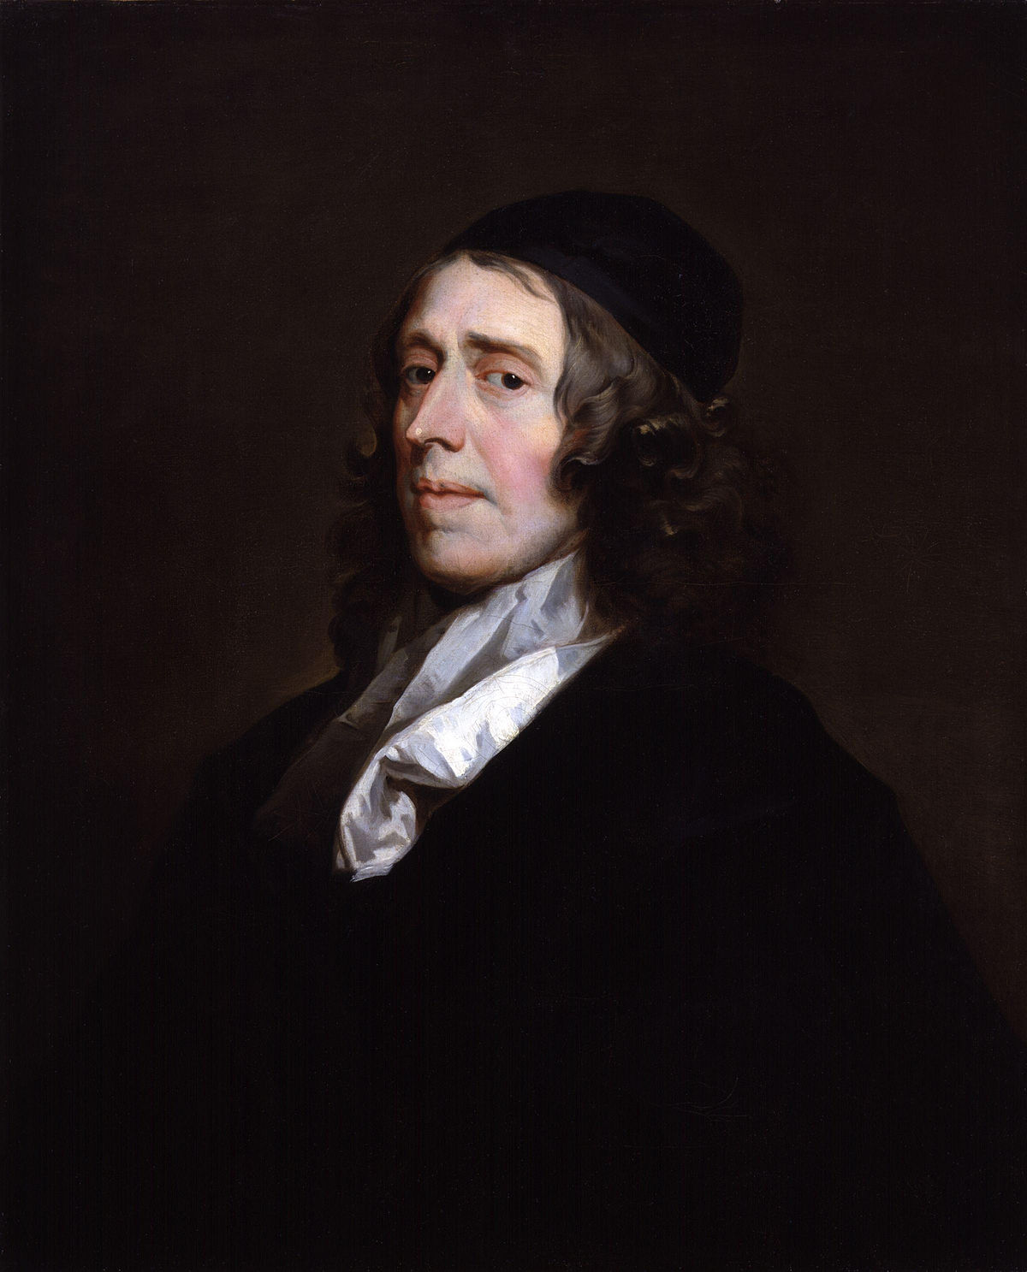

Slide 10
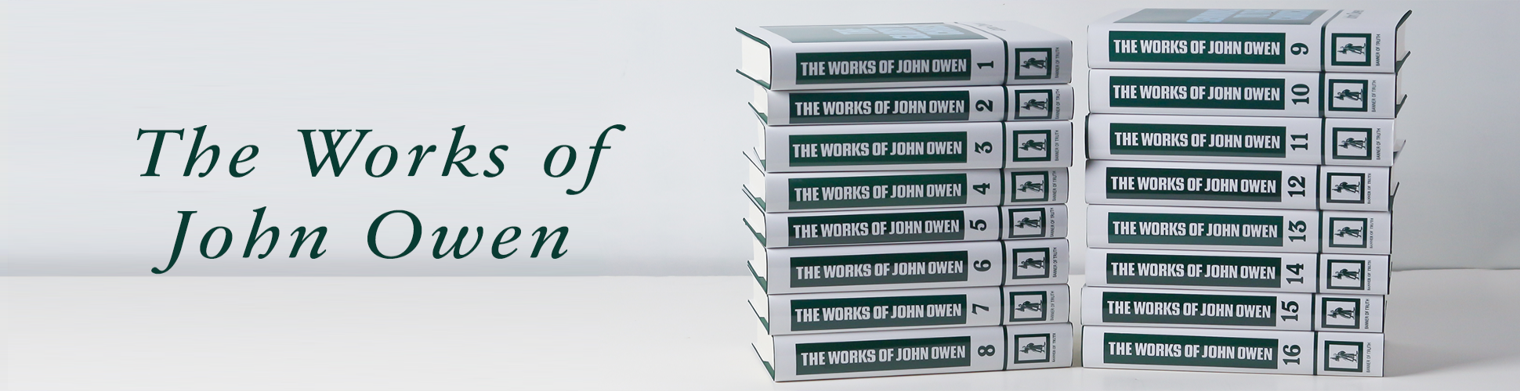

Slide 11
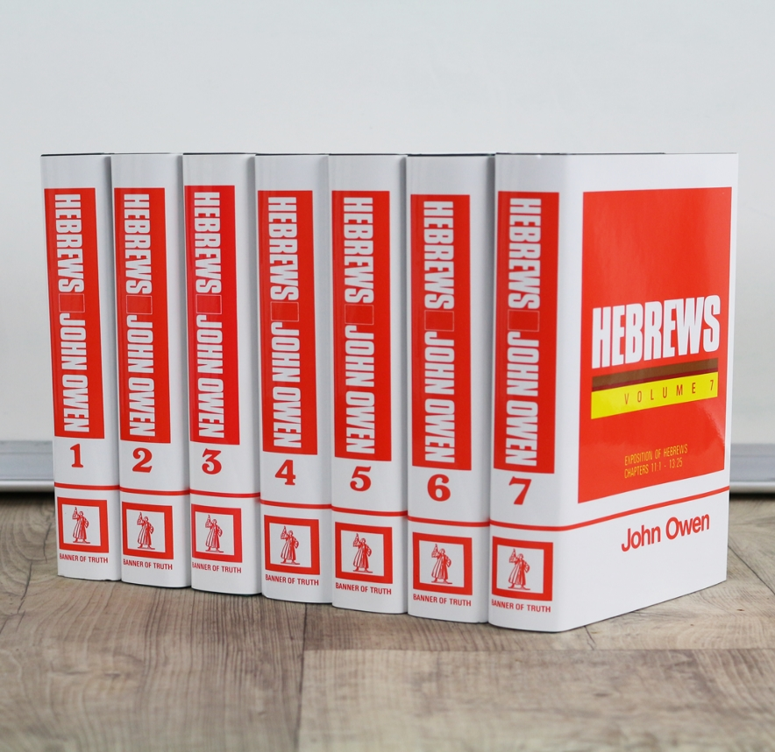

Slide 12
John Owen
(1616-1683)

Slide 13
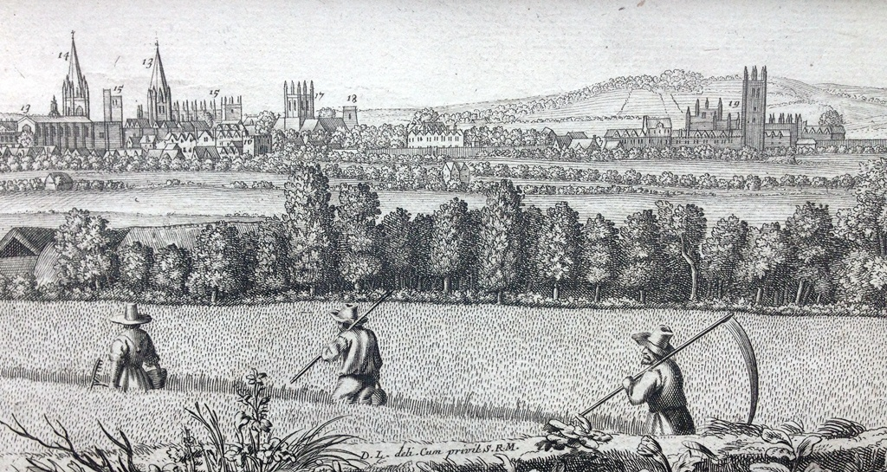
Vice-Chancellor of Oxford University (1651-1660)

Slide 14
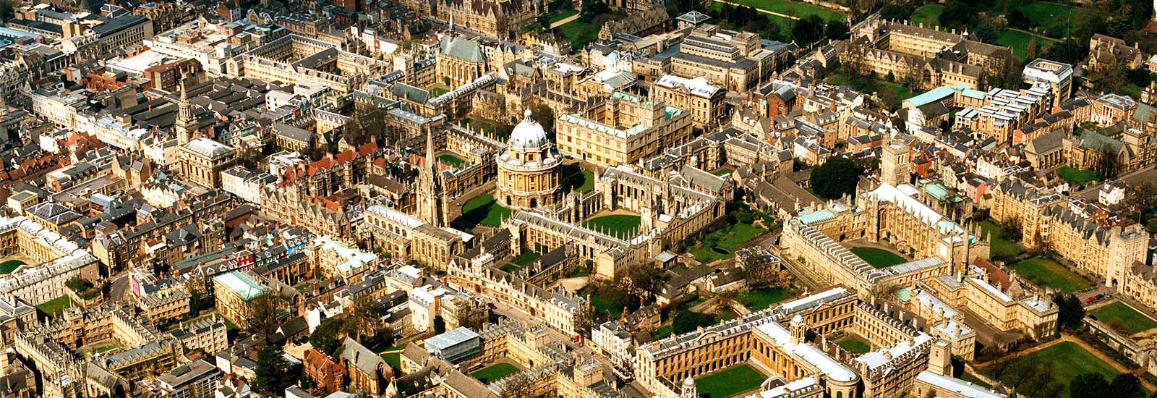

Slide 15
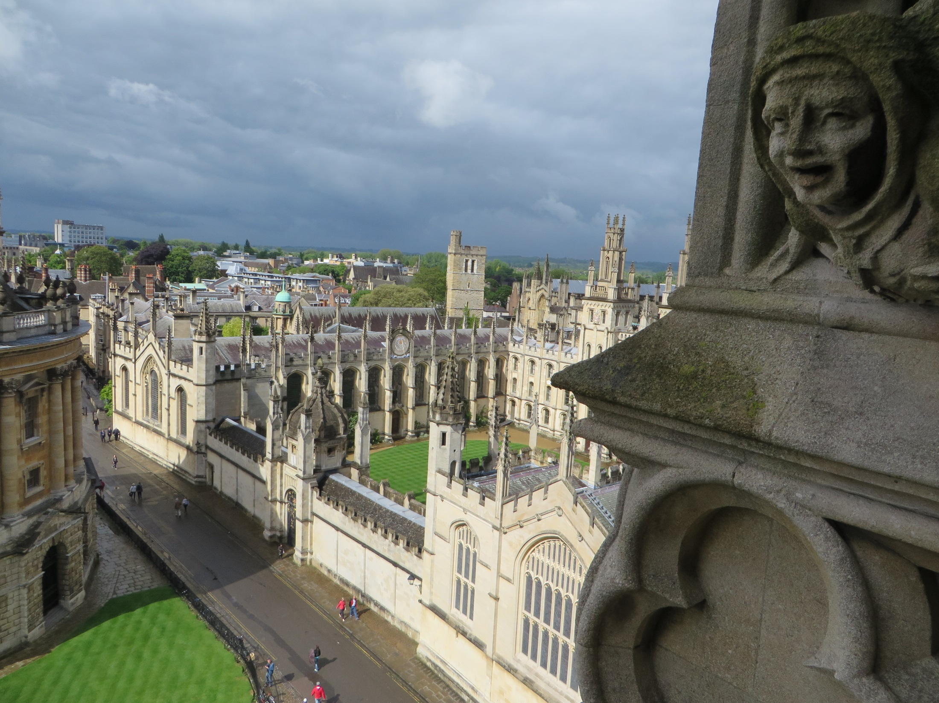

Slide 16
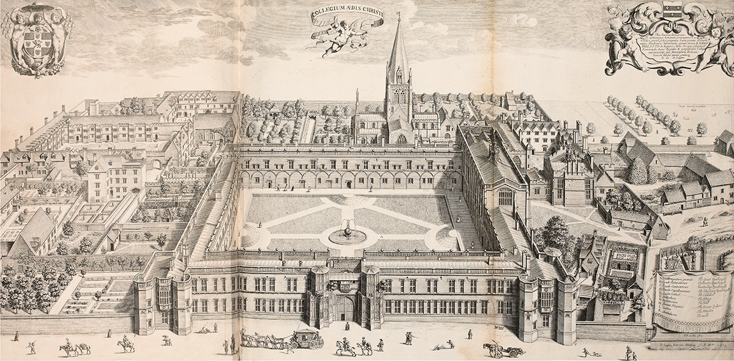
Dean of Christ Church College
David Loggan's 1675 view of Christ Church for Oxonia Illustrata lacks the landmark Tom Tower and

Slide 17
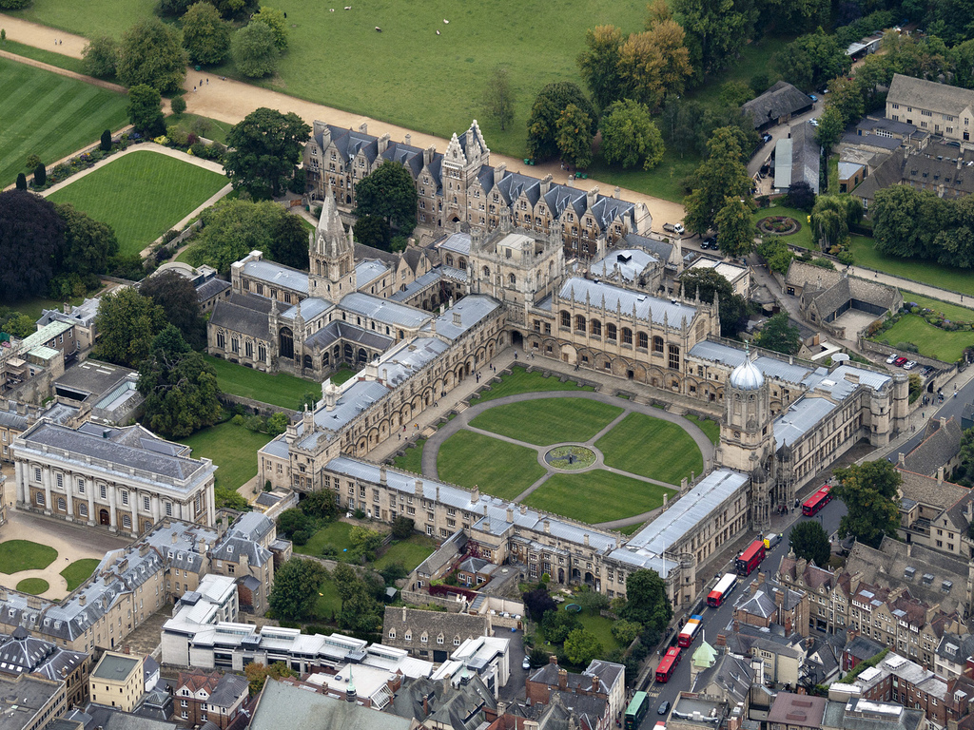

Slide 18
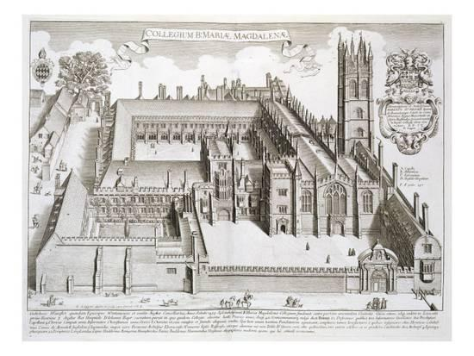

Slide 19
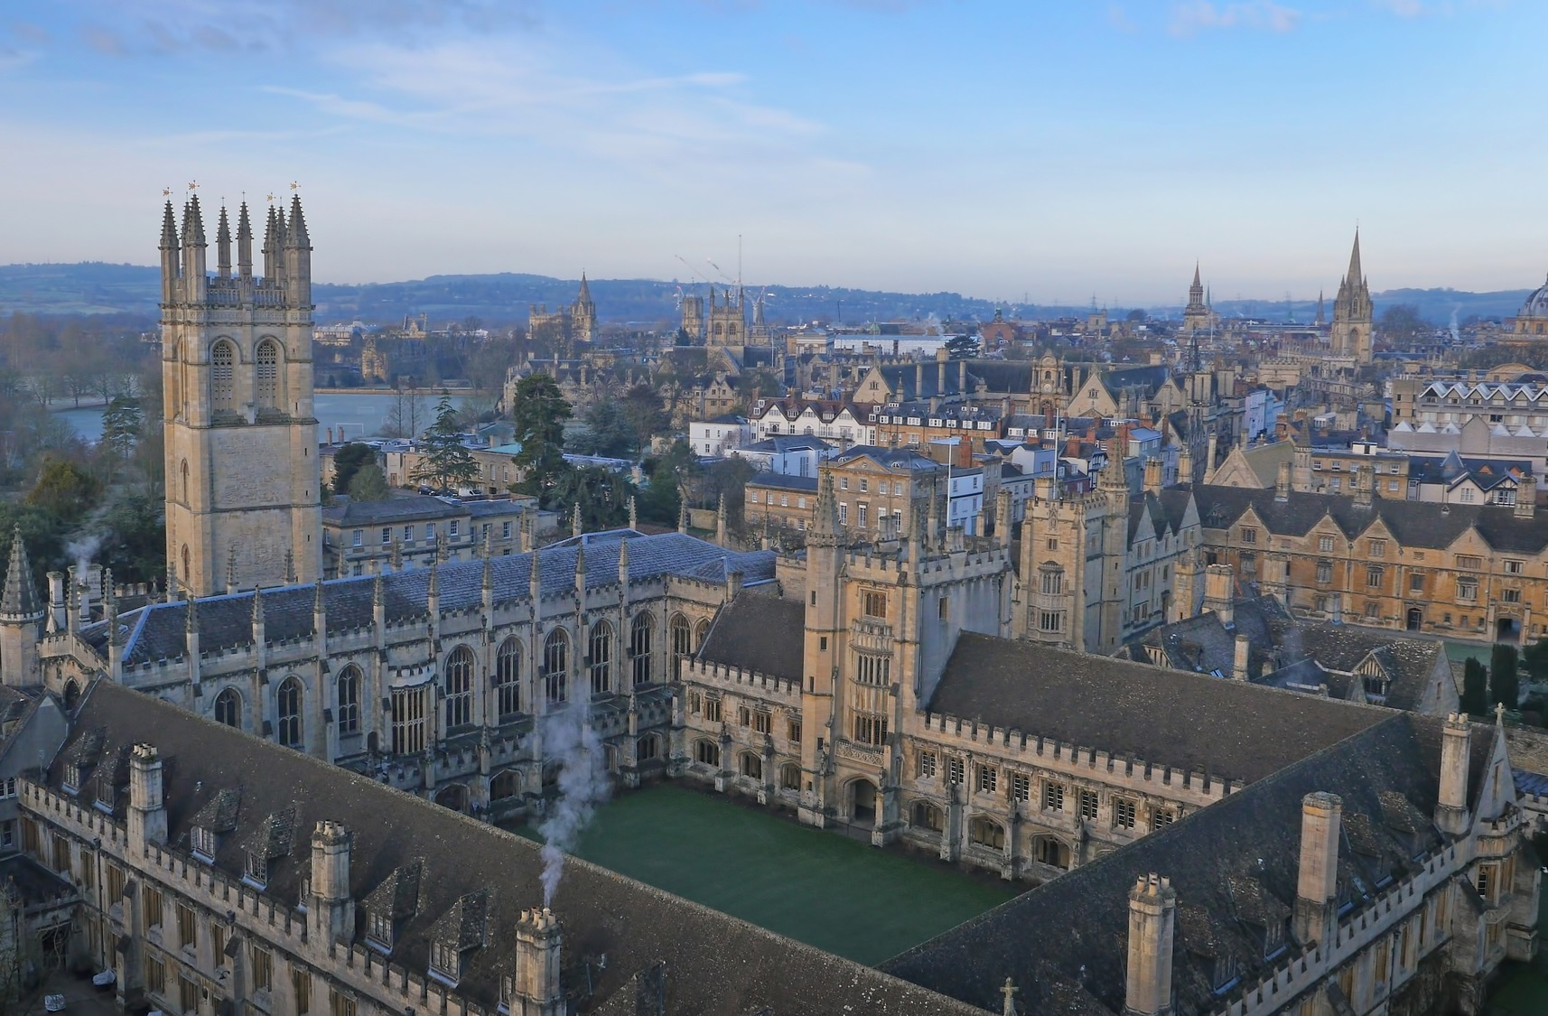

Slide 20
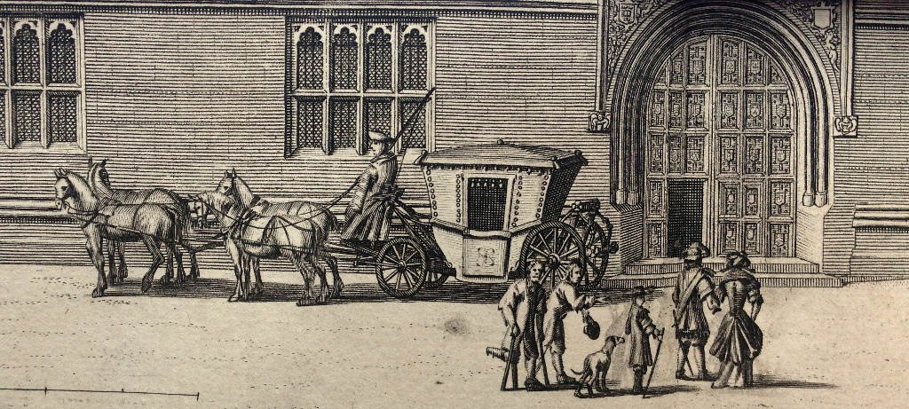
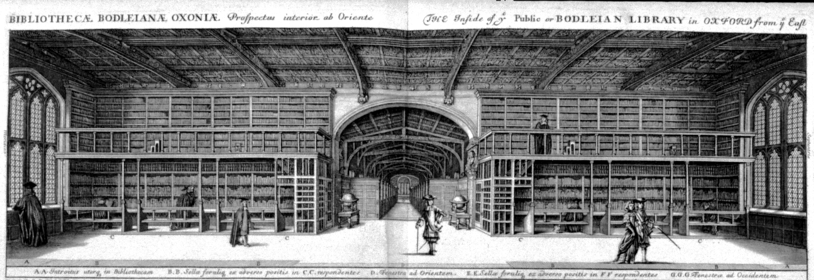
1675 first edition of David Loggan’s Oxonina illustrata

Slide 21
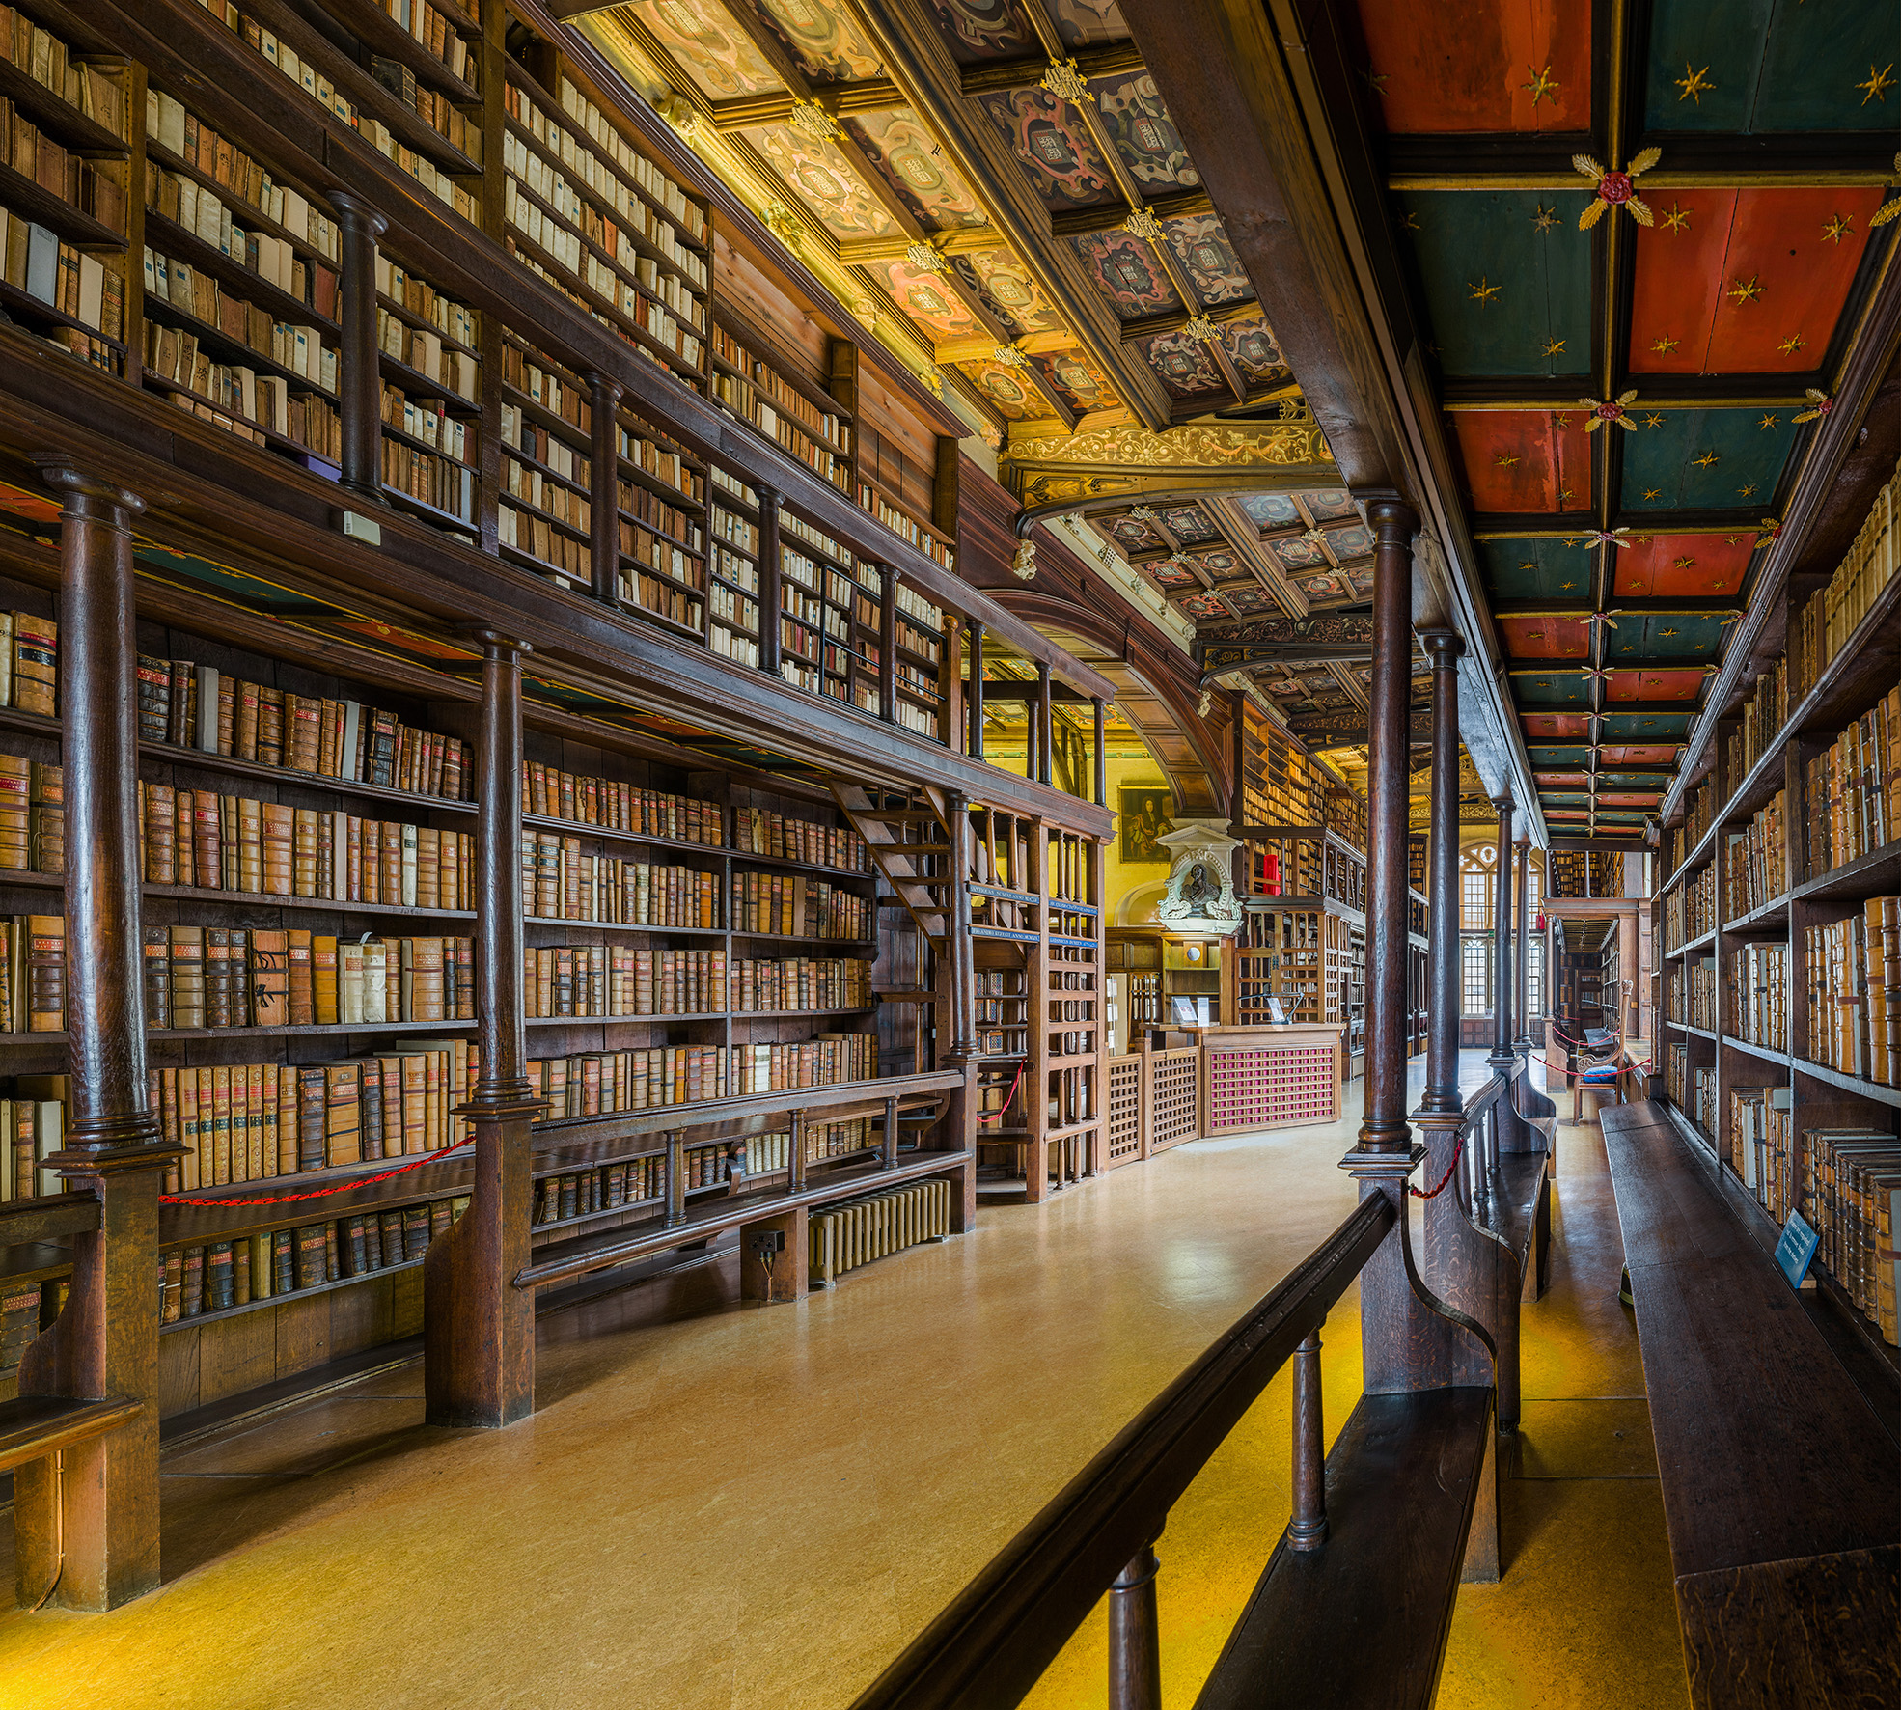

Slide 22
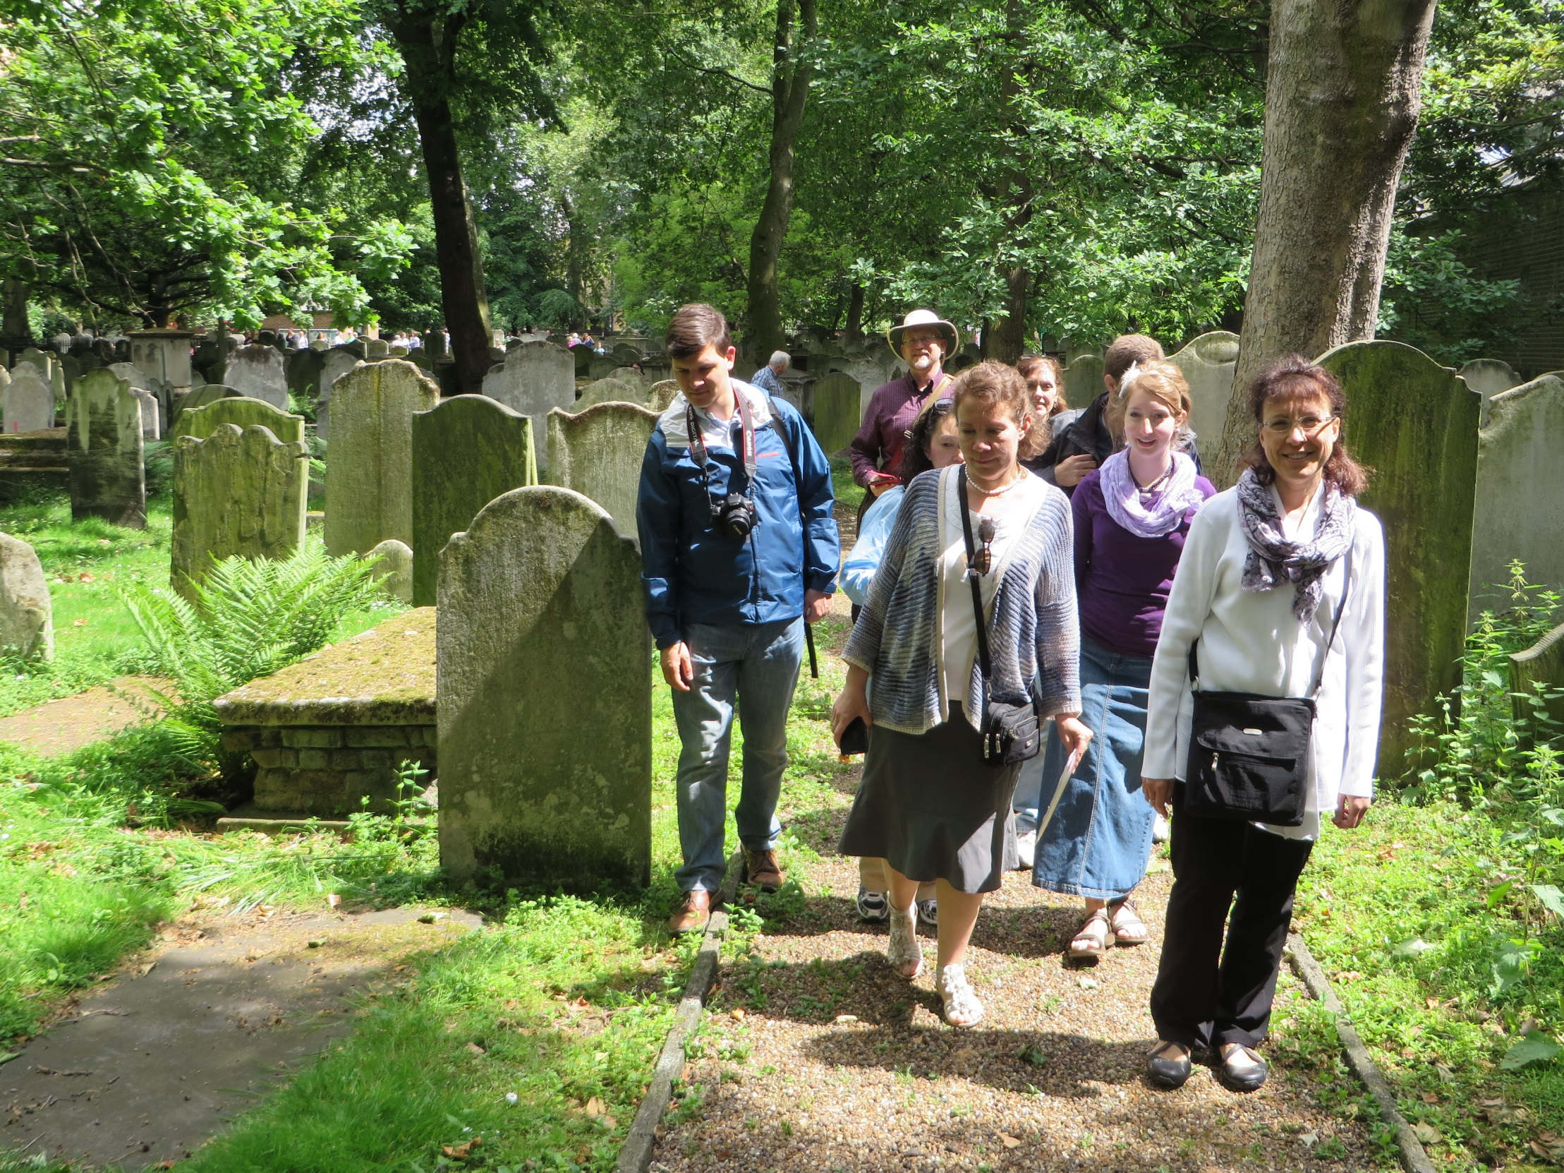

Slide 23
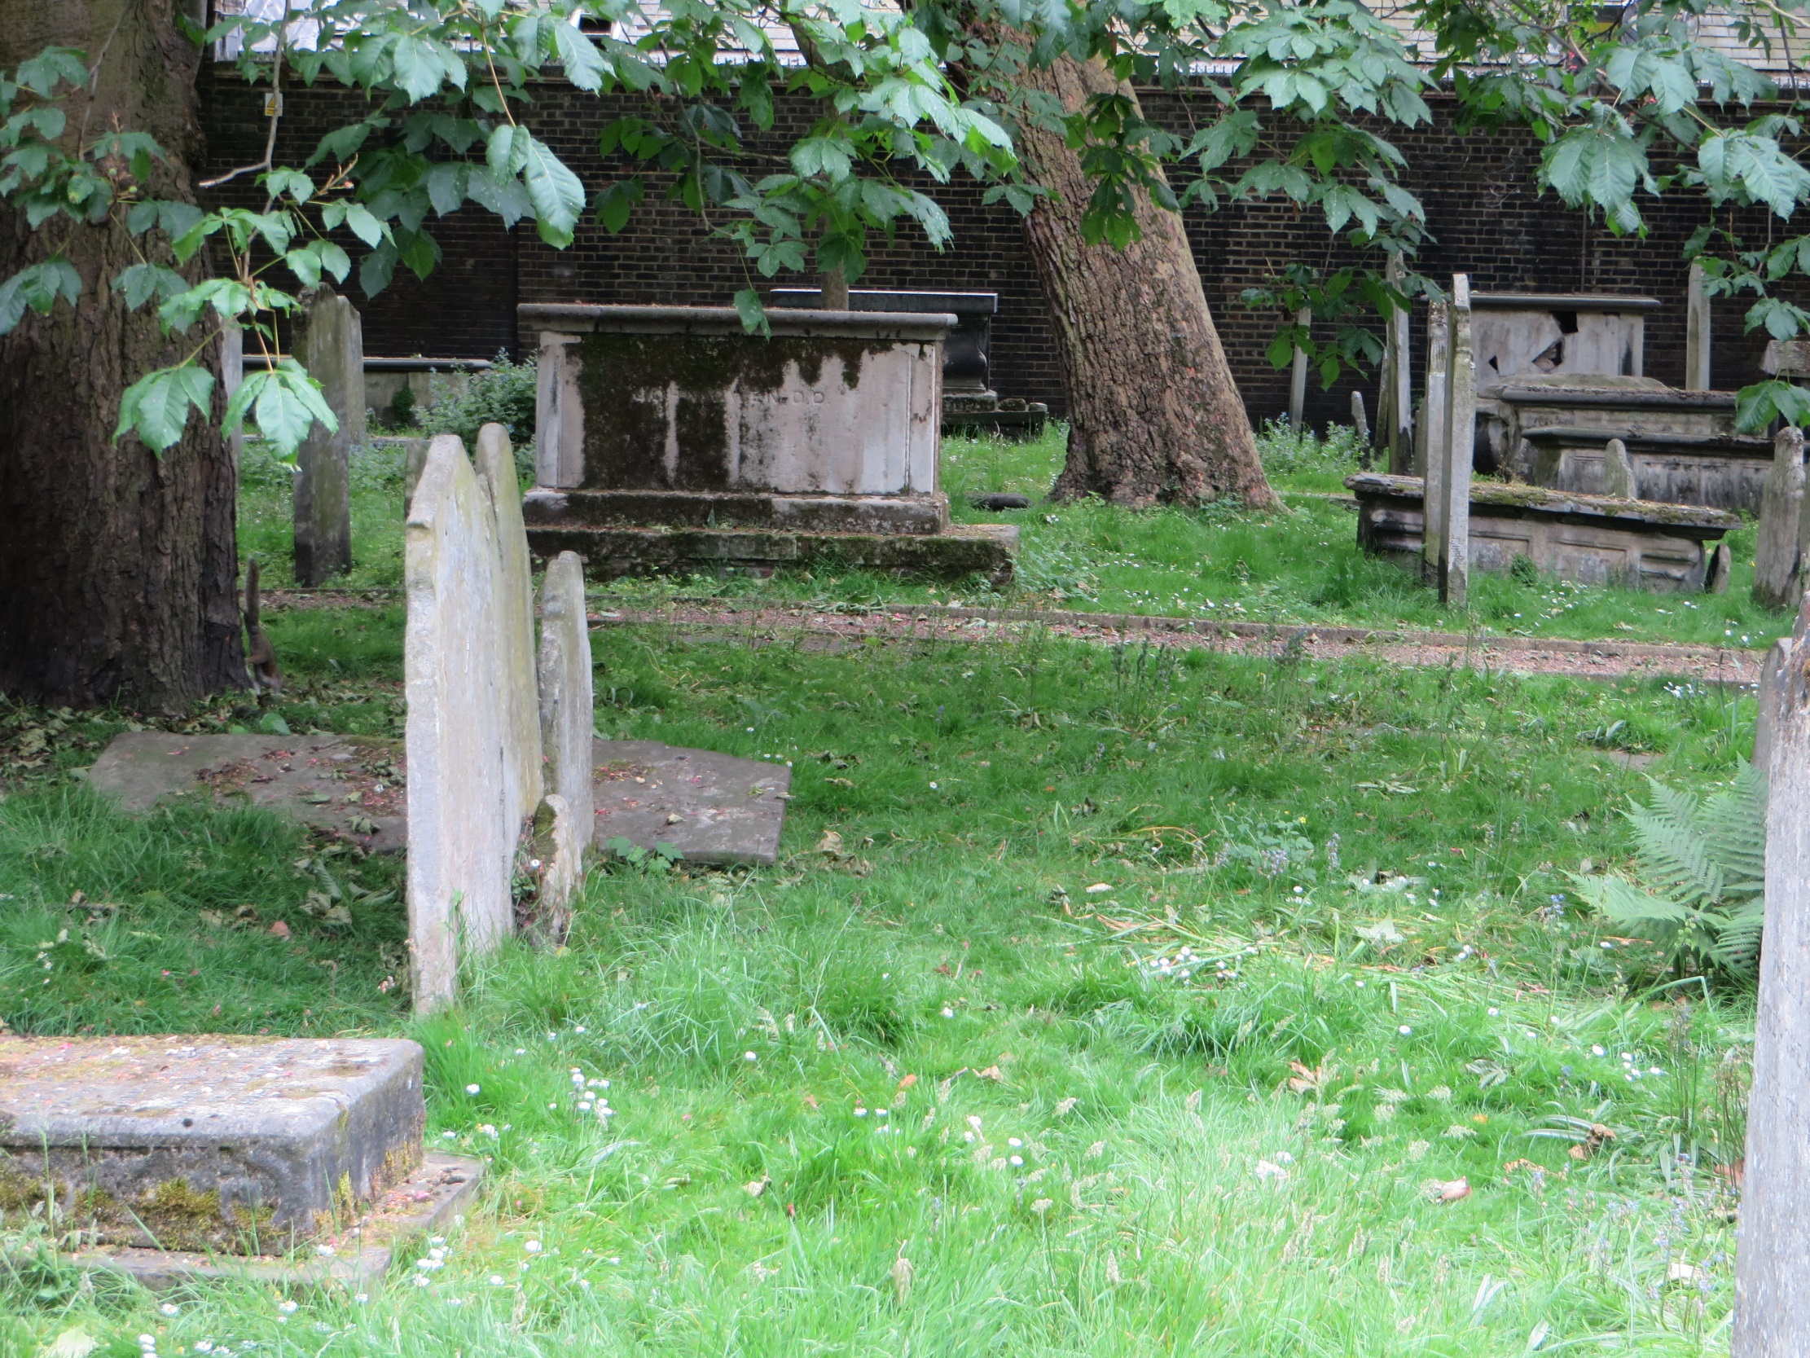

Slide 24
The long wished for day has
come in which I shall see
that glory in another manner than I have ever done, or was capable of doing in this world.
One of last things he wrote was a meditation on the glory of Christ (in vol. 1 of his works). William Payne, a Puritan minister, came and told him that its first sheets had passed through the press. With uplifted hands and eyes Owen replied, “I am glad to hear it; but, oh brother Payne,. . .

Slide 25
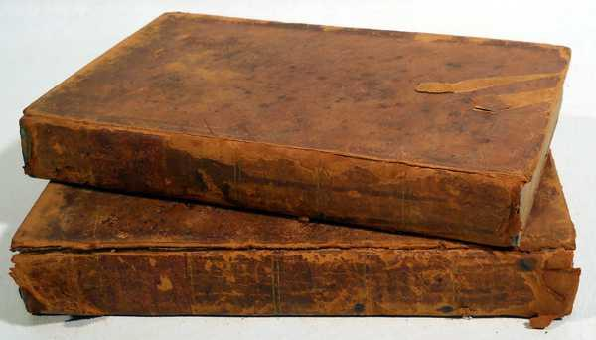

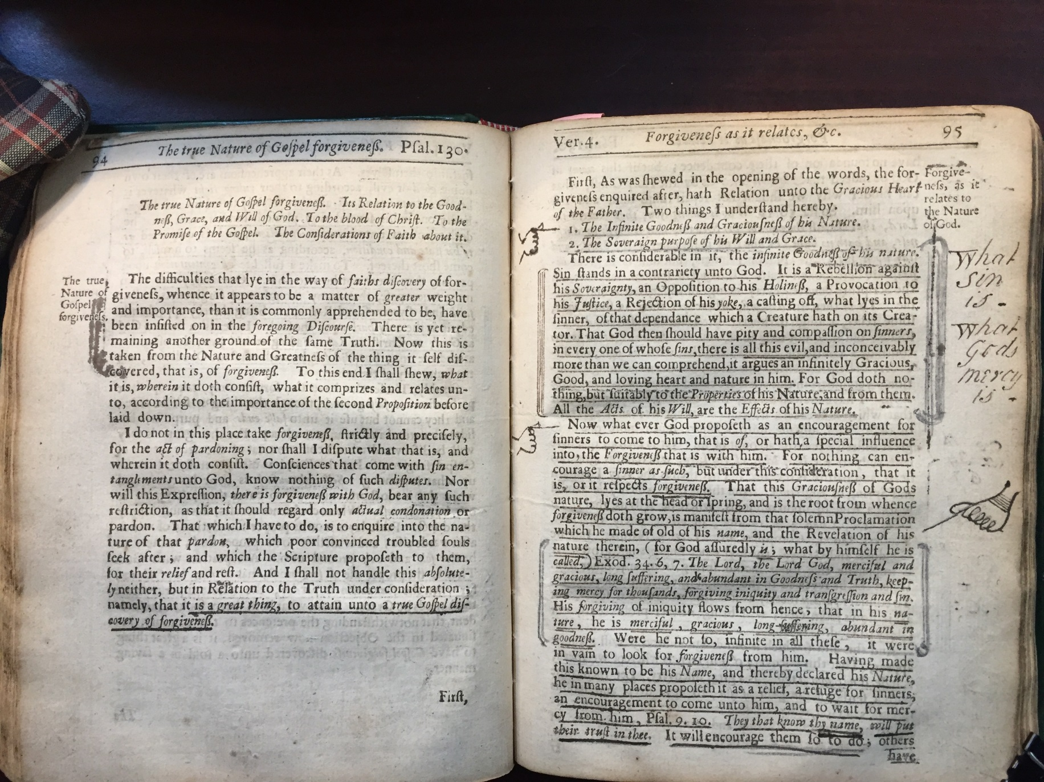
Volume 9 of his Works.

Slide 26
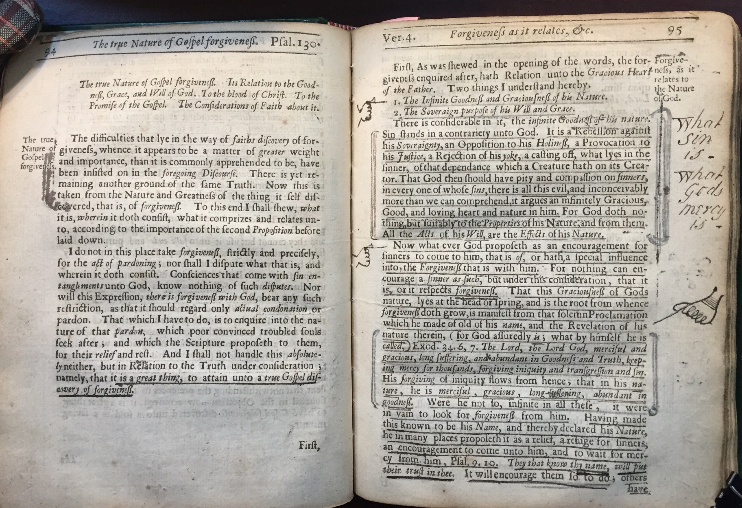

Slide 27
God The Saints’ Rock
From the end of the earth will I cry
to thee, when my heart is overwhelmed:
Lead me to the rock that is higher than I.
Psalm 61:2

Slide 28
God The Saints’ Rock
In the most overwhelming,
calamitous distresses. . . faith still
eyes a reserve in God, and delights
to break through all to come to him,
though, at the same time, . . .

Slide 29
God The Saints’ Rock
In the most overwhelming,
calamitous distresses. . . faith still
eyes a reserve in God, and delights
to break through all to come to him,
though, at the same time, it looks
upon God as the author of those
calamities.

Slide 30
God The Saints’ Rock
Some Instances:
Jonah 2:2-4

Slide 31
God The Saints’ Rock
In the most overwhelming,
calamitous distresses. . . faith still
eyes a reserve in God, and delights
to break through all to come to him,
though, at the same time, it looks
upon God as the author of those
calamities.

Slide 32
God The Saints’ Rock
Some Instances:
Psalm 3

Slide 33
God The Saints’ Rock
In the most overwhelming,
calamitous distresses. . . faith still
eyes a reserve in God, and delights
to break through all to come to him,
though, at the same time, it looks
upon God as the author of those
calamities.

Slide 34
God The Saints’ Rock
Some Instances:
II. The Grounds: Whence it is
that faith does this.

Slide 35
1. Because faith is able to
distinguish between the covenant itself,
and the administration of the covenant.
The covenant is firm, stable, and
invariable.

Slide 36
1. Because faith is able to
distinguish between the covenant itself,
and the administration of the covenant.
The covenant is firm, stable, and
invariable.
The administration of the covenant
is various and changeable.

Slide 37
1. Because faith is able to
distinguish between the covenant itself,
and the administration of the covenant.
Psalm 89:30-34

Slide 38
1. Because faith is able to
distinguish between the covenant itself,
and the administration of the covenant.
Isaiah 38:15-20

Slide 39
v. 16

Slide 40
v. 16 One would think the next words
would be, “By these things men die.”
No, but, “By these things believers live,
and in all these things is the life of my
soul.” Because they are all administered
from an invariable covenant for the good
of the souls of them who are exercised
with them.

Slide 41
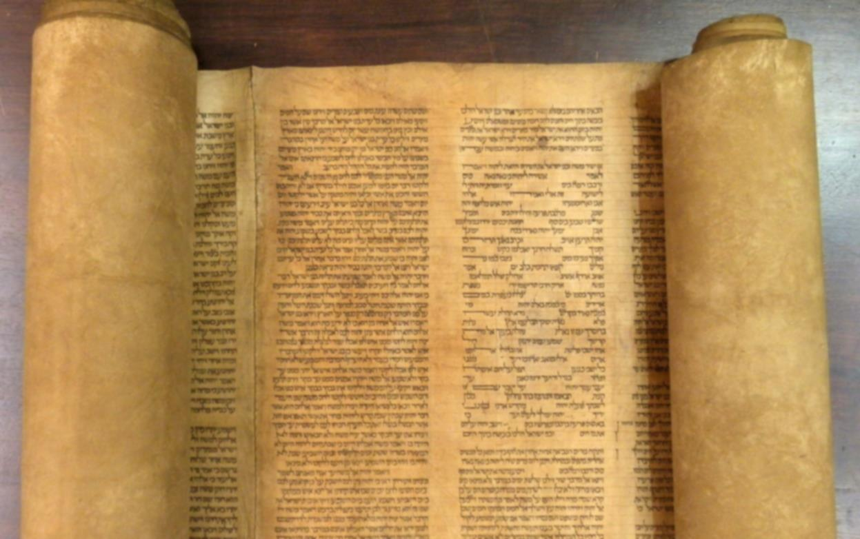
I will wait for the LORD who
is hiding His face from the house of Jacob; I will even eagerly look for Him
(Isaiah 8:17).

Slide 42
Now when the soul is sensible of
no communication of love, nor promise
of it, then God is said to hide his face.
what will faith do in such a case? Betake
itself unto anything else for relief?
“No,” saith he, “I will wait upon God,
that hideth His face.”

Slide 43
As a traveler, when the sky
is filled with clouds and darkness,
tempests and storms, that are
ready to break upon him
everywhere, yet remembers that
these are but interpositions,
and the Sun is. . .

Slide 44
God The Saints’ Rock
Some Instances:
II The Grounds: Whence it is
that faith does this.

Slide 45
1. Because faith is able to
distinguish between the covenant itself,
and the administration of the covenant.

Slide 46
1. Because faith is able to
distinguish between the covenant itself,
and the administration of the covenant.
2. Because faith will act thus
naturally. It is the principle of the
new nature in us, that came from
God.

Slide 47
2. Because faith will act thus
naturally. It is the principle of the
new nature in us, that came from
God.
(1) Evangelical faith has a
natural tendency to flee to
Christ.

Slide 48
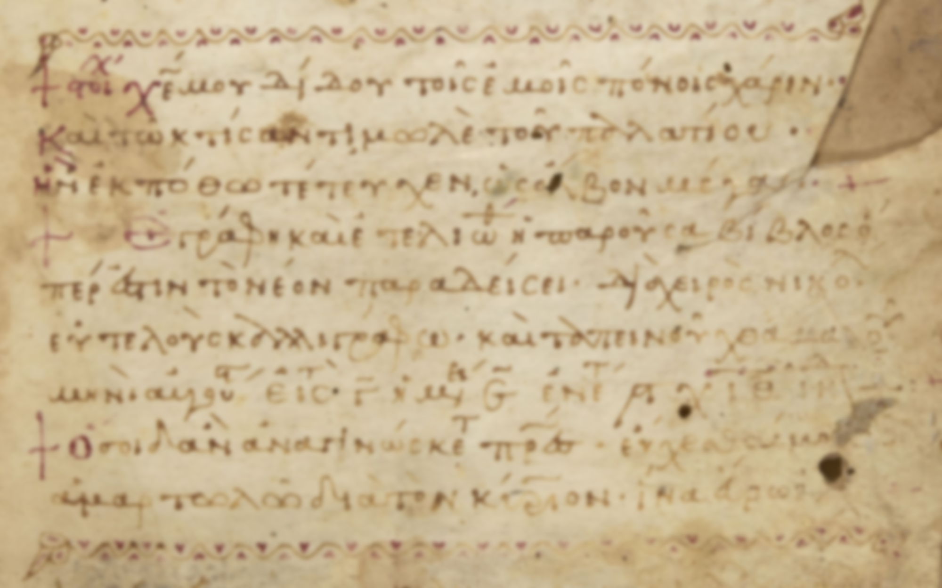
. . . who through Him are
believers in God, who raised
Him from the dead and gave
Him glory, so that your faith
and hope are in God.
--I Peter 1:21

Slide 49
When many a poor soul hath the
knife at the throat of all his consolations,
ready to die away, he hears a voice
behind him, that makes him look and
see Christ provided for him, as a
substituted sacrifice in his room.

Slide 50
Where there is but the least faith,
it will have relief in this, that Christ
was substituted in its room against all
real indignation and wrath from God.

Slide 51
God The Saints’ Rock
From the end of the earth will I cry
to thee, when my heart is overwhelmed:
Lead me to the rock that is higher than I.
Psalm 61:2

Slide 52
God The Saints’ Rock
In the most overwhelming,
calamitous distresses. . . faith still
eyes a reserve in God, and delights
to break through all to come to him,
though, at the same time, it looks
upon God as the author of those
calamities.

