Slide 1

In what way can we obtain the gracious provisions of God’s covenants?
For there is one God, and one mediator between God and men, the man Christ Jesus (KJV; I Tim. 2:5).
. . . the great God and our Saviour Jesus Christ; who gave himself for us, that he might redeem us from all iniquity, and purify unto himself a peculiar people, zealous of good works (KJV; Tit. 2:13b-14).
For this reason He is the mediator of a new covenant, so that, since a death has taken place for the redemption of the transgressions that were committed under the first covenant, those who have been called may receive the promise of the eternal inheritance (NASB; Heb. 9:15).
36

Slide 2
The one way, the only way that we can
obtain the gracious provisions of God’s
covenants is through the Redeemer,
the Lord Jesus Christ.

Slide 3
What offices does Jesus Christ execute as our Redeemer?
Moses said, “THE LORD GOD WILL RAISE UP FOR YOU A PROPHET LIKE ME FROM YOUR BRETHREN; TO HIM YOU SHALL GIVE HEED to everything He says to you. And it will be that every soul that does not heed that prophet shall be utterly destroyed from among the people” (NASB; Acts 3:22-23).
Just as He says also in another passage, YOU ARE A PRIEST FOREVER ACCORDING TO THE ORDER OF MELCHIZEDEK” (NASB; Heb. 5:6).
He who sits in the heavens laughs, the Lord scoffs at them. Then He
will speak to them in His anger. . . “But as for Me, I have installed My King upon Zion, My holy mountain” (NASB; Psalm 2:4-5a, 6).
37

Slide 4
Jesus Christ executes as our Redeemer
the offices of prophet, priest and king,
in both His humiliation and His exaltation.
(Adapted from Westminster Shorter Catechism, Q. 23)

Slide 5
How does Christ execute the office of a prophet?
God, after He spoke long ago to the fathers in the prophets in many portions and many ways, in these last days has spoken to us in His Son . . . (NASB; Heb. 1:1-2a).
No one has seen God at any time; the only begotten God who is in the bosom of the Father, He has explained Him
(NASB; John 1:18).
. . . all things that I have heard from My Father I have made known to you (NASB; John 15:15b).
John 16:7-15
38

Slide 6
Christ executes the office of a prophet in revealing to us, by His Word and Spirit,
the will of God for our salvation.
(Westminster Shorter Catechism, Q. 24)

Slide 7
How does Christ execute the office of a priest?
Therefore, He had to be made like His brethren in all things, so that He might become a merciful and faithful high priest in things pertaining to God, to make propitiation for the sins of the people (NASB; Heb. 2:17).
But He, having offered one sacrifice for sins for all time, SAT DOWN AT THE RIGHT HAND OF GOD (NASB; Heb. 10:12).
But Jesus. . . because He continues forever, holds His priesthood permanently. Therefore He is able also to save forever those who draw near to God through Him, since He always lives to make intercession for them (NASB; Heb. 7:24-25).
39

Slide 8
Christ executes the office of a priest in offering up Himself as the once-for-all sacrifice to satisfy Divine justice and to reconcile us to God, and in making continual intercession for us.
(adapted from Westminster Shorter Catechism, Q. 25)

Slide 9
How does Christ execute the office of a king?
“Turn to Me and be saved, all the ends of the earth; for I am God, and there is no other. I have sworn by Myself, the word has gone forth from My mouth in righteousness and will not turn back, that to Me every knee will bow, every tongue will swear allegiance” (NASB; Is. 45:22-23; see Phil. 2:9-11).
Do homage to the Son. . . (NASB; Ps. 2:12a).
The LORD says to my Lord: “Sit at My right hand until I make Your enemies a footstool for Your feet” (NASB; Ps. 110:1).
For He must reign until He has put all His enemies under His feet. The last enemy that will be abolished is death (NASB; I Cor. 15:25-26).
40

Slide 10
Christ executes the office of a king, in subduing us to Himself, in ruling and defending us, and in restraining and conquering all His and our enemies.
(Westminster Shorter Catechism, Q. 26)

Slide 11
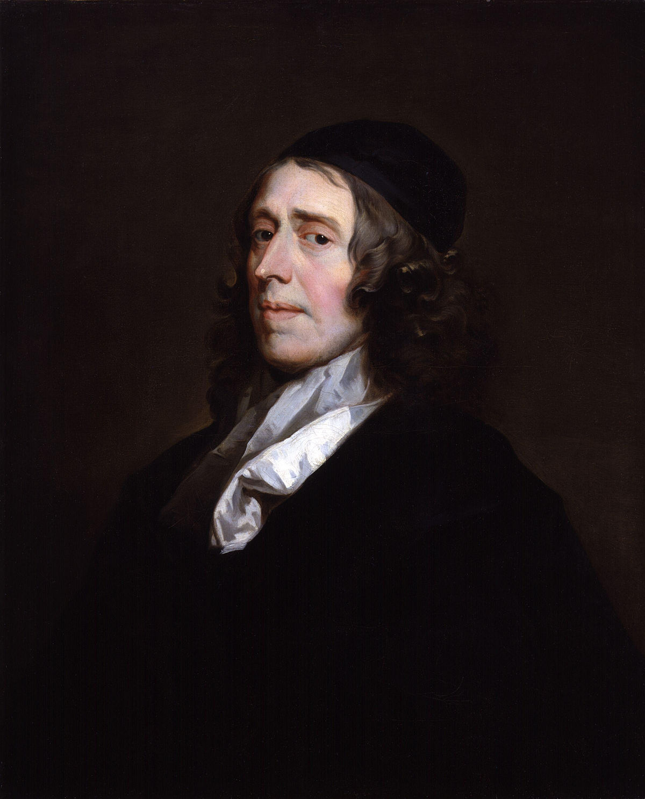
John Owen
(1616-1683)

Slide 12
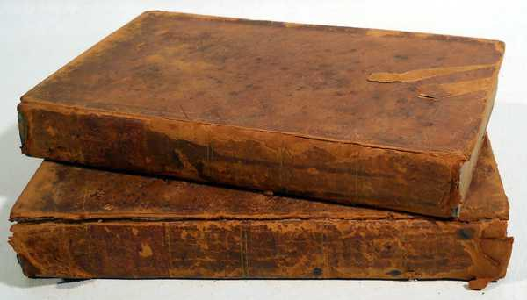

Volume 9 of his Works.

Slide 13
God The Saints’ Rock
From the end of the earth will I cry
to thee, when my heart is overwhelmed:
Lead me to the rock that is higher than I.
Psalm 61:2

Slide 14
God The Saints’ Rock
In the most overwhelming,
calamitous distresses. . . faith still
eyes a reserve in God, and delights
to break through all to come to him,
though, at the same time, . . .

Slide 15
God The Saints’ Rock
In the most overwhelming,
calamitous distresses. . . faith still
eyes a reserve in God, and delights
to break through all to come to him,
though, at the same time, it looks
upon God as the author of those
calamities.
His wife, Mary Rook, bore him 11 children. Only one lived to adulthood.

Slide 16
God The Saints’ Rock
Some Instances:
II. The Grounds: Whence it is
that faith does this.

Slide 17
God The Saints’ Rock
Some Instances:
II. The Grounds: Whence it is
that faith does this.

Slide 18
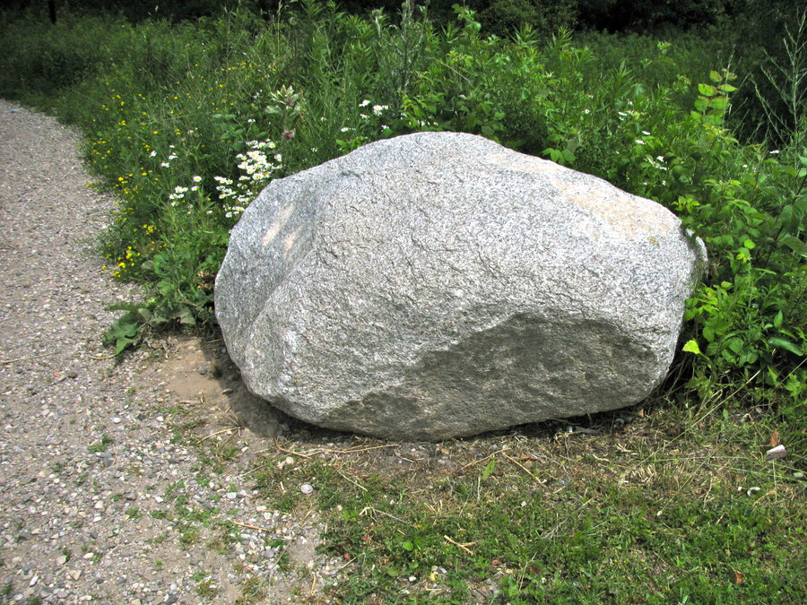

Slide 19
God The Saints’ Rock
From the end of the earth will I cry
to thee, when my heart is overwhelmed:
Lead me to the rock that is higher than I.
Psalm 61:2

Slide 20
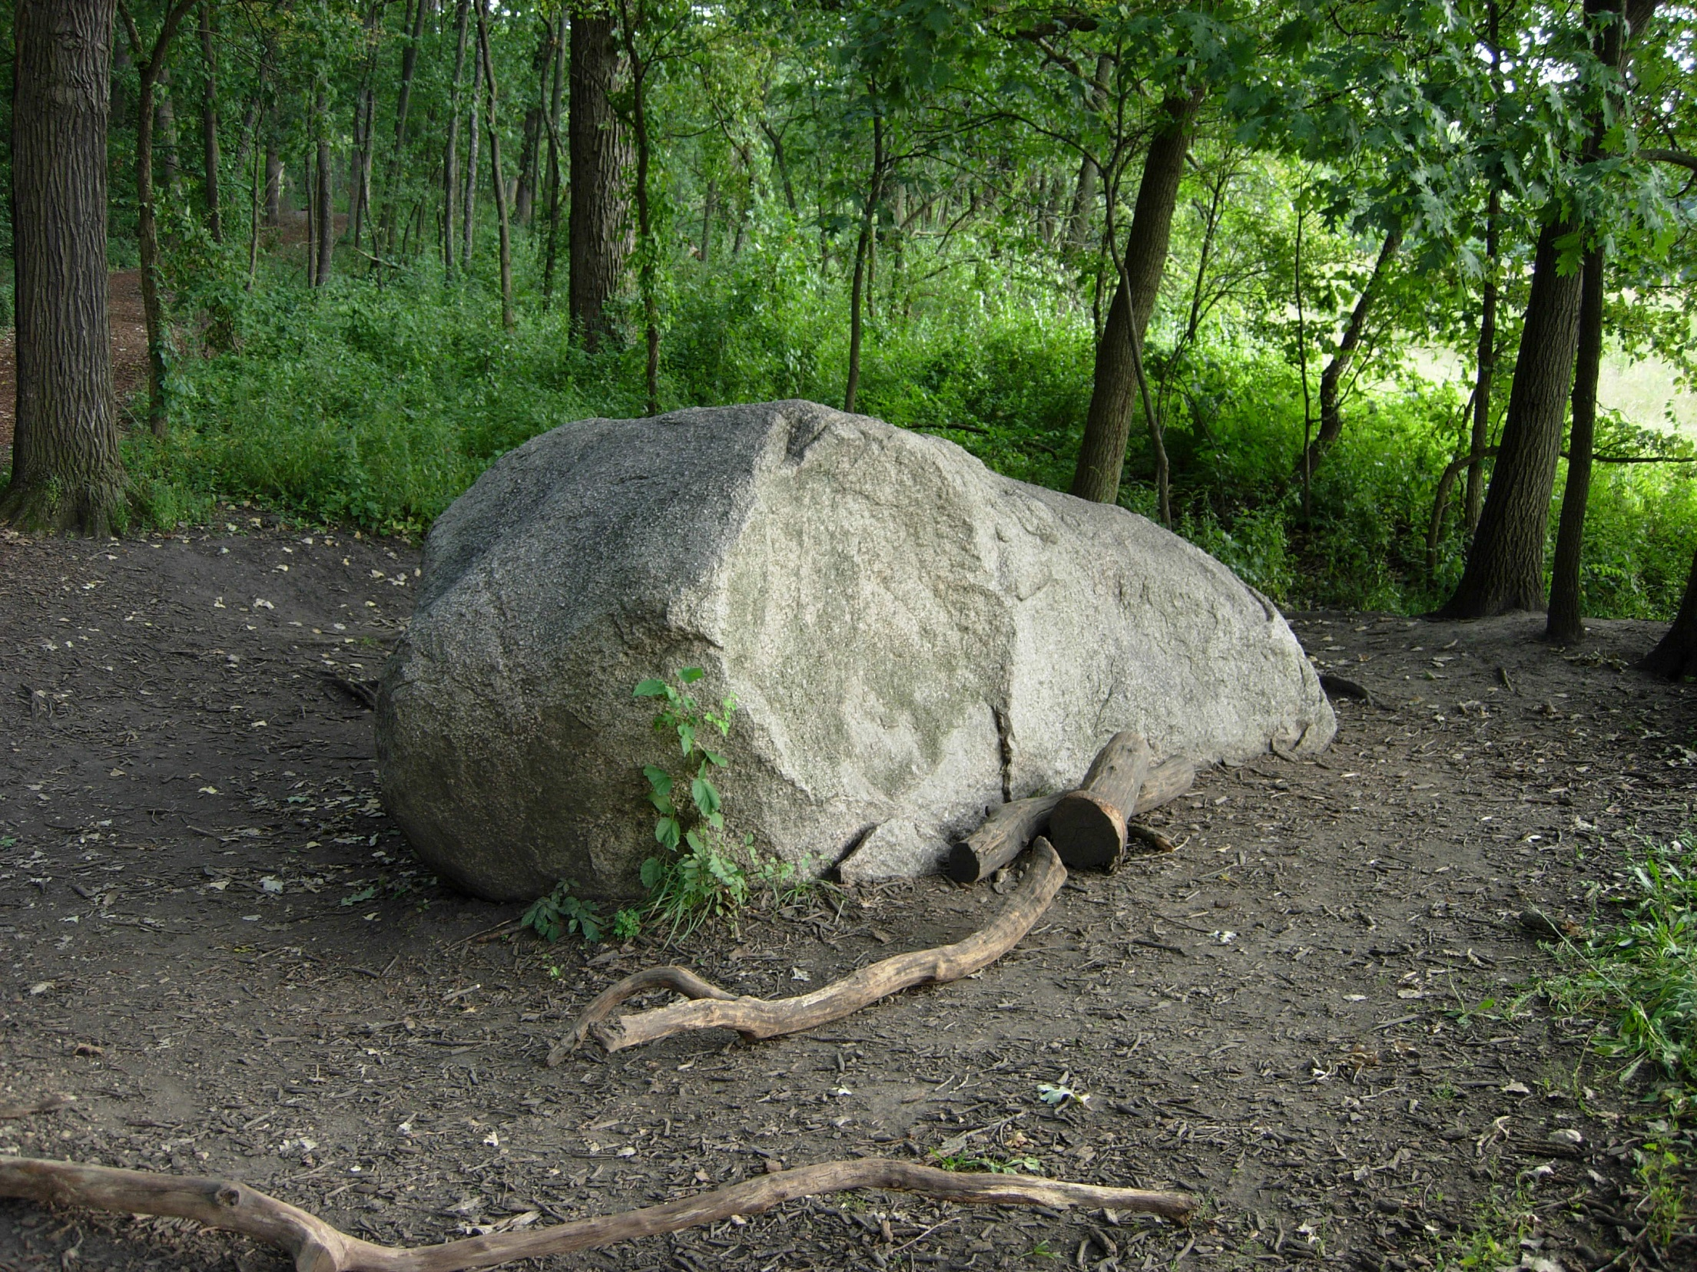

Slide 21
God The Saints’ Rock
From the end of the earth will I cry
to thee, when my heart is overwhelmed:
Lead me to the rock that is higher than I.
Psalm 61:2

Slide 22
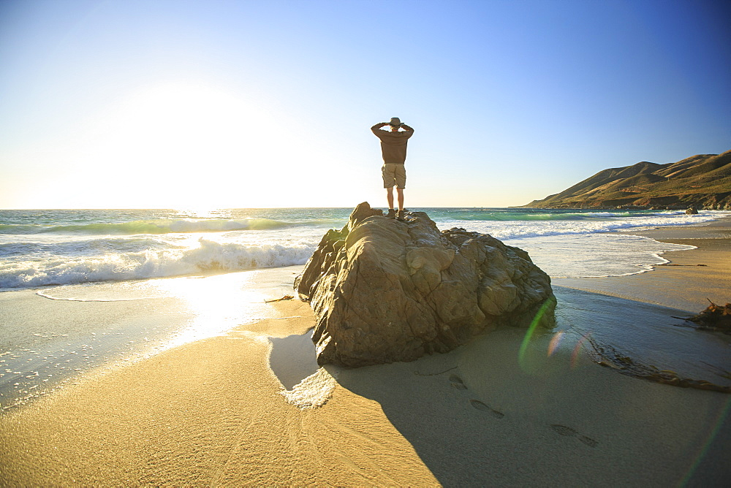

Slide 23
God The Saints’ Rock
From the end of the earth will I cry
to thee, when my heart is overwhelmed:
Lead me to the rock that is higher than I.
Psalm 61:2

Slide 24
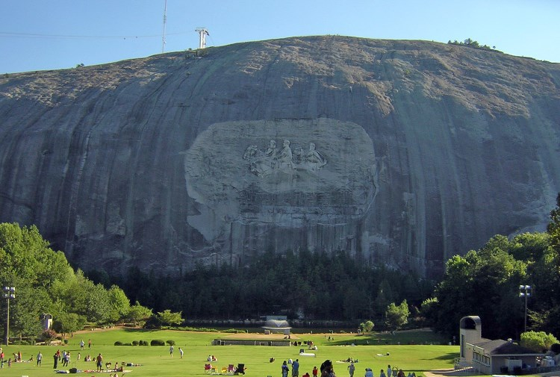
Stone Mountain. Georgia.

Slide 25
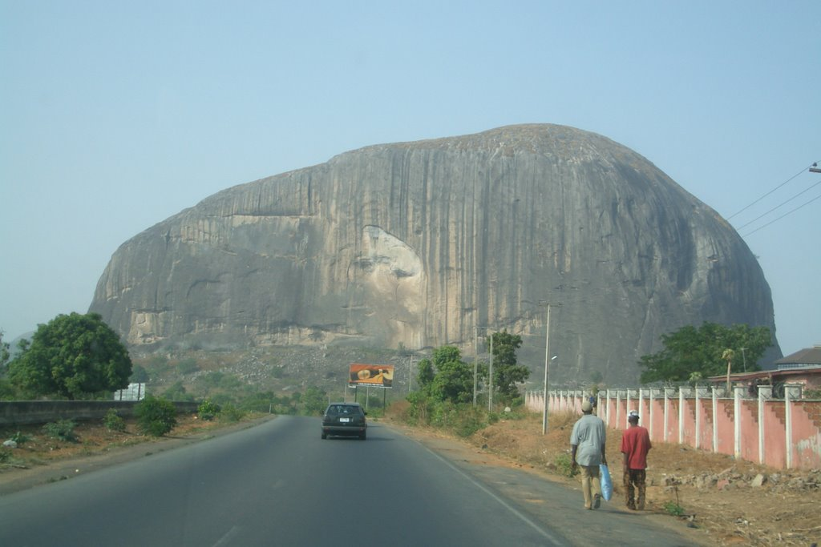
Zuma Rock. Nigeria.

Slide 26
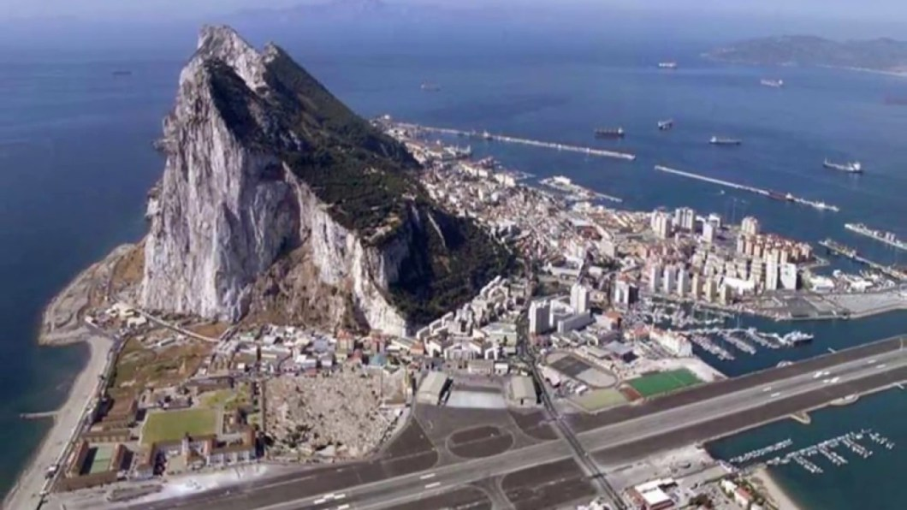

Slide 27
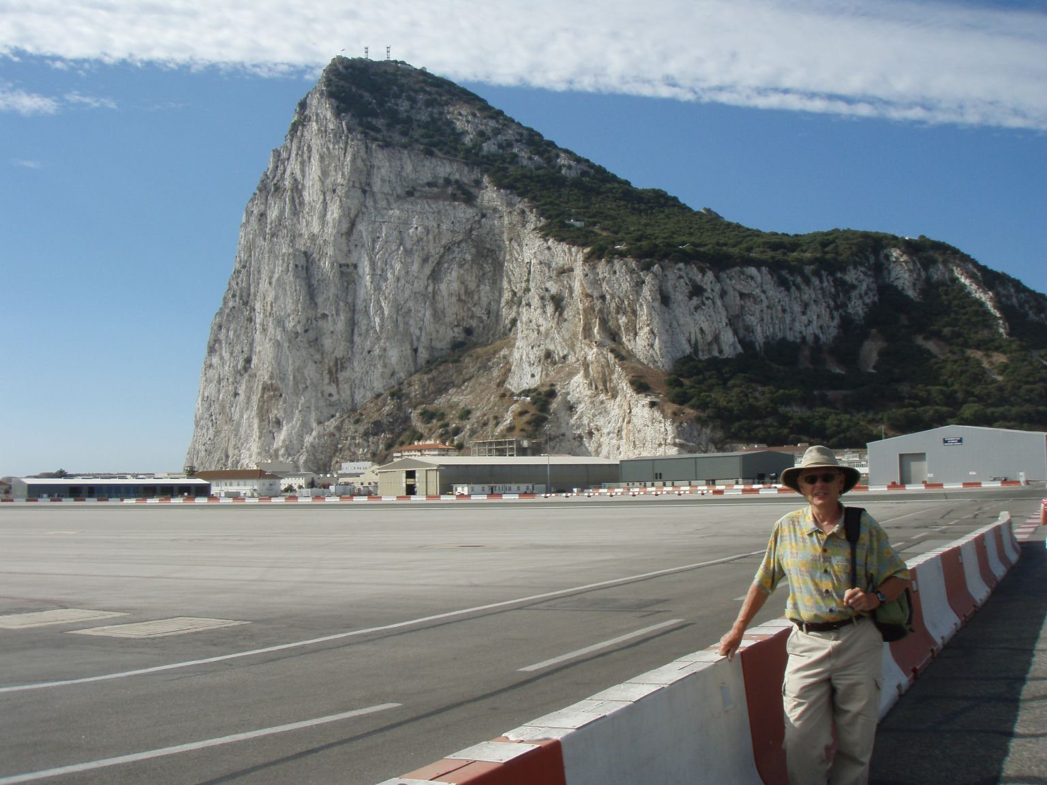

Slide 28
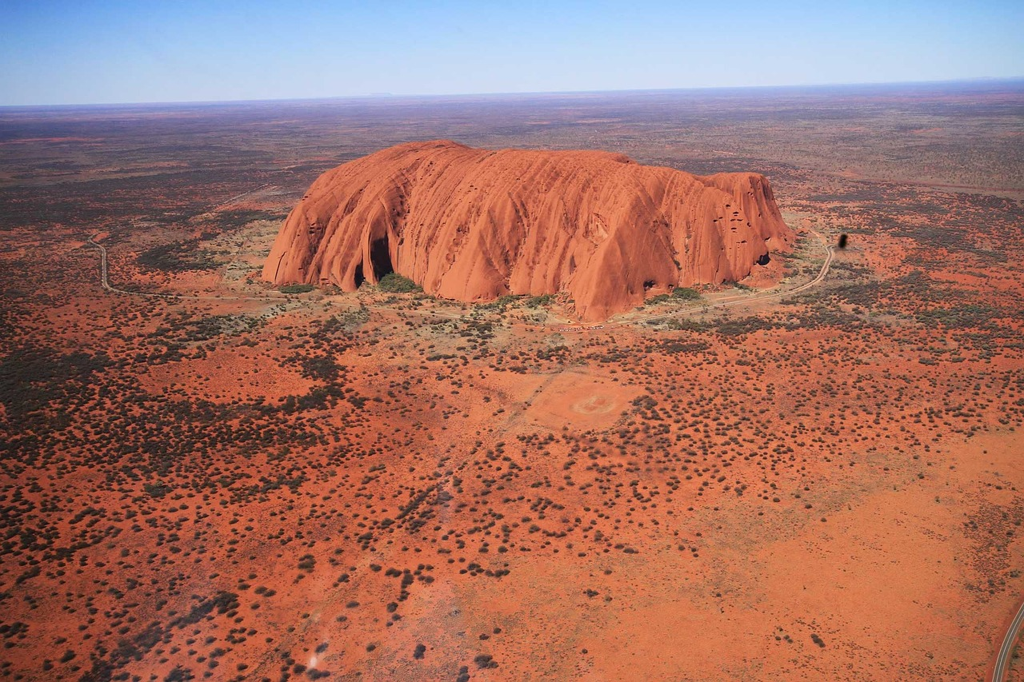

Slide 29
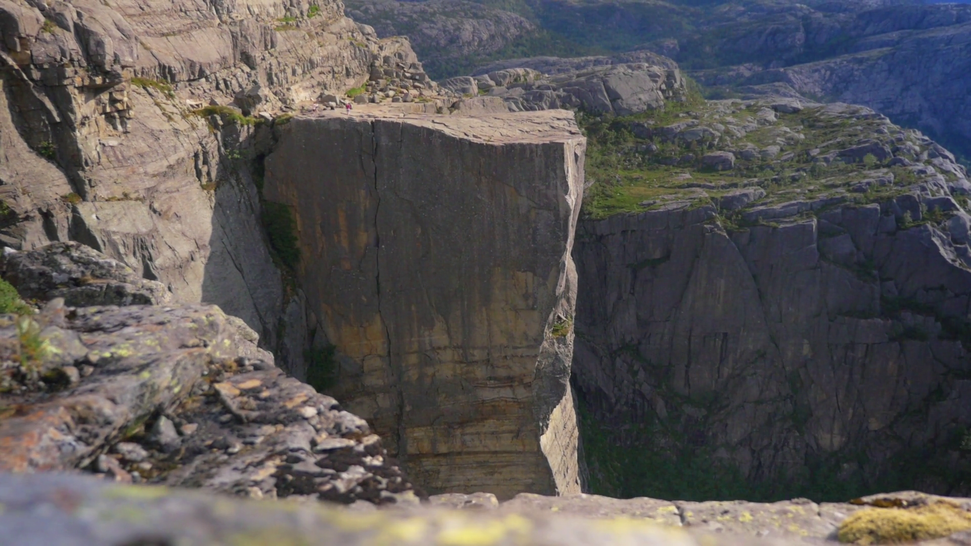
Pulpit rock in Norway.

Slide 30
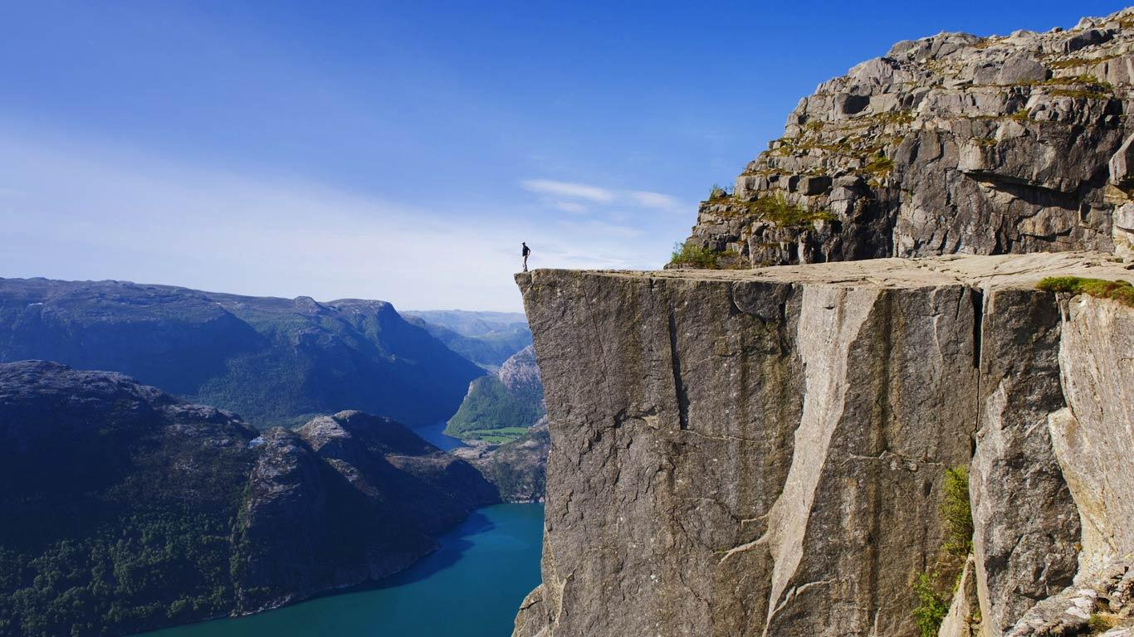
Big enough and high enough for me.

Slide 31
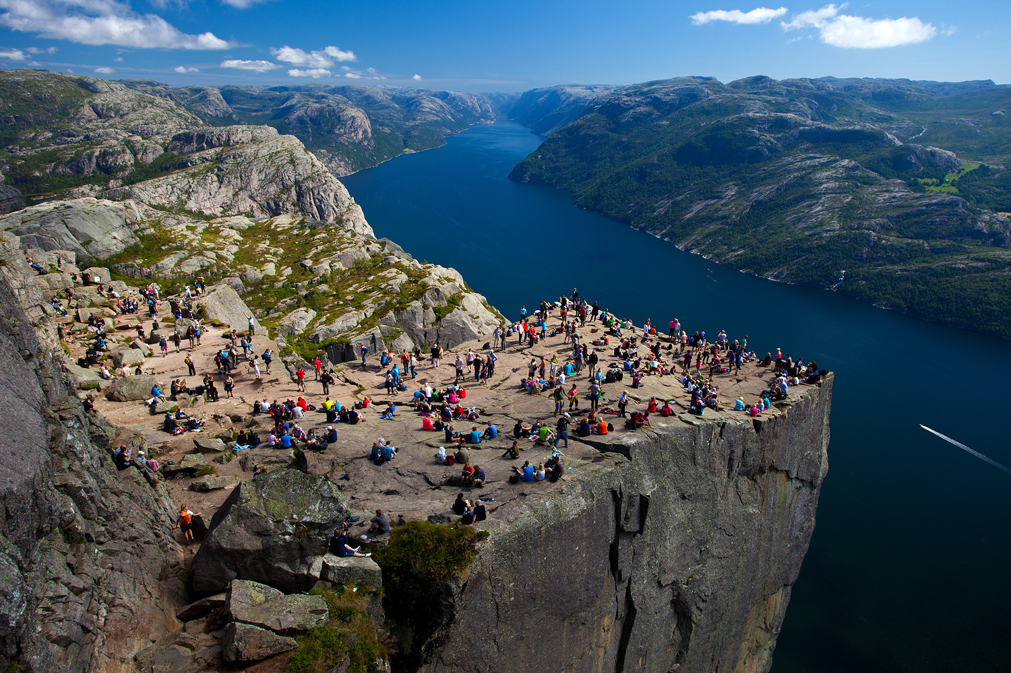
But actually, big enough and high enough for many people like me. Owen directs us to think about what it is about God that makes Him like this. Like a great, high rock for our support and relief.

Slide 32
God The Saints’ Rock
Some Instances:
II. The Grounds: Whence it is
that faith does this.
III. What Faith Regards in God
for Support and Relief.

Slide 33
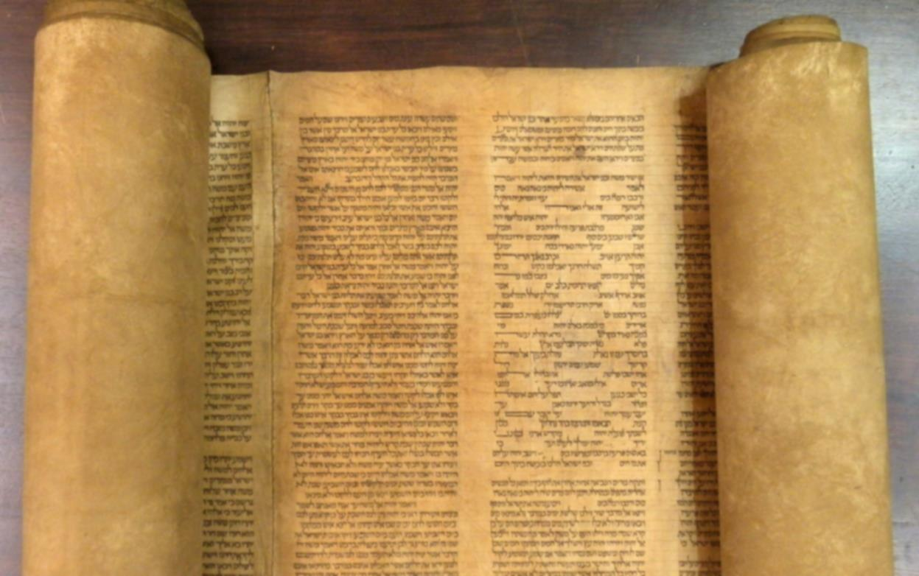
Hosea 11:9

Slide 34
Truly, we regard Him as our support and relief, precisely because He is not a man like I am.

Slide 35
Seek the LORD while He may be found; Call upon Him while He is near.
This is God’s own encouragement to us when He appeals to us to seek Him even though we are sinful.

Slide 36
Let the wicked forsake His way,
and the unrighteous man His thoughts; and let him return
to the LORD,

Slide 37
and He will have compassion on him, and to our God, for He will abundantly pardon.

Slide 38
For my thoughts are not your thoughts, nor are your ways my ways, declares the LORD.

Slide 39
For as the heavens are higher than the earth, so are my ways than
your ways and my thoughts
than your thoughts.

Slide 40
Numbers 23:19

Slide 41
II Sam. 24:14

Slide 42
The first thing faith considers,
in such a condition, is the
nature of God Himself and
His excellencies.

Slide 43
There are circumstances that befall us in our distress, that
faith can get no relief against,
but from the essential
properties of the nature
of God.

Slide 44
1. Distress due to circumstance
of place.
Believers may be brought into distress in all places of the world; in a lion’s den with Daniel; in a dungeon with Jeremiah; banished to the ends of the earth with John on Patmos; driven into the wilderness as the woman by the fury of the dragon.

Slide 45
Jerem. 23:23-24

Slide 46
The whole church may be
cast into places where no
eye can see them, no hand
relieve them,--where no one
knows if they are among the
living or the dead.

Slide 47
What can give relief against
this circumstance of distress?
It is all in vain. The essential
omnipresence of God can alone relieve the souls of
believers against this great

Slide 48
circumstance of various places, whither they may be driven to
suffer distresses and be overwhelmed with them.

Slide 49
1. Distress due to circumstance
of place.
2. Distress due to circumstance
of time.

Slide 50
1. Distress due to circumstance
of place.
2. Distress due to circumstance
of time.
Deuteronomy 33:26-27

Slide 51
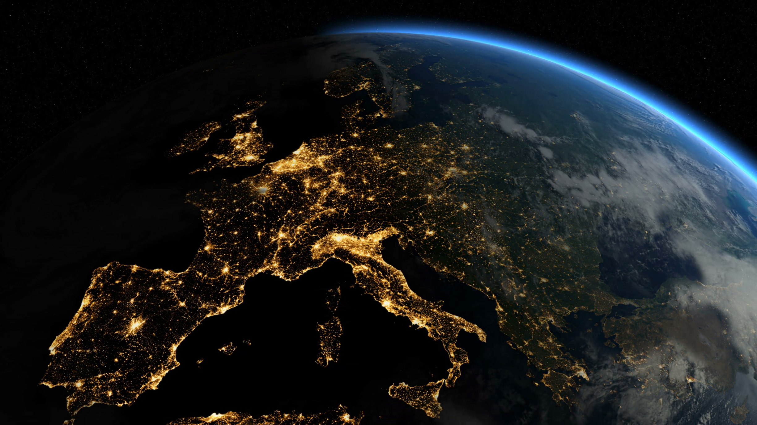

Slide 52
They did not say, “Where is the LORD, Who brought us up out of the land of Egypt, Who led us through the wilderness, through a land of deserts and of pits, through a land of drought and of deep darkness. . . ?” Jer. 2:6

Slide 53
As for you, my son Solomon,
know the God of your father. . .
--I Chron. 28:9

Slide 54
Psalm 44

Slide 55
I am leaving the ship of the church in a storm, but while the great Pilot is in it the loss of a poor underrower will be inconsiderable.
Owen’s last surviving letter. Dictated to Charles Fleetwood, Aug. 22, 1683.

Slide 56
Live and pray and hope and wait patiently, and do not despair.

Slide 57
Live and pray and hope and wait patiently, and do not despair. The promise stands invincible that he will never leave thee nor forsake thee.

Slide 58
From the end of the earth I call when my heart is faint;
Lead me to the rock that is
higher than I.
Psalm 61:2

