Slide 1
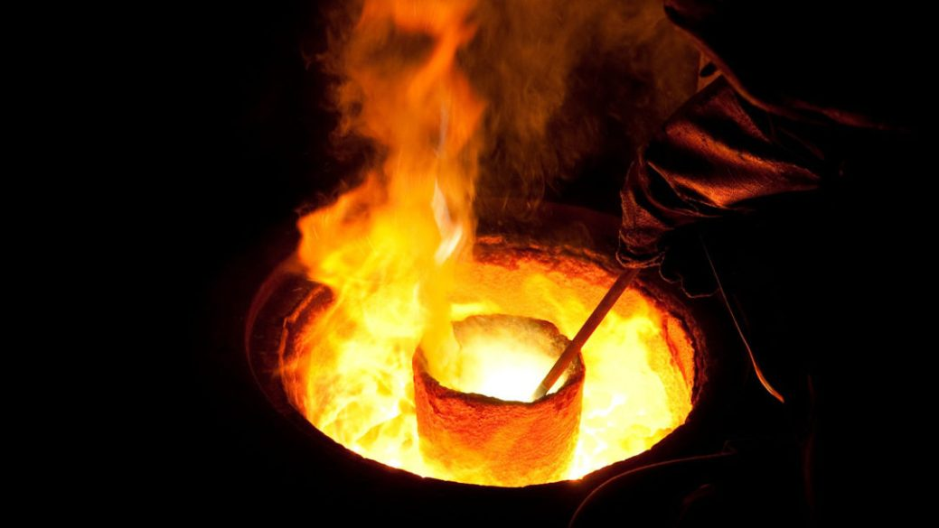
I am exceedingly afflicted:
Revive me, O LORD, according to Your word.
--Psalm 119:107

Slide 2
You also, as living stones, are being built up as a spiritual house. . .
(I Peter 2:5).

Slide 3
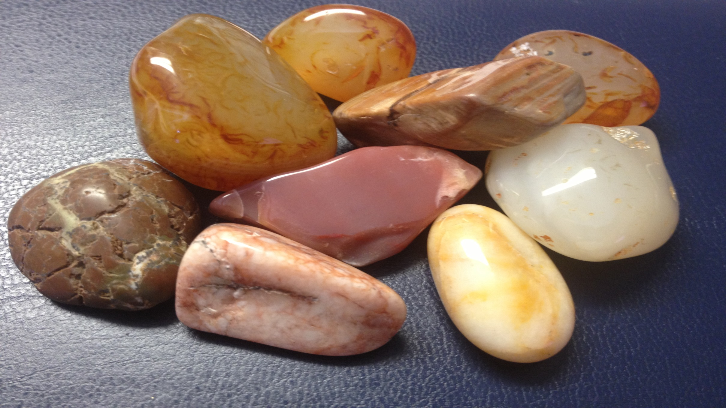

Slide 4



Slide 5


Slide 6
I am exceedingly afflicted: Revive me, O LORD, according to Your word.
Psalm 119:107

Slide 7
It would seem that this holy saint’s
covenanting season was a time of deep
affliction: while his determined resolution
to keep God’s word of obedience gave
boldness to his pleading that God would
perform his word of promise.

Slide 8
And this is our high privilege, that we are
permitted to pour our troubles into the ear
of One who is able perfectly to enter into
and to sympathize with us in them; who
knoweth our frame (Ps. 103:14), who hath
himself laid the affliction upon us (Ps.
39:9). . .

Slide 9
There are none—not even those most dear
to us—to whom we can unbosom ourselves
as we do to our heavenly Friend.

Slide 10
Our wants, griefs, burdens of every kind;
we roll them all upon him, with special
relief in the hour of affliction.

Slide 11
An affecting contrast to those who are
indeed afflicted very much; whose souls,
drawing near unto death, and knowing
no refuge, are ready to burst with their
own sorrows, the sorrow of the world
—unmitigated, unrelieved, working
death (II Cor. 7:10).

Slide 12
There is a “needs-be” (I Pet. 1:6, 7) for the
afflictions of the Lord’s people. The stones
of the spiritual temple cannot be polished or fitted to their place without the strokes of the hammer.

Slide 13
The gold cannot be purified without the furnace. The vine must be pruned for greater fruitfulness (John 15:2).

Slide 14
The measure of discipline varies indefinitely.

Slide 15
But such is the inveteracy of fleshly lusts, that very much affliction may be the needful regimen (II Cor. 12:7).

Slide 16
Yet it will be tempered by One who knows the precise measure,

Slide 17
Yet it will be tempered by One who knows the precise measure, who can make no mistakes in our constitutions,

Slide 18
Yet it will be tempered by One who knows the precise measure, who can make no mistakes in our constitutions, and whose fatherly pity will chasten not for his pleasure but for our profit (Ps. 103:13-14; Heb. 12:10).

Slide 19
And need we speak of the afflictions of our trials, that they are infinitely disproportioned to our deserts—

Slide 20
—that they are light and but for a moment

Slide 21
—that they are light and but for a moment when compared with eternity (II Cor. 4:17)—

Slide 22
—that greater comfort is vouchsafed in the endurance of them than we even ventured to anticipate from their removal (II Cor. 12:8-10)—

Slide 23
—that the fruit at the end more than balances the trials themselves?

Slide 24
Need we say—how richly they ought to be prized, as conforming us to the image of
our suffering Lord (I Pet. 4:13);

Slide 25
how clearly we shall one day read in them our Father’s commission, as messengers of love;

Slide 26
and how certainly the end of the Lord will be that the Lord is very pitiful and of tender mercy? (Jam. 5:11; Job 42:10-12).

Slide 27
Perhaps affliction—at least very much affliction—may not be our present lot. Yet it is our duty and wisdom, as the good soldier in the time of truce, to burnish our armor for the fight.

Slide 28
Because the wicked have no changes, therefore they fear not God (Ps. 55:19). The continual changes in Christian experience may well remind us of the necessity of walking humbly with God that we may not, by an unprepared spirit, lose the blessing of the sanctified cross.

Slide 29
How many of the Lord’s dear children may bear Ephraim’s name—For God hath caused me to be fruitful in the land of my affliction (Gen. 41:52)?

Slide 30
Sometimes they are so conscious of the present good, that they dread affliction
leaving them, more than the inexperienced professor dreads its coming.

Slide 31
But great affliction is as hard to bear as great prosperity. Some whose Christian profession had drawn out the esteem of others, have shown by faintness in the day of adversity their strength to be small (Prov. 24:10),

Slide 32
and themselves almost untaught in this school of discipline—shaken, confused, broken. Special need indeed have we under the smart of the rod, of reviving grace to preserve us from stout-heartedness or dejection.

Slide 33
We think we could bear the stroke, did we know it to be paternal, not judicial. Have we, then, forgotten the exhortation which speaketh unto us as unto children? Do we despise the chastening of the Lord?

Slide 34
Revive me, Lord, that I may be preserved in a humble, wakeful, listening posture to hear and improve the message of thy blessing of the sanctified cross.

Slide 35
Revive me, O Lord, that I sink not under the blow of thy hand. Thus will this Divine influence save us from the horrible sin of being offended with God in our fretting spirit.

Slide 36
We shall receive his chastisement with humility without dispondency, and with reverence without distrust: hearkening to the voice that speaks, while we tremble under the rod which strikes;

Slide 37
yet so mingling fear with confidence, that we may at the same moment adore the hand which we feel, and rest in mercy that is promised (Mic. 7:8-9).

Slide 38
Do not rejoice over me, O my enemy.
Thou I fall I will rise;
Though I dwell in darkness, the Lord is light for me.

Slide 39
I will bear the indignation of the LORD
because I have sinned against Him, until He pleads my case and executes justice for me.
He will bring me out to the light, and I will see His righteousness.

Slide 40
Our best support in the depths of affliction is prayer for reviving according to Your word. And which of the exercised children of God has ever found one jot or one tittle of it to fail?

Slide 41
Tribulation brings about perseverance; and perseverance, proven character; and proven character, hope; and hope does not disappoint (Rom. 5:3b-5a).

Slide 42
All this is the abundant answer to prayer.
Nothing will bear looking back to with comfort, like those trials, which though painful to the flesh, have tended to break our spirit, mold our will, and strengthen the simplicity of our walk with God.

