Slide 1
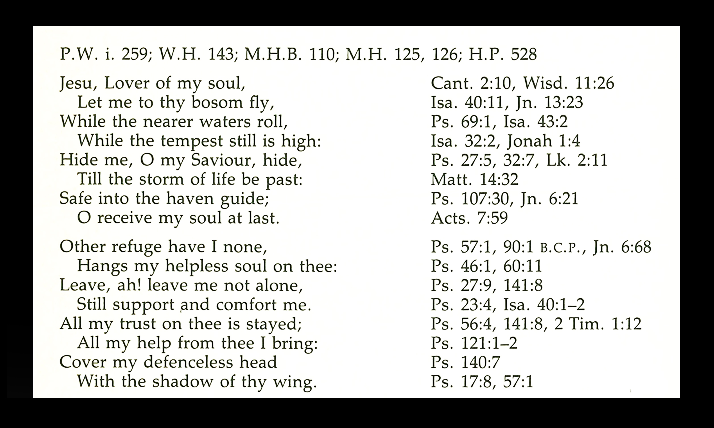

Slide 2
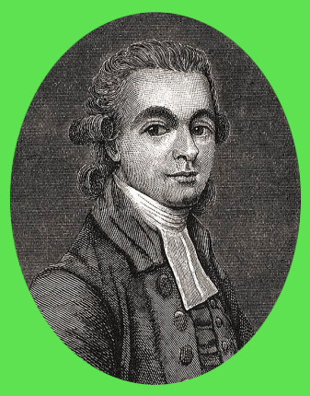
John Rippon
(April 29, 1751 –December 17, 1836)

Slide 3
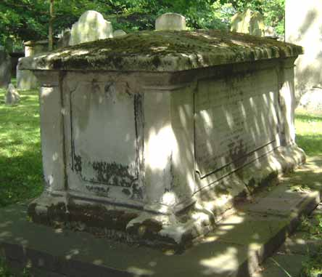
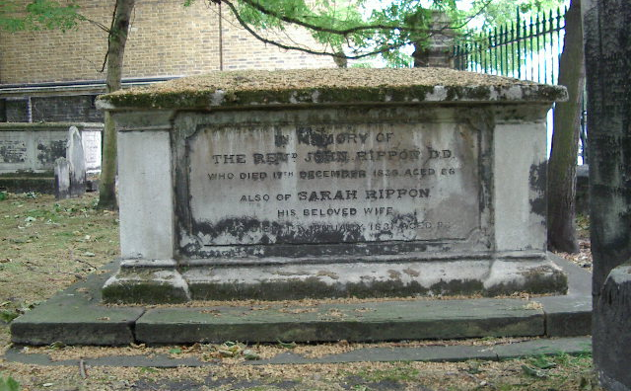
John Rippon

Slide 4
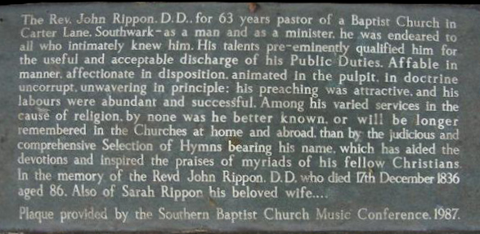
John Rippon

Slide 6
How Firm A Foundation-1
How firm a foundation, ye saints of the Lord,
Is laid for your faith in His excellent Word!
What more can He say than to you He hath said,
To you who for refuge to Jesus have fled?

Slide 7
How Firm A Foundation-2
In ev’ry condition – in sickness, in health,
In poverty’s vale, or abounding in wealth;
At home or abroad, on the land, on the sea,
As days may demand, shall thy strength ever be.

Slide 8
How Firm A Foundation-3
Fear not, I am with thee, O be not dismayed,
For I am thy God, I will still give thee aid;
I’ll strengthen thee, help thee,
and cause thee to stand,
Upheld by My gracious, omnipotent hand.

Slide 9
How Firm A Foundation-4
When through the deep waters I call thee to go,
The rivers of sorrow shall not overflow,
For I will be with thee, thy trials to bless,
And sanctify to thee thy deepest distress.

Slide 10
How Firm A Foundation-5
When through fiery trials thy pathway shall lie,
My grace all-sufficient shall be thy supply;
The flame shall not hurt thee; I only design
Thy dross to consume, and thy gold to refine.

Slide 11
How Firm A Foundation-6
The soul that on Jesus hath leaned for repose,
I will not, I will not desert to his foes;
That soul, though all hell
should endeavor to shake,
I’ll never, no never, no never forsake!

