Slide 1
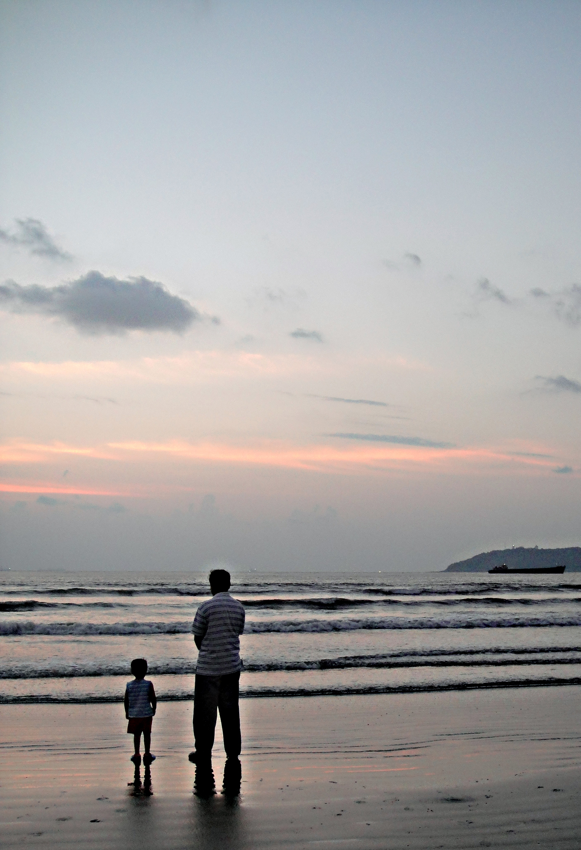

Slide 2
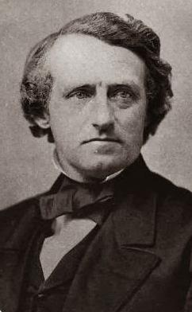
Austin Phelps (1820-1890)
President, Andover Theological Seminary (1869-1879)

Slide 3
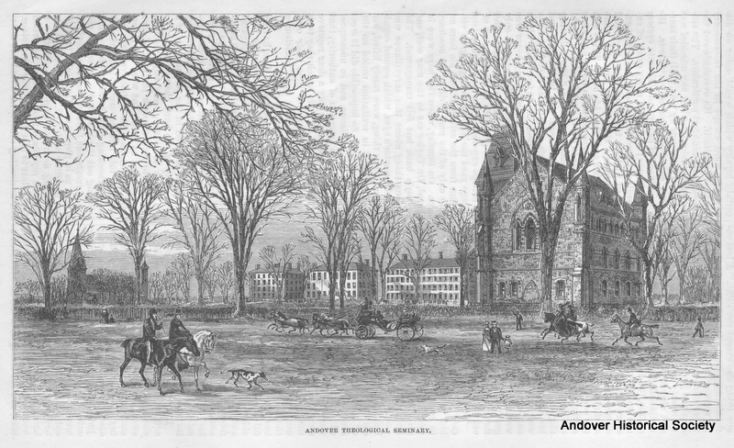

Slide 4
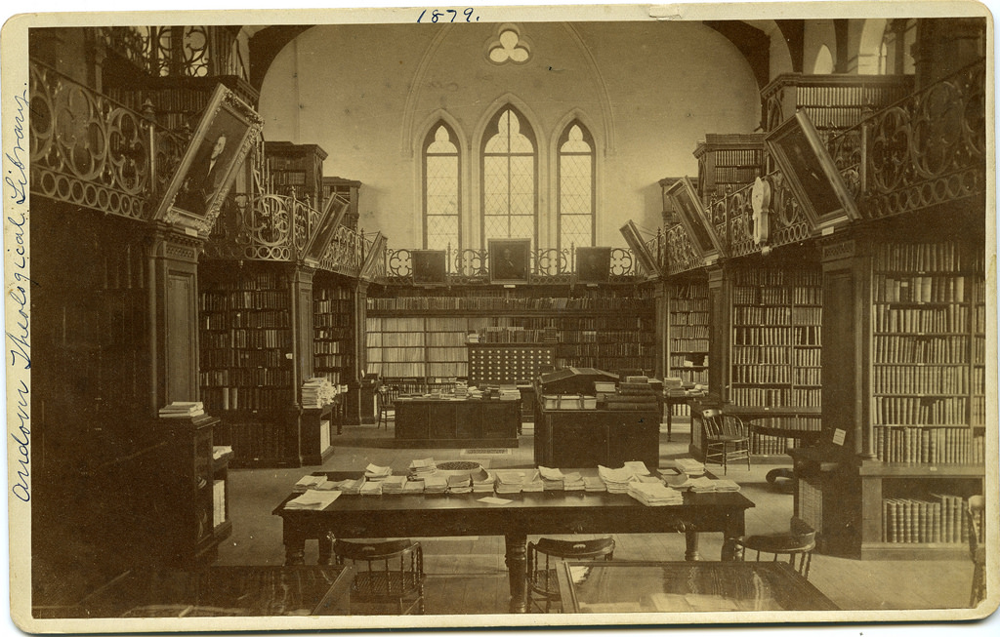

Slide 5
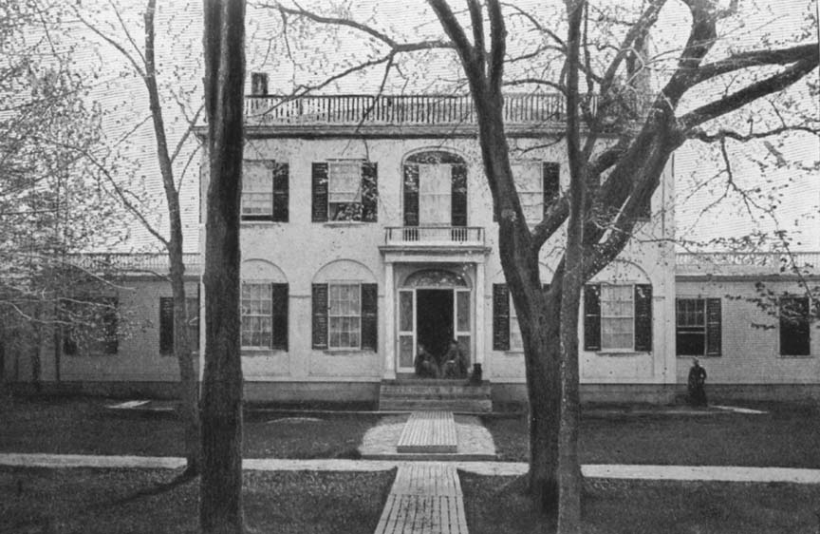

Slide 6
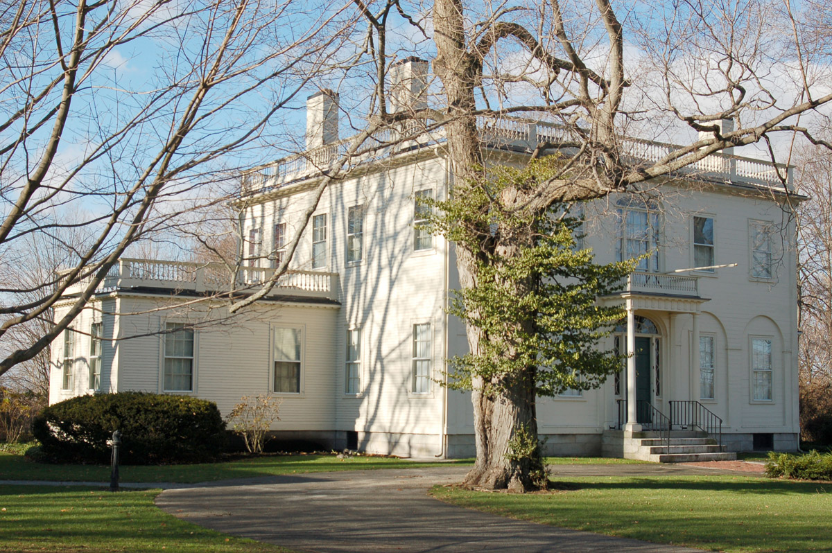


Slide 7


Slide 8
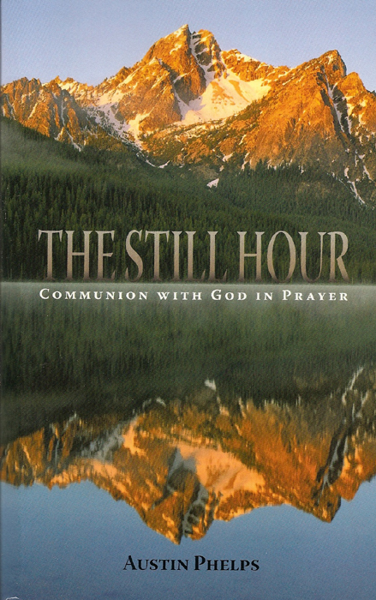

Slide 9


Slide 10
Oh, that I knew where I might find Him!
--Job 23:3

Slide 11
If God had not said, “Blessed are those that hunger,” I know not what could keep weak Christians from sinking in despair.
--Joseph Hall (1574-1656)

Slide 12
A consciousness of the absence of God is one of the standing incidents of the religious life.

Slide 13
Are there not many “closet hours,” in which the chief feeling is an oppressed consciousness of the absence of reality from his own exercises. He has no words which are, as George Herbert says, “heart deep.”

Slide 14
“Never any more wonder,” says an old writer, “that men
pray so seldom. For there are
very few that feel the relish,
and are enticed with the
deliciousness, and refreshed with the comforts, and acquainted with the secrets, of a holy prayer.”

Slide 15
Absence of piety
Offering prayers which we are not willing to have answered
Not cultivating the temperament of prayer

Slide 16
          Absence of piety
  An impenitent sinner never prays. . . finds no such thing in his heart. . . If he drives himself
  into it for a time, by forcing upon his soul the forms of devotion, he cannot stay there. He is like one gasping in a vacuum.

Slide 17
          Absence of piety
  Such a soul does not enjoy God.

Slide 18
Absence of piety
Offering prayers which we are not willing to have answered

Slide 19
          Many of the objects of prayer enchant us only in the distance. Brought near to us, and in concrete forms, and made to grow lifelike with our conceptions, they very sensibly abate the pulse of our longing to possess them. . .

Slide 20
          . . . because we cannot but discover that , to realize them in our lives, certain other darling objects must be sacrificed, which we are not willing to part with.

Slide 21
          The paradox is true to the life, that a man may even fear an answer to his prayers.

Slide 22
          Perhaps that single sin has woven itself like a web over large spaces of our life. It may have run like a shuttle to and fro in the texture of some plan of life, on which our conscience has never glared
  fiercely as upon a crime, because the usage of the world has blindfolded conscience by the respectability of such a sin.

Slide 23
          Yet it has been all the while tightening its folds around us, repressing our liberty in prayer, stopping the life-blood and stiffening the fiber of our moral being, till we are like kneeling corpses in worship.

Slide 24
Absence of piety
Offering prayers which we are not willing to have answered
Not cultivating the temperament of prayer

Slide 25
Prayer is an expression of
feeling.
We have not sufficiently
cherished our Christian sensibilities.
We have not cultivated habits of
religious desire. . . We have not so trained our hearts that a certain emotive current is always . . . welling up from the depths of the soul, like the springs of the deepest sea. . .

Slide 26
Prayer is an expression of
feeling.
We have not sufficiently
cherished our Christian sensibilities.
We have not cultivated habits of
religious desire. . . We have not so trained our hearts that a certain emotive current is always . . . welling up from the depths of the soul, like the springs of the deepest sea. . .

Slide 27
We need a culture of sensibility which shall demand these Psalms as a medium of utterance.

Slide 28
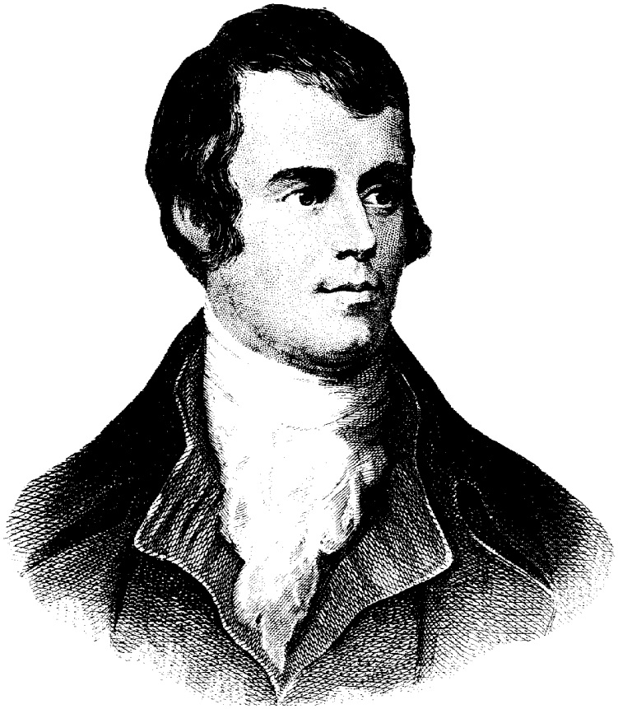
Robert Burns lamented that he could not pour out his soul without reserve to any human being, without danger of one day repenting his confidence.

Slide 29
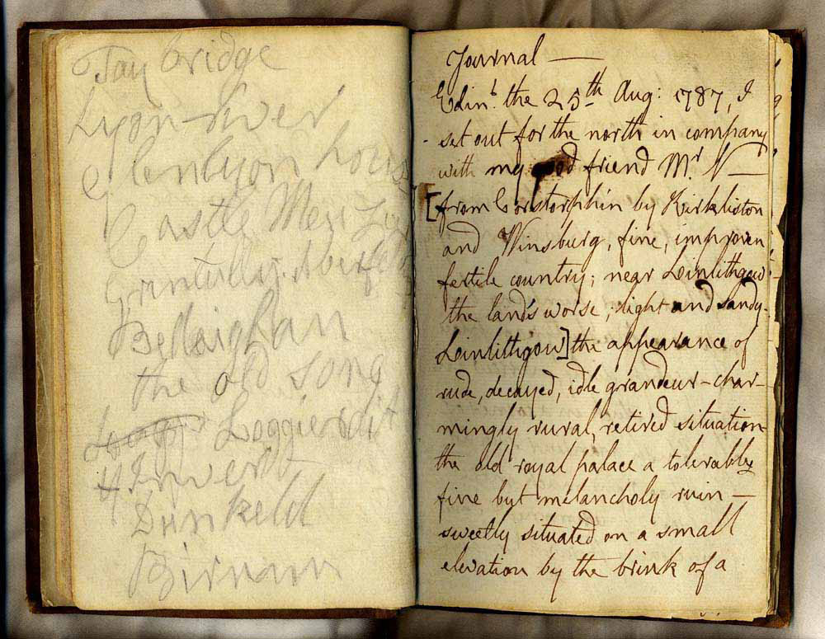

Slide 30
. . . as a substitute for a confidential friend. . . Which he could record himself in, without peril of having his confidence betrayed.

Slide 31


Slide 32
Absence of piety
Offering prayers which we are not willing to have answered
Not cultivating the temperament of prayer
Neglecting fragmentary prayer

Slide 33
Prayer. . . Is, in the highest conception of it, a state rather than an act. A full fruition of its benefits depends on a continuity of its influences.

Slide 34
Absence of piety
Offering prayers which we are not willing to have answered
Not cultivating the temperament of prayer
Neglecting fragmentary prayer

Slide 35
If God had not said, “Blessed are those that hunger,” I know not what could keep weak Christians from sinking in despair.
--Joseph Hall (1574-1656)

