Slide 1
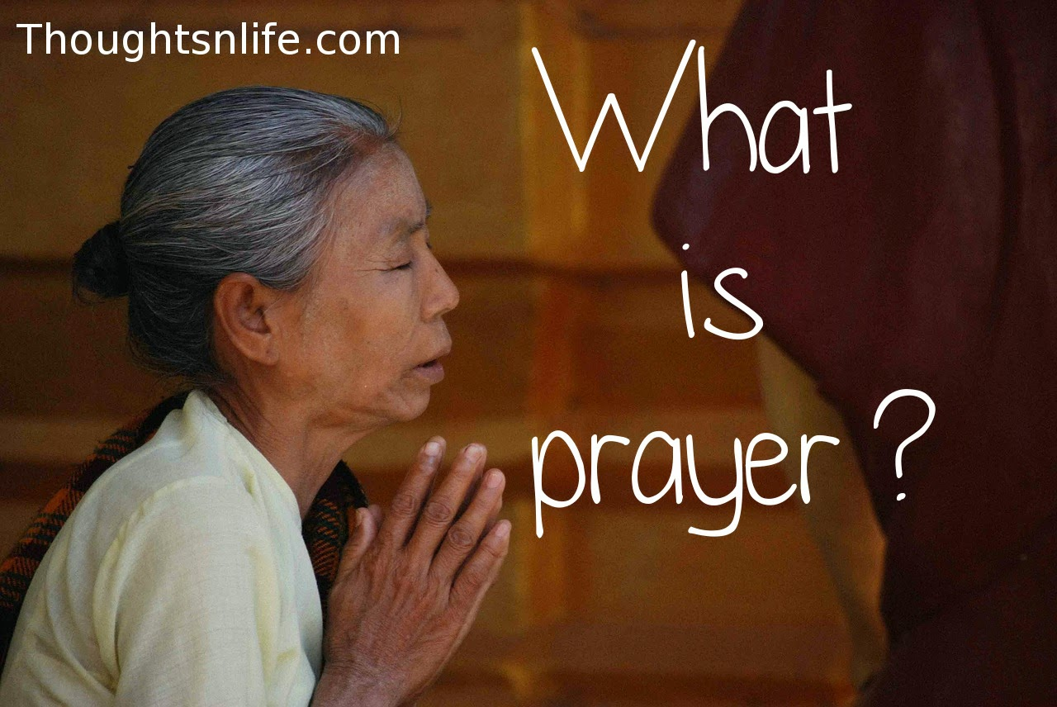
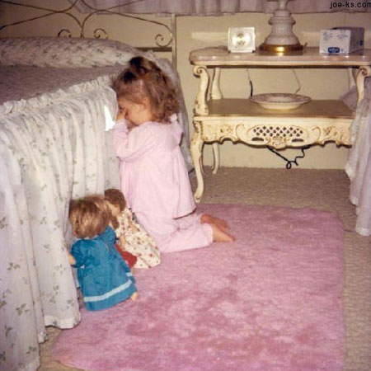
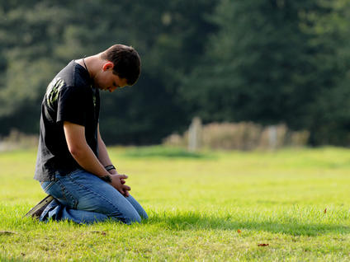
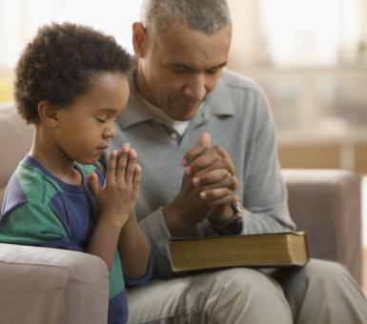
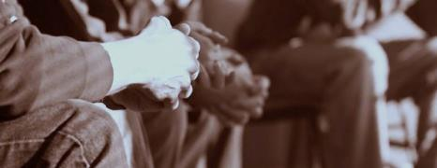

Slide 2

Westminster Shorter Catechism (1647)
Westminster Assembly: Thomas Manton, Thomas Goodwin, Jeremiah Burroughs, Samuel Rutherford.
108 questions and answers.
12-14 of the men who produced the Catechism had already written their own catechisms. It was the fruit of five years work.
Not a sentence was admitted into them until after the most protracted and thorough consideration. Not a word was allowed a place in them until it had been subjected to the closest scrutiny, and had proved itself to be just the right word to express the meaning intended (Strickler, “Nature, Value and Specific Utility of Catechisms,” 130.
Wesley’s edition wasn’t published separately. It first appeared in vol. 14 of his A CHRISTIAN LIBRARY: CONSISTING OF
EXTRACTS FROM AND ABRIDGMENTS OF THE CHOICEST PIECES
OF PRACTICAL DIVINITY WHICH HAVE BEEN PUBLISHED IN THE ENGLISH TONGUE. IN THIRTY VOLUMES:
FIRST PUBLISHED IN 175O, IN FIFTY VOLUMES, DUODECIMO.
BY JOHN WESLEY, MA. LATE FELLOW OF LINCOLN COLLEGE, OXFORD.

Slide 3
Westminster Shorter Catechism (1647)
A Baptist Catechism (Keach’s; 1677)
Wesley’s edition wasn’t published separately. It first appeared in vol. 14 of his A CHRISTIAN LIBRARY: CONSISTING OF
EXTRACTS FROM AND ABRIDGMENTS OF THE CHOICEST PIECES
OF PRACTICAL DIVINITY WHICH HAVE BEEN PUBLISHED IN THE ENGLISH TONGUE. IN THIRTY VOLUMES:
FIRST PUBLISHED IN 175O, IN FIFTY VOLUMES, DUODECIMO.
BY JOHN WESLEY, MA. LATE FELLOW OF LINCOLN COLLEGE, OXFORD.

Slide 4
Westminster Shorter Catechism (1647)
A Baptist Catechism (Keach’s; 1677)
Philadelphia Baptist Association (1742)
Wesley’s edition wasn’t published separately. It first appeared in vol. 14 of his A CHRISTIAN LIBRARY: CONSISTING OF
EXTRACTS FROM AND ABRIDGMENTS OF THE CHOICEST PIECES
OF PRACTICAL DIVINITY WHICH HAVE BEEN PUBLISHED IN THE ENGLISH TONGUE. IN THIRTY VOLUMES:
FIRST PUBLISHED IN 175O, IN FIFTY VOLUMES, DUODECIMO.
BY JOHN WESLEY, MA. LATE FELLOW OF LINCOLN COLLEGE, OXFORD.

Slide 5
Westminster Shorter Catechism (1647)
A Baptist Catechism (Keach’s; 1677)
Philadelphia Baptist Association (1742)
Wesley’s Edition of the Shorter Catech. (1750)
Wesley’s edition wasn’t published separately. It first appeared in vol. 14 of his A CHRISTIAN LIBRARY: CONSISTING OF
EXTRACTS FROM AND ABRIDGMENTS OF THE CHOICEST PIECES
OF PRACTICAL DIVINITY WHICH HAVE BEEN PUBLISHED IN THE ENGLISH TONGUE. IN THIRTY VOLUMES:
FIRST PUBLISHED IN 175O, IN FIFTY VOLUMES, DUODECIMO.
BY JOHN WESLEY, MA. LATE FELLOW OF LINCOLN COLLEGE, OXFORD.

Slide 6
Prayer is an offering up of our desires unto God, for things agreeable to His will, in the name of Christ, with confession of our sins, and thankful acknowledgment of His mercies.

Slide 7
Prayer is an offering up of our desires unto God,

Slide 8
Prayer is an offering up of our desires unto God, for things agreeable to His will,

Slide 9
Prayer is an offering up of our desires unto God, for things agreeable to His will, in the name of Christ,

Slide 10
Prayer is an offering up of our desires unto God, for things agreeable to His will, in the name of Christ, with confession of our sins,

Slide 11
Prayer is an offering up of our desires unto God, for things agreeable to His will, in the name of Christ, with confession of our sins, and thankful acknowledgment of His mercies.

Slide 12
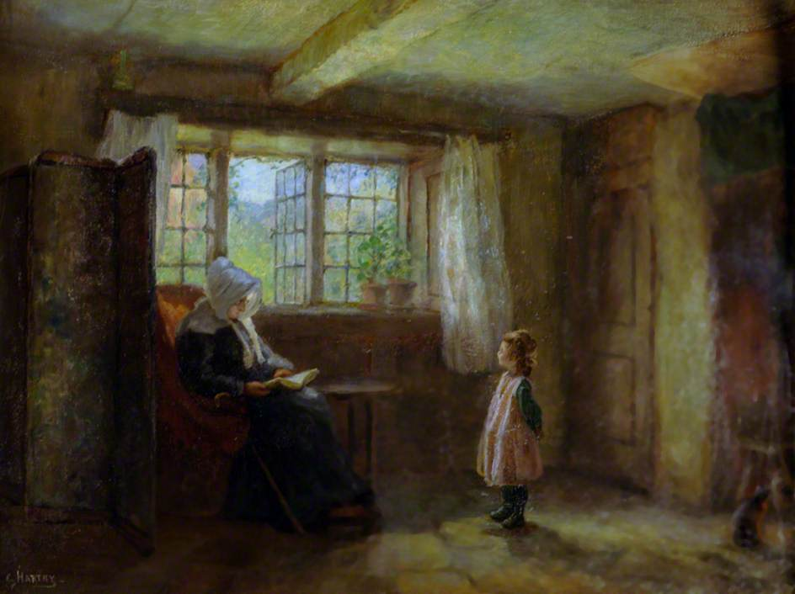

Slide 13
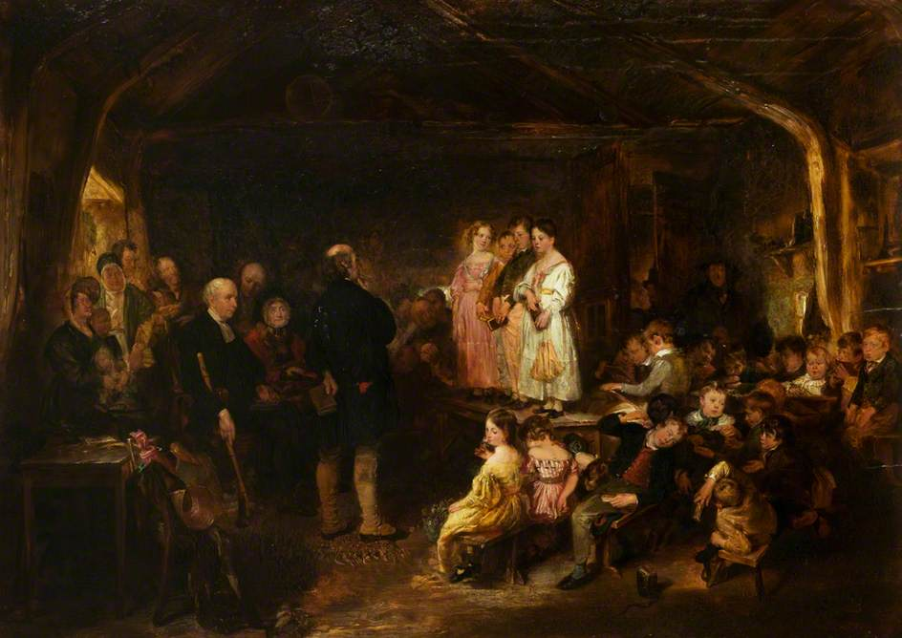

Slide 14
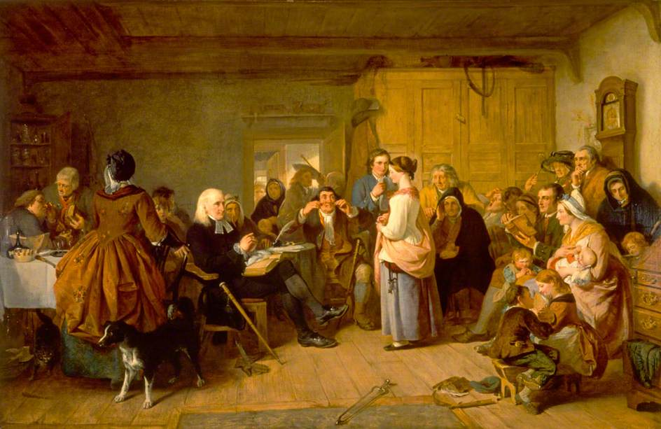

Slide 15
. . . in the name of Christ. . .

Slide 16
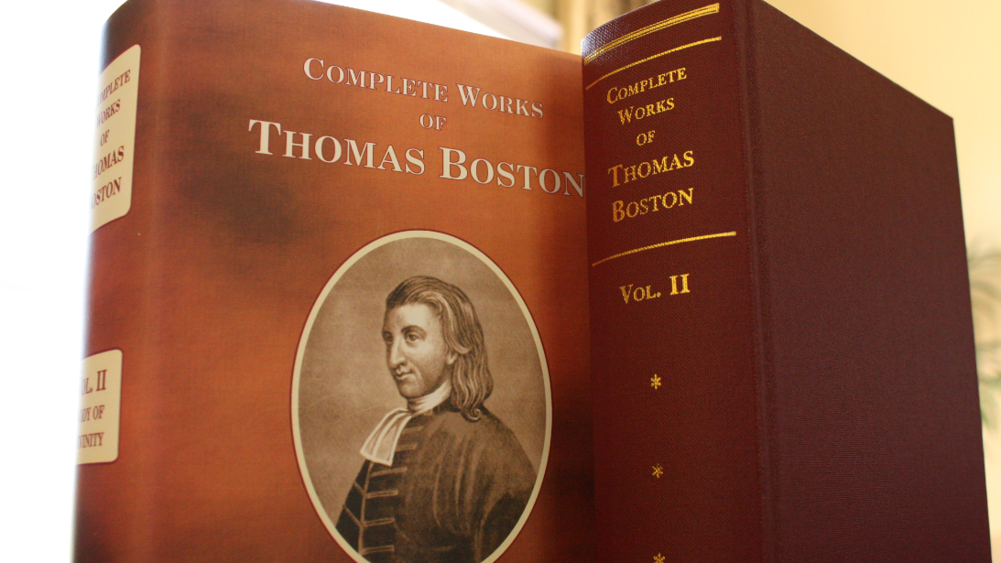

Slide 17
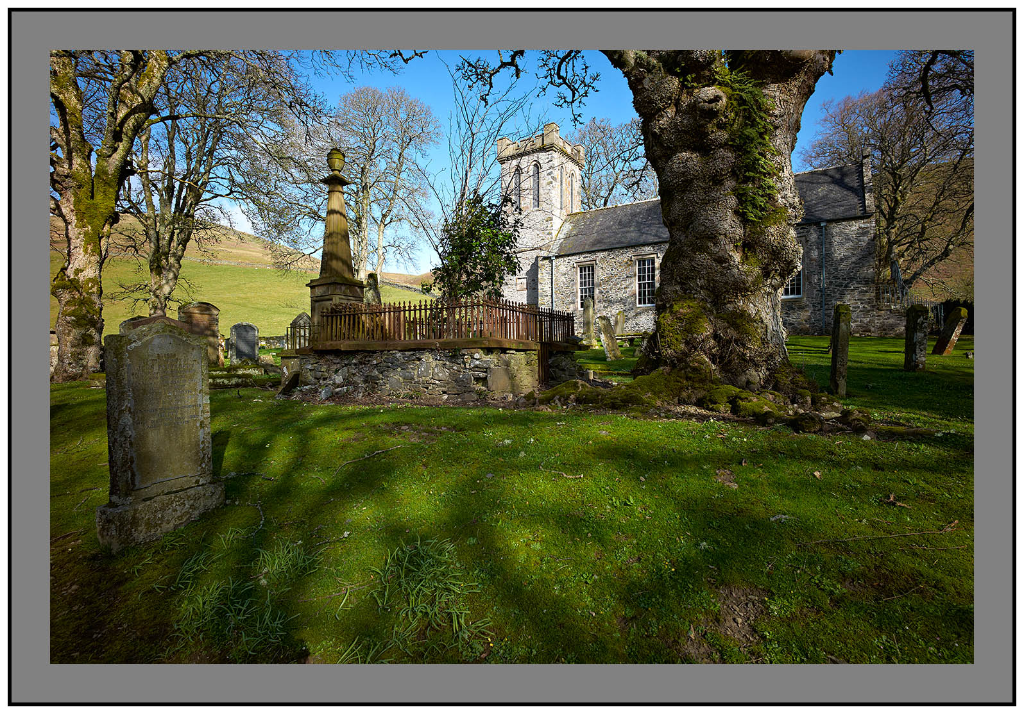
1710 there were 57 communicants. 1731, last time, there were 777.

Slide 18
Whatsoever ye shall ask the Father in my name, he will give it to you.
--John 16:23
Boston preached a series of sermons to his people in 1728, entitled, “Of Praying in the name of Jesus Christ.” His text was John 16:23.

Slide 19

We must begin, carry on, and conclude our prayers in the name of Christ.

Slide 20
In Jesus’ name. . .
Commence. . .

Slide 21
In Jesus’ name. . .
Commence. . . Continue. . .

Slide 22
In Jesus’ name. . .
Commence. . . Continue. . . . Conclude

Slide 23
The virtue is not in the words, but in the faith wherewith they are used.

Slide 24
Commencing in His name:
How do we do this by faith?

Slide 25
Commencing in His name:
We must go to God at
Christ’s command, and by order from him.

Slide 26
Continuing in His name:

Slide 27
Continuing in His name:
We must pray for Christ’s
sake, as our motive.
That Christ will be the One Who gains. He’ll develop this in a series of four points which grow successively out of one another.

Slide 28
Continuing in His name:
We must pray for Christ’s
sake, as our motive.
(1) Acceptable petitioners hold Christ in
high esteem.
Don’t just begin because He commands, but enter into out of great respect. We won’t even think of what He gains unless we have great respect for Him.
So great, that we are asking, what is there in this for Christ? This is a non-negotiable with the Father.

Slide 29
No man’s prayer will be
acceptable to God, who
wants (lacks) a transcendent
esteem of the Lord Christ. . .

Slide 30
No man’s prayer will be
acceptable to God, who
wants (lacks) a transcendent
esteem of the Lord Christ. . .
John 5:23
Thomas Shepard, the American Puritan, called this “God’s Main Plot.”

Slide 31
How does this high esteem for Christ manifest itself in prayers that are for His sake?

Slide 32
In the prayers of Monday, 9th November, I spread the Hebrew Bible before Him, and cried to the Father, that for the sake of His Son, He would by the Spirit shine on it unto me, give light into and discover His mind in the word; that He would give me life, health, strength, time, and inclination, to the study and blessing thereon. . .
This is found in Boston’s journal for 1730, two years after the sermons. It illustrates what he meant by “for Christ’s sake, as our motive.” He wanted to understand the Hebrew text in order to honor Christ.

Slide 33
We must pray for Christ’s
sake, as our motive.
(1) Acceptable petitioners hold Christ in
high esteem.
(2) We comply with the duty out of love
for Christ.
It is our duty to honor Him. But our complying with this duty has its own motivation. Not merely obligation, but love.

Slide 34
One praying indeed in the name of Christ, is acted by a principle of love to him, which, oiling the wheels of the soul, sets all in motion, so that the heart is poured out like water before the Lord. And where that principle is wanting, there is acting by constraint.

Slide 35
There was a second point. . . which still remained dark; and therefore I went back purposely to God for it. I found my heart in prayer much going out in love to Christ; my heart was knit to Him as the dearly beloved of my soul; which made me to express my love to Christ, not in an ordinary way, as I used to do. I was helped to depend, and got strength to my heart to wait for light in it.
Journal for May 26, 1699. He is a young preacher, awaiting a call to a church, and having occasional opportunities to fill pulpits.

Slide 36
(1) Acceptable petitioners hold Christ in
high esteem.
(2) We comply with the duty out of love
for Christ.
(3) We comply with the duty out of
respect for His honor and glory.

Slide 37
Every act of praying in his name glorifies Him, being an acknowledgment before God of the unspeakable dignity of his merit and intercession, as procuring that access for sinners unto God, that no other way could have been obtained.
His point here is that the praying itself, not just the answer obtained, but the very act of praying honors Christ. We pray in his name, that is for his sake, when we continue in it because doing so honors him.

Slide 38
(1) Acceptable petitioners hold Christ in
high esteem.
(2) We comply with the duty out of love
for Christ.
(3) We comply with the duty out of
respect for His honor and glory.
(4) We pray with heart and good will.

Slide 39
Commencing in His name:
We must go to God at Christ’s command, and by order from him.

Slide 40
Commencing in His name:
We must go to God at Christ’s command, and by order from him.
Continuing in His name:
We must pray for Christ’s sake, as our motive.

Slide 41
1710 there were 57 communicants. 1731, last time, there were 777.

Slide 42
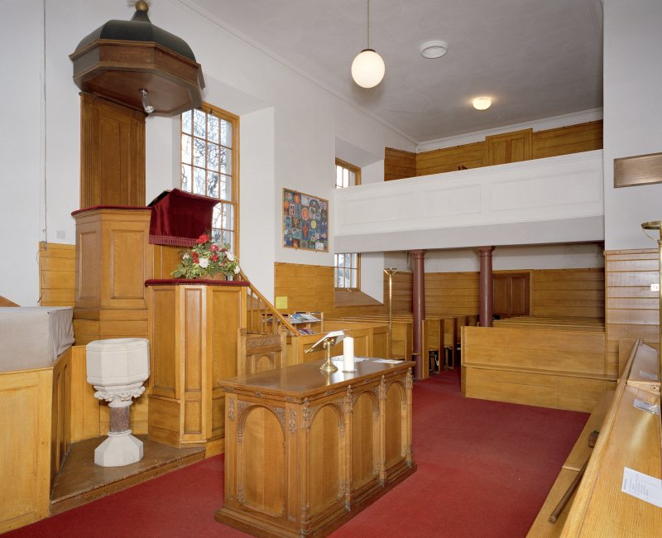
The pulpit is a classic Scottish 'double decker' with the precentor's box, below the minister's pulpit, with sounding board.

