Slide 1


Slide 2

Prayer is an offering up of our desires unto God,

Slide 3
Prayer is an offering up of our desires unto God, for things agreeable to His will,

Slide 4
Prayer is an offering up of our desires unto God, for things agreeable to His will, in the name of Christ,

Slide 5
Prayer is an offering up of our desires unto God, for things agreeable to His will, in the name of Christ, with confession of our sins,

Slide 6
Prayer is an offering up of our desires unto God, for things agreeable to His will, in the name of Christ, with confession of our sins, and thankful acknowledgment of His mercies.

Slide 7
Westminster Shorter Catechism (1647)
Wesley’s edition wasn’t published separately. It first appeared in vol. 14 of his A CHRISTIAN LIBRARY: CONSISTING OF
EXTRACTS FROM AND ABRIDGMENTS OF THE CHOICEST PIECES
OF PRACTICAL DIVINITY WHICH HAVE BEEN PUBLISHED IN THE ENGLISH TONGUE. IN THIRTY VOLUMES:
FIRST PUBLISHED IN 175O, IN FIFTY VOLUMES, DUODECIMO.
BY JOHN WESLEY, MA. LATE FELLOW OF LINCOLN COLLEGE, OXFORD.

Slide 8
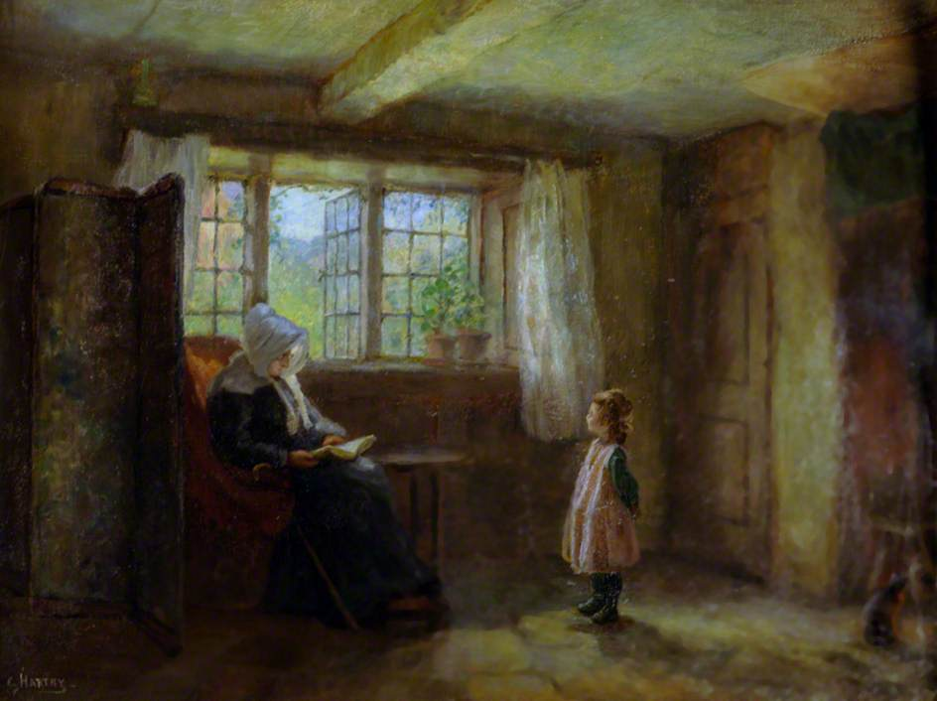

Slide 9
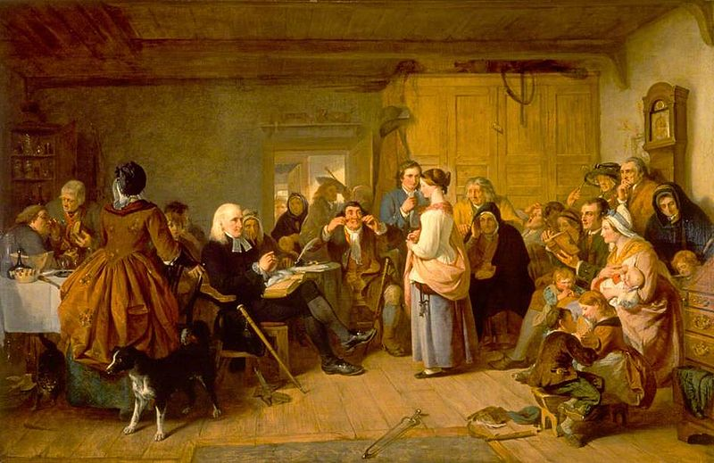

Slide 10
Westminster Shorter Catechism (1647)
A Baptist Catechism (Keach’s; 1677)
Wesley’s edition wasn’t published separately. It first appeared in vol. 14 of his A CHRISTIAN LIBRARY: CONSISTING OF
EXTRACTS FROM AND ABRIDGMENTS OF THE CHOICEST PIECES
OF PRACTICAL DIVINITY WHICH HAVE BEEN PUBLISHED IN THE ENGLISH TONGUE. IN THIRTY VOLUMES:
FIRST PUBLISHED IN 175O, IN FIFTY VOLUMES, DUODECIMO.
BY JOHN WESLEY, MA. LATE FELLOW OF LINCOLN COLLEGE, OXFORD.

Slide 11
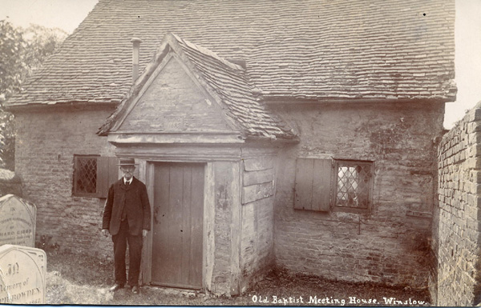

Slide 12
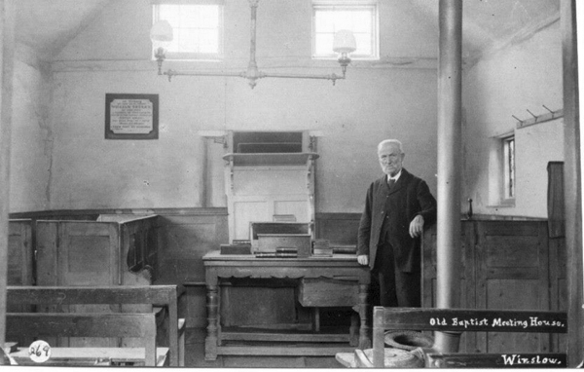
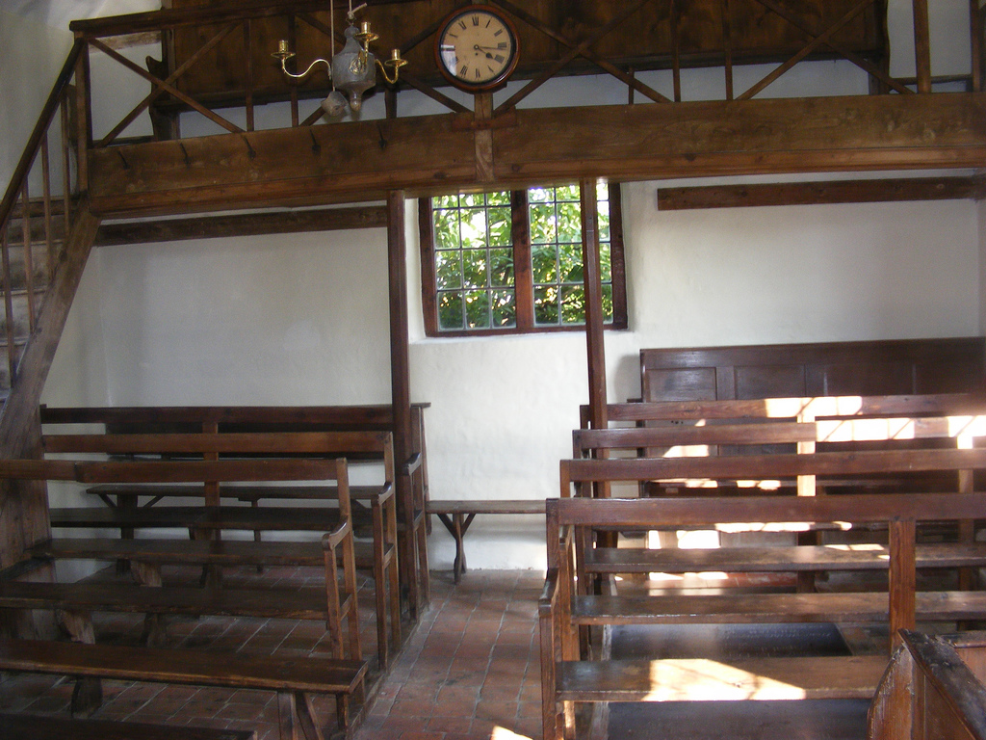

Slide 13
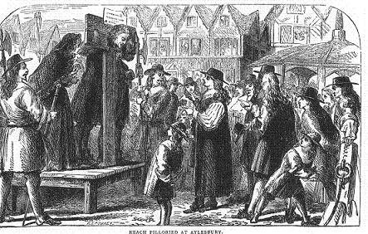

Slide 14
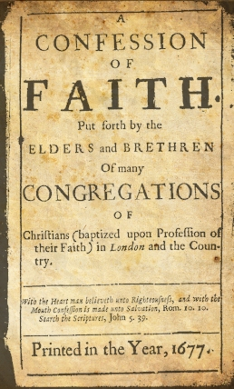
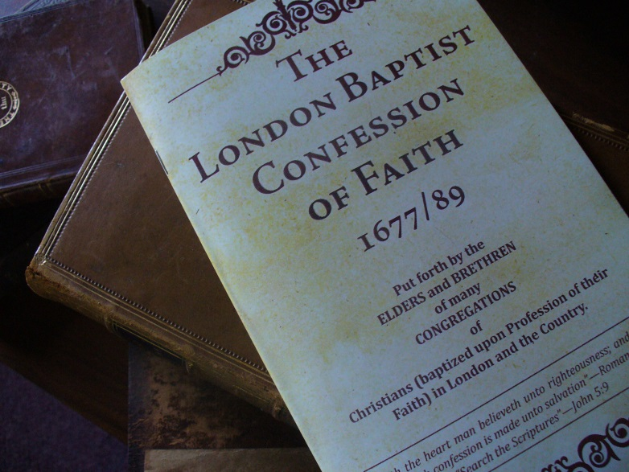
Westminster Shorter Catechism (1647)
A Baptist Catechism (Keach’s; 1677)
Wesley’s edition wasn’t published separately. It first appeared in vol. 14 of his A CHRISTIAN LIBRARY: CONSISTING OF
EXTRACTS FROM AND ABRIDGMENTS OF THE CHOICEST PIECES
OF PRACTICAL DIVINITY WHICH HAVE BEEN PUBLISHED IN THE ENGLISH TONGUE. IN THIRTY VOLUMES:
FIRST PUBLISHED IN 175O, IN FIFTY VOLUMES, DUODECIMO.
BY JOHN WESLEY, MA. LATE FELLOW OF LINCOLN COLLEGE, OXFORD.

Slide 15
Westminster Shorter Catechism (1647)
A Baptist Catechism (Keach’s; 1677)
Philadelphia Baptist Association (1742)
--Revised the 1689 London Confession
--Reprinted Keach’s Catechism
Wesley’s edition wasn’t published separately. It first appeared in vol. 14 of his A CHRISTIAN LIBRARY: CONSISTING OF
EXTRACTS FROM AND ABRIDGMENTS OF THE CHOICEST PIECES
OF PRACTICAL DIVINITY WHICH HAVE BEEN PUBLISHED IN THE ENGLISH TONGUE. IN THIRTY VOLUMES:
FIRST PUBLISHED IN 175O, IN FIFTY VOLUMES, DUODECIMO.
BY JOHN WESLEY, MA. LATE FELLOW OF LINCOLN COLLEGE, OXFORD.

Slide 16
Westminster Shorter Catechism (1647)
A Baptist Catechism (Keach’s; 1677)
Philadelphia Baptist Association (1742)
Wesley’s Edition of the Shorter Catech. (1750)
Wesley’s edition wasn’t published separately. It first appeared in vol. 14 of his A CHRISTIAN LIBRARY: CONSISTING OF
EXTRACTS FROM AND ABRIDGMENTS OF THE CHOICEST PIECES
OF PRACTICAL DIVINITY WHICH HAVE BEEN PUBLISHED IN THE ENGLISH TONGUE. IN THIRTY VOLUMES:
FIRST PUBLISHED IN 175O, IN FIFTY VOLUMES, DUODECIMO.
BY JOHN WESLEY, MA. LATE FELLOW OF LINCOLN COLLEGE, OXFORD.

Slide 17
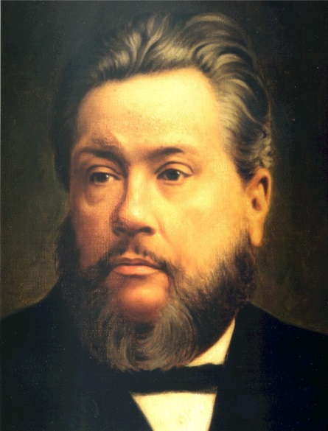
This ancient document is a most excellent epitome of the things most surely believed among us.

Slide 18
This little volume is not issued as an authoritative rule, or code of faith, whereby ye are to be fettered,
Wesley’s edition wasn’t published separately. It first appeared in vol. 14 of his A CHRISTIAN LIBRARY: CONSISTING OF
EXTRACTS FROM AND ABRIDGMENTS OF THE CHOICEST PIECES
OF PRACTICAL DIVINITY WHICH HAVE BEEN PUBLISHED IN THE ENGLISH TONGUE. IN THIRTY VOLUMES:
FIRST PUBLISHED IN 175O, IN FIFTY VOLUMES, DUODECIMO.
BY JOHN WESLEY, MA. LATE FELLOW OF LINCOLN COLLEGE, OXFORD.

Slide 19
This little volume is not issued as an authoritative rule, or code of faith, whereby ye are to be fettered, but as an assistance to you in controversy,
Wesley’s edition wasn’t published separately. It first appeared in vol. 14 of his A CHRISTIAN LIBRARY: CONSISTING OF
EXTRACTS FROM AND ABRIDGMENTS OF THE CHOICEST PIECES
OF PRACTICAL DIVINITY WHICH HAVE BEEN PUBLISHED IN THE ENGLISH TONGUE. IN THIRTY VOLUMES:
FIRST PUBLISHED IN 175O, IN FIFTY VOLUMES, DUODECIMO.
BY JOHN WESLEY, MA. LATE FELLOW OF LINCOLN COLLEGE, OXFORD.

Slide 20
This little volume is not issued as an authoritative rule, or code of faith, whereby ye are to be fettered, but as an assistance to you in controversy, a confirmation in faith,
Wesley’s edition wasn’t published separately. It first appeared in vol. 14 of his A CHRISTIAN LIBRARY: CONSISTING OF
EXTRACTS FROM AND ABRIDGMENTS OF THE CHOICEST PIECES
OF PRACTICAL DIVINITY WHICH HAVE BEEN PUBLISHED IN THE ENGLISH TONGUE. IN THIRTY VOLUMES:
FIRST PUBLISHED IN 175O, IN FIFTY VOLUMES, DUODECIMO.
BY JOHN WESLEY, MA. LATE FELLOW OF LINCOLN COLLEGE, OXFORD.

Slide 21
This little volume is not issued as an authoritative rule, or code of faith, whereby ye are to be fettered, but as an assistance to you in controversy, a confirmation in faith, and as a means of edification in righteousness.
Wesley’s edition wasn’t published separately. It first appeared in vol. 14 of his A CHRISTIAN LIBRARY: CONSISTING OF
EXTRACTS FROM AND ABRIDGMENTS OF THE CHOICEST PIECES
OF PRACTICAL DIVINITY WHICH HAVE BEEN PUBLISHED IN THE ENGLISH TONGUE. IN THIRTY VOLUMES:
FIRST PUBLISHED IN 175O, IN FIFTY VOLUMES, DUODECIMO.
BY JOHN WESLEY, MA. LATE FELLOW OF LINCOLN COLLEGE, OXFORD.

Slide 22

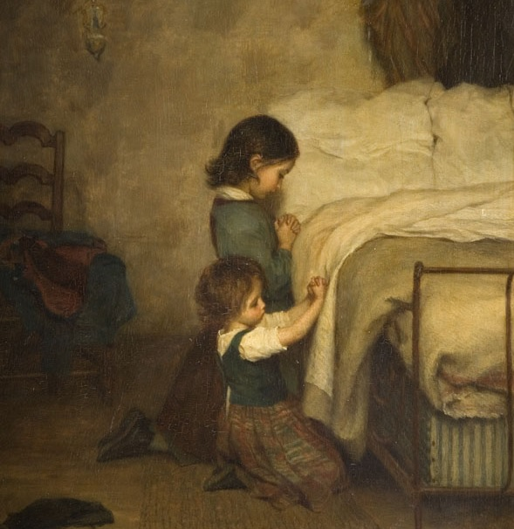

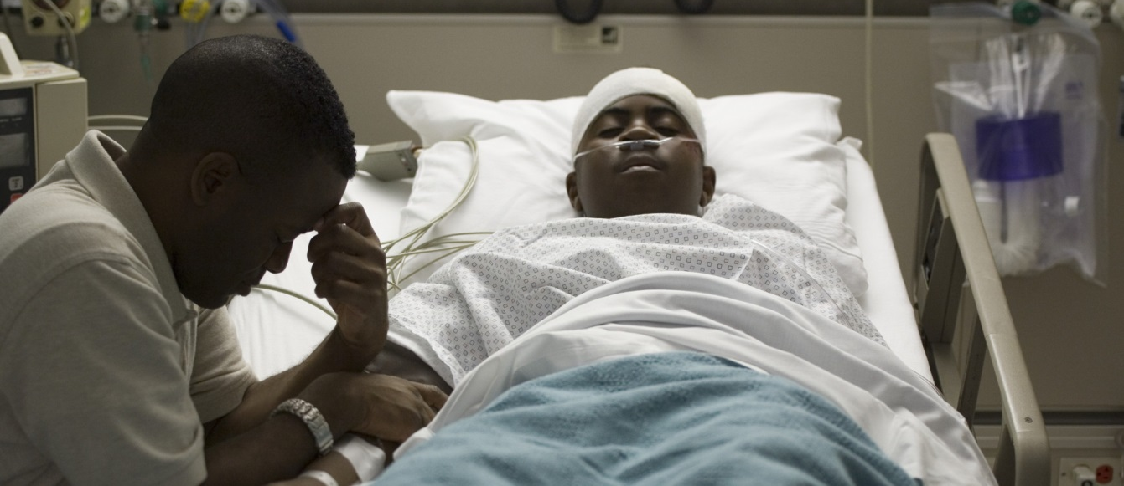

Slide 23
A sincere, sensible, affectionate pouring out of the soul to God in the name of Christ, for what God hath promised.
--Instruction for the Ignorant
(John Bunyan, 1675)

Slide 24
Prayer is an offering up of our desires unto God, for things agreeable to His will, in the name of Christ, with confession of our sins, and thankful acknowledgment of His mercies.
A sincere, sensible, affectionate pouring out of the soul to God in the name of Christ, for what God hath promised.

Slide 25
Prayer is an offering up of our desires unto God, for things agreeable to His will, in the name of Christ, with confession of our sins, and thankful acknowledgment of His mercies.
A sincere, sensible, affectionate pouring out of the soul to God in the name of Christ, for what God hath promised.

Slide 26
Prayer is an offering up of our desires unto God, for things agreeable to His will, in the name of Christ, with confession of our sins, and thankful acknowledgment of His mercies.
A sincere, sensible, affectionate pouring out of the soul to God in the name of Christ, for what God hath promised.

Slide 27
Prayer is an offering up of our desires unto God, for things agreeable to His will, in the name of Christ, with confession of our sins, and thankful acknowledgment of His mercies.
A sincere, sensible, affectionate pouring out of the soul to God in the name of Christ, for what God hath promised.

Slide 28
Q. What is prayer?
A. Prayer is an offering up our desires to God, by the assistance of the Holy Spirit, for things agreeable to his will, in the name of Christ, believing, with confession of our sins, and thankful acknowledgments of his mercies.
--The Charleston Association (1813)

Slide 29
Q. What is prayer?
A. Prayer is an offering up our desires to God, by the assistance of the Holy Spirit, for things agreeable to his will, in the name of Christ, believing, with confession of our sins, and thankful acknowledgments of his mercies.
--The Charleston Association (1813)

Slide 30
Q. What is prayer?
A. Prayer is an offering up our desires to God, by the assistance of the Holy Spirit, for things agreeable to his will, in the name of Christ, believing, with confession of our sins, and thankful acknowledgments of his mercies.
--The Charleston Association (1813)

Slide 31


