Slide 1

What is marriage of God’s making?
The LORD God fashioned into a woman the rib which He had taken from the man, and brought her to the man. The man said, “This is now bone of my bones, and flesh of my flesh; she shall be called Woman, because she was taken out of Man.” For this reason a man shall leave his father and his mother, and be joined to his wife; and they shall become one flesh (NASB; Gen. 2:22-24).
. . . she is your companion and your wife by covenant (NASB; Mal. 2:14).
So they are no longer two, but one flesh. What therefore God has joined together, let no man separate (NASB; Matt. 19:6).
For the married woman is bound by law to her husband while he is living; but if her husband dies, she is released from the law concerning the husband (NASB; Rom. 7:2).
21

Slide 2

Marriage of God’s making is the joining by covenant of one male and one female to become one flesh until parted by death.
Note: Male and female are the two genders created by God
and multiplied naturally by their sexual union. Male and
female He created them. God blessed them; and God
said to them, “Be fruitful and multiply” (Gen. 1:27b-28a).

Slide 3
What is the cause of the death and depravity of man, made in God’s image?
When the woman saw that the tree was good for food, and that it was a delight to the eyes, and that the tree was desirable to make one wise, she took from its fruit and ate; and she gave also to her husband with her, and he ate (NASB; Gen. 3:6).
. . . through one man sin entered into the world, and death through sin, and so death spread to all men, because all sinned (NASB; Rom. 5:12).
Behold, I was brought forth in iniquity, and in sin my mother conceived me (Ps. 51:5).
22

Slide 4
The cause of the death and depravity of man made in God’s image, is the fall and disobedience of our first parents, Adam and Eve, so that our nature became so corrupt that we are all conceived and born in sin.
(Adapted from the Heidelberg Catechism, Q. 7)

Slide 5
What is the state of sin into which we are all conceived and born?
Through the one man’s disobedience the many were made sinners
(Rom. 5:19).
THERE IS NONE RIGHTEOUS, NOT EVEN ONE (NASB; Rom. 3:10). Also see Romans 3:10-19.
And you were dead in your trespasses and sins, in which you formerly walked according to the course of this world, according to the prince of the power of the air, of the spirit that is now working in the sons of disobedience. Among them we too all formerly lived in the lusts of the flesh, indulging the desires of the flesh and of the mind, and were by nature children of wrath, even as the rest (Eph. 2:1-3).
23

Slide 6
The state of sin into which we are all conceived and born consists in the guilt of Adam’s first sin, the lack of original righteousness, the corruption of our whole nature (commonly called original sin), and all the actual transgressions which proceed from it.
(Adapted from the Westminster Shorter Catechism, Q. 18)

Slide 7
What is the state of misery into which we are all conceived and born?
. . . darkened in their understanding, excluded from the life of God because of the ignorance that is in them, because of the hardness of their heart (Eph. 4:18).
. . . by nature children of wrath (Eph. 2:3).
CURSED IS EVERYONE WHO DOES NOT ABIDE BY ALL THINGS WRITTEN IN THE BOOK OF THE LAW, TO PERFORM THEM (Gal. 3:10).
The wages of sin is death (NASB; Rom. 6:23).
This is the second death, the lake of fire. And if anyone’s name was not found written in the book of life, he was thrown into the lake of fire (Rev. 20:14b-15).
24

Slide 8
The state of misery into which we are all conceived and born consists in lost communion with God, life under His wrath and curse, and liability to all miseries in this life, death itself, and the pains of hell forever.
(Adapted from the Westminster Shorter Catechism, Q. 19)

Slide 9
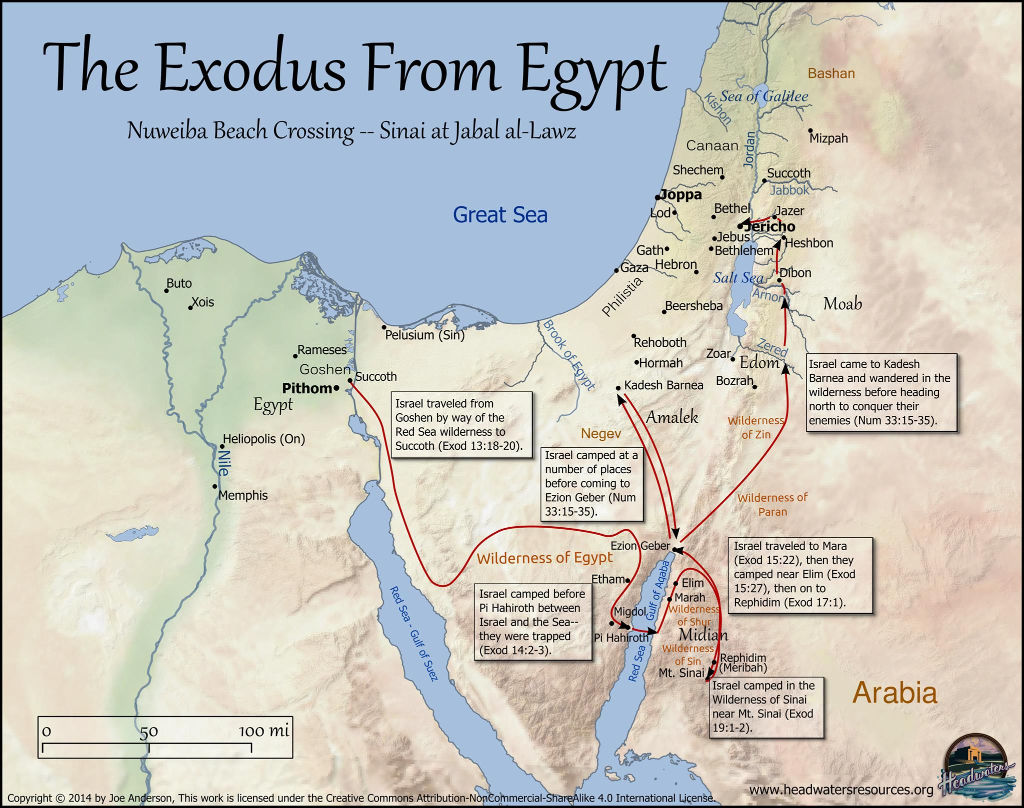

Slide 10

Numbers 13:27 Thus they told him, and said, "We went in to the land where you sent us; and it certainly does flow with milk and honey, and this is its fruit.

Slide 11
Numbers 13:27 Thus they told him, and said, "We went in to the land where you sent us; and it certainly does flow with milk and honey, and this is its fruit.
²⁸ "Nevertheless, the people who live in the land are strong, and the cities are fortified and very large; and moreover, we saw the descendants of Anak there.

Slide 12
²⁹ "Amalek is living in the land of the Negev and the Hittites and the Jebusites and the Amorites are living in the hill country, and the Canaanites are living by the sea and by the side of the Jordan.“

Slide 13
³⁰ Then Caleb quieted the people before Moses and said, "We should by all means go up and take possession of it, for we will surely overcome it."

Slide 14
³¹ But the men who had gone up with him said, "We are not able to go up against the people, for they are too strong for us." ³² So they gave out to the sons of Israel a bad report of the land which they had spied out, saying, "The land through which we have gone, in spying it out, is a land that devours its inhabitants; and all the people whom we saw in it are men of great size.

Slide 15
³³ "There also we saw the Nephilim (the sons of Anak are part of the Nephilim); and we became like grasshoppers in our own sight, and so we were in their sight."

Slide 16
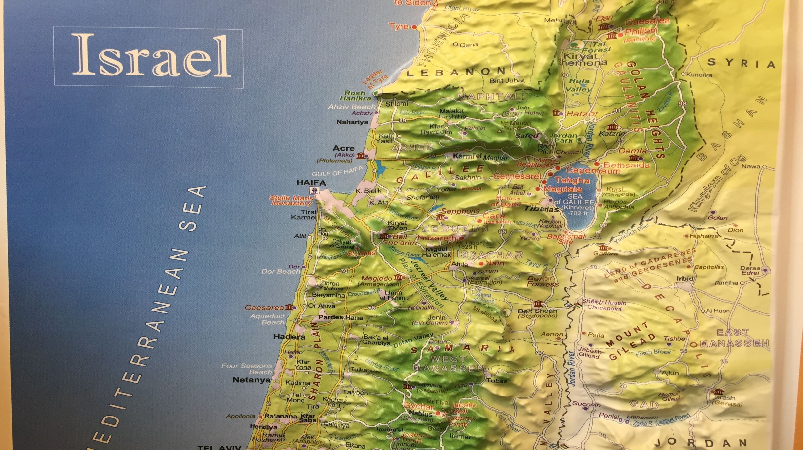

Slide 17
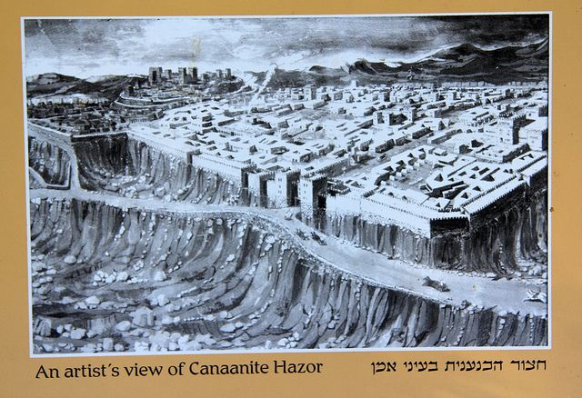

Slide 18
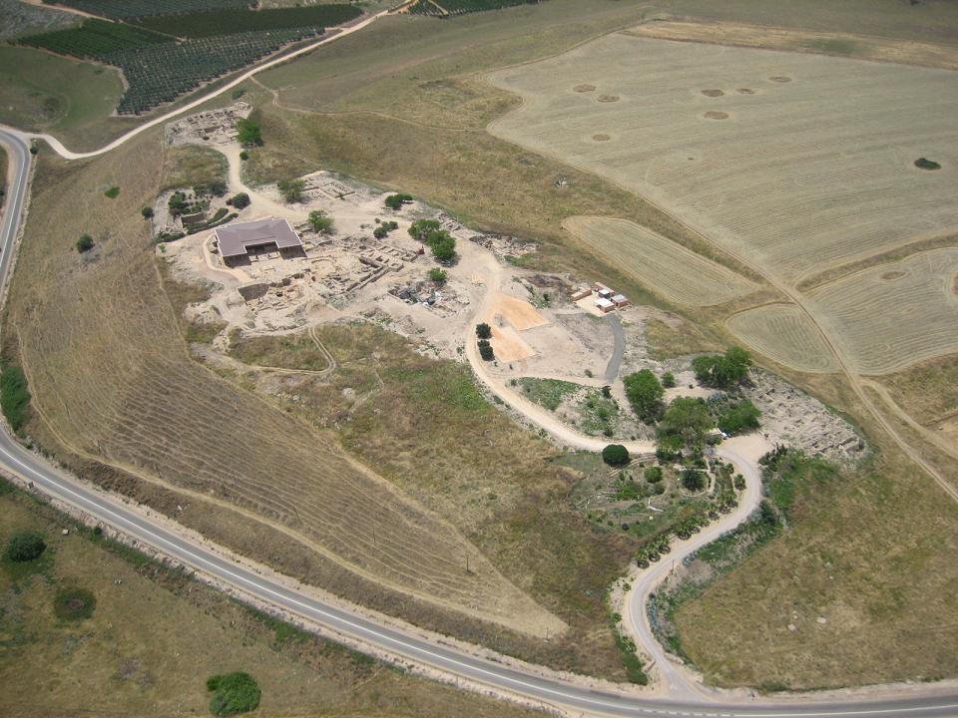

Slide 19
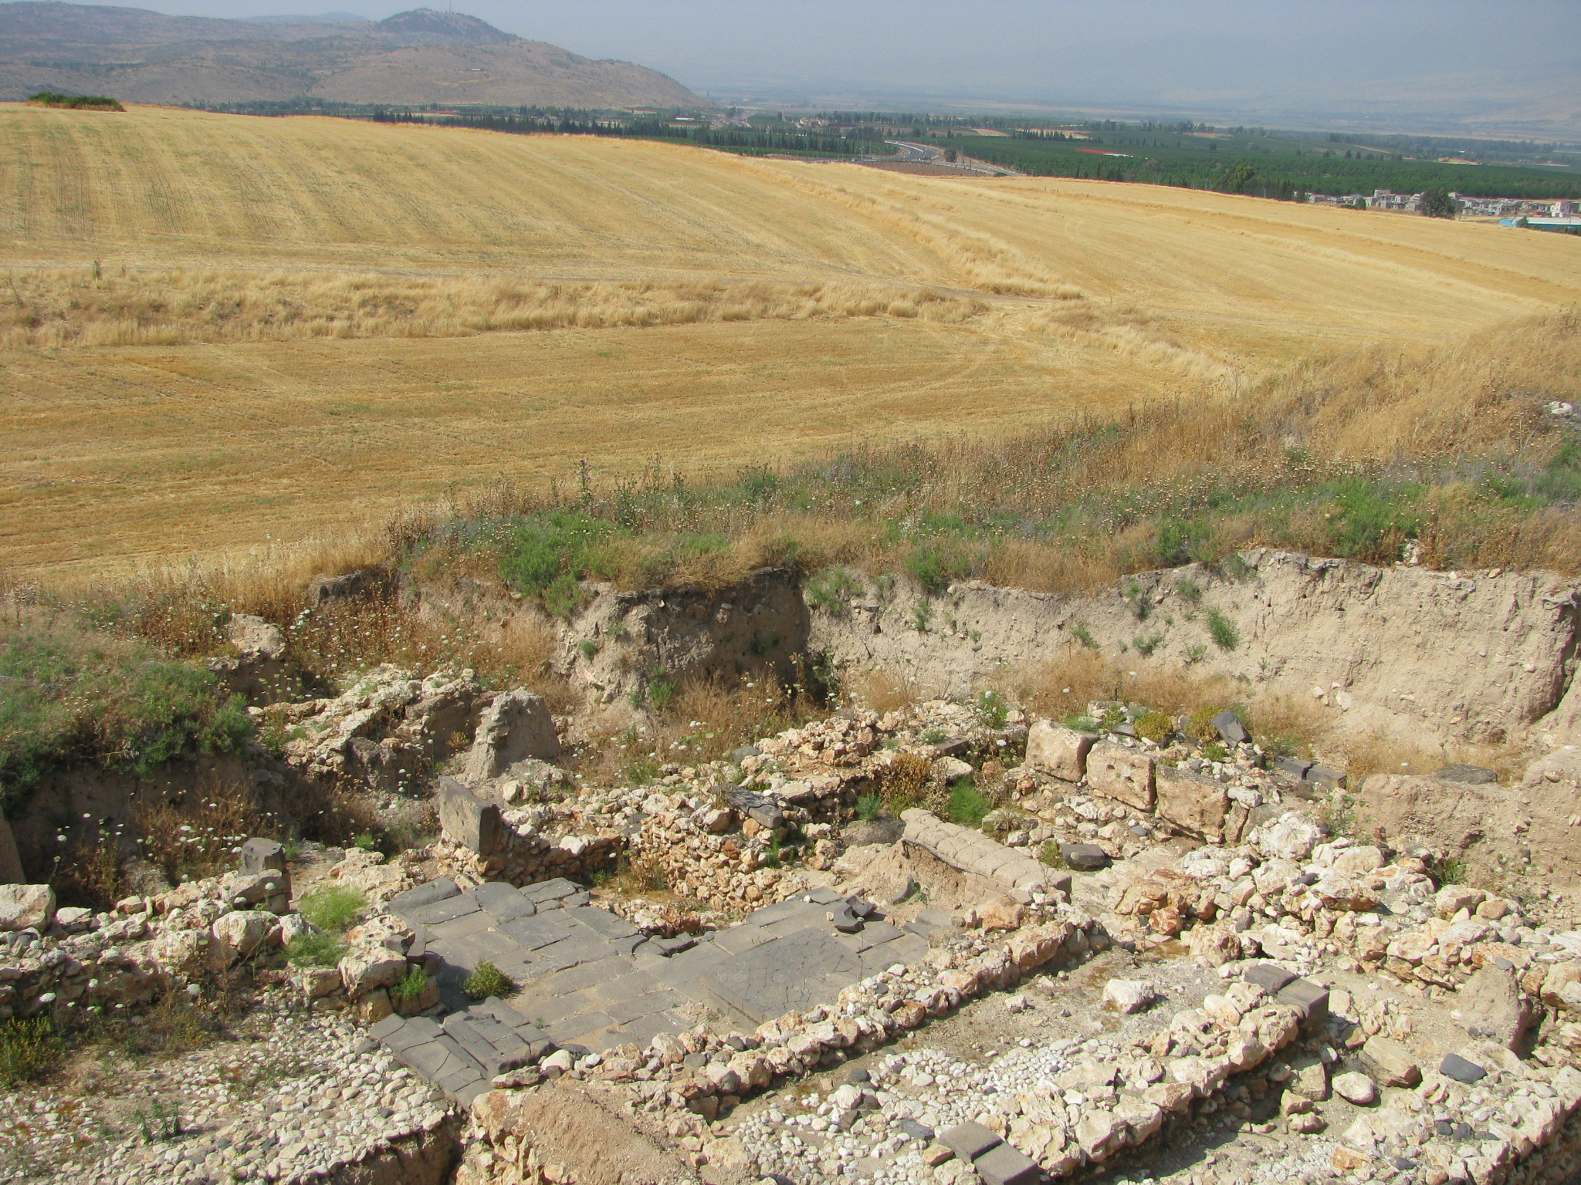
The Hazor expedition headed by Yigal Yadin in the mid-1950s was the most important dig undertaken by Israel in its early years of statehood. Tel Hazor is the largest archaeological site in northern Israel, featuring an upper tell of 30 acres and a lower city of more than 175 acres.^{[1]}

Slide 20
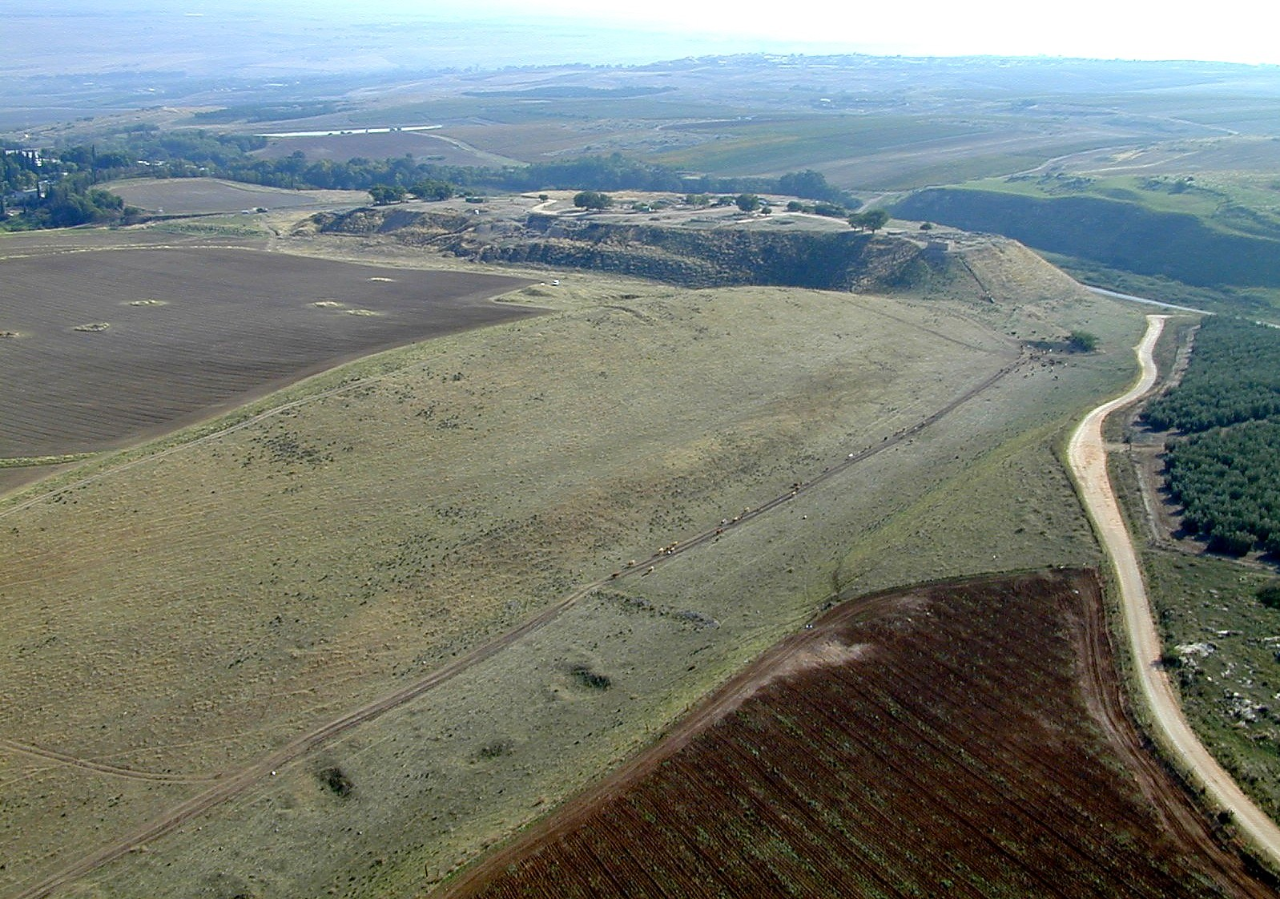

Slide 21
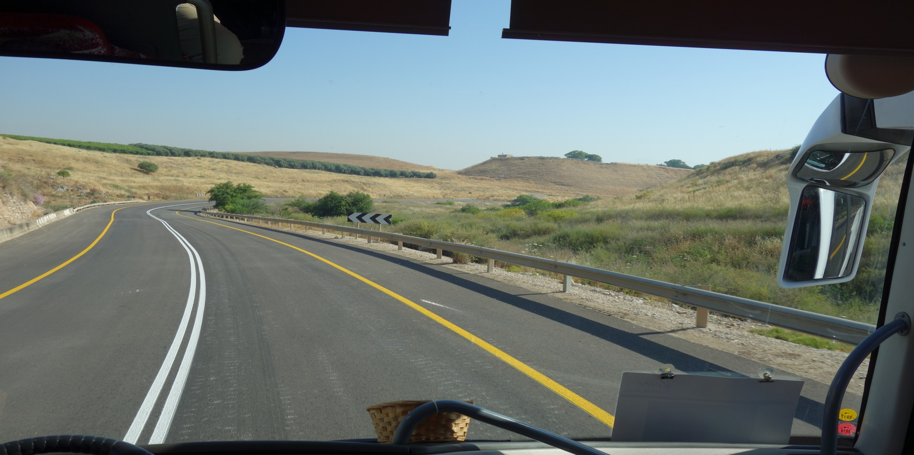

Slide 22
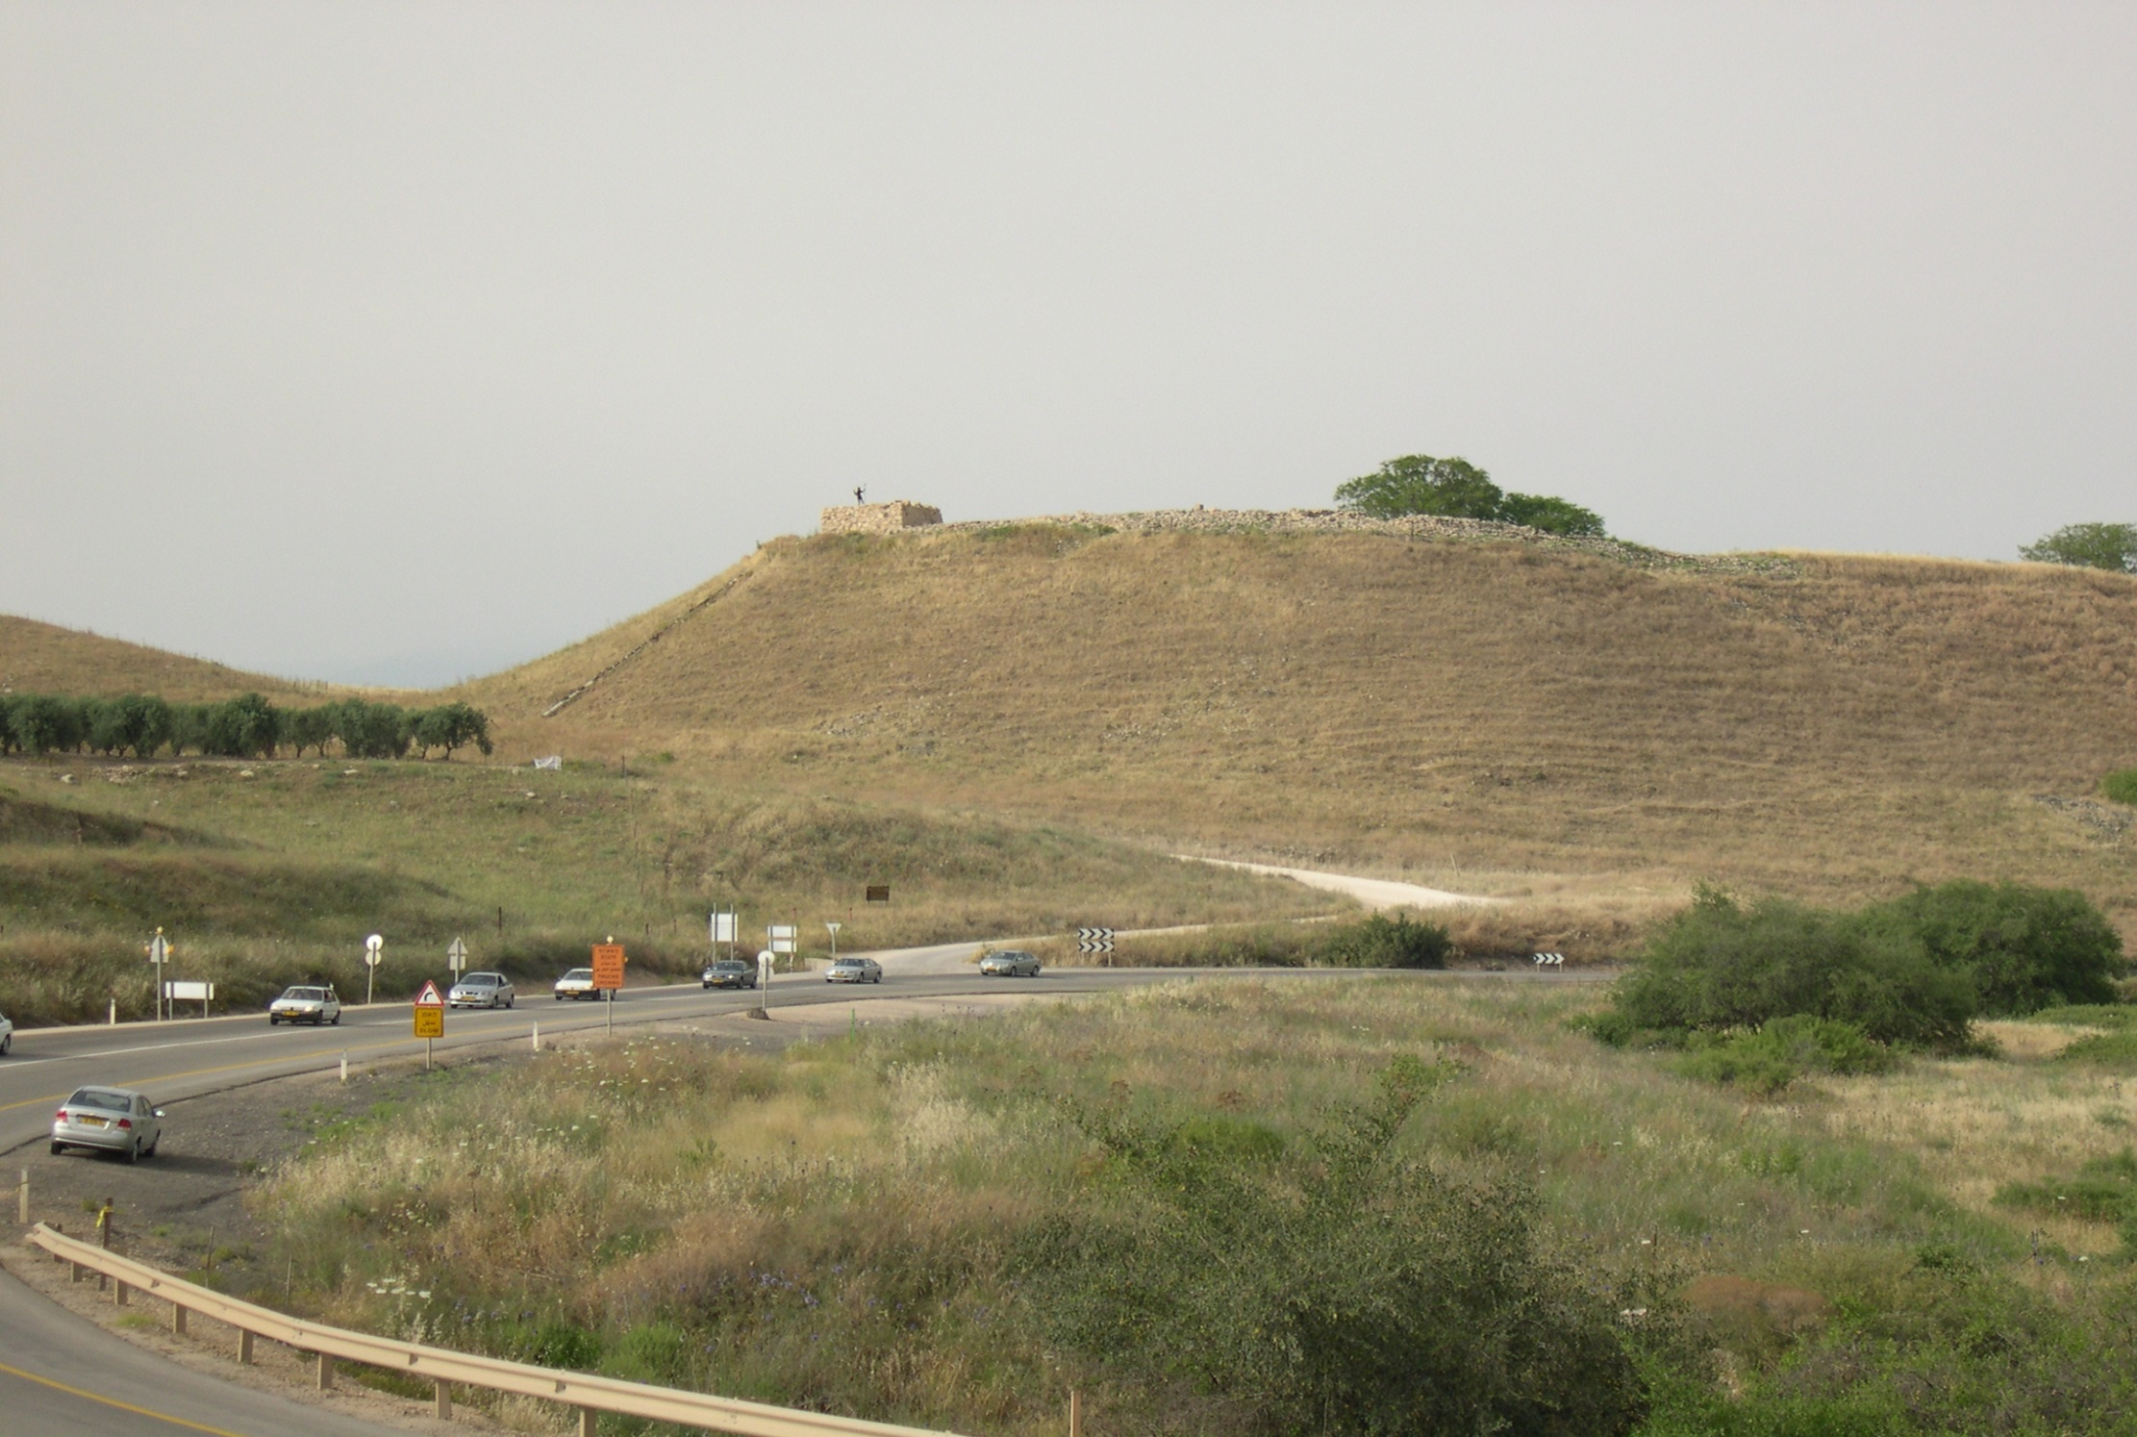

Slide 23
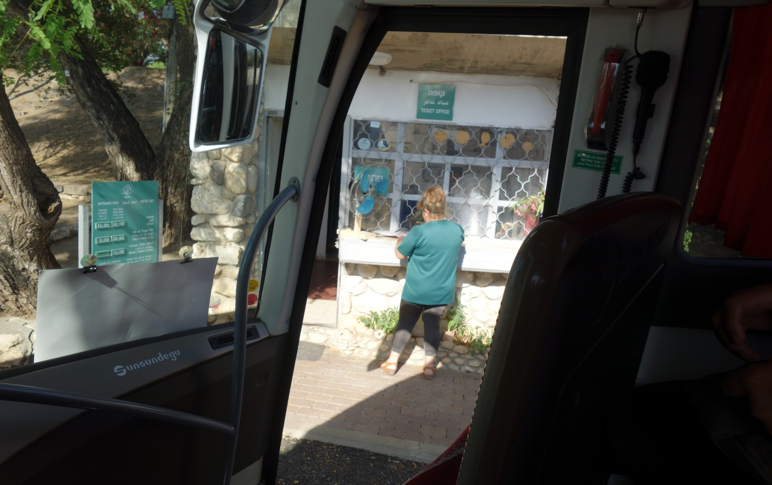

Slide 24
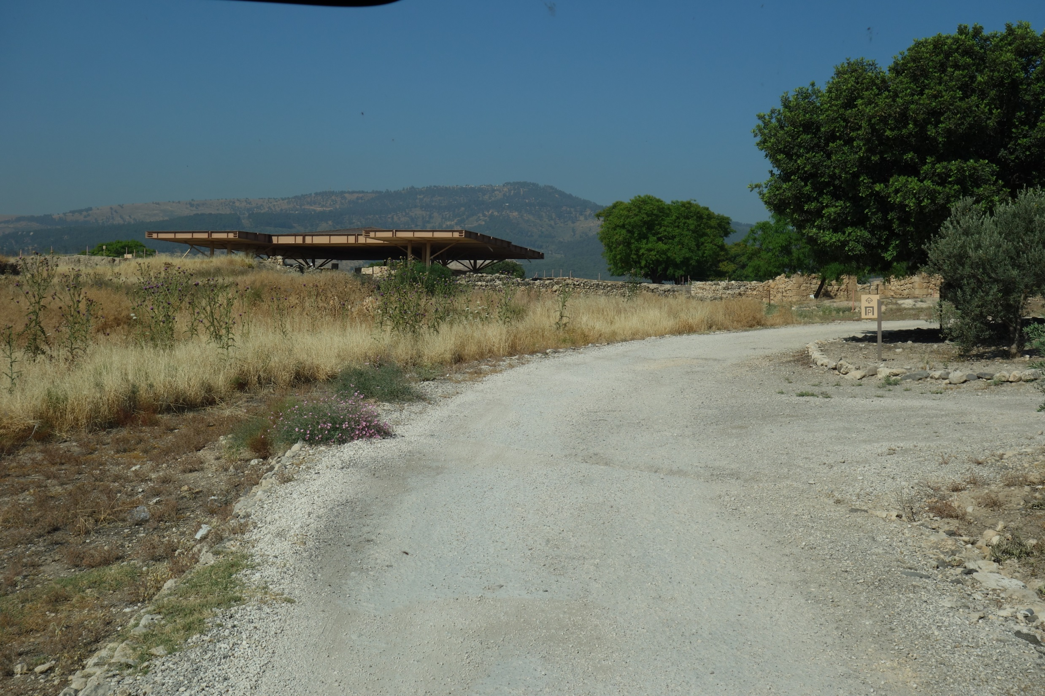

Slide 25
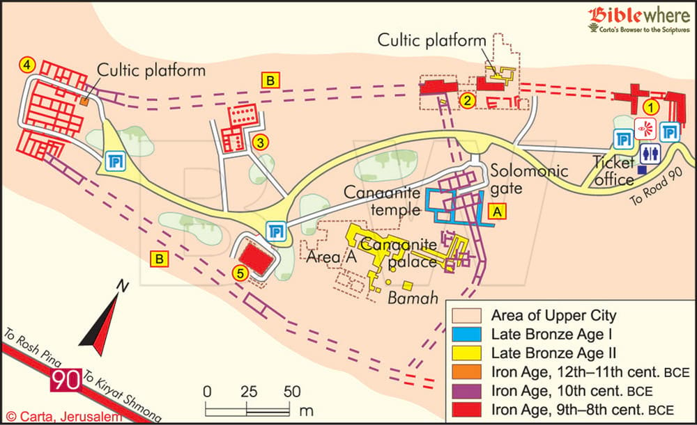

Slide 26
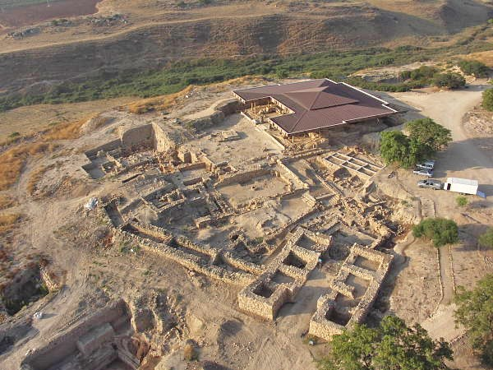

Slide 27
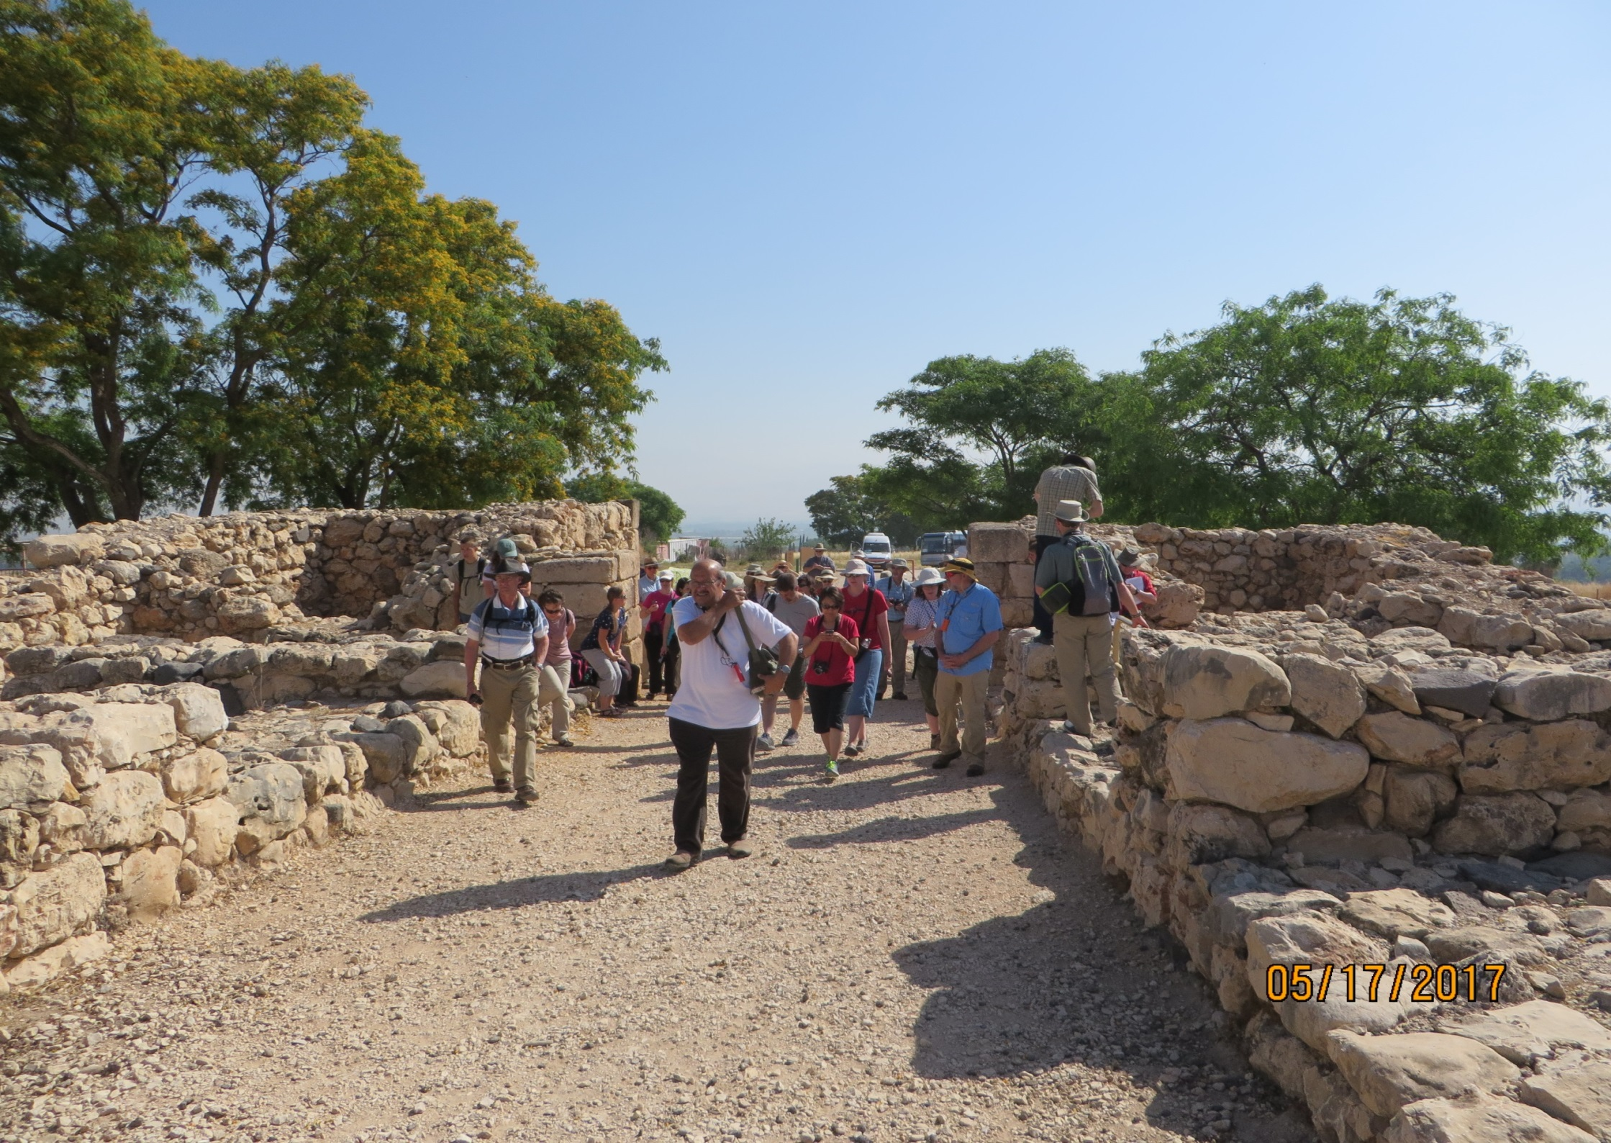

Slide 28
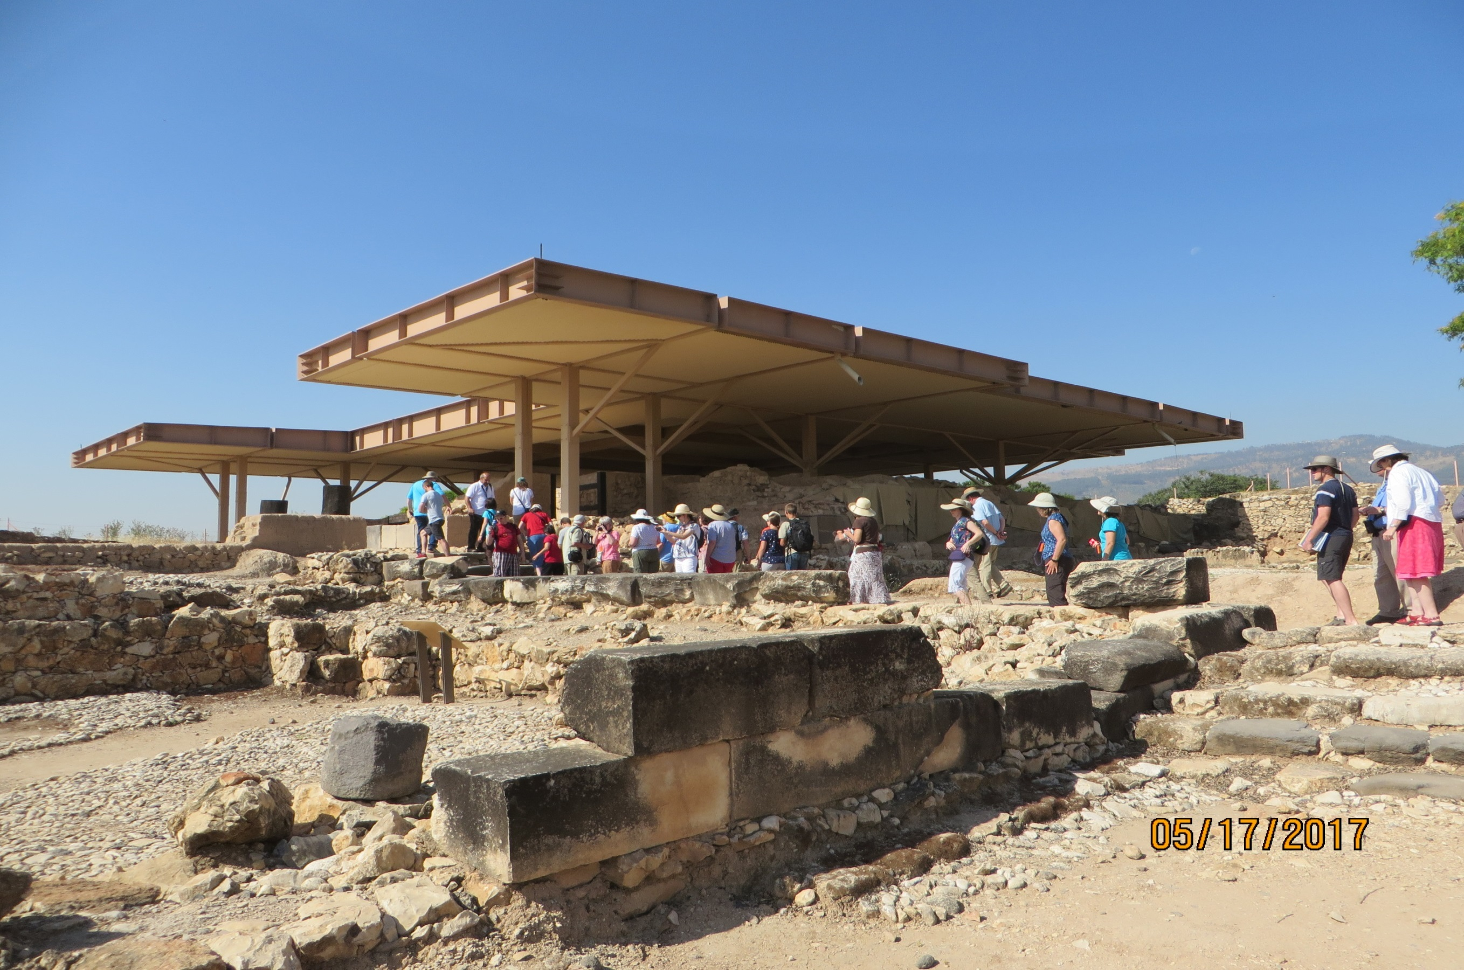

Slide 29
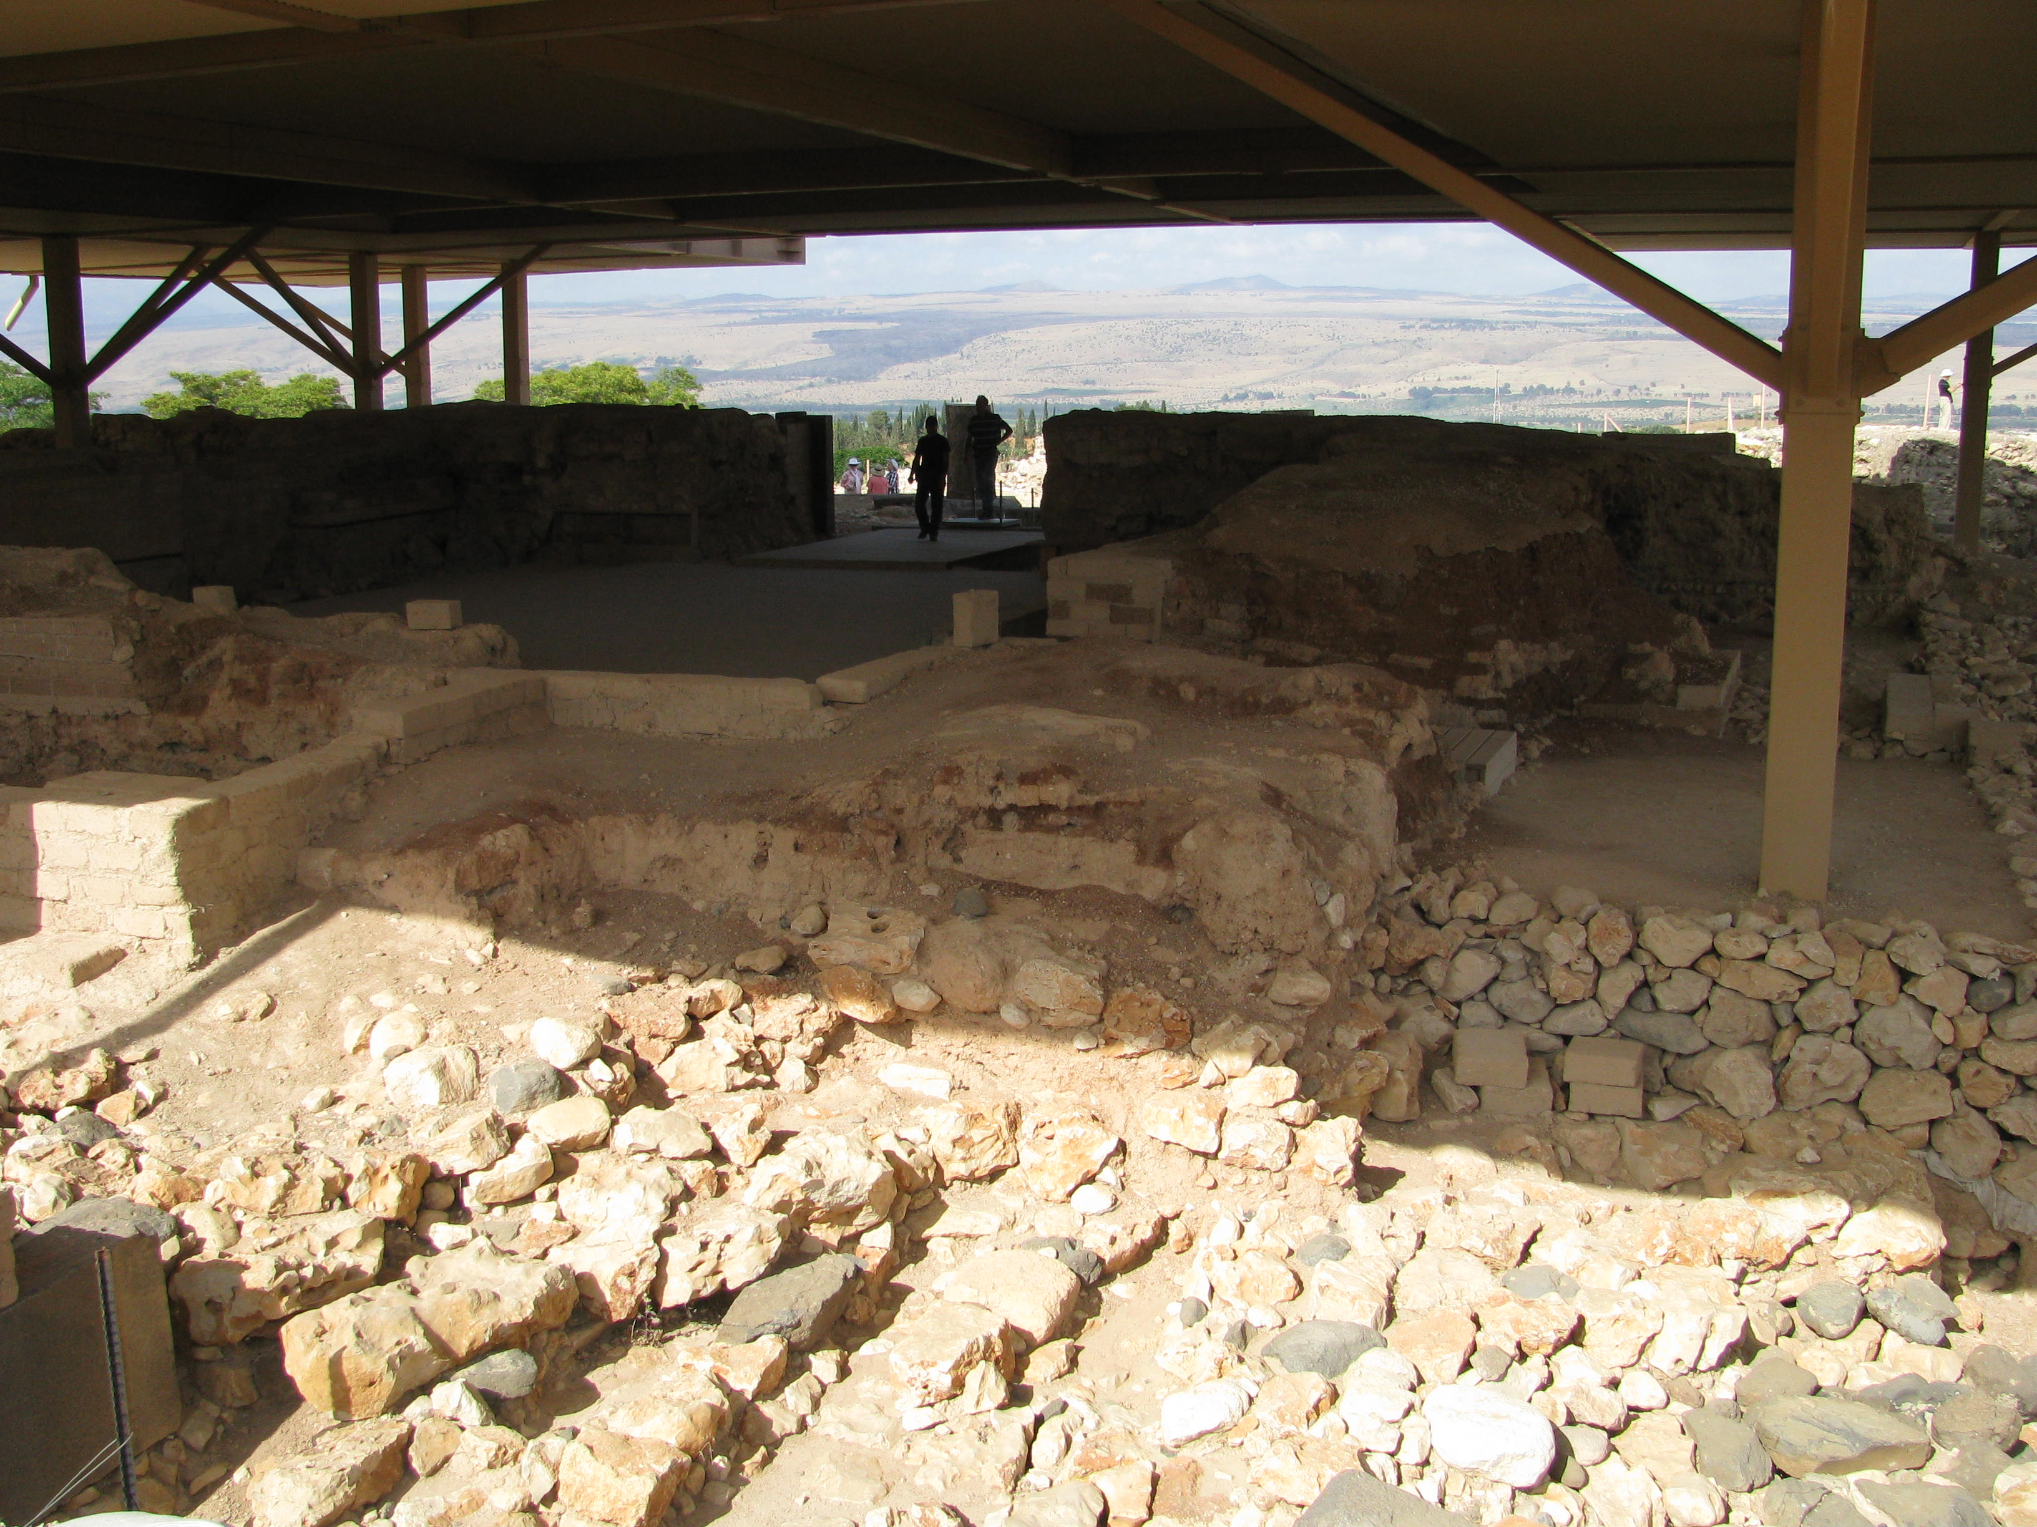

Slide 30
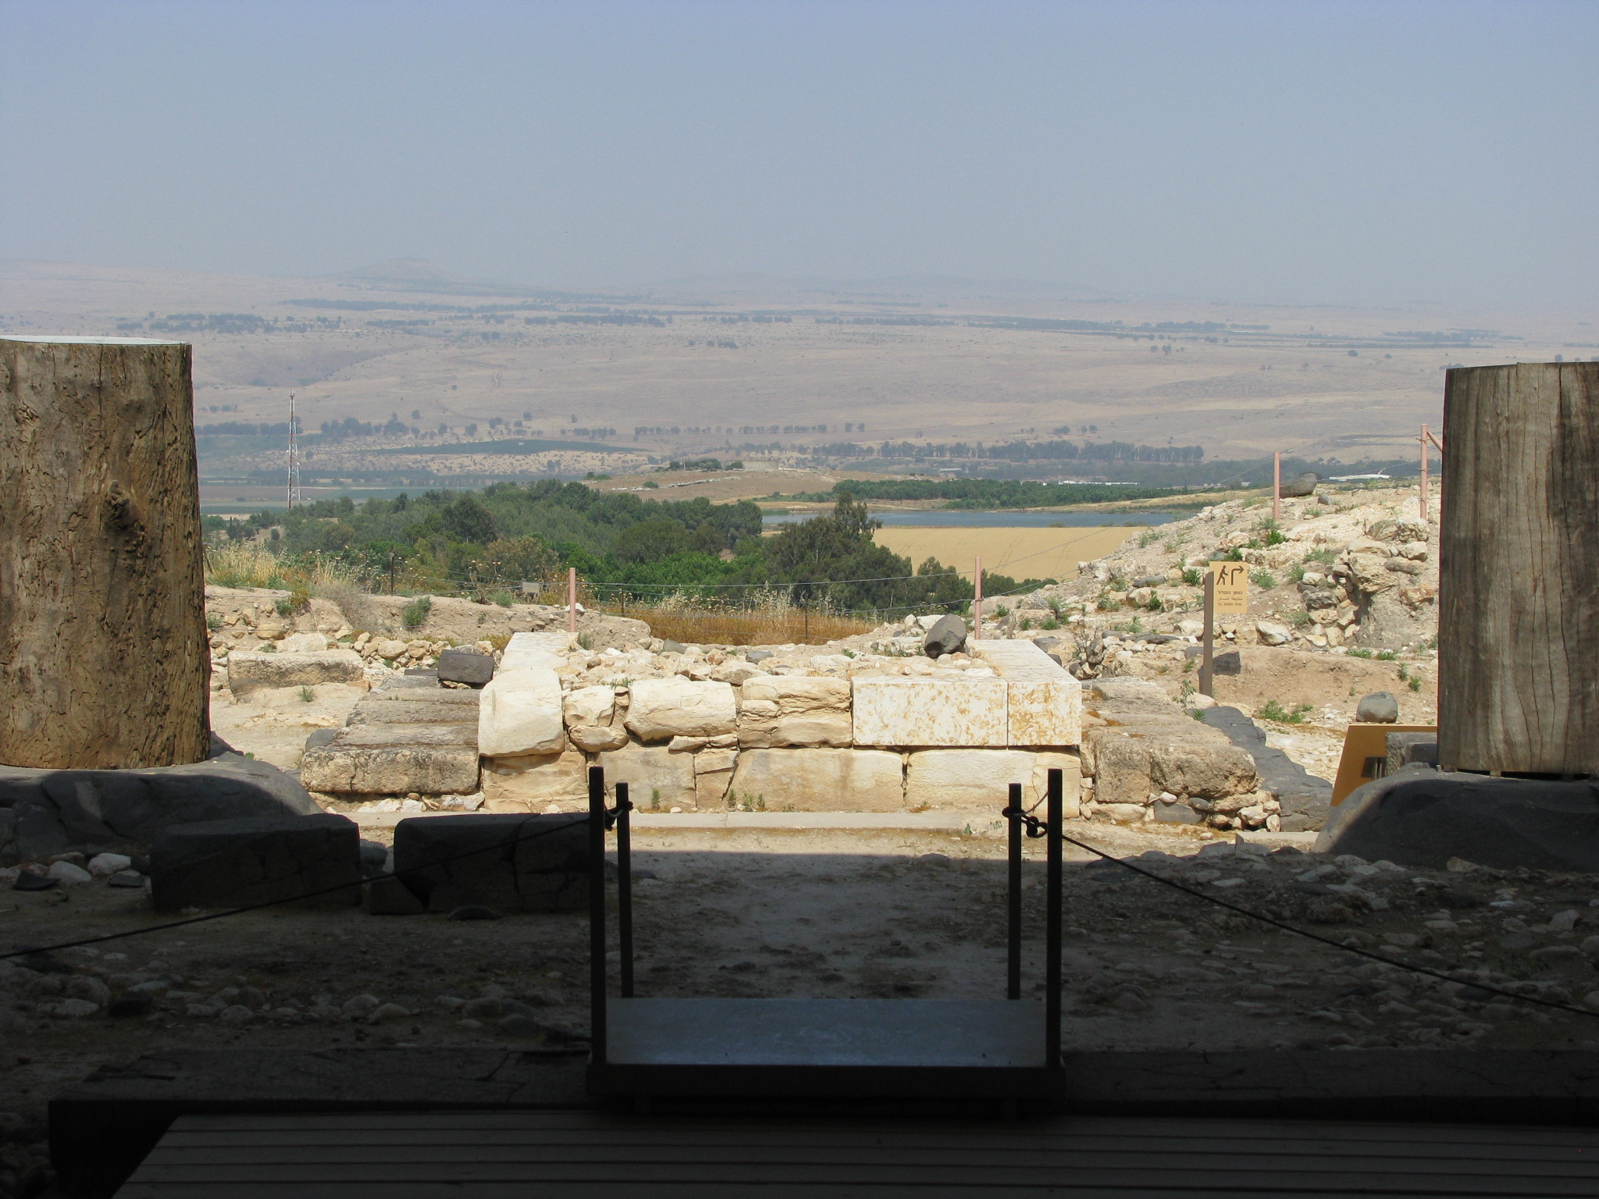

Slide 31
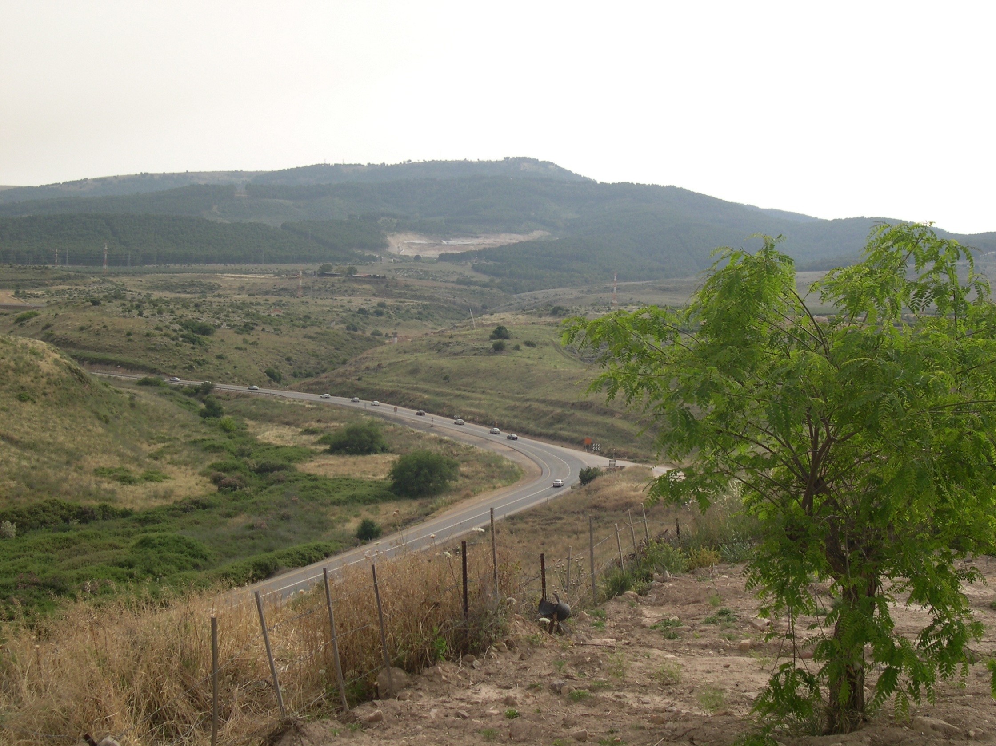

Slide 32
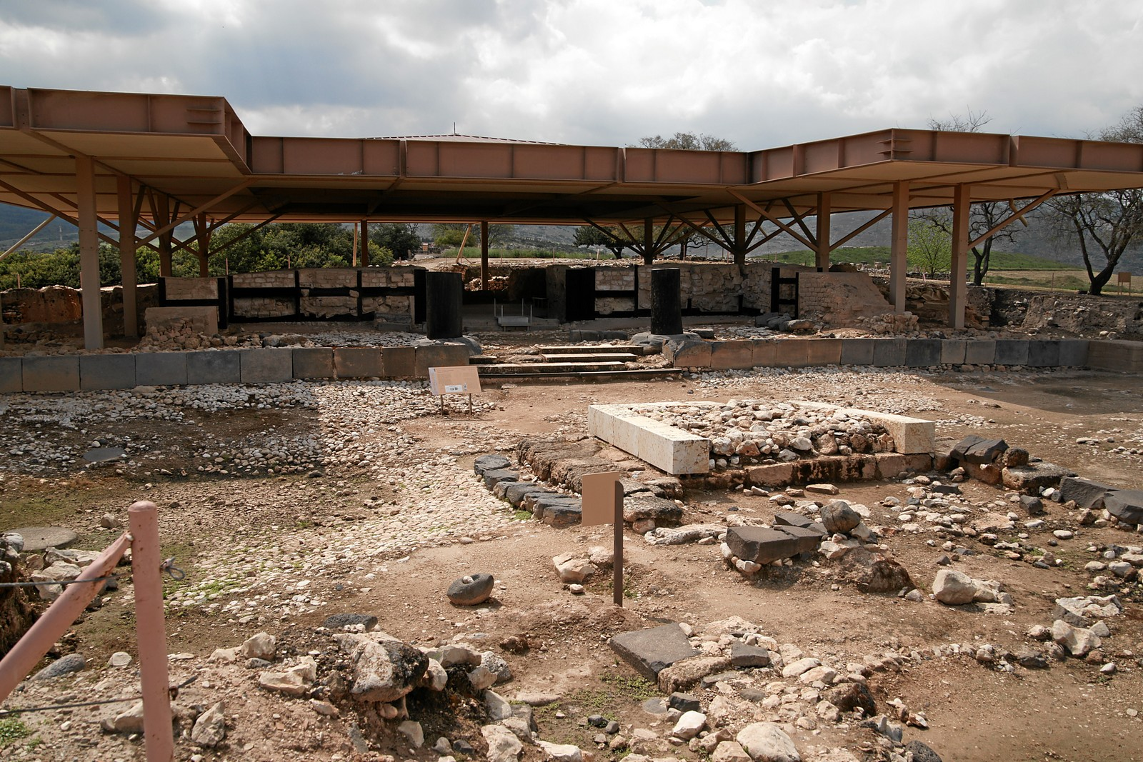

Slide 33
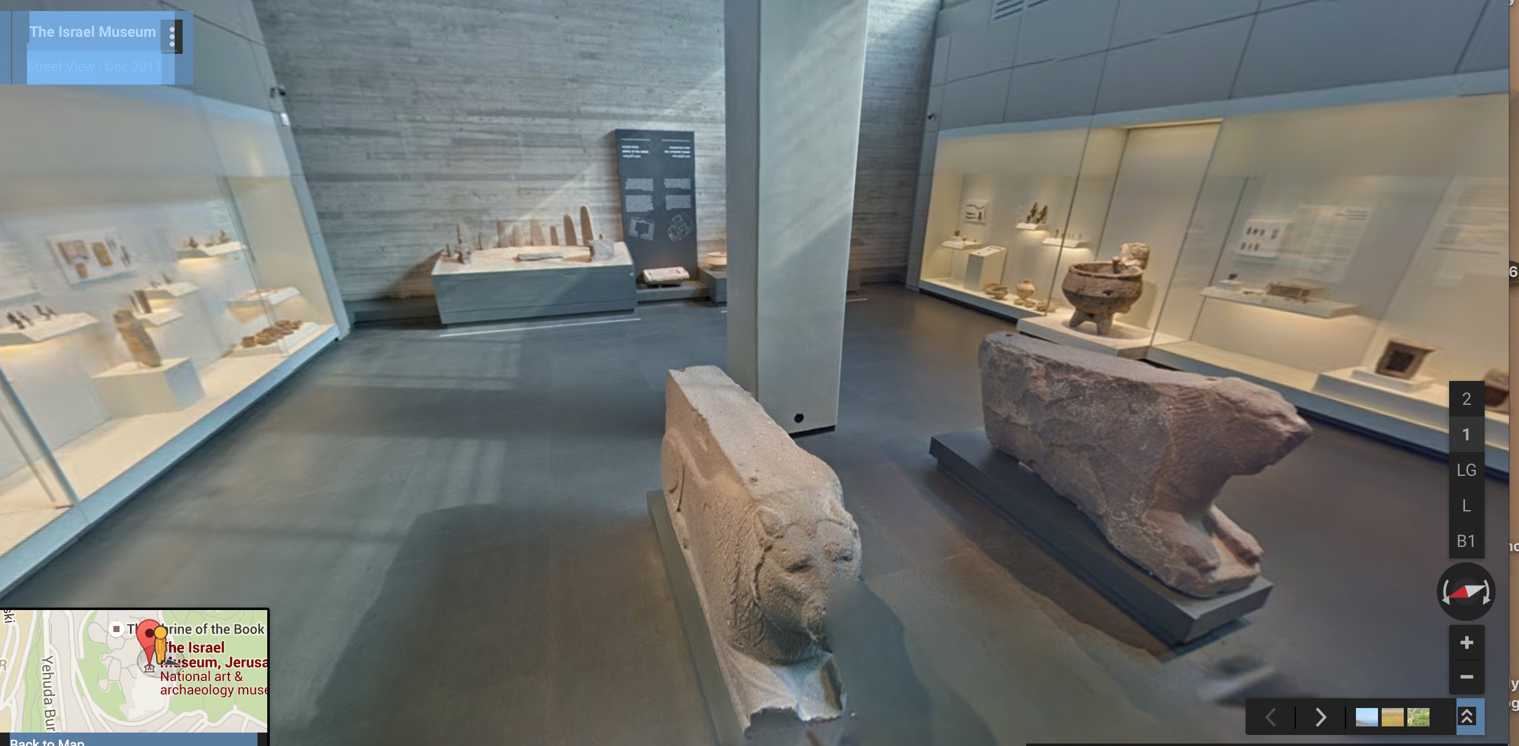

Slide 34
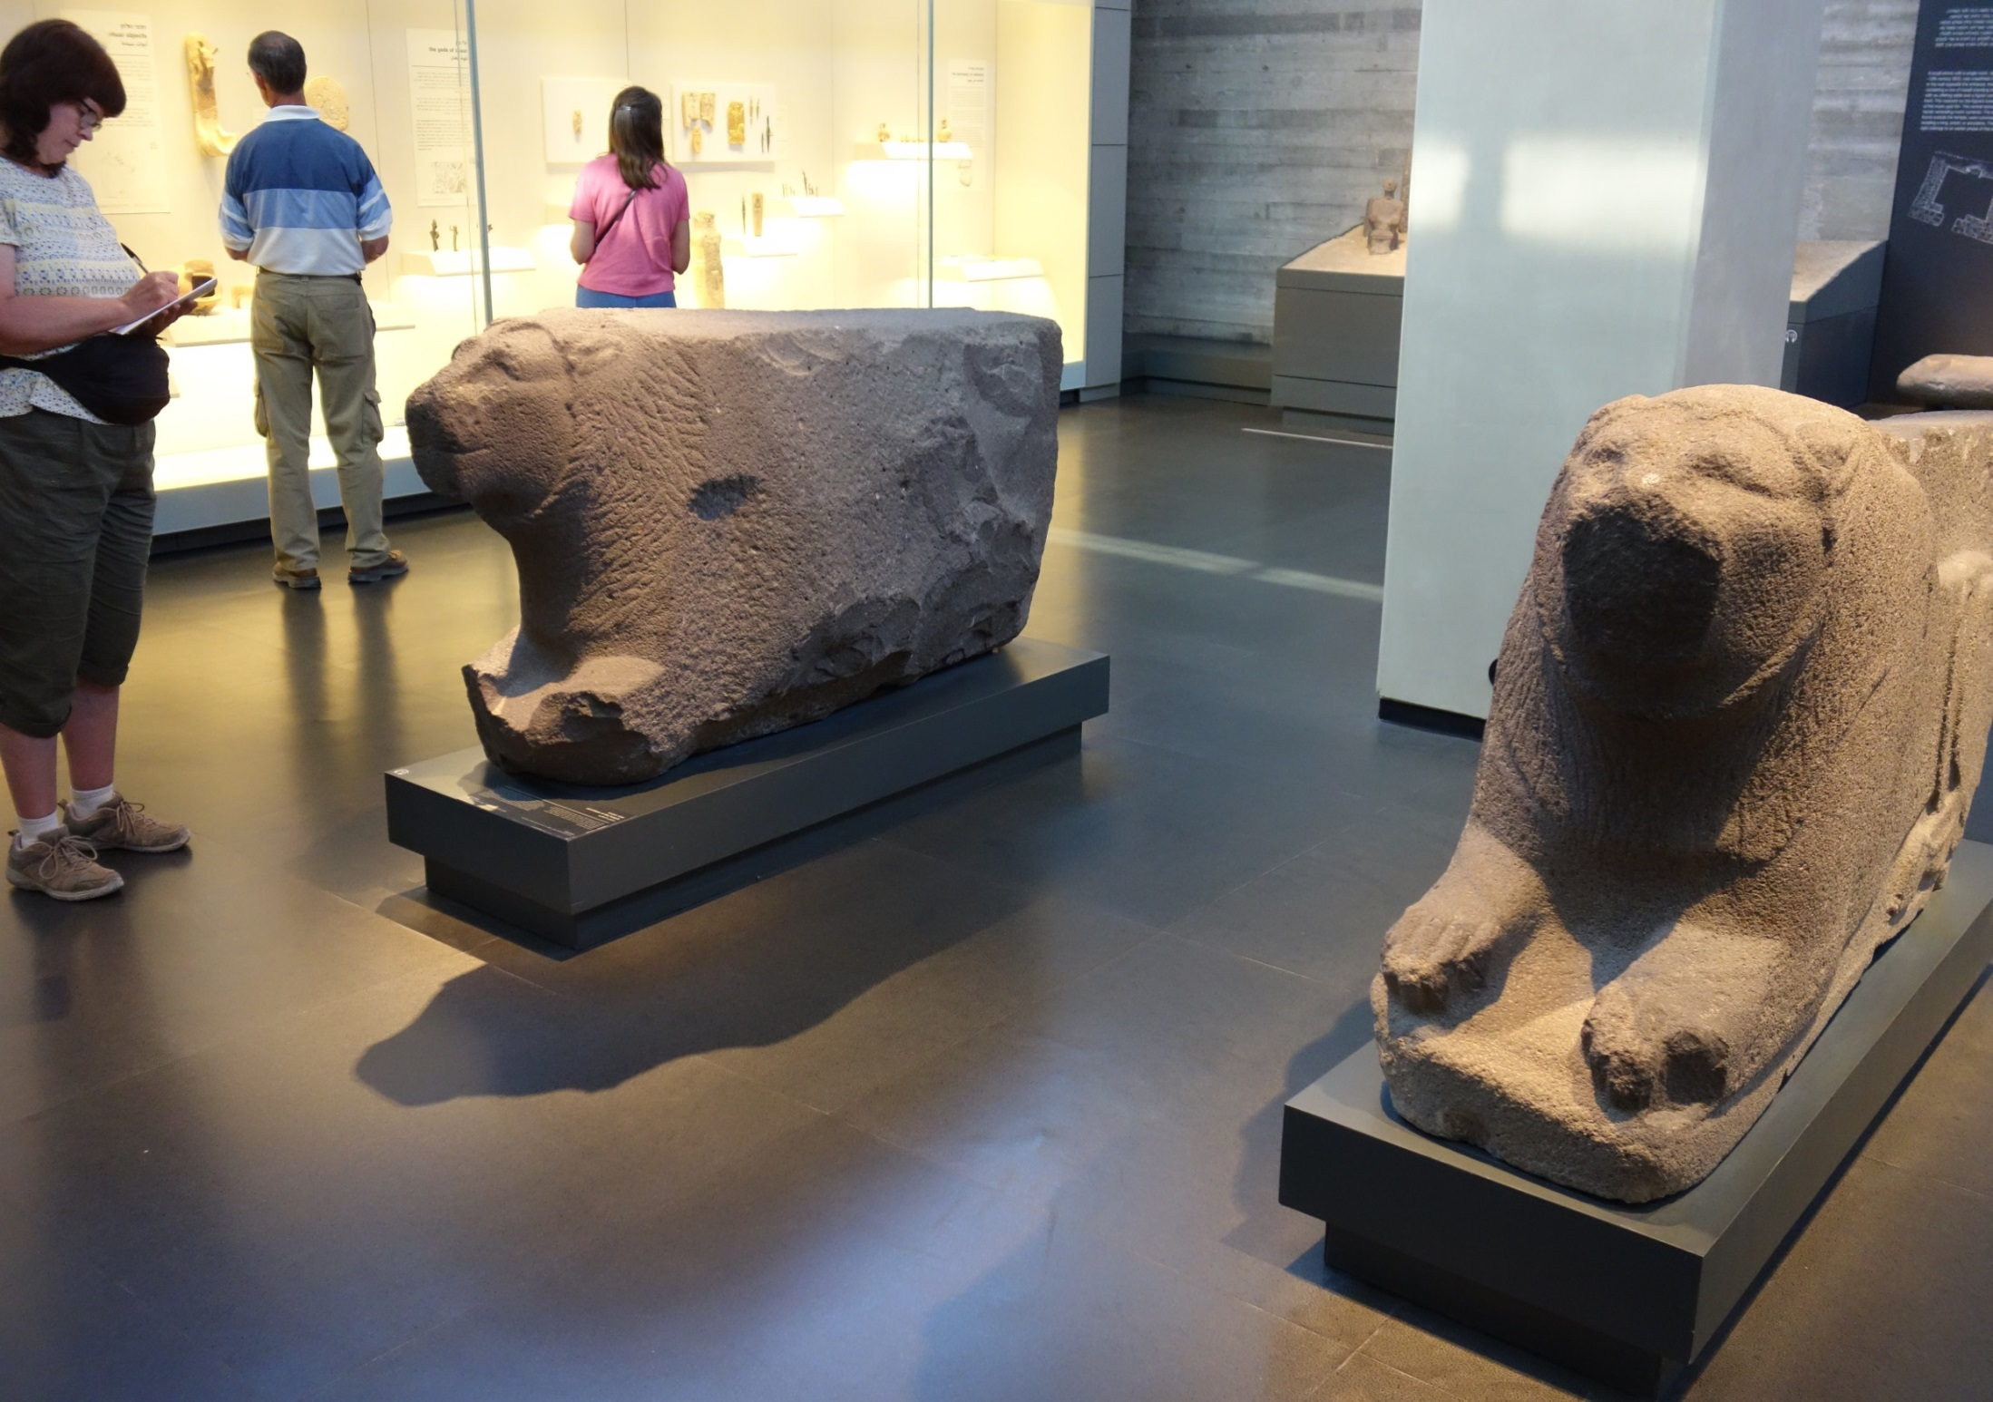

Slide 35
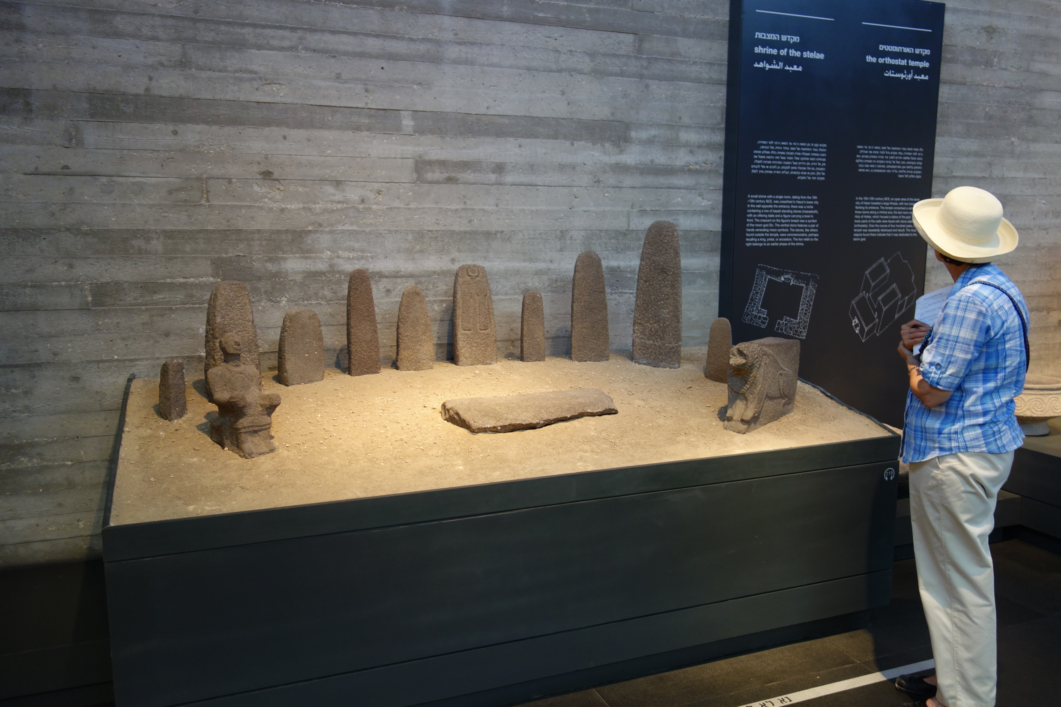

Slide 36
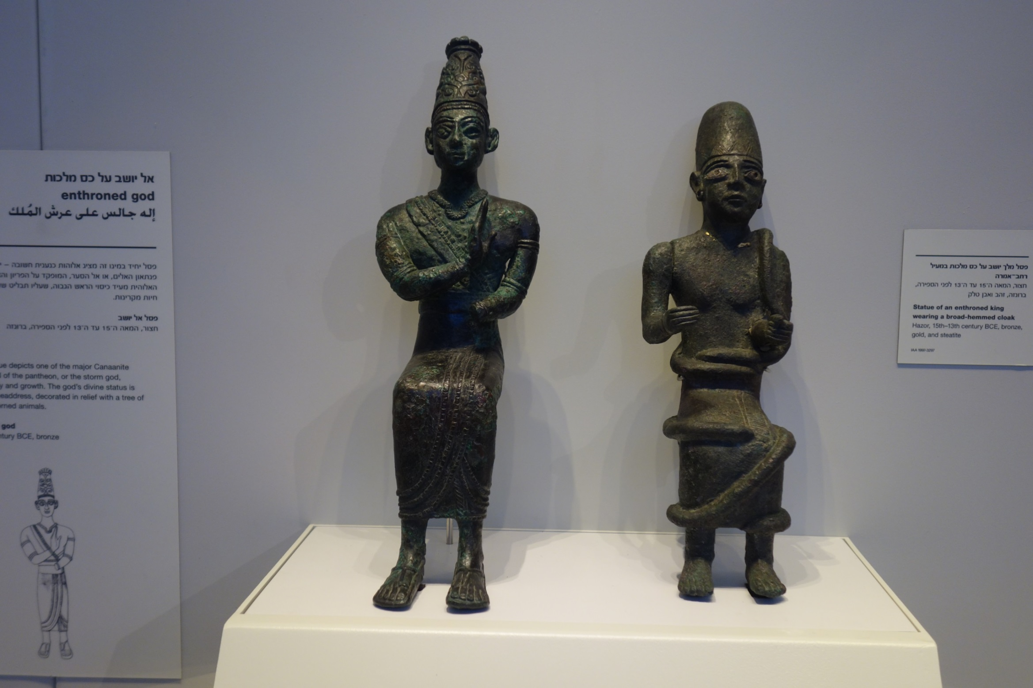

Slide 37
Joshua 11:1-12

Slide 38
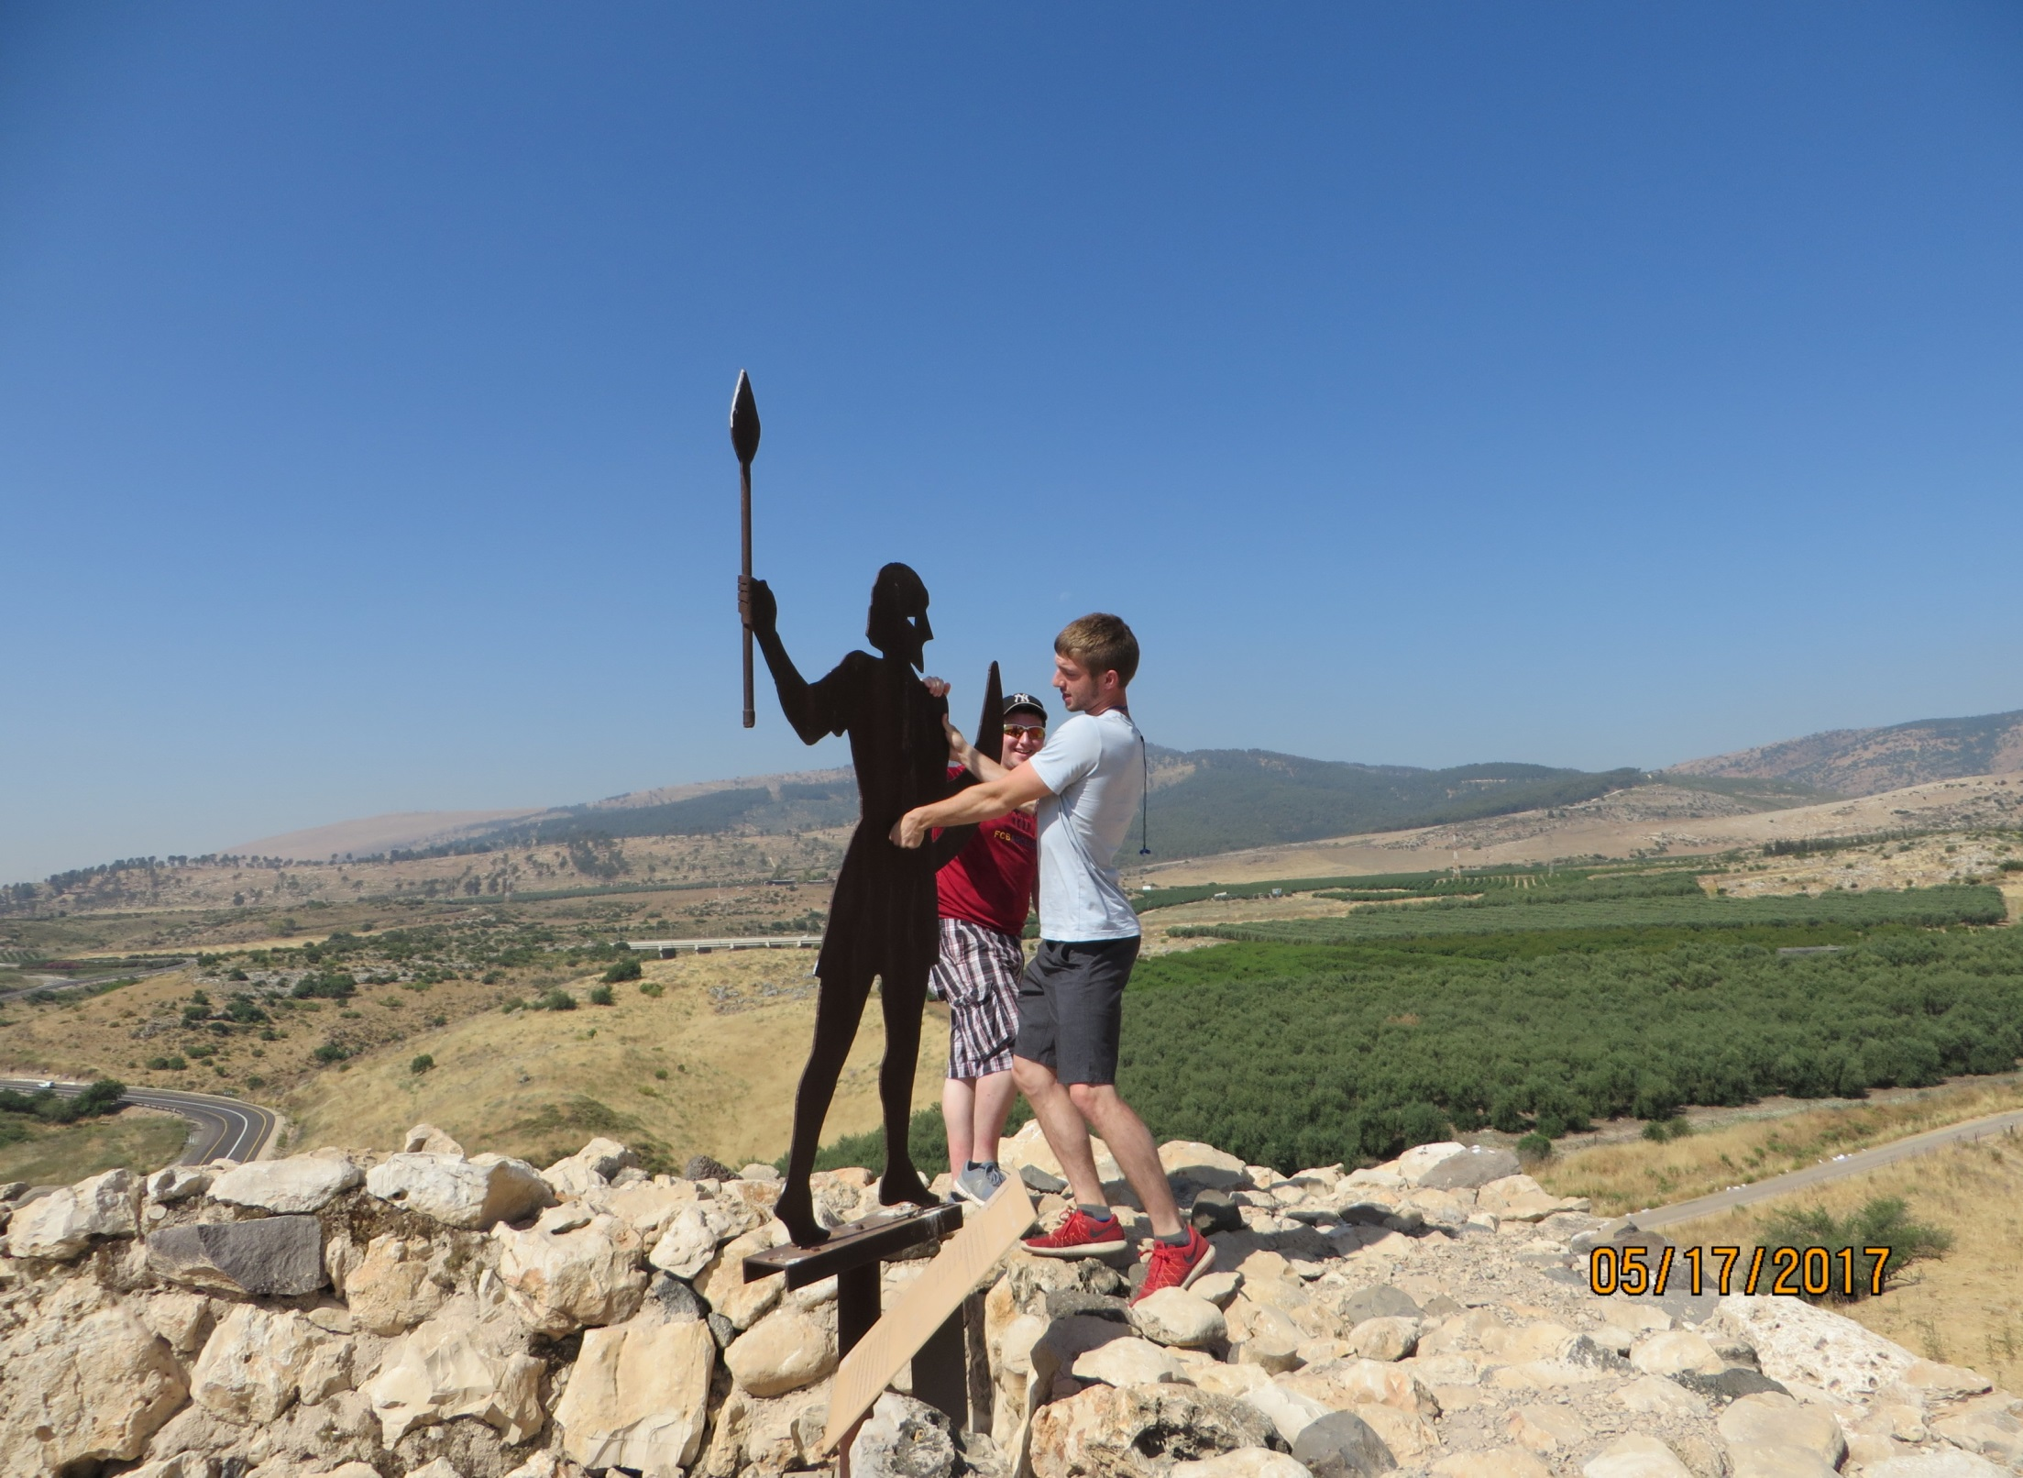

Slide 39
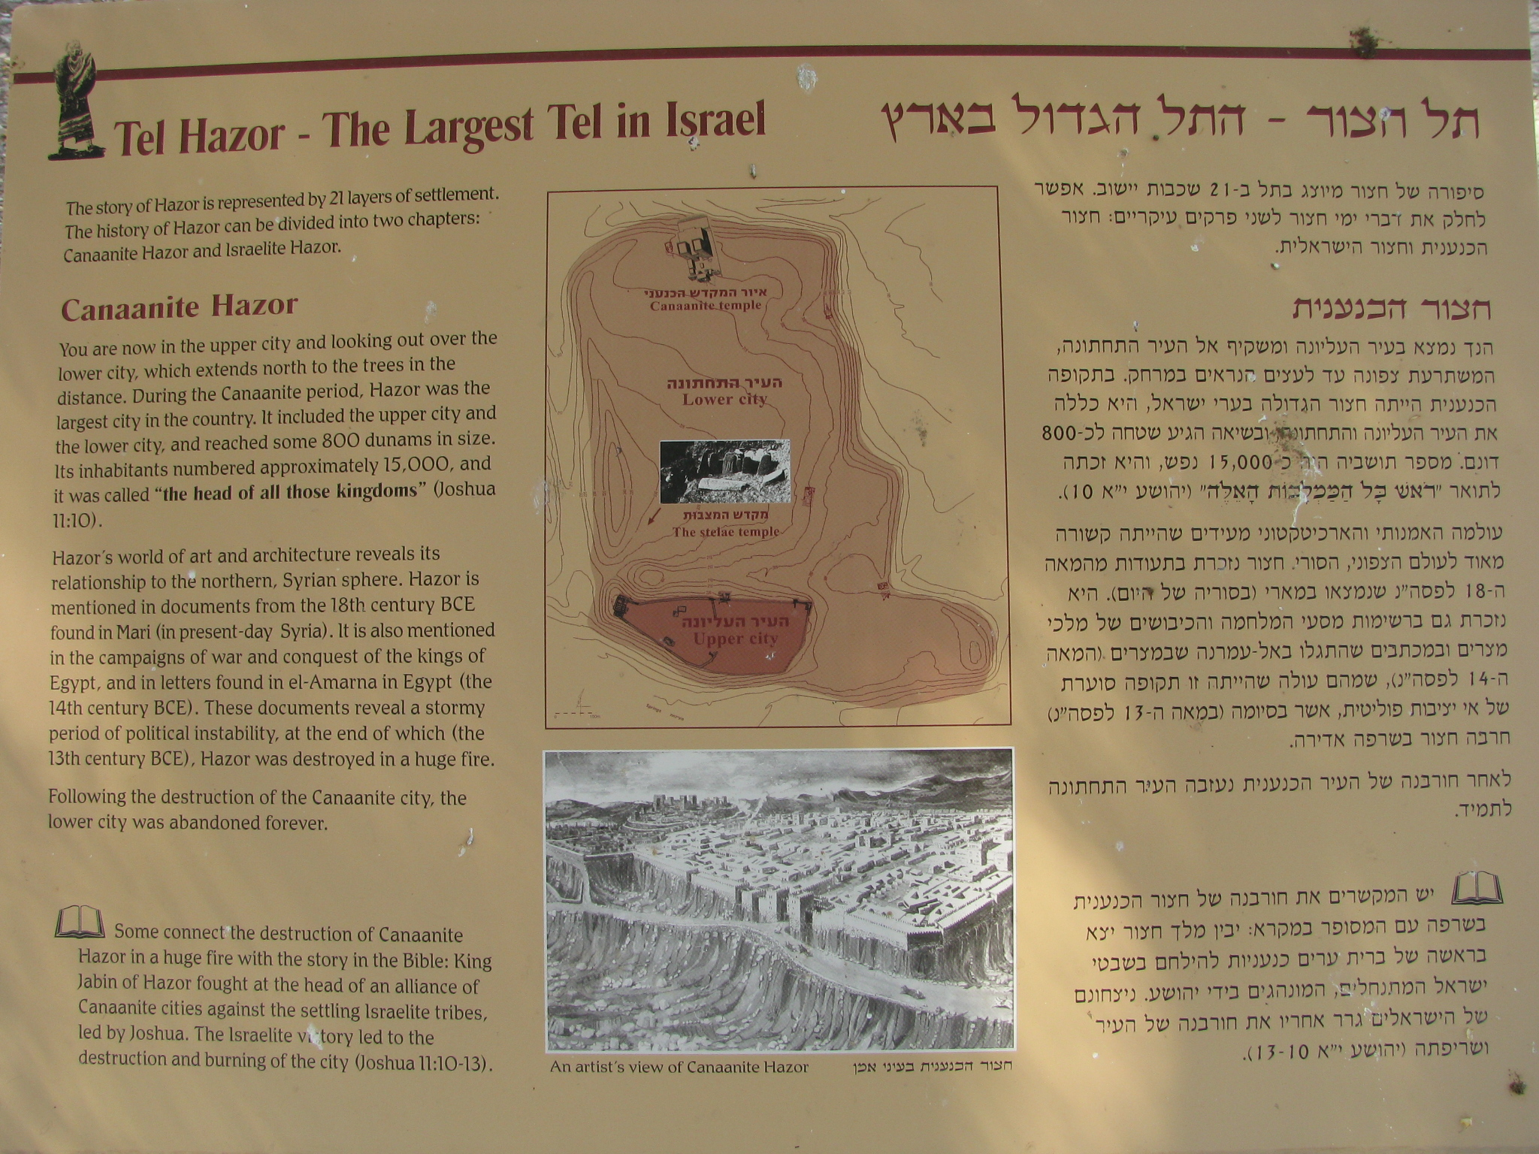

Slide 40
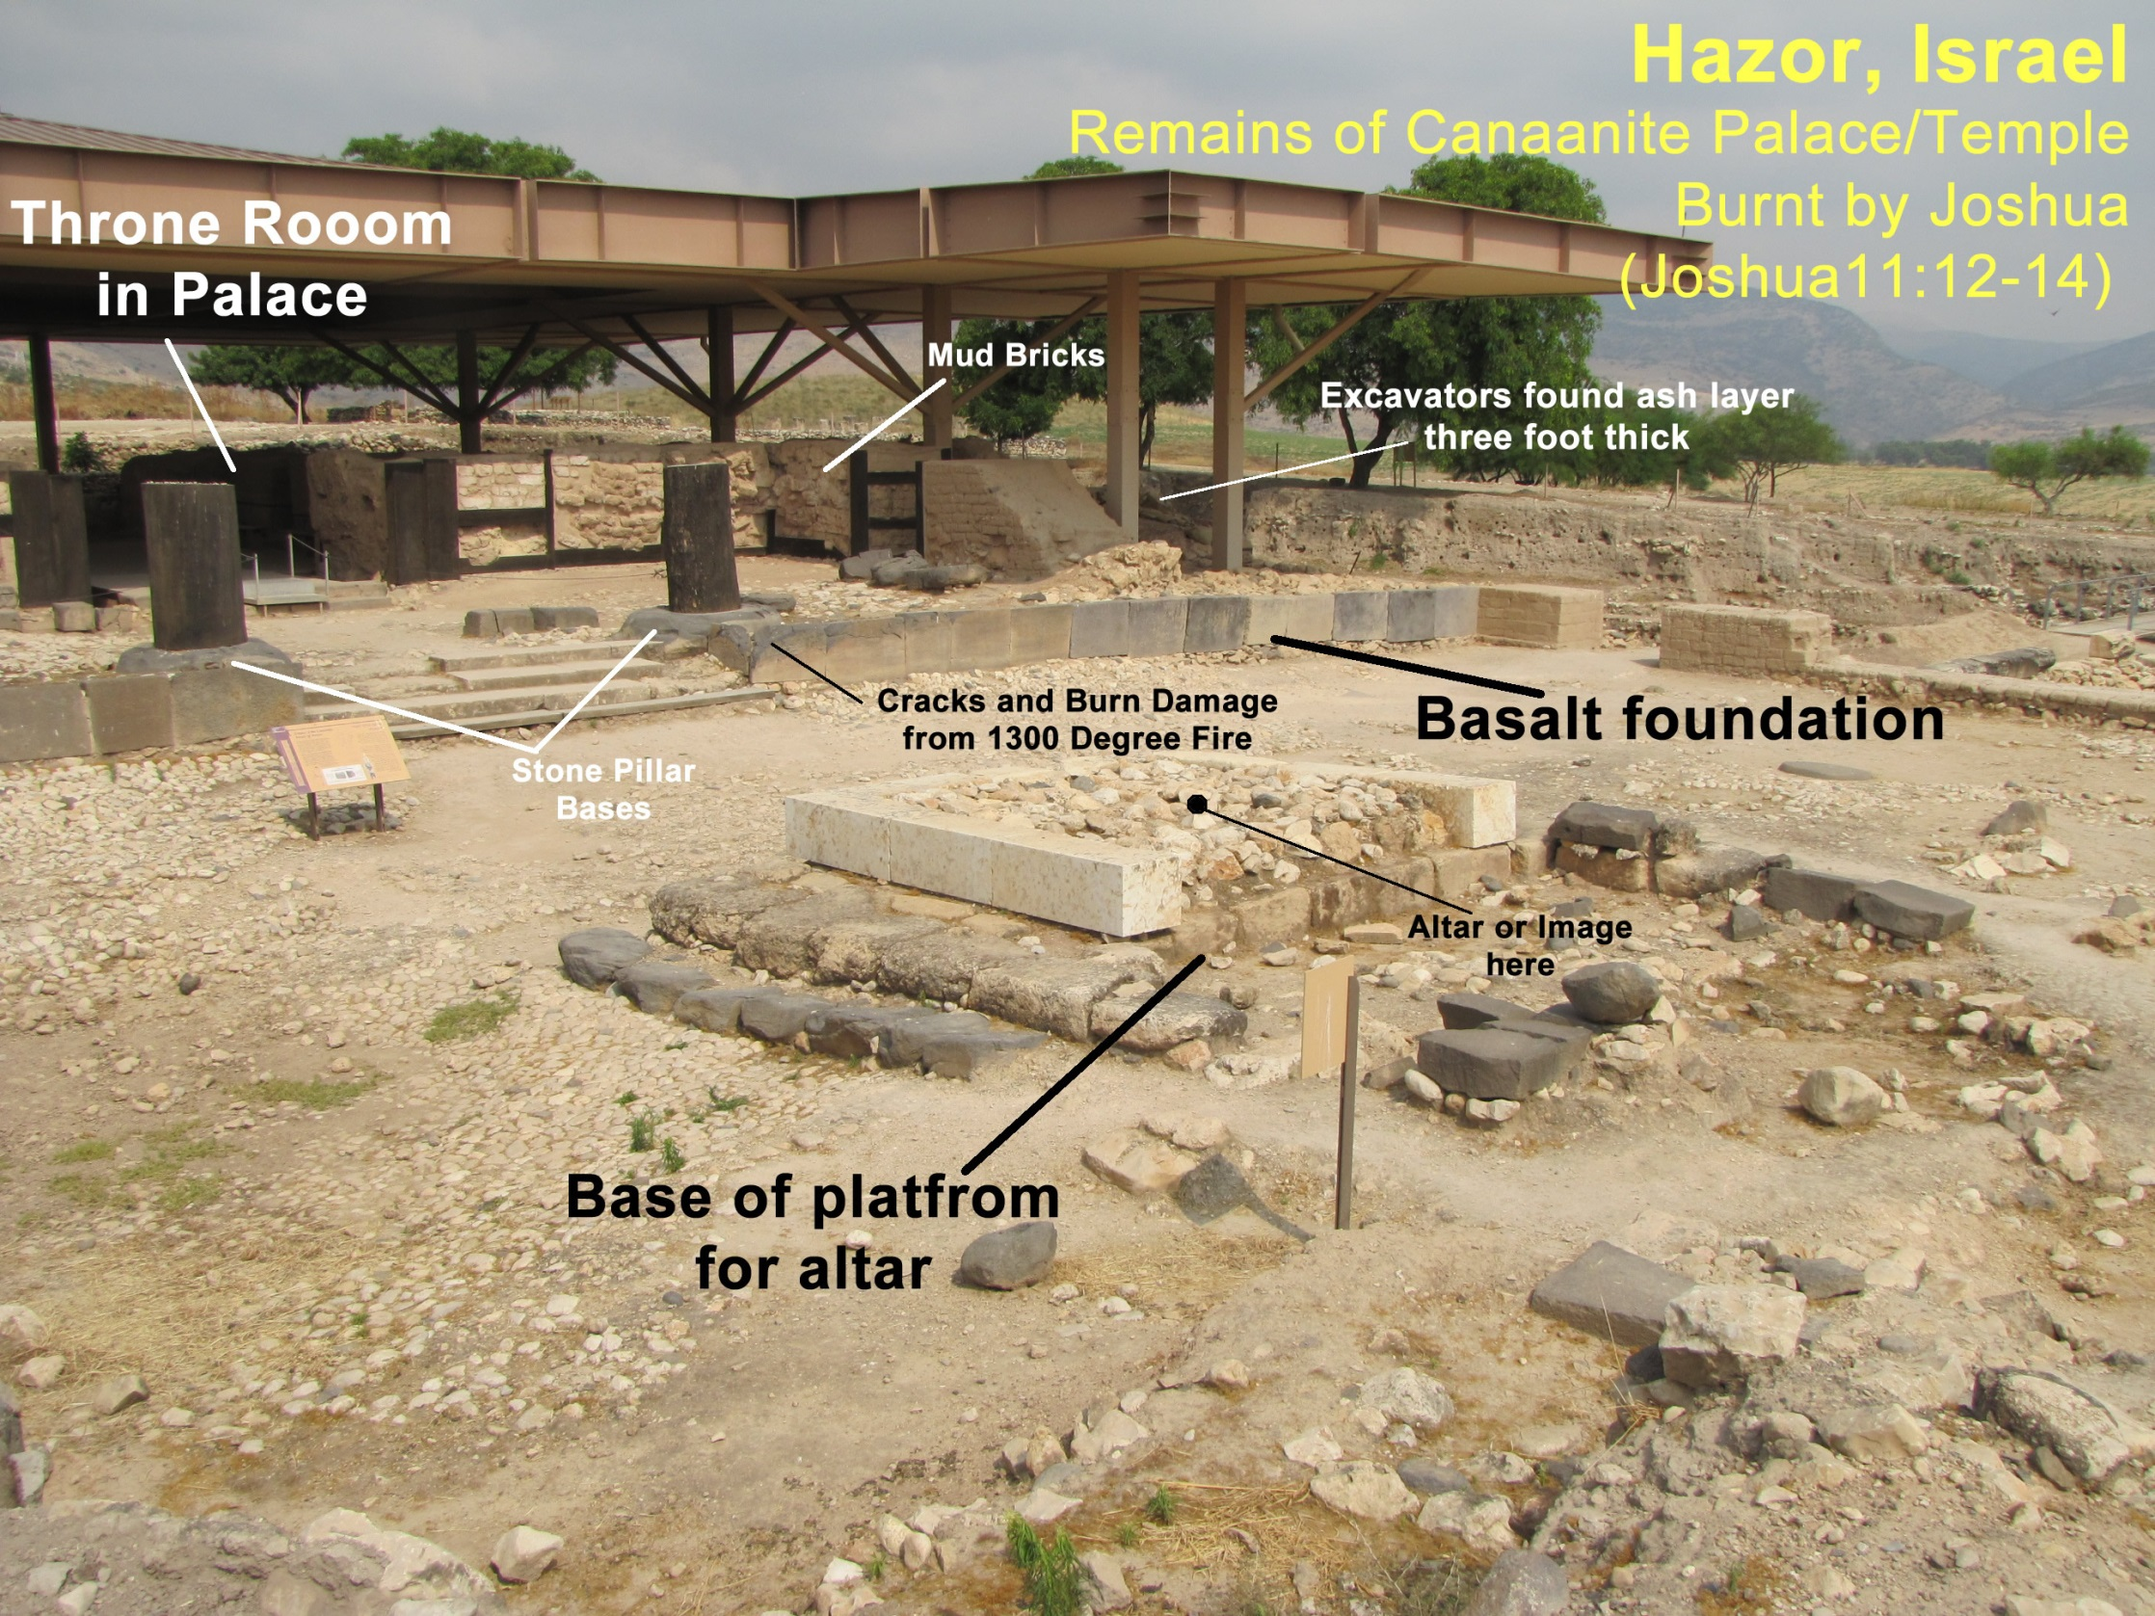

Slide 41
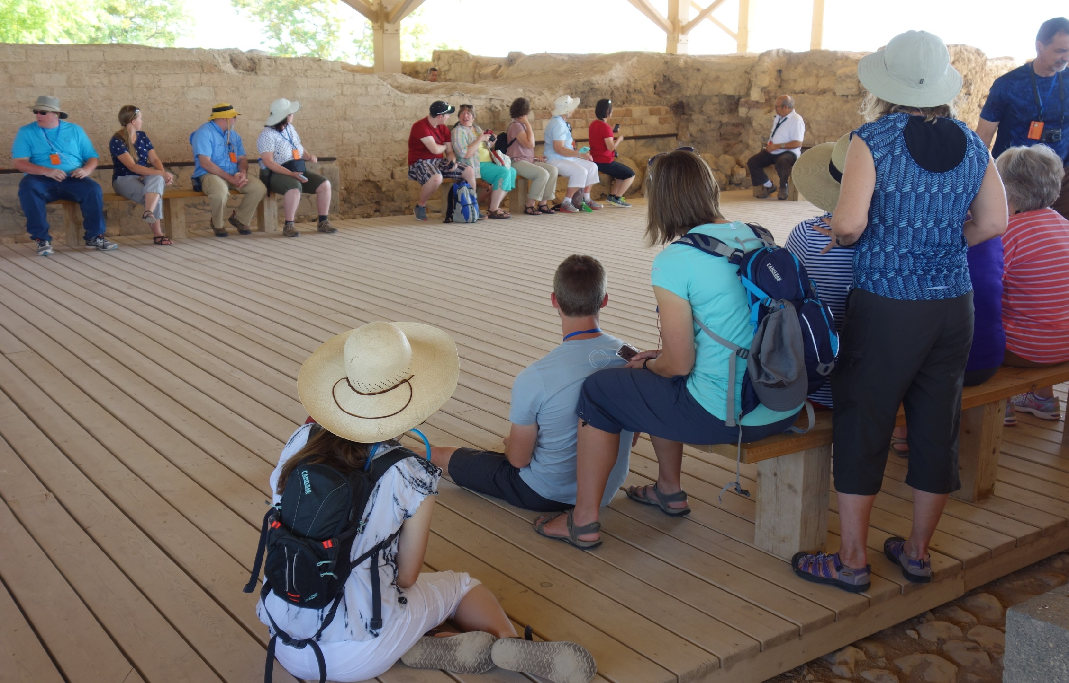

Slide 42
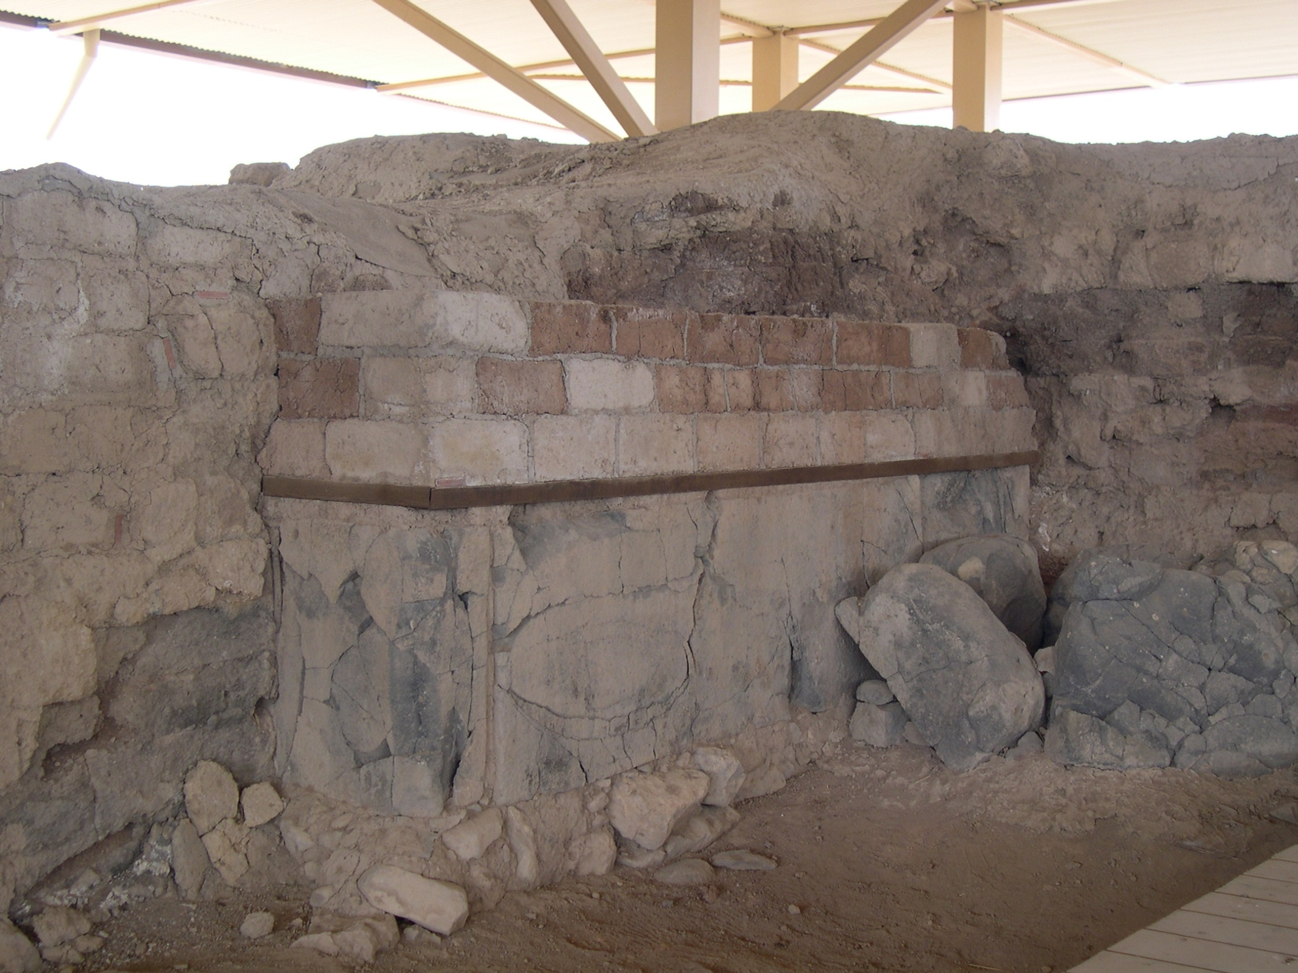

Slide 43
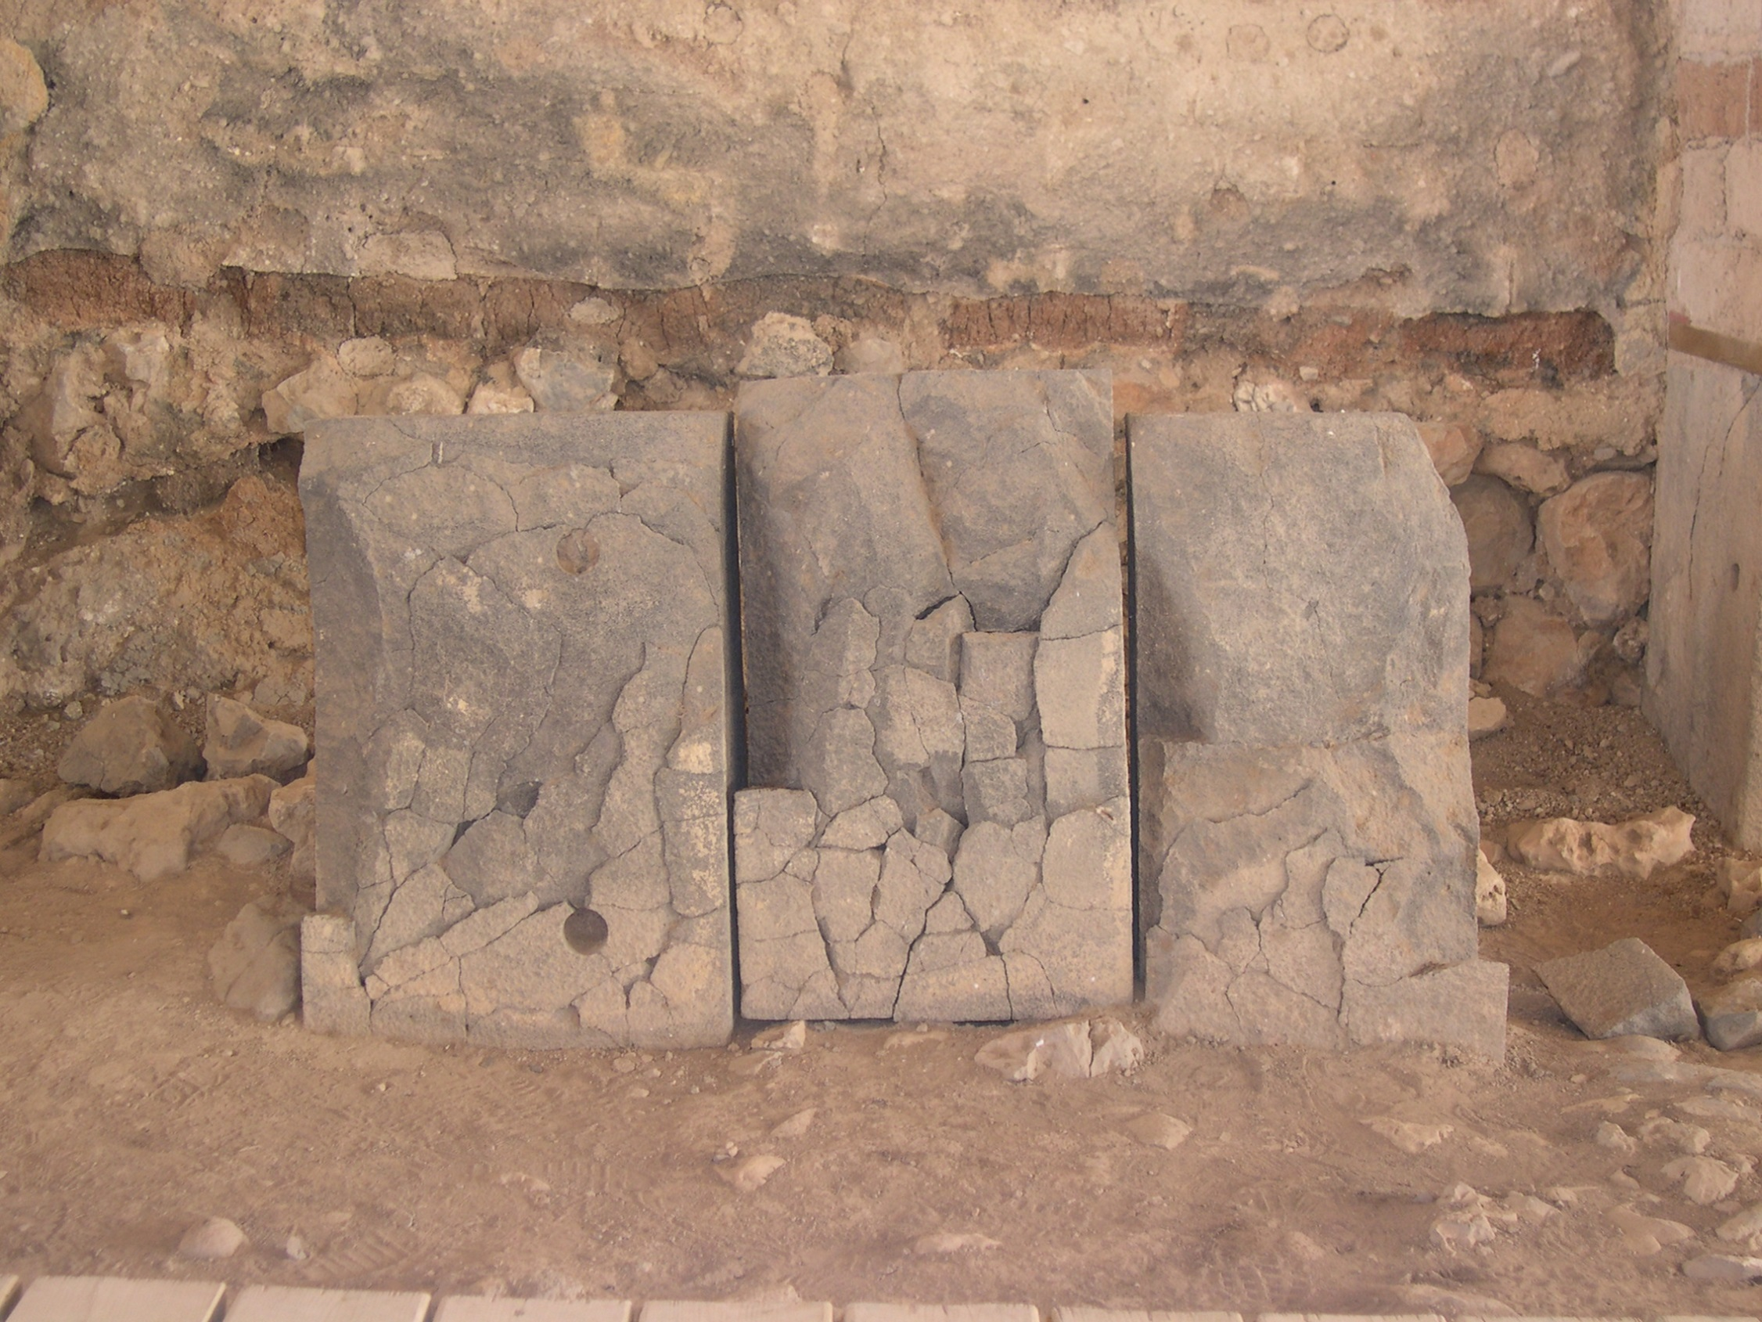

Slide 44
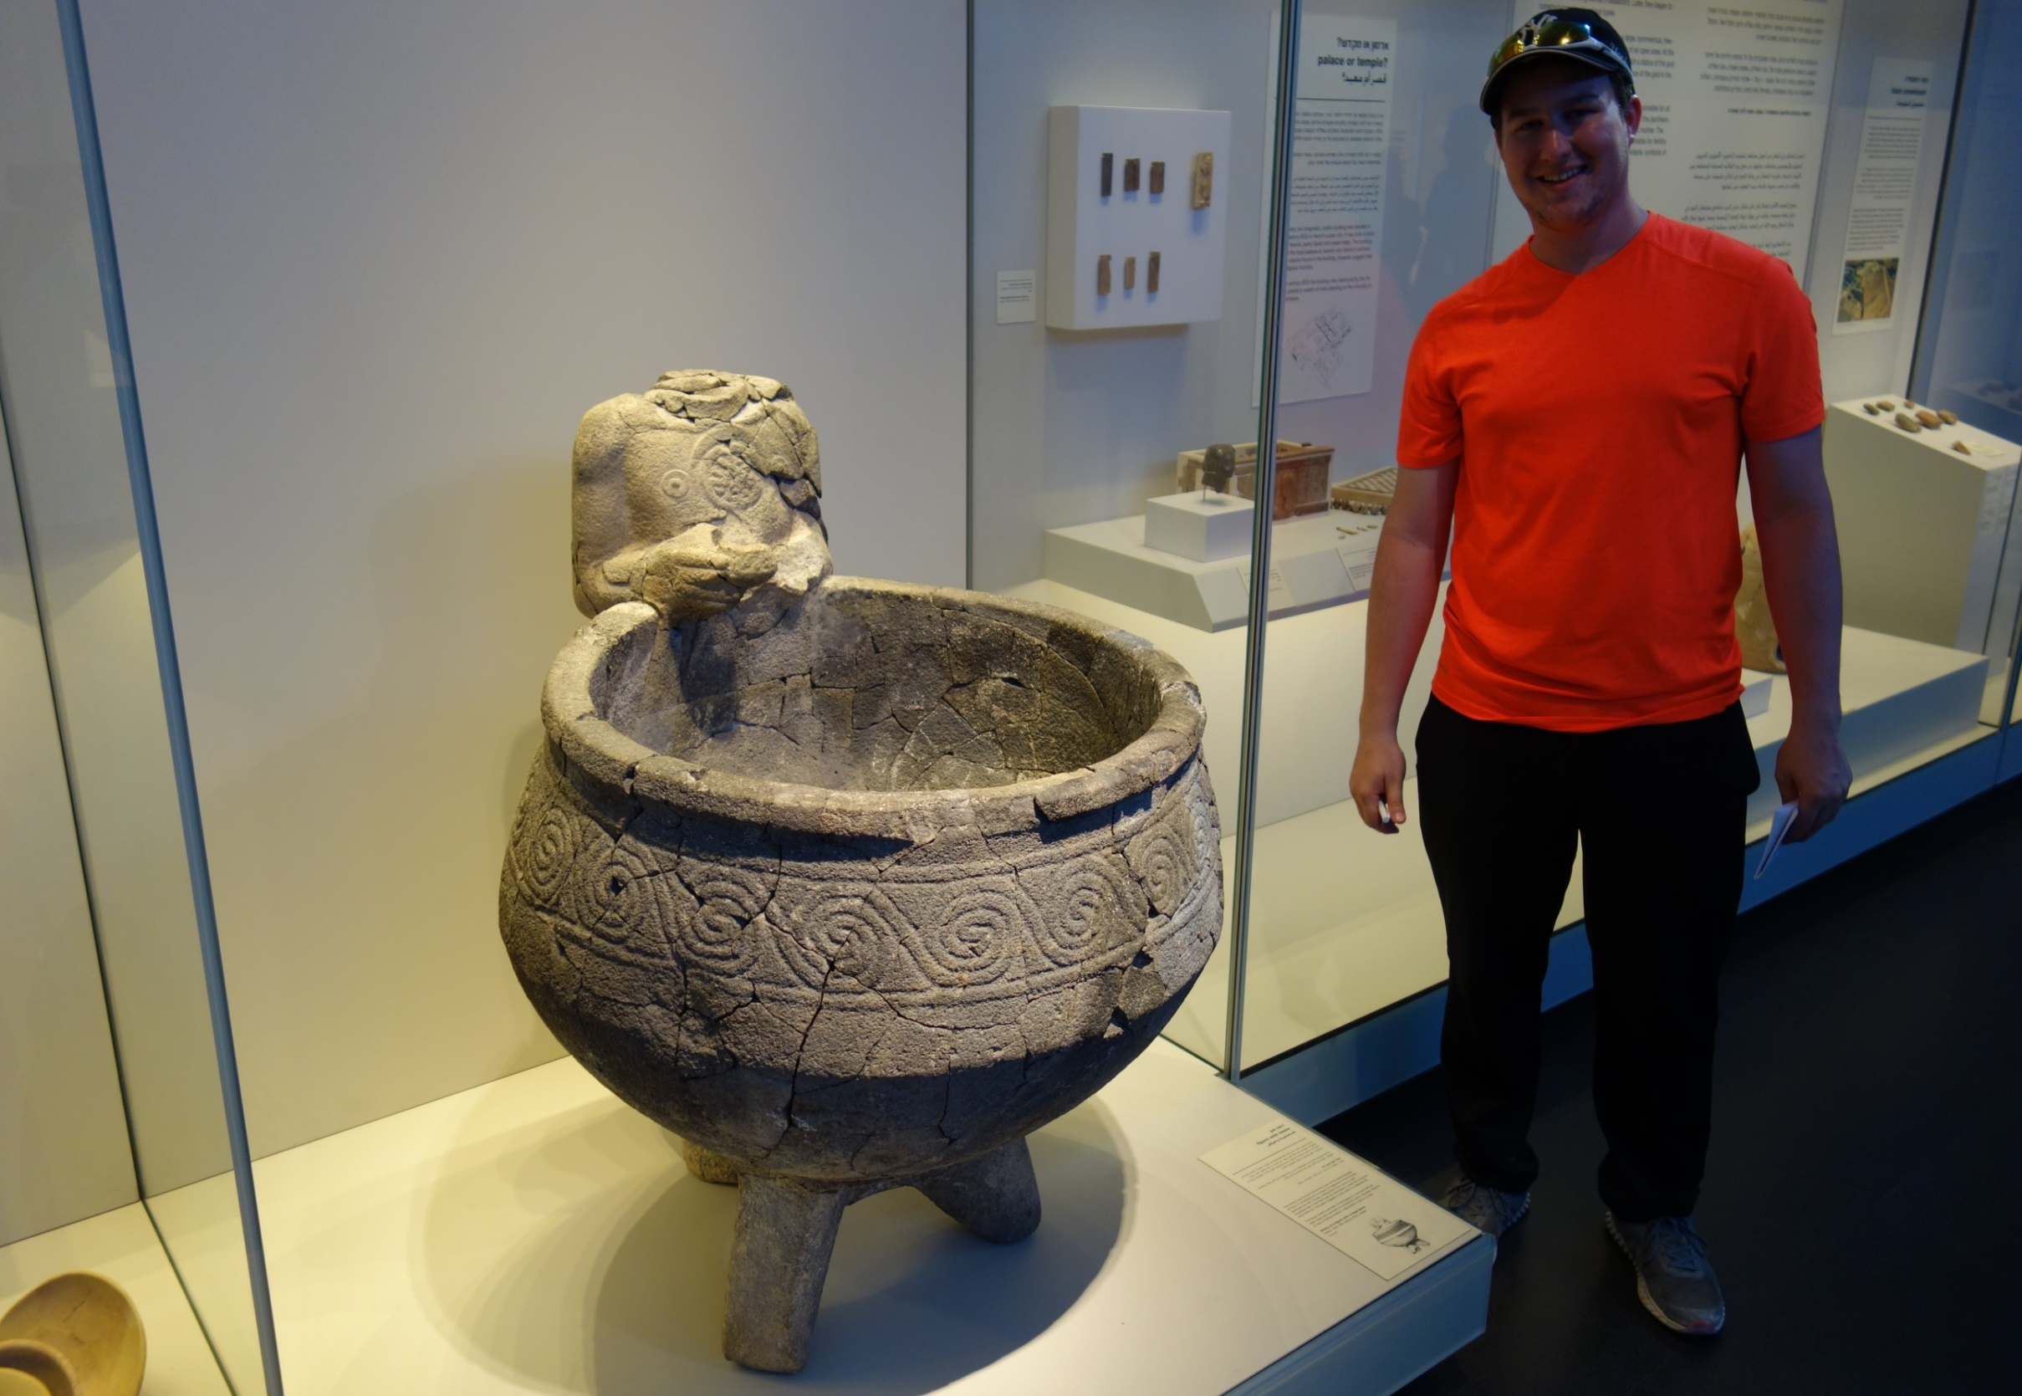

Slide 45
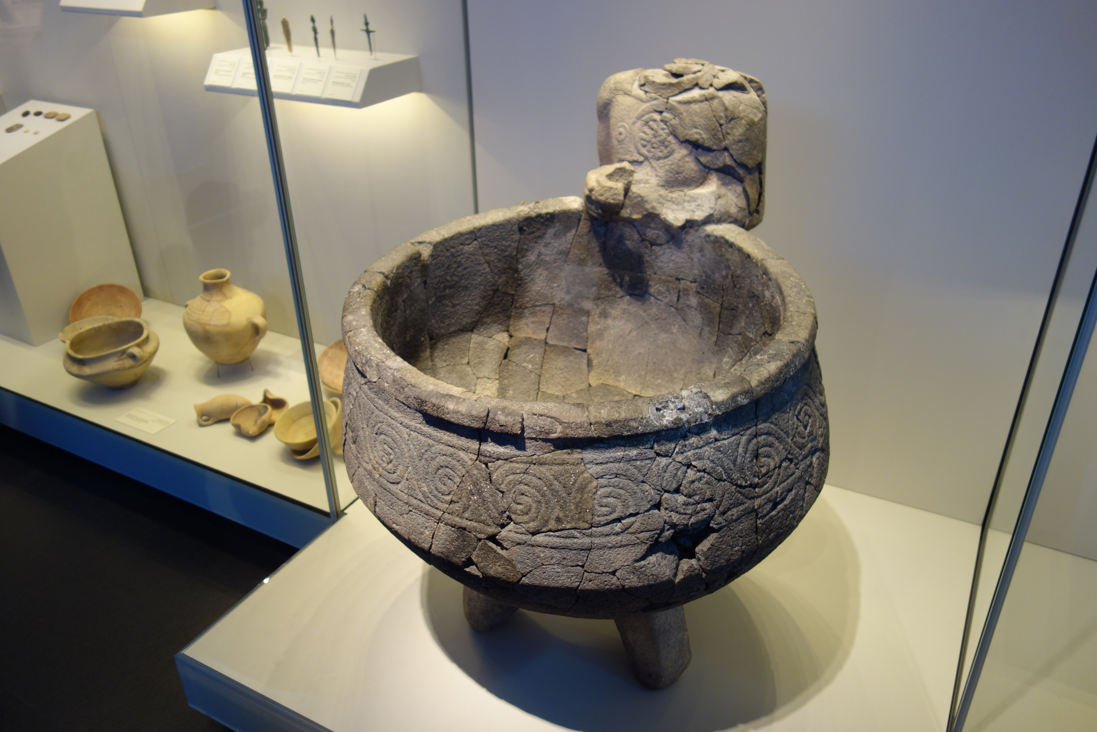

Slide 46
1 Kings 9:15 ¶ Now this is the account of the forced labor which King Solomon levied to build the house of the LORD, his own house, the Millo, the wall of Jerusalem, Hazor, Megiddo, and Gezer.

Slide 47
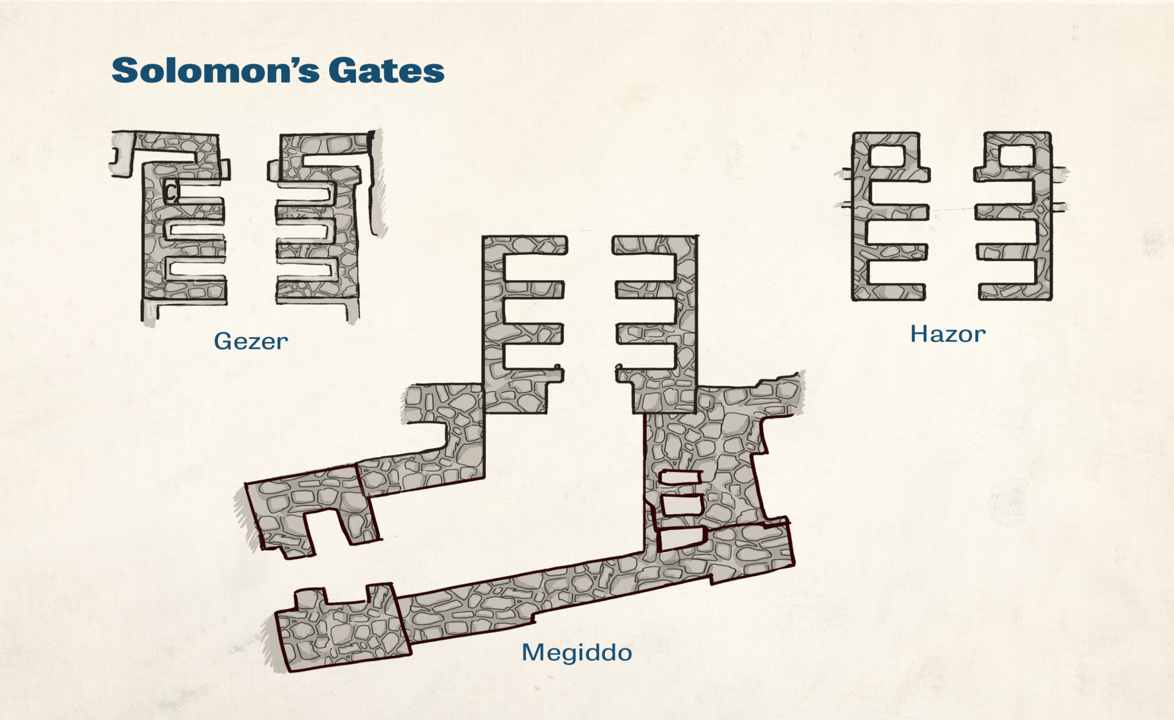

Slide 48
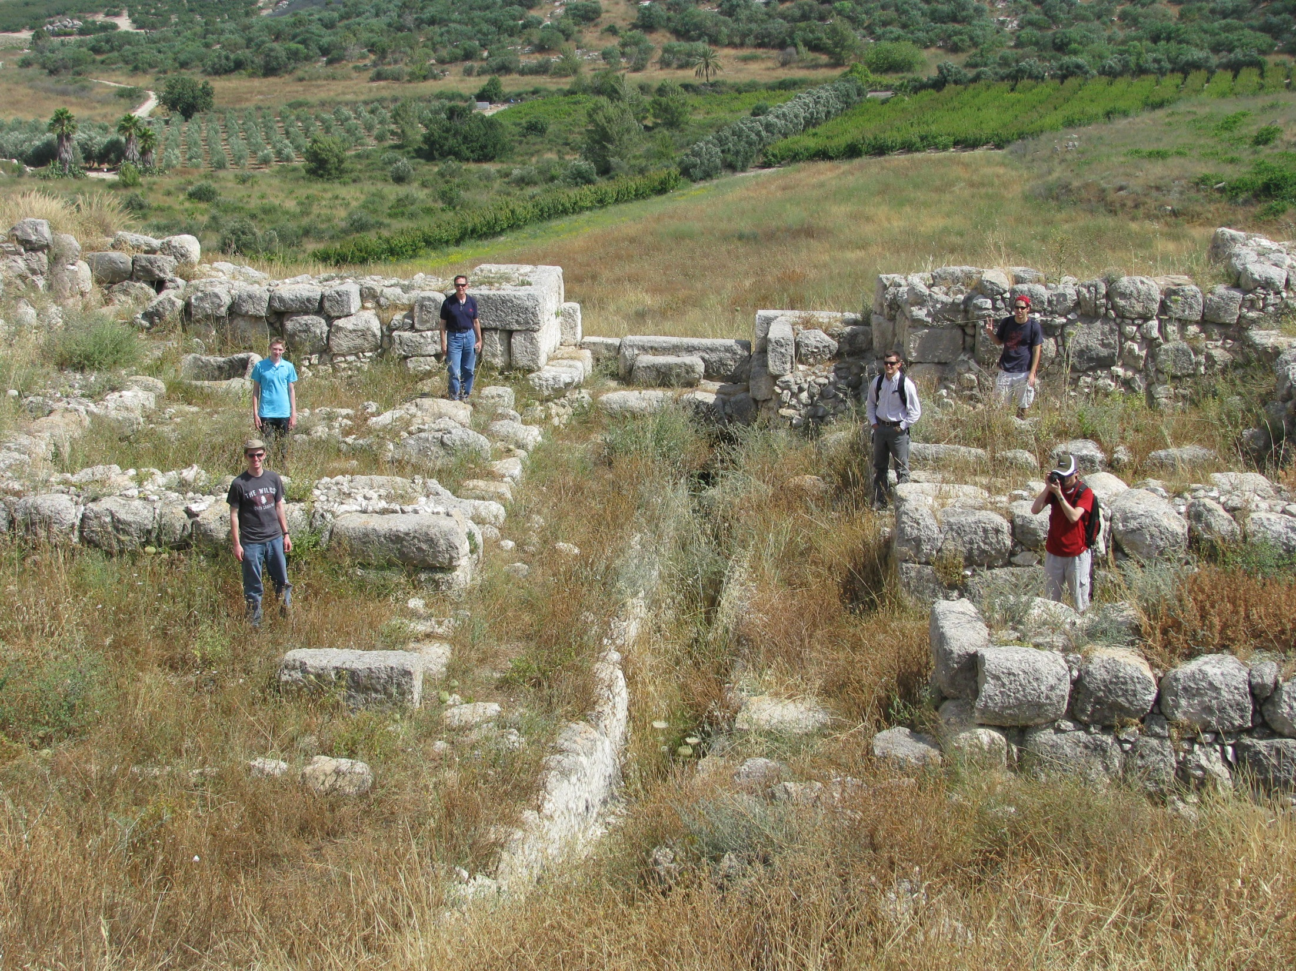

Slide 49
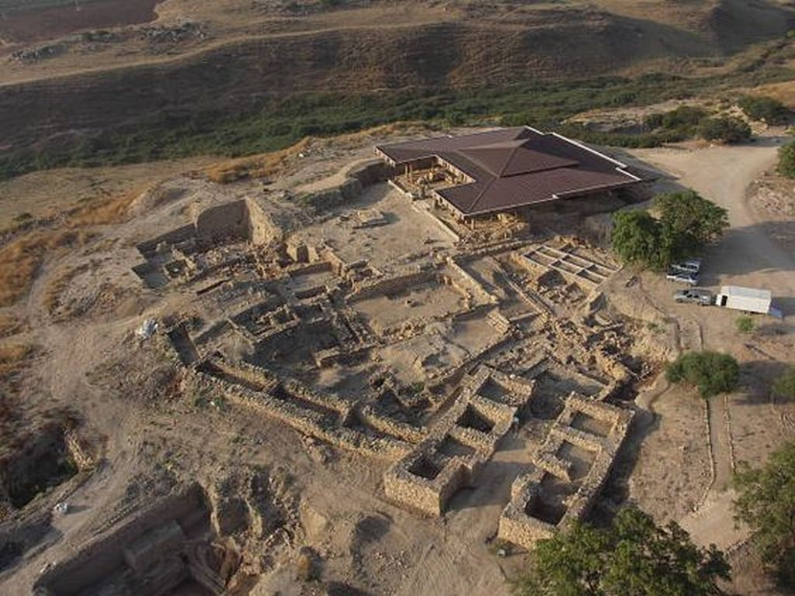

Slide 50
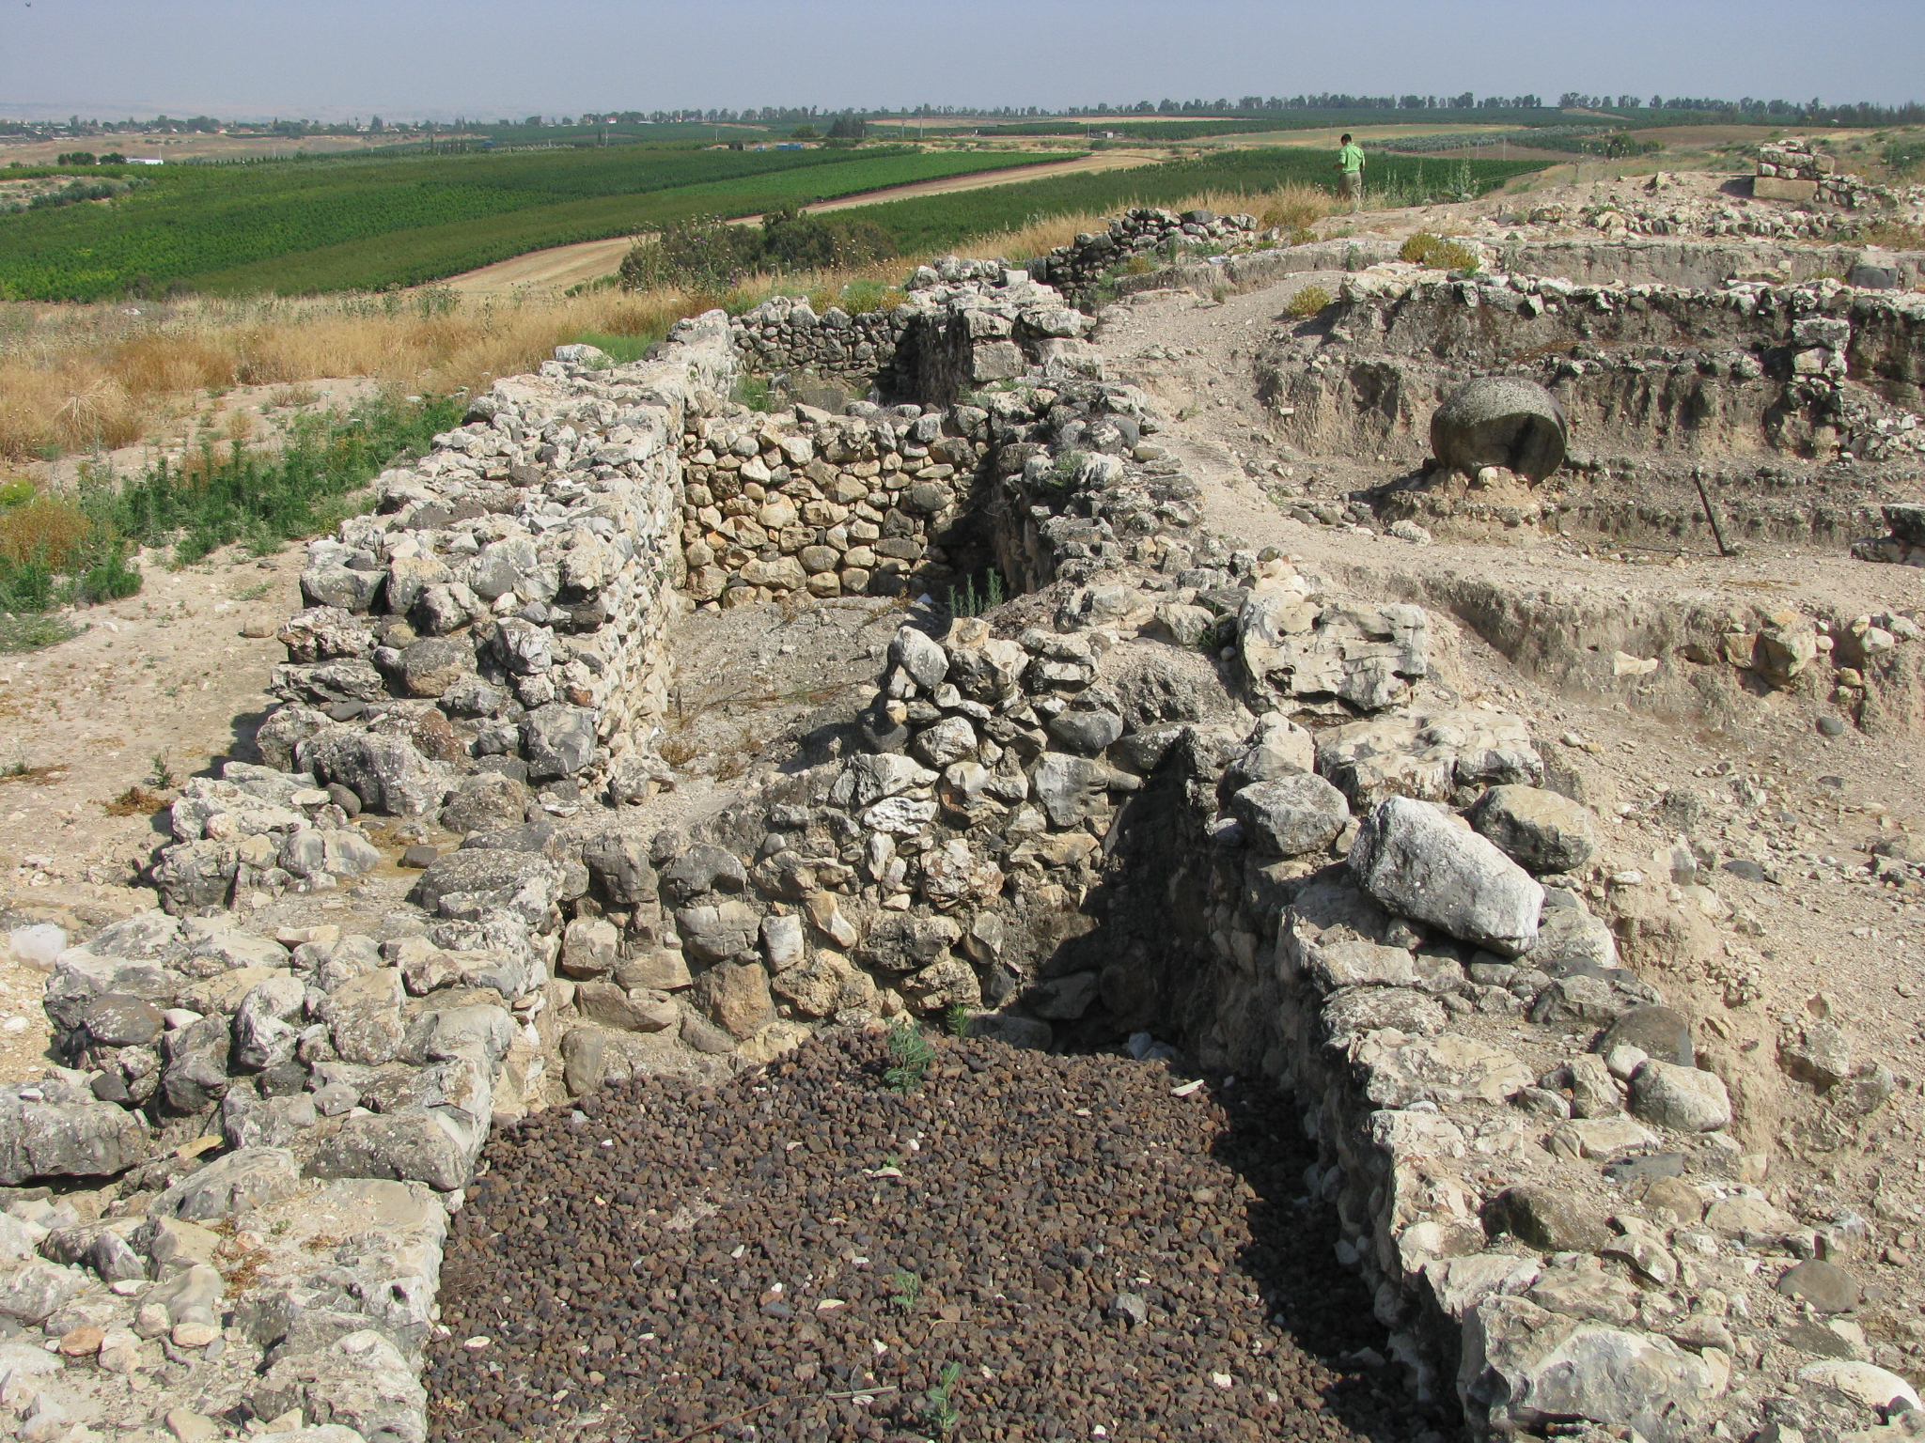

Slide 51
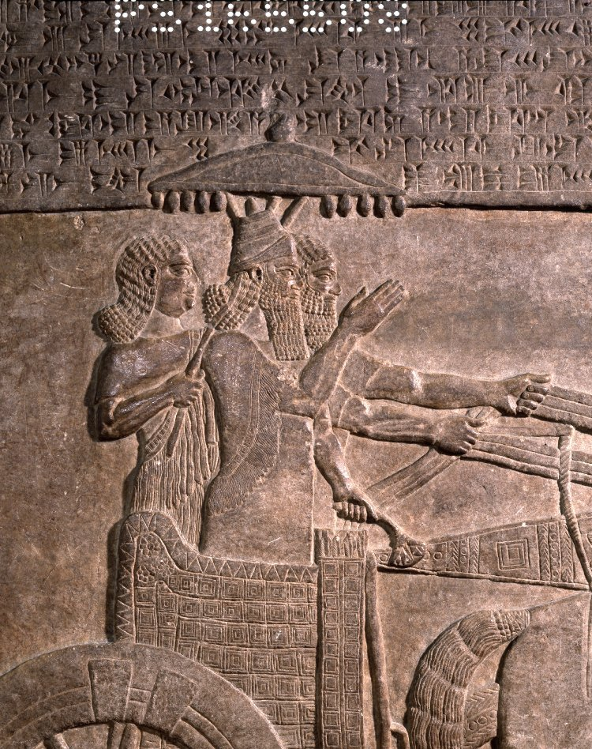
II Kings 15:29 In the days of
Pekah king of Israel, Tiglath-pileser king of Assyria came and captured Ijon and Abel-beth-maacah and Janoah and Kedesh and Hazor and Gilead and Galilee, all the land of Naphtali; and he carried them captive to Assyria.

Slide 52
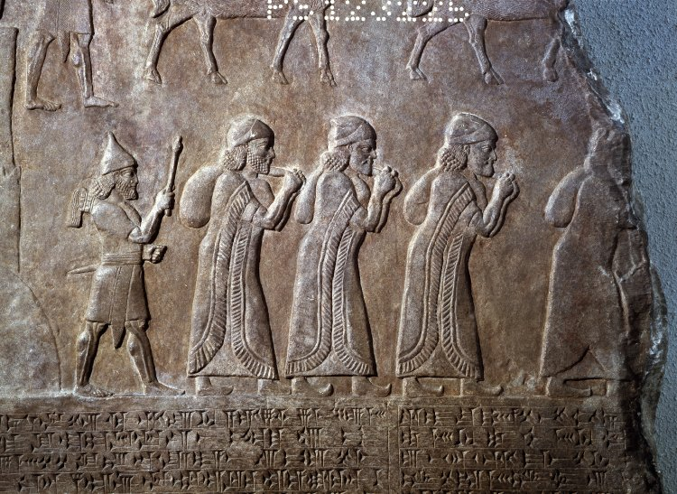

Slide 53
Jeremiah 49:30 "Run away, flee! Dwell in the depths, O inhabitants of Hazor," declares the LORD; "For Nebuchadnezzar king of Babylon has formed a plan against you And devised a scheme against you. . . ³³ "Hazor will become a haunt of jackals, A desolation forever; No one will live there, Nor will a son of man reside in it."

Slide 56
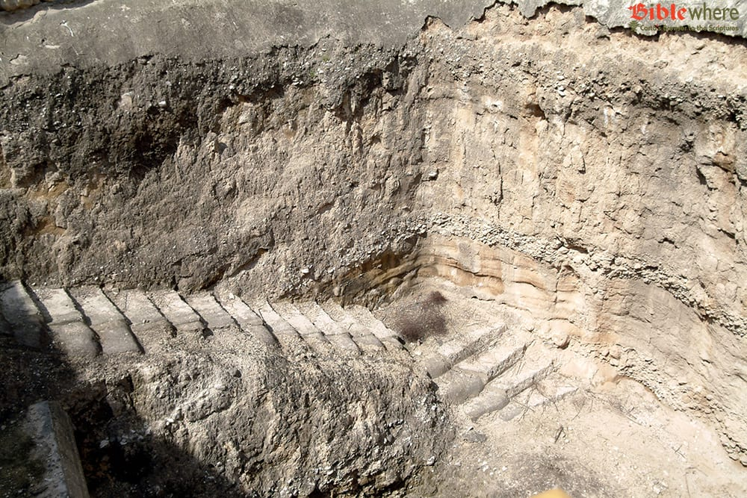

Slide 57
