Slide 1
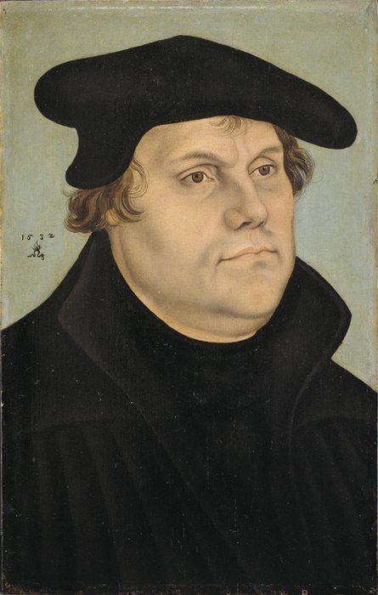
Martin Luther (1483-1546)
Portrait of Martin Luther,
by Lucas Cranach the Elder, 1532

Slide 2
Martin Luther (1483-1546)
John Wycliffe (died 1384)
Portrait of Martin Luther,
by Lucas Cranach the Elder, 1532

Slide 3
Martin Luther (1483-1546)
John Wycliffe (died 1384)
Columbus’ lst voyage (1492)
Portrait of Martin Luther,
by Lucas Cranach the Elder, 1532

Slide 4
Martin Luther (1483-1546)
John Wycliffe (died 1384)
Columbus’ lst voyage (1492)
Henry VIII (1491-1547)
Portrait of Martin Luther,
by Lucas Cranach the Elder, 1532

Slide 5
Martin Luther (1483-1546)
John Wycliffe (died 1384)
Columbus’ lst voyage (1492)
Henry VIII (1491-1547)
John Calvin (1509-1564)
Portrait of Martin Luther,
by Lucas Cranach the Elder, 1532

Slide 6
Martin Luther (1483-1546)
John Wycliffe (died 1384)
Columbus’ lst voyage (1492)
Henry VIII (1491-1547)
John Calvin (1509-1564)
Tyndale’s NT (1526)
Portrait of Martin Luther,
by Lucas Cranach the Elder, 1532

Slide 7
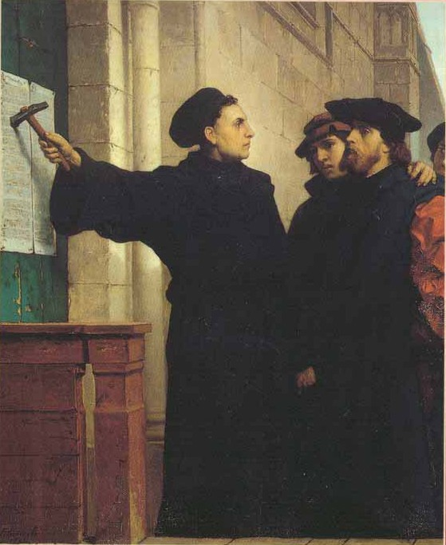
October 31, 1517

Slide 8
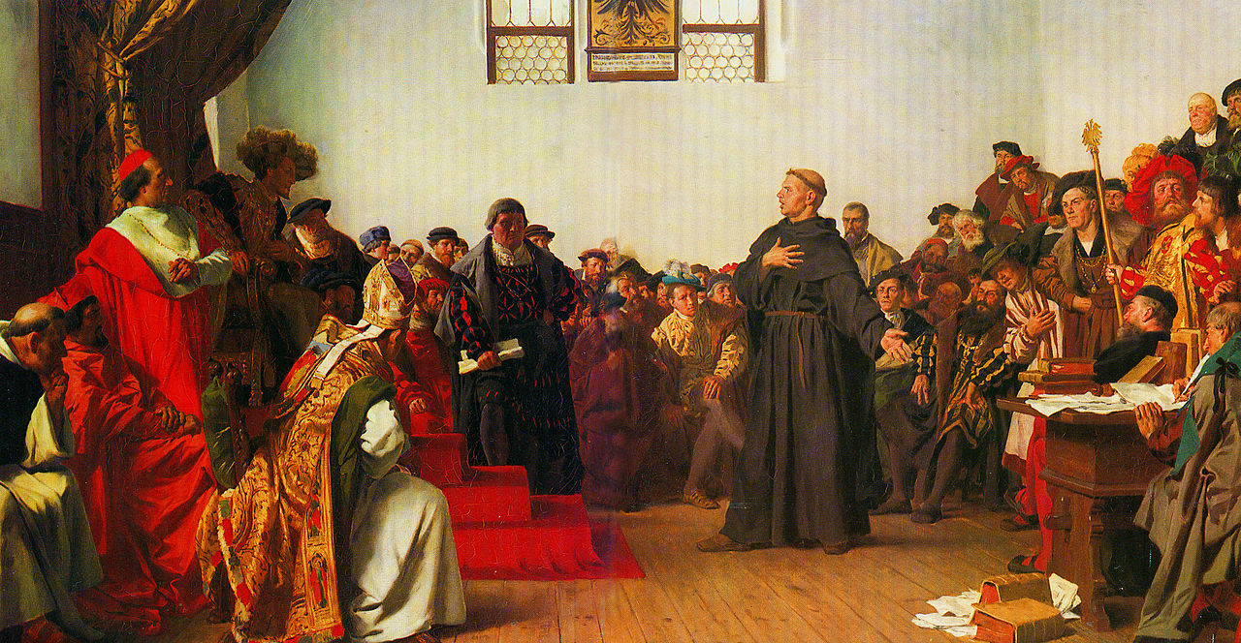
October 31, 1517

Slide 9
October 31, 1517
January to May, 1521

Slide 10
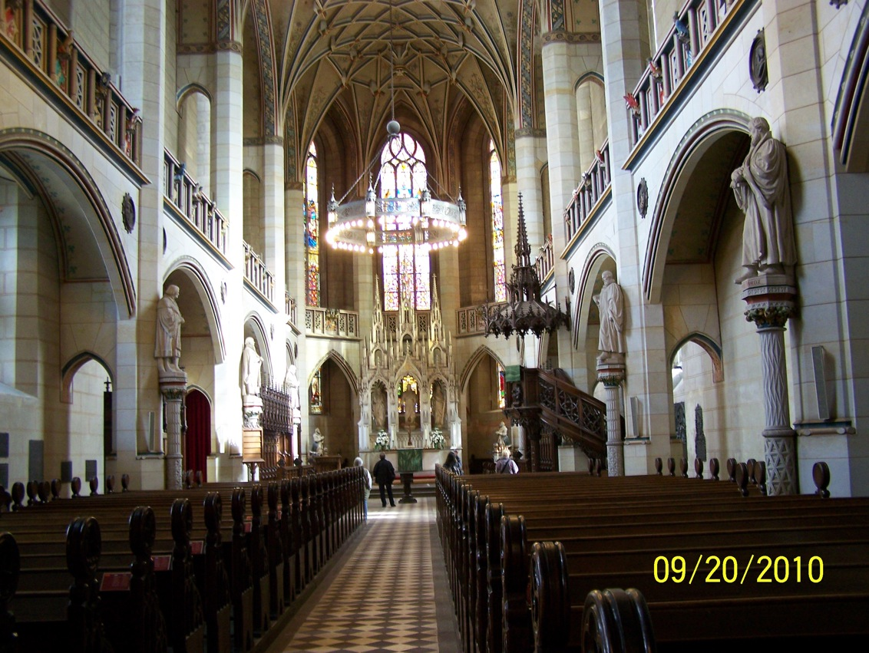
All Saints Church

Slide 11
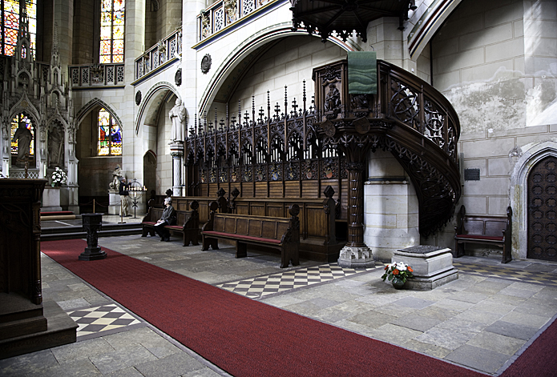

Slide 12
Exposition of the Lord’s Prayer (1519)
Personal Prayer Book (1522)
Small and Large Catechisms (1529)
A Simple Way to Pray (1535)

Slide 13
I cannot sufficiently admire the singular steadfastness, the happy attitude, the faith and hope of this man in serious times. But he nurtures this without surcease by diligent occupation with the divine Word. There is not a day on which he does not devote at least three hours, the very ones most suitable for studying, to prayer (Veit Dietrich).

Slide 14
Prayer is. . . the hardest work of all. . . a labor above all labors, since he who prays must wage a mighty warfare against the doubt and murmuring excited by the faintheartedness and unworthiness we feel within us.

Slide 15
WHY SHOULD WE PRAY?

Slide 16
WHY SHOULD WE PRAY?
God’s promises

Slide 17
WHY SHOULD WE PRAY?
God’s promises
Because he has promised that our prayer shall certainly be fulfilled.

Slide 18
WHY SHOULD WE PRAY?
God’s promises
Our needs and miseries

Slide 19
WHY SHOULD WE PRAY?
God’s promises
Our needs and miseries
To exercise/display our faith

Slide 20
First: God’s commandment

Slide 21
Thou shalt not take the name of the LORD, thy
God, in vain (Exodus 20:7).

Slide 22
Thou shalt not take the name of the LORD, thy
God, in vain (Exodus 20:7).
Pray, then, in this way. . . (Matthew 6:9).

Slide 23
Thou shalt not take the name of the LORD, thy
God, in vain (Exodus 20:7).
Pray, then, in this way. . . (Matthew 6:9).
Pray without ceasing (I Thessalonians 5:17).

Slide 24
Thou shalt not take the name of the LORD, thy
God, in vain (Exodus 20:7).
Pray, then, in this way. . . (Matthew 6:9).
Pray without ceasing (I Thessalonians 5:17).
I want the men in every place to pray (I Tim. 2:8).

Slide 25
We are as strictly and solemnly commanded to pray as we are to have no other God, to commit no murder and never to steal. Let no one think that it is all the same whether he prays or not, as do the uninstructed people in their delusion who say:

Slide 26
“Why should I pray? Who knows whether or not God will hear and regard my prayer? If I do not pray another will.”
And thus they fall into the habit of never praying (Large Catechism, Third Part. point 169).

Slide 27
This we must observe and remember above all things, and thereby silence and repel the thoughts which would deter or withhold us from prayer by the plea that prayer is a matter of little consequence or confined as a duty to those who are holier and more pleasing to God than we.

Slide 28
The human heart is by nature so perverse that it always flees from God, thinking that he is averse to our prayers because we are sinners and have merited only his wrath.

Slide 29
By this commandment he makes plain that he will not thrust us aside nor cast us out because we are sinners, but that he would rather draw us to himself and induce us to humble ourselves before him, to confess our misery and need, and pray for mercy and help.

Slide 30
We read in the Scriptures of his anger against those who, when punished for their sins, did not return to him and by prayer soften his anger and seek his mercy.

Slide 31
A child should beware of disobedience to parents; it should always reflect: “The work is one of obedience and what I do is done with the understanding that I move on the path of obedience and divine precept; on this I rest, of this I boast, therein I seek my pride, not because of my own worthiness, but because of the commandment.”

Slide 32
We allow ourselves to be led astray and deterred by thoughts like these: I am not holy enough, not worthy enough. If I were as godly and holy as St. Peter or St. Paul, I would pray.
Away with such thoughts!

Slide 33
The same commandment which bade St. Paul to pray applies to me; the second commandment is given just as much for my sake as for his. He can boast no better or holier commandment than I.

Slide 34
The prayer I offer is as precious, as holy and pleasing to God, as that of St. Paul and the holiest of saints. I freely admit that such a one is holier because of his person, but not because of his command. God does not value prayer on account of the person, but on account of his Word and the obedience shown.

Slide 35
WHY SHOULD WE PRAY?
God’s commandment
(Let this be the first and most necessary point to consider.)
God’s promises
Our needs and miseries
To exercise/display our faith

Slide 36
August 22, 1530
My dearest son:
I am glad to know that you learn well and pray hard. Keep on, my lad, and when I come home, I'll bring you a whole fair.
I know a lovely garden where many children in golden frocks gather rosy apples under the trees, as well as pears, cherries, and plums.

Slide 37
They sing, skip, and are happy. And they have fine ponies with golden bridles and silver saddles.
I asked the gardener who were these children, and he said, “They are the children who like to pray and learn and be good.”

Slide 38
And I said, “Good man, I too have a son, and his name is Hans Luther.
Couldn't he come into the garden, too, and eat the rosy apples and the pears and ride a fine pony and play with these children?”

Slide 39
And the man said, “If he likes to pray and learn and be good, he too may come into the garden, and Lippus and Jost [the sons of Melanchthon and Jonas] as well; and when they all come together, they shall have golden whistles and drums and fine silver crossbows."

Slide 40
But it was early, and the children had not yet had their breakfasts, so I couldn’t wait for the dance. I said to the man, “I will go at once and write all this to my dear son Hans that he may work hard, pray well, and be good, so that he too may come into this garden. But he has an Aunt Lena he’ll have to bring too.”

Slide 41
“That will be alright,” said he. “Go and write this to him.”
So, my darling son, study and pray hard and tell Lippus and Jost to do this too, so that you may all come together in the garden. May the dear God take care of you. Give my best to Auntie Lena and give her a kiss for me.
Your loving father

Slide 42
If you then, being evil, know how to give good gifts to your children, how much more will your Father who is in heaven give what is good to those who ask Him! --Matthew 7:11

