Slide 1
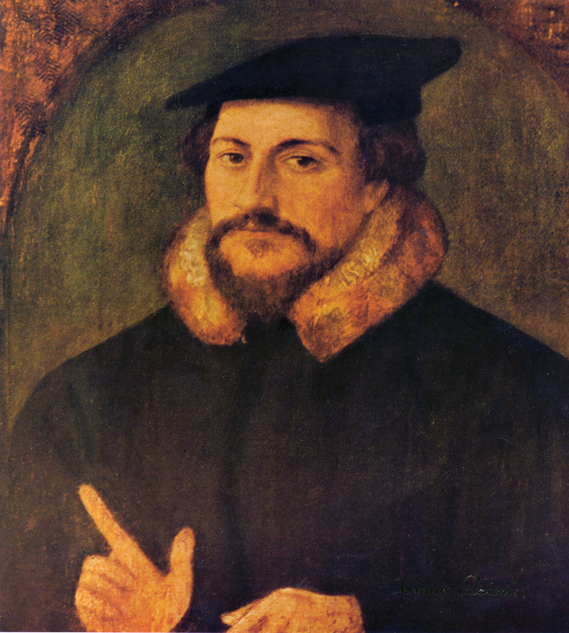
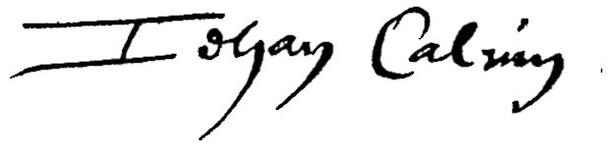
John Calvin was born in Noye, France in 1509

Slide 2
John Calvin 1509-1564

Slide 3
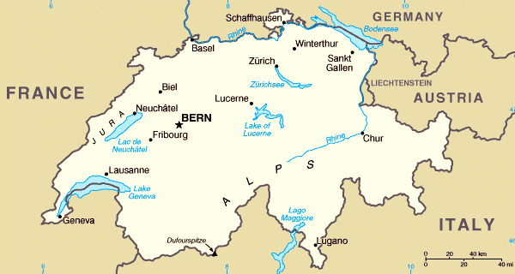

Slide 4
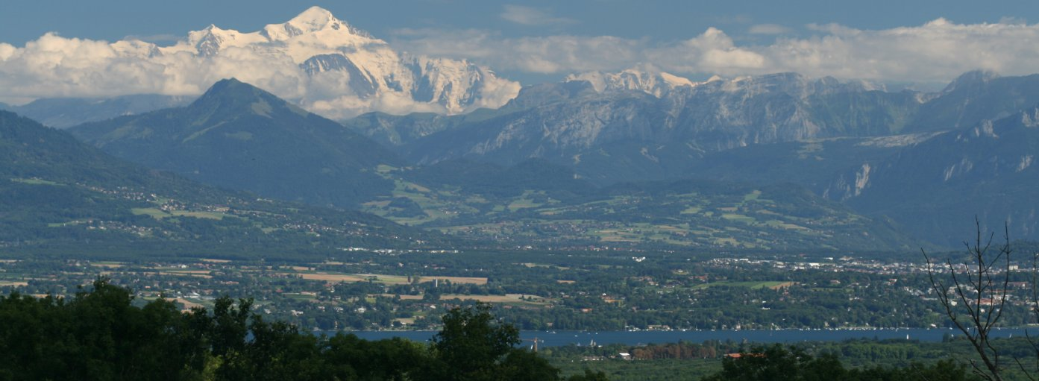

Slide 5
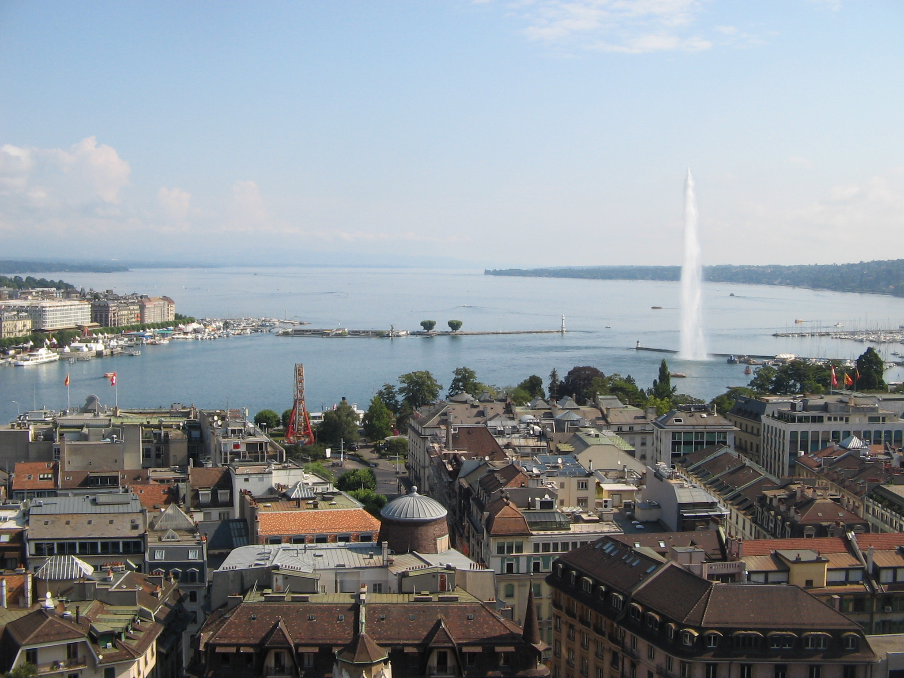

Slide 6
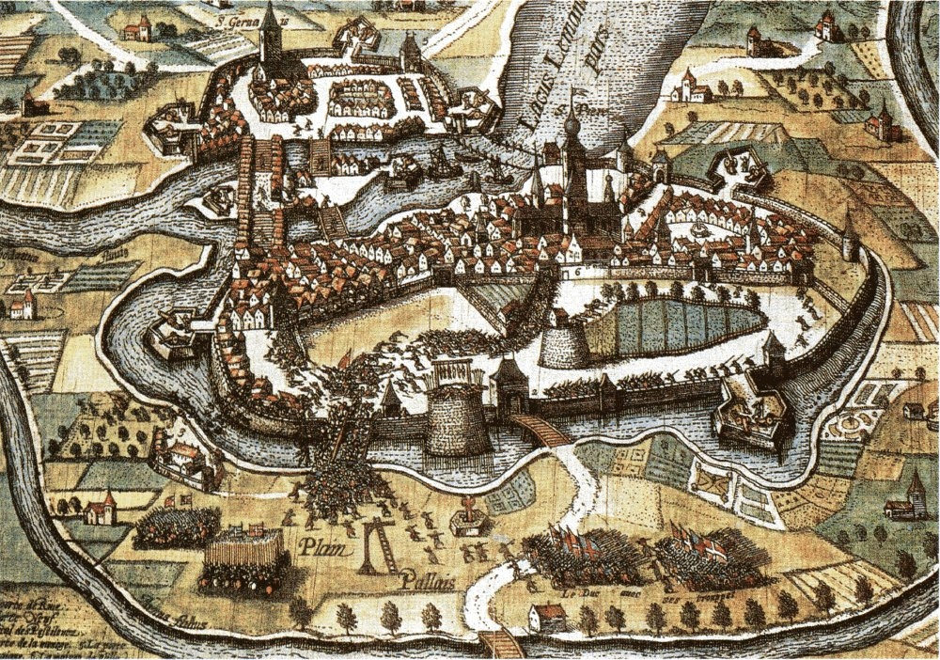

Slide 7
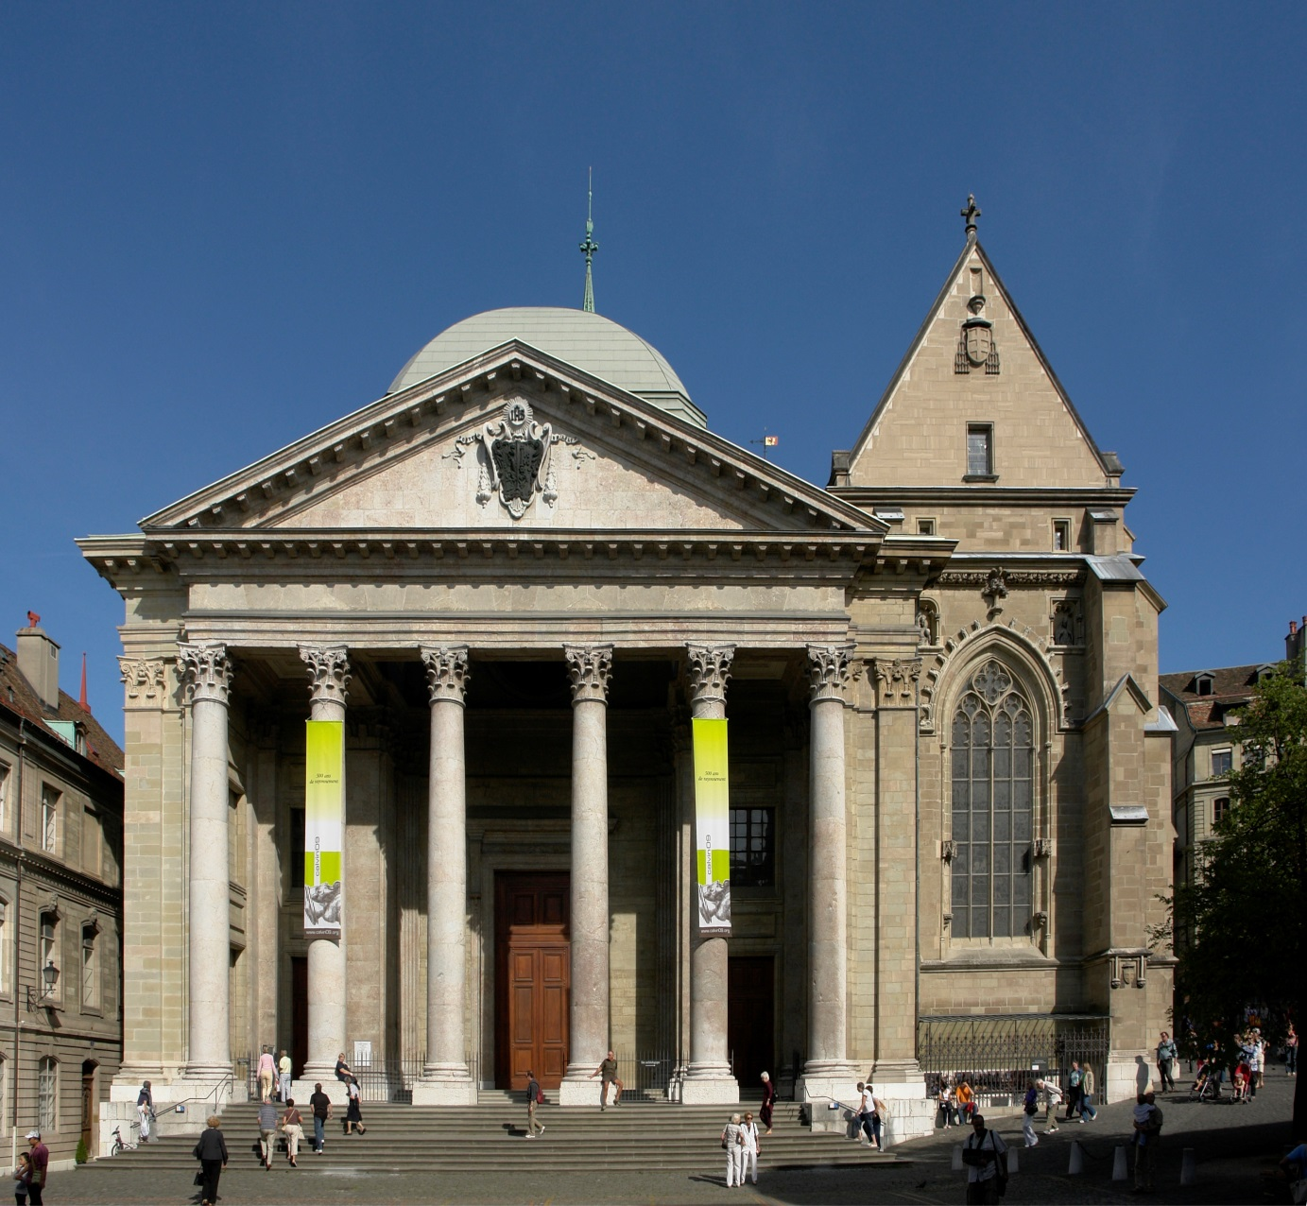

Slide 8
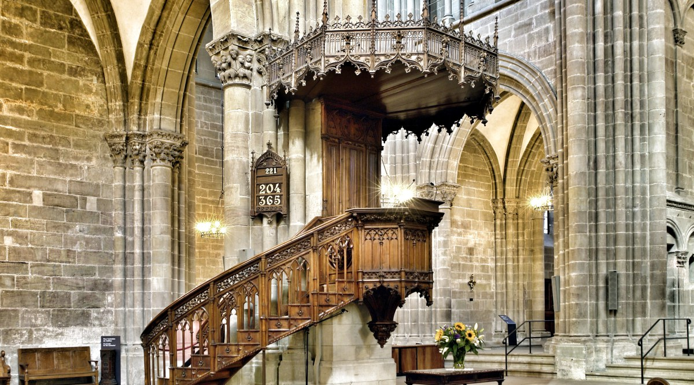

Slide 9
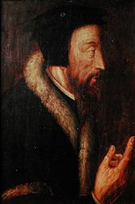
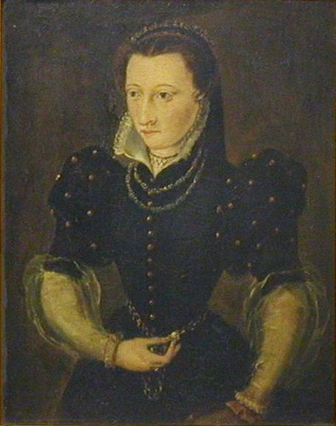

Slide 10
"O God of Abraham, and of all our fathers, in thee have the faithful trusted during so many past ages, and none of them have trusted in vain. I also will hope".
--March, 1549

Slide 11
“I draw my breath with difficulty and expect each moment to breathe my last. It is enough that I live and die for Christ, who is to all his followers a gain both in life and in death.”
--May 27, 1564

Slide 12
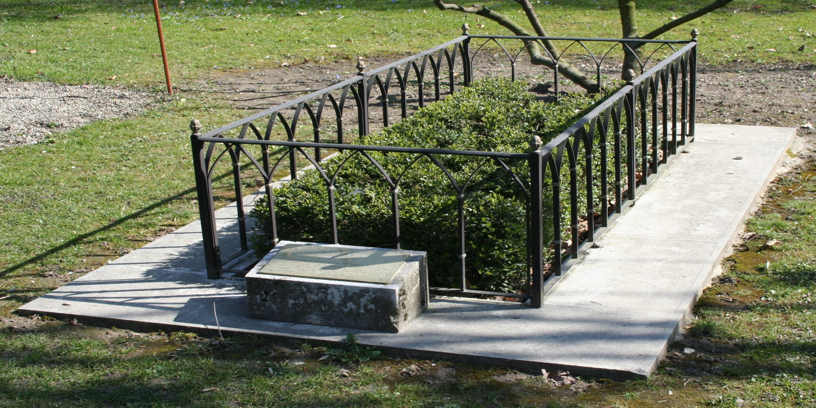

Slide 13
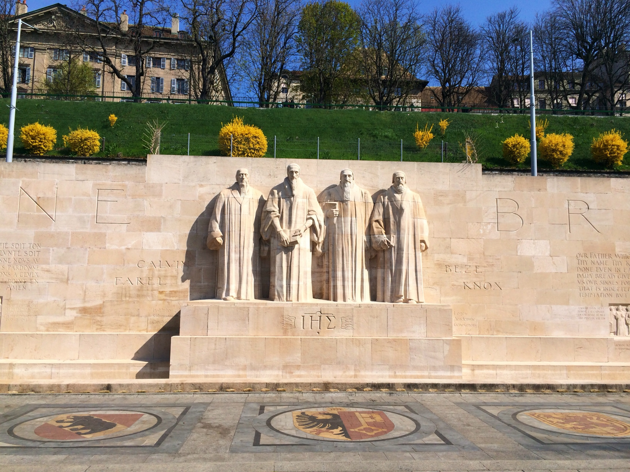

Slide 14
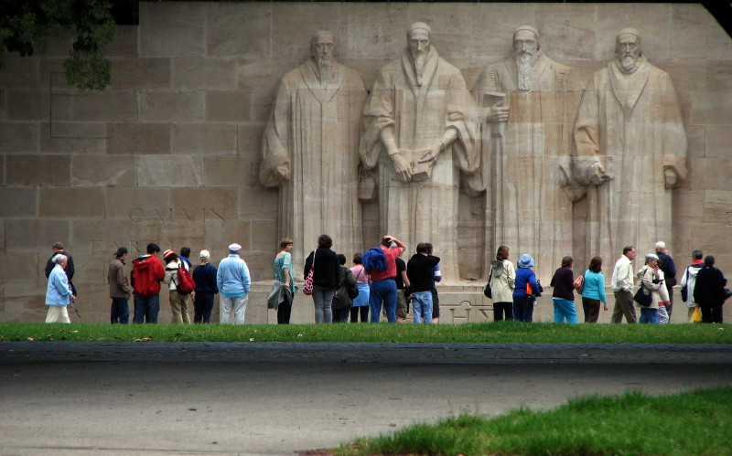

Slide 15
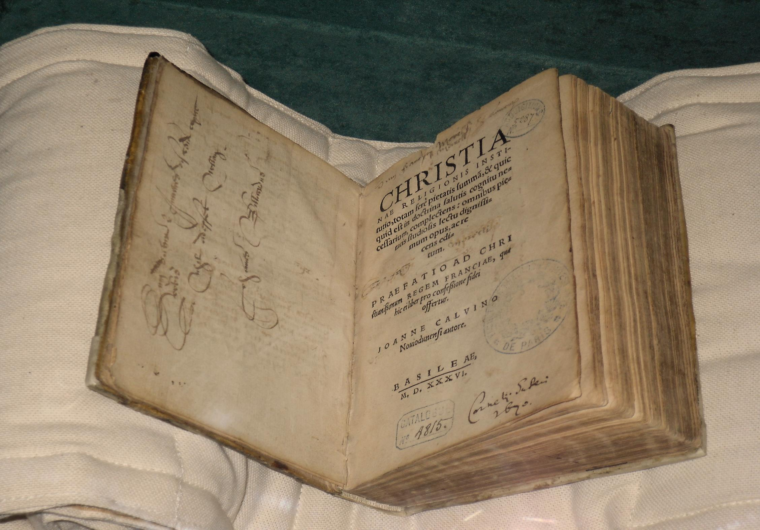

Slide 16
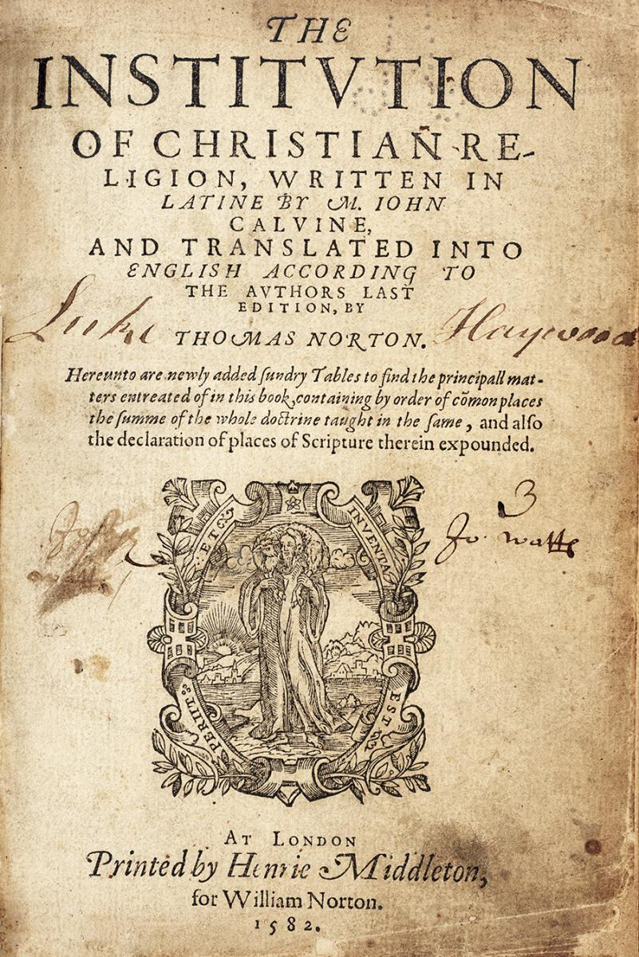

Slide 17
Chapter XX
Prayer, Which is the Chief Exercise of Faith. . .

Slide 18
. . . and by Which We Daily Receive God’s Benefits

Slide 19
What is the Relationship Between Our Faith in Christ and Prayer?

Slide 20


In Christ he offers all happiness in place of our misery, all wealth in place of our neediness; in him he opens to us the heavenly treasures that our whole faith may contemplate his beloved Son, our whole expectation depend upon him, our whole hope cleave to and rest in him. This, indeed, is that secret and hidden philosophy. . .

Slide 21
It remains for us to seek in him, and in prayers to ask of him, what we have learned to be in him.

Slide 22
To us nothing is promised to be expected from the Lord, which we are not also bidden to ask of him in prayers. So true is it that we dig up by prayer the great treasures that were pointed out by the Lord’s gospel, and which our faith has gazed upon.

Slide 23
We grow dull and stupid toward
our miseries.

Slide 24
We grow dull and stupid toward
our miseries.
He watches and keeps guard.

Slide 25
We grow dull and stupid toward
our miseries.
He watches and keeps guard.
And sometimes even helps us
unasked.

Slide 26
Why does
God Require Us
To Pray?

Slide 27
That our hearts may be fired with a burning desire ever to seek, love, and serve him, while we become accustomed in every need to flee to him. . .

Slide 28
To fan the flame of our love.
2 That there may enter our hearts no desire and no wish at all of which we should be ashamed to make him a witness, while we learn to set all our wishes before his eyes. . .

Slide 29
To enflame our love.
To winnow our wishes.
That we be prepared to receive his benefits with true gratitude of heart and thanksgiving, benefits that our prayer reminds us come from his hand.

Slide 30
To enflame our love.
To winnow our wishes.
To prepare our gratitude.
Having obtained what we were seeking, and being convinced that he has answered our prayers , we should be led to meditate upon his kindness more ardently.

Slide 31
To enflame our love.
To winnow our wishes.
To prepare our gratitude.
To provoke our meditation.
That at the same time we embrace with more delight those things which we acknowledge have been obtained by prayer.

Slide 32
To enflame our love.
To winnow our wishes.
To prepare our gratitude.
To provoke our meditation.
To increase our delight.
That use and experience may, according to the measure of our feebleness, confirm his providence.

Slide 33
To enflame our love.
To winnow our wishes.
To prepare our gratitude.
To provoke our meditation.
To increase our delight.
To confirm His providence.

Slide 34
What is the Relationship Between Our Faith in Christ and Prayer?
Why Does God Require Us To Pray?

Slide 35
What is the Relationship Between Our Faith in Christ and Prayer?
Why does God Require Us To Pray?
Why does God
Sometimes Seem to be Unresponsive?

Slide 36
Our most merciful Father, although he never sleeps or idles, still very often gives the impression of one sleeping or idling in order that he may thus train us, otherwise idle and lazy, to seek, ask, and entreat him to our great good.

Slide 37
That memorable saying of the psalm attests this, and to it many similar passages correspond, “For the eyes of the Lord are upon the righteous, and his ears are open toward their prayers” (Psalm 34:15).

Slide 38
And so both are true: “that the keeper of Israel neither slumbers nor sleeps” (Ps. 121:4), and yet that he is inactive, as if forgetting us, when he sees us idle and mute.

Slide 39
I Kings 18:41-42

Slide 43
