Slide 1
My house shall be called ‘a house of prayer’ for all the nations.
--Mark 11:17 (Isaiah 56:7)

Slide 2
Why Learn to Pray?

Slide 3
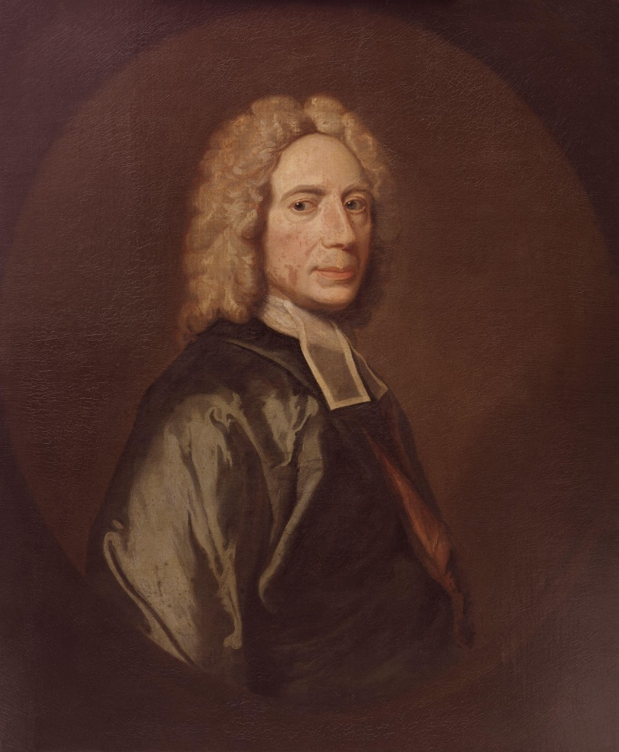


Slide 4
Prayer is the holy skill of conversation with God.

Slide 5
Why Learn to Pray?
Why Pray?

Slide 6
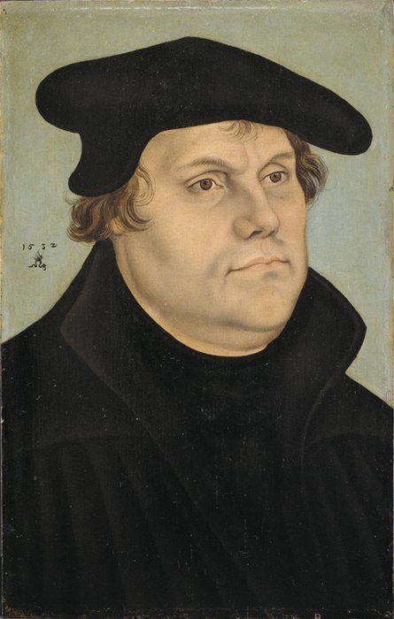
We are as strictly and solemnly commanded to pray as we are to have no other God, to commit no murder and never to steal. Let no one think that it is all the same whether he prays or not. . .

Slide 7
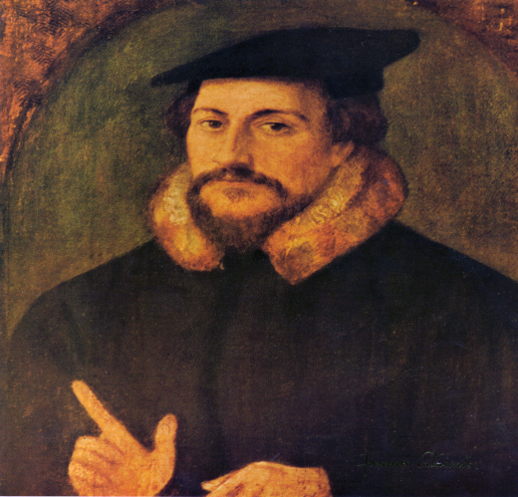
To enflame our love.
To winnow our wishes.
To prepare our gratitude.
To provoke our meditation.
To increase our delight.
To confirm His providence.

Slide 8
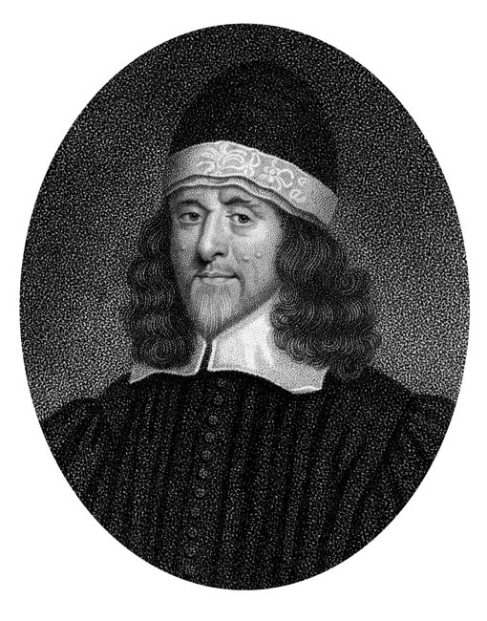
Have communion with Him as His friend.
When you come into his presence, be telling him how well thou lovest him.

Slide 9
Why Learn to Pray?
Why Pray?
What is Prayer?

Slide 10

Prayer is an offering up of our desires unto God, for
things agreeable to His will, in the name of Christ, with confession of our sins, and thankful acknowledgment of His mercies.

Slide 11
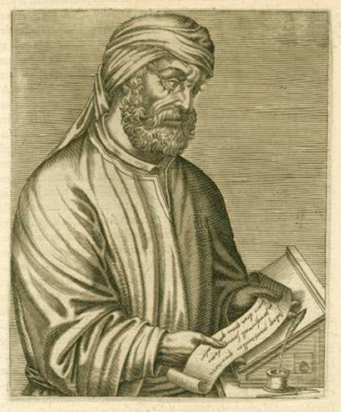
Jesus Christ’s teaching on prayer is new wine stored in new bottles.

Slide 12
God alone was competent to teach us how he wished to be prayed to.

Slide 13
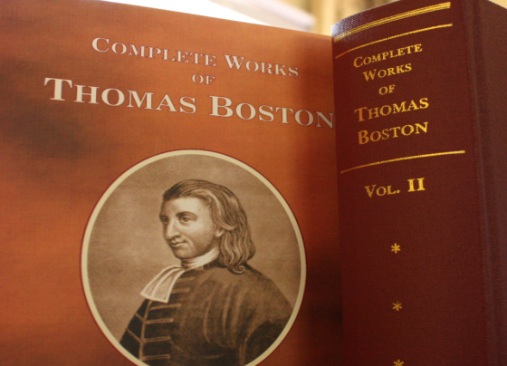
We must begin, carry on, and conclude our prayers in the name of Christ.

Slide 14
Commencing in His name:
We must go to God at Christ’s command, and by order from him.
Continuing in His name:
We must pray for Christ’s sake, as our motive.
Concluding in His name:
We must pray for Christ’s sake as the only procuring cause of the success of our prayers.

Slide 15
Why Learn to Pray?
Why Pray?
What is Prayer?
How to View Ourselves?

Slide 16
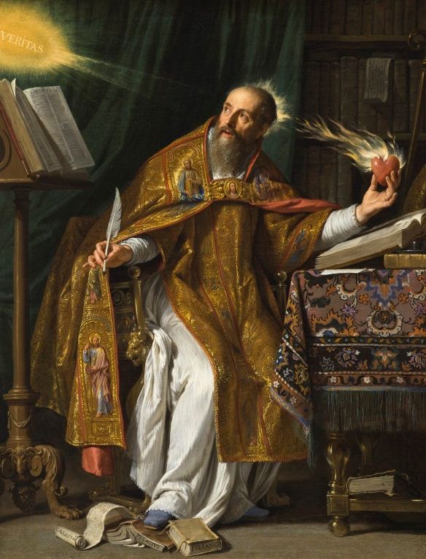
Letter CXXX (A.D. 412)
It becomes you, out of love to this true life to account yourself “desolate “ in this world, however great the prosperity of your lot may be.

Slide 17
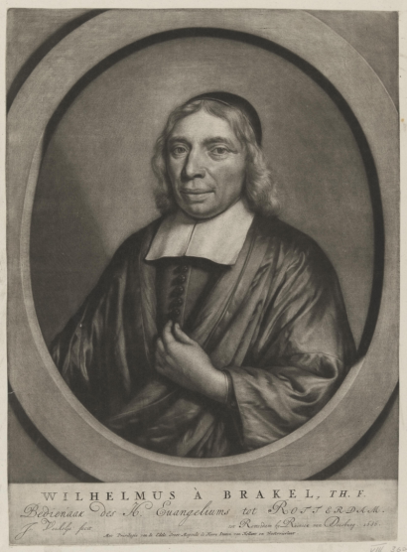
3 Objects of Attention:
1. Ourself
--impotent
He perishes from hunger. . . He also knows that no creature can give him this and he also does not desire to receive it from a creature.

Slide 18
3 Objects of Attention:
1. Ourself
--impotent
--unworthy

Slide 19
Why Learn to Pray?
Why Pray?
What is Prayer?
How to View Ourselves?
Unanswered Prayers?

Slide 20
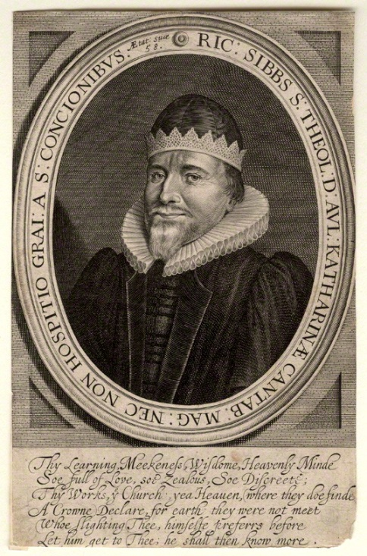
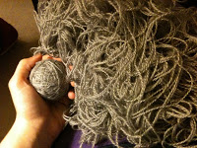
. . . I’ve prayed a long time
. . . I’m worse and worse
. . . I’m not heard
. . . I might as well quit
praying
The Knot of Prayer

Slide 21
The Knot of Prayer Loosed

Slide 22
Conditions on our part
(2)Limitations on God’s part

Slide 23
Conditions on our part
The thing prayed for must be
lawful.
Things must be asked and desired
in the right order.

Slide 24
Conditions on our part
(2) Limitations on God’s part
--The quality of the thing
--The timing for the thing

Slide 25
Why Learn to Pray?
Why Pray?
What is Prayer?
How to View Ourselves?
Unanswered Prayers?
Answered Prayers!

Slide 27
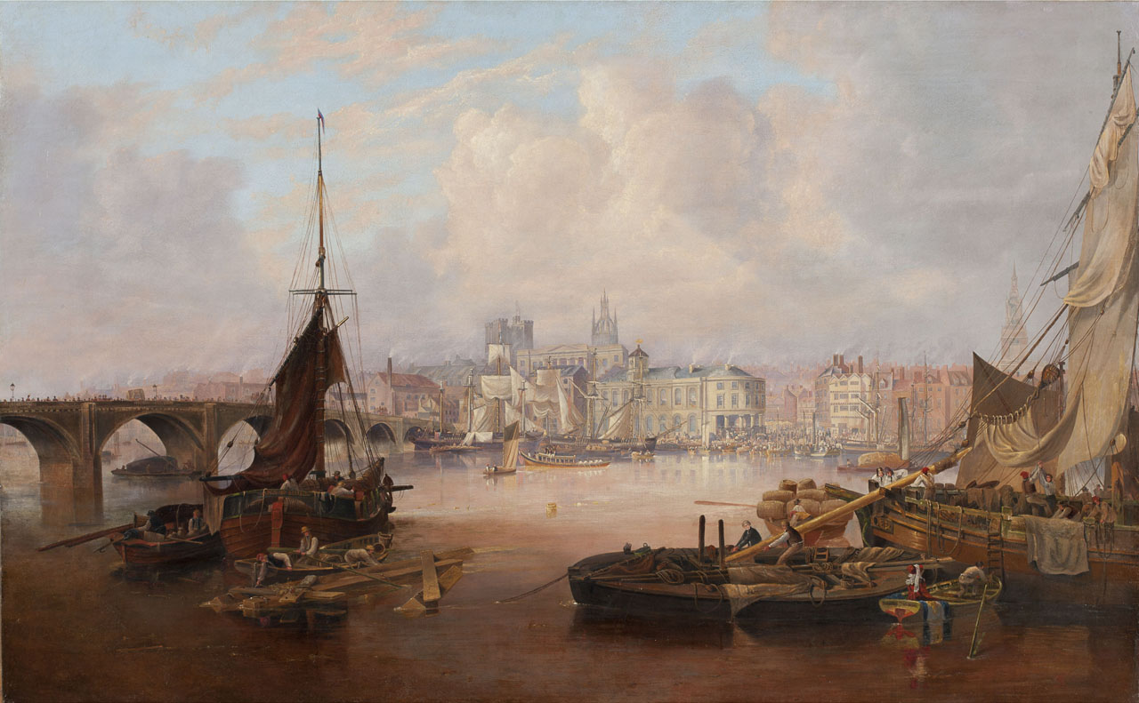

Slide 28
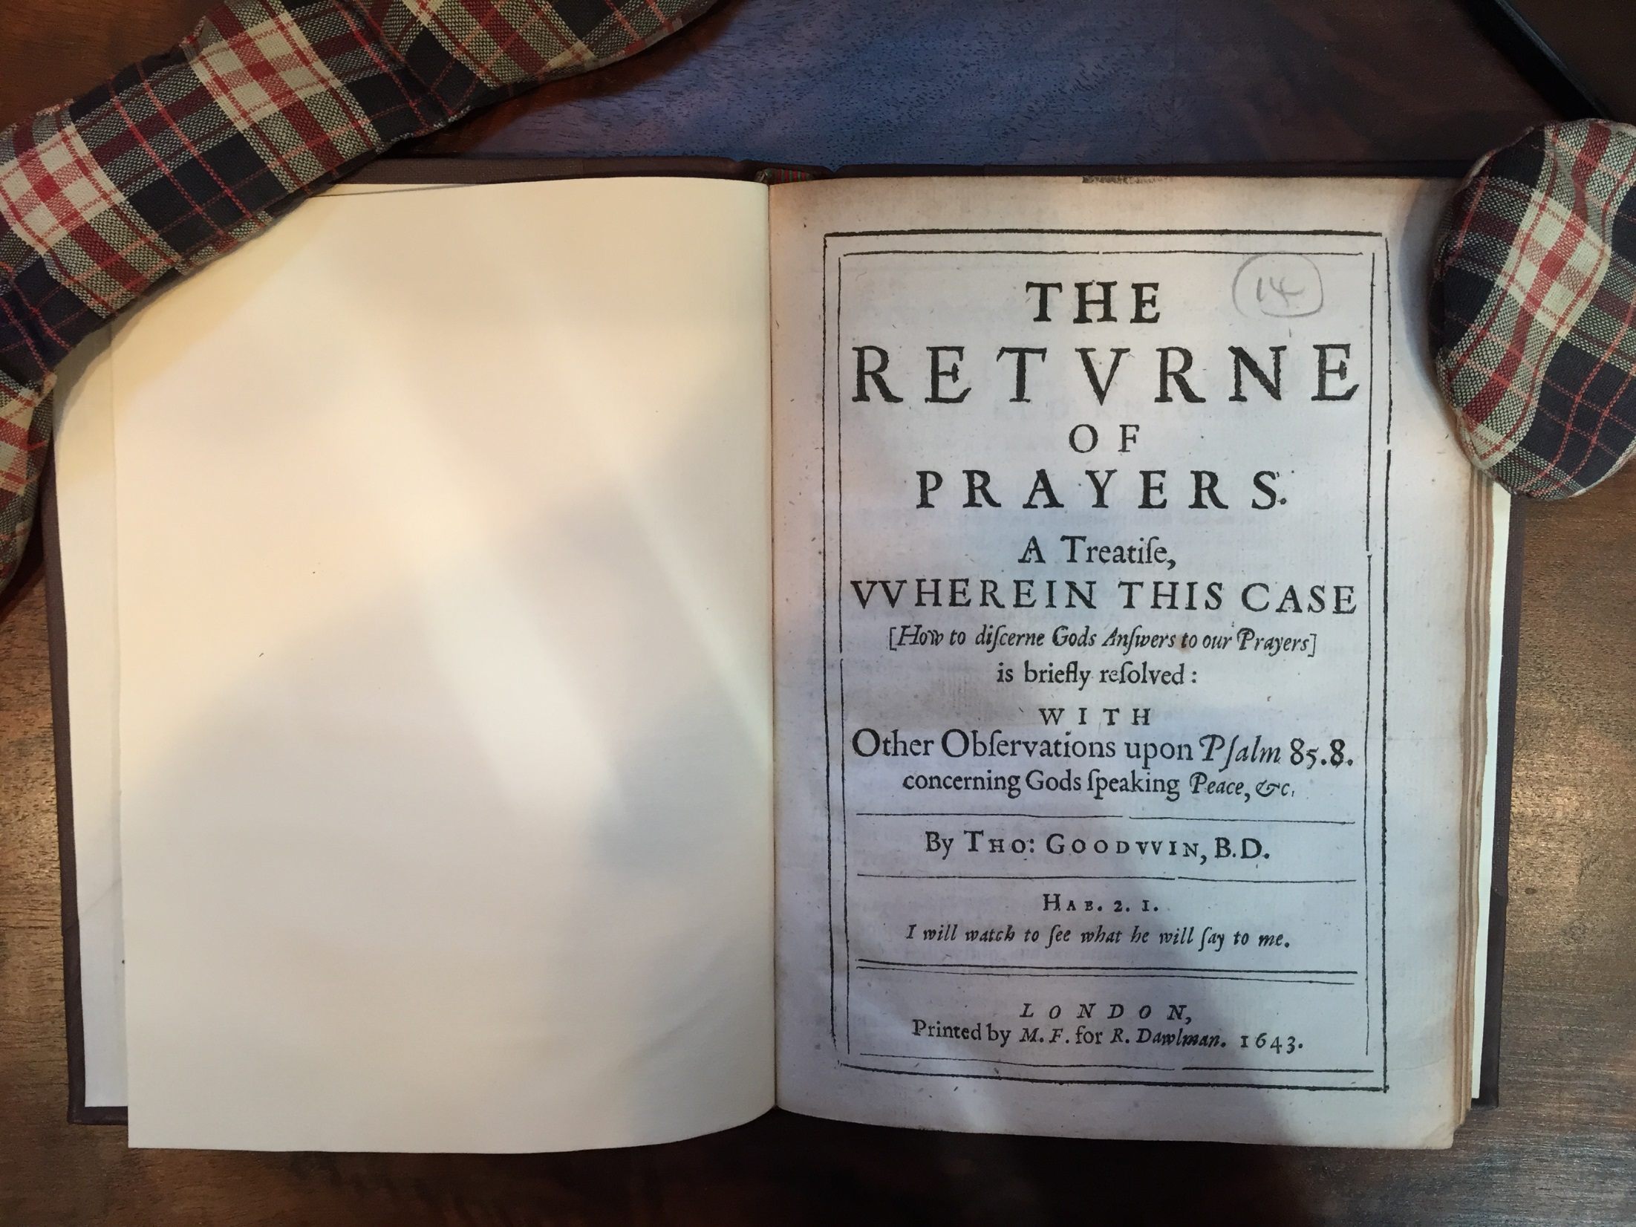

Slide 29
The reason that we pray so
much and give thanks so little is that we do not observe God’s answers when they come. We do not study them.

Slide 30
You are to “ask, and . . . receive, that your joy may be full” (John 16:24). By this means, even the smallest things which we enjoy or use become sources of comfort if they were obtained by prayer.

Slide 31


Why Learn to Pray?
Why Pray?

Slide 32



What is Prayer?
How to View Ourselves?
Unanswered Prayers?
Answered Prayers!

Slide 33
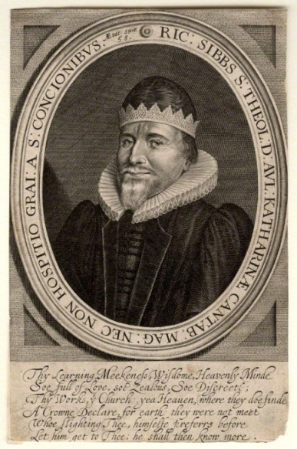
Unanswered Prayers?
Answered Prayers!

Slide 34
My house shall be called ‘a house of prayer’ for all the nations.
--Mark 11:17 (Isaiah 56:7)

