Slide 1
My house shall be called a house of prayer for all the nations.
--Mark 11:17 (Isaiah 56:7)

Slide 2
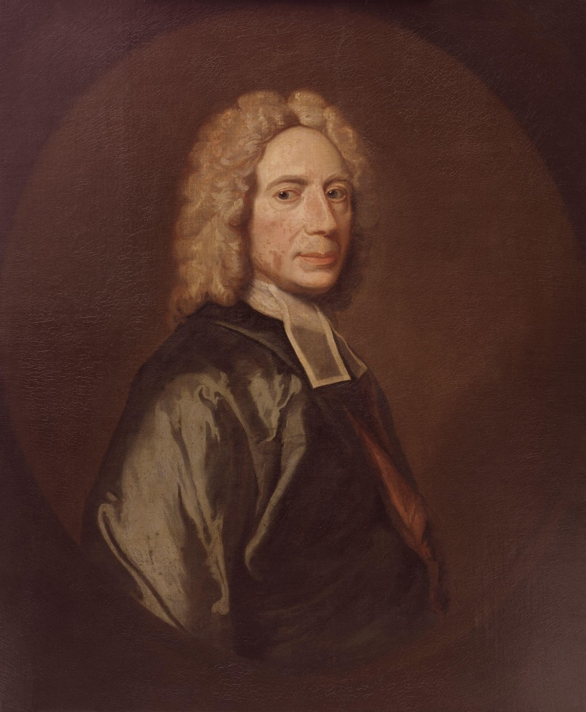


Slide 3
Prayer is the holy skill of conversation with God.

Slide 4
There are children who can only cry after their father and stammer out a broken word or two by which he can understand their meaning.

Slide 5
But these are ungrown infants. The father would rather see his children advancing to manhood and occupying themselves daily with that broad and free conversation with himself which he allows and to which he graciously invites them.

Slide 6
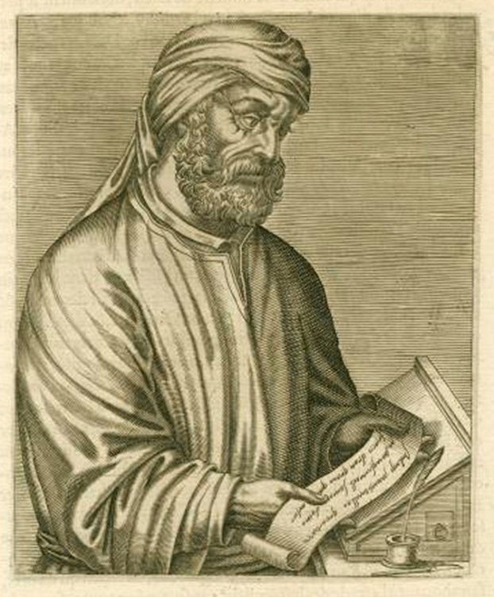
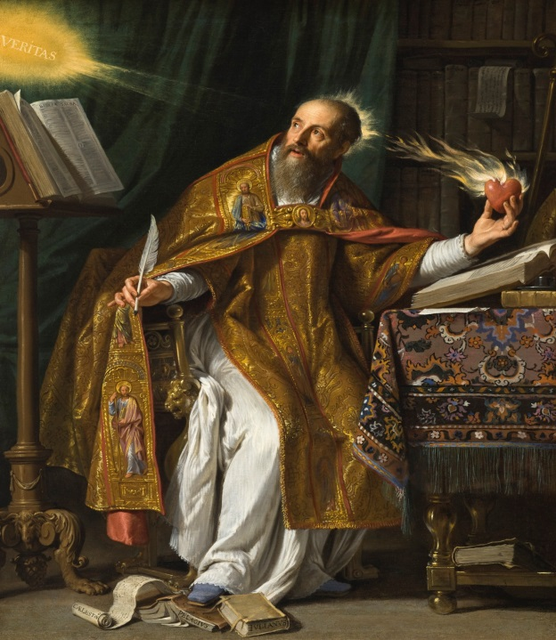
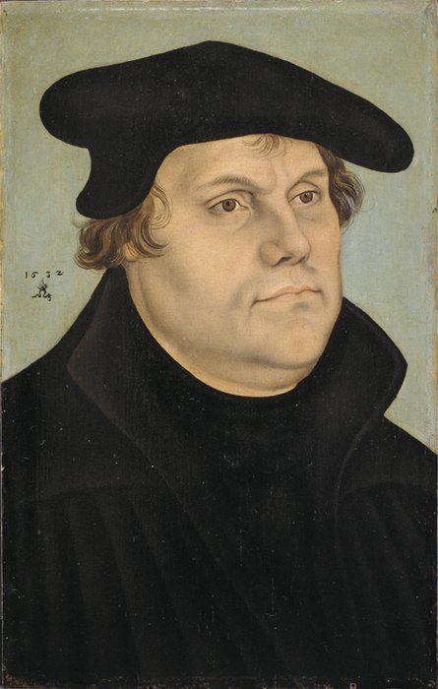
Luther 1483-1546 AD
Tertullian 160-220 AD
Augustine 354-430 AD

Slide 7
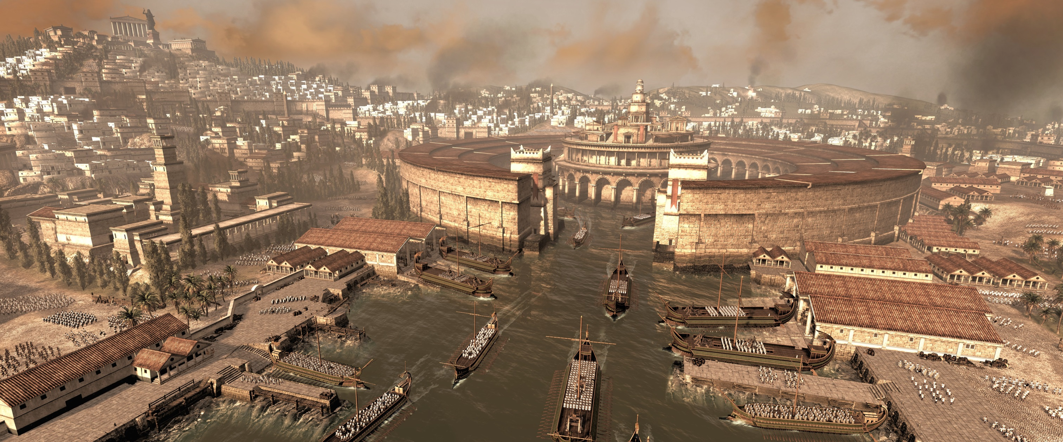

Tertullian (160-220)

Slide 8
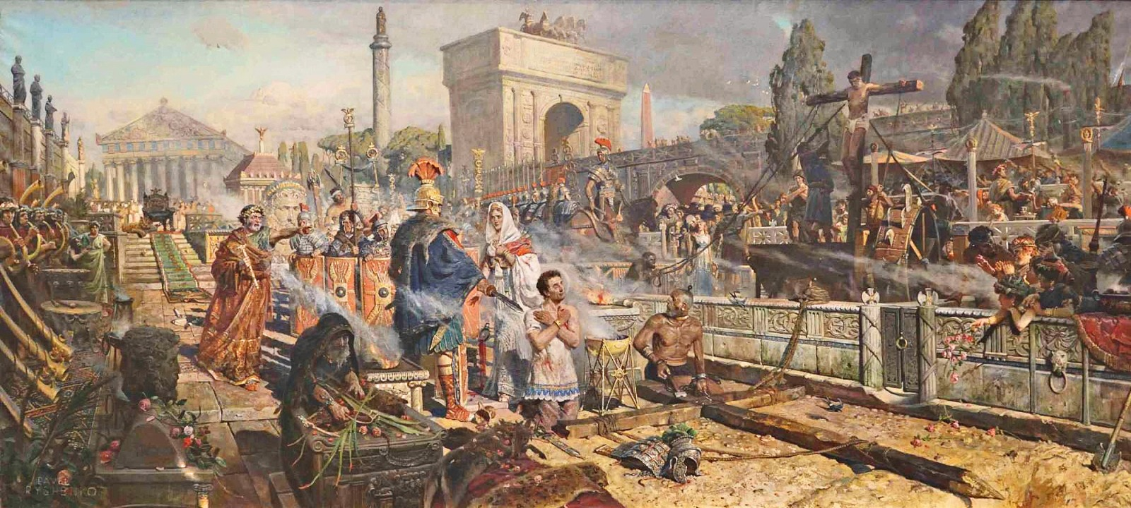

Slide 9
Tertullian (160-220)
Defender of the Faith
To heretics, Against Praxeas
To pagans, Apology
The more you mow us down, the more we multiply. The blood of the Christians is seed.

Slide 10

Apology
Having refuted the charges laid against us, let me now show what we really are. We are a body knit together by one faith, one discipline and one hope.

Slide 11
We meet together as a congregation, uniting together to offer prayer to God. We pray for the emperors and all in authority, for the welfare of the world, for peace and for the delay of the final end.

Slide 12
Jesus Christ’s teaching on prayer is new wine stored in
new bottles.

Slide 13
The old prayer, no doubt, brought deliverance from fire and wild beasts and hunger, while yet it had not received its pattern from Christ. Then how much more fully operative is the Christian prayer?

Slide 14
It does not establish the angel of the dew in the midst of the fire, nor block the mouths of lions, nor transfer to the hungry the peasant’s dinner. It turns away by delegated grace no perception of suffering. . .

Slide 15
. . . Yet it arms with endurance those who do suffer and perceive and grieve. It makes grace multiply in power, so that faith may know what it obtains from the Lord, while it understands what, for God’s name, it is suffering.

Slide 16
Moreover, of old time prayer induced plagues, put to flight the hosts of the enemy, withheld the benefits of rain. . .

Slide 17
Now, however, the prayer of righteousness turns aside the whole wrath of God, keeps watch on behalf of foes, makes supplication for persecutors.

Slide 18
It was Christ’s wish for it to work no evil. He has conferred upon it all power concerning good.

Slide 19
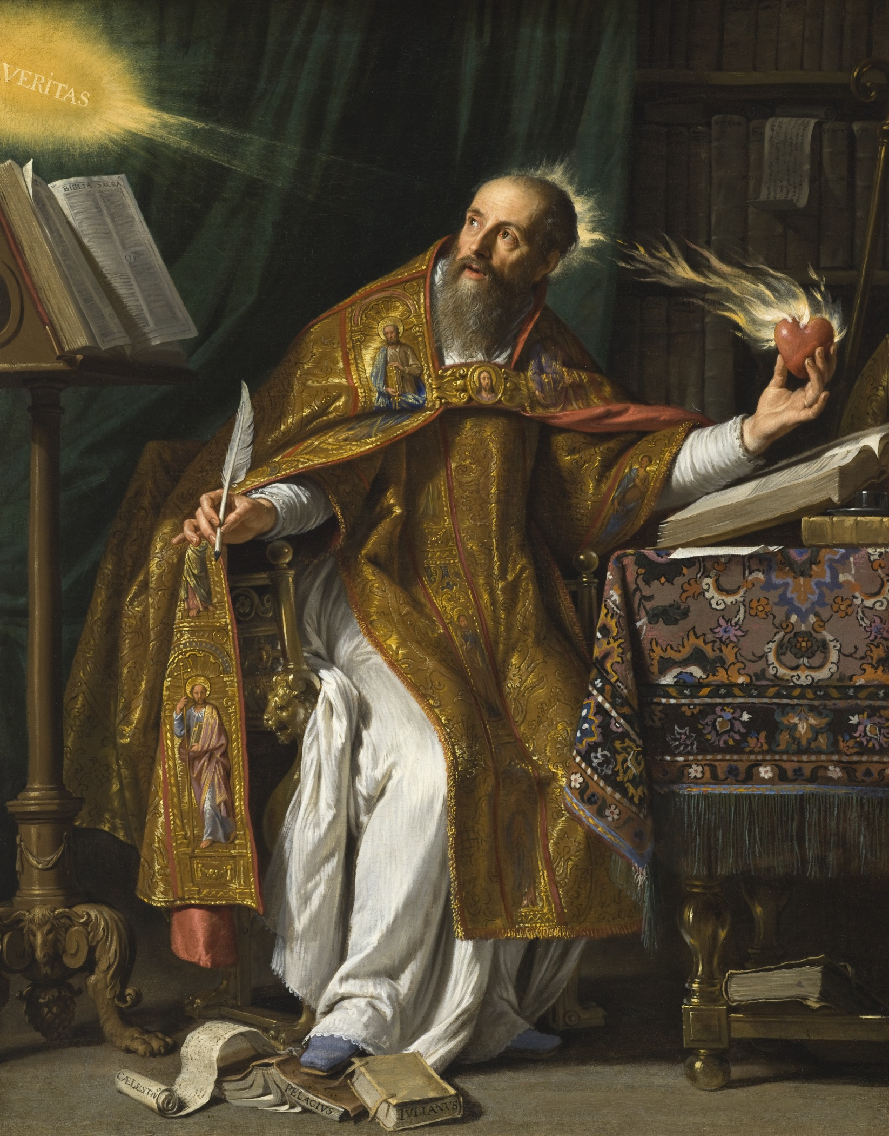
Augustine (354-430)

Slide 20
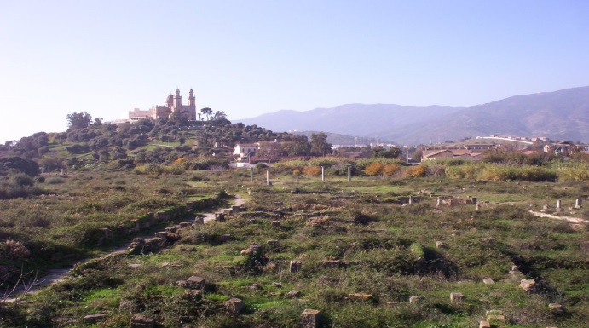

Letter CXXX
(A.D. 412)
What Manner of Person You Should Be
Augustine

Slide 21
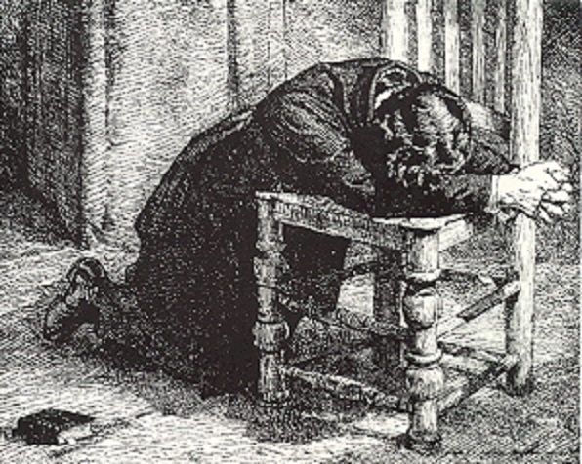

Slide 22
Letter CXXX
(A.D. 412)
It becomes you, out of love to this true life to account yourself “desolate “ in this world, however great the prosperity of your lot may be.
Augustine

Slide 23
Augustine
A widow is “desolate” indeed, even though she has sons and grandchildren, and conducts her household piously, entreating all dear to her to put their hope in God: and in the midst of all this, she says in her prayer,

Slide 24
“My soul thirsteth for Thee, my flesh longeth in a dry and thirsty land, where
no water is;” and this dying life is nothing else than such a land, however numerous our mortal comforts, however pleasant our companions in the pilgrimage, and however
Augustine

Slide 25
great the abundance of our
possessions. You know how uncertain all these things are; and even if they were not uncertain, what would they be in comparison with the happiness which is promised in the life to come!
Augustine

Slide 26
Letter CXXX
(A.D. 412)
What Manner of Person You Should Be
What You Ought To Pray For
You were disturbed by the words, “We know not what we should pray for as we ought.”
Augustine

Slide 27
Letter CXXX
(A.D. 412)
A short solution to your difficulty may be given thus,
Augustine

Slide 28
Letter CXXX
(A.D. 412)
“Pray for a happy life.”
Augustine

Slide 29
Martin Luther (1483-1546)
Portrait of Martin Luther,
by Lucas Cranach the Elder, 1532

Slide 30
We are as strictly and solemnly commanded to pray as we are to have no other God, to commit no murder and never to steal. Let no one think that it is all the same whether he prays or not, as do the uninstructed people in their delusion who say:

Slide 31
“Why should I pray? Who knows whether or not God will hear and regard my prayer? If I do not pray another will.”
And thus they fall into the habit of never praying.
--Large Catechism, Third Part. point 169

Slide 32
The human heart is by nature so perverse that it always flees from God, thinking that he is averse to our prayers because we are sinners and have merited only his wrath.

Slide 33
By this commandment he makes plain that he will not thrust us aside nor cast us out because we are sinners, but that he would rather draws us to himself and induce us to humble ourselves before him, to confess our misery and need, and pray for mercy and help.

Slide 34
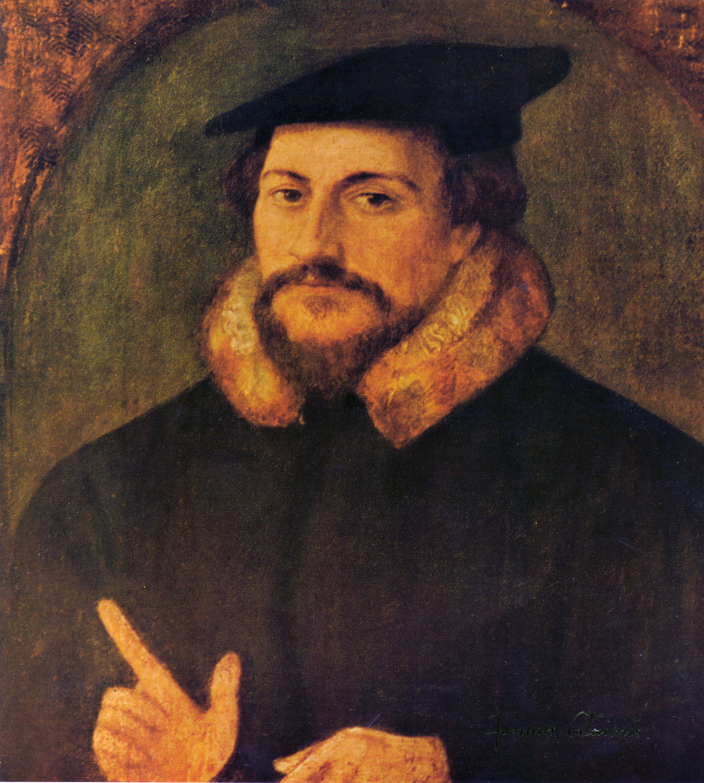
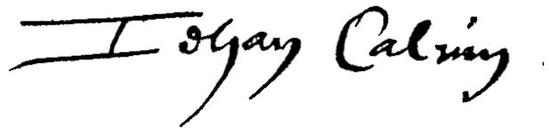
John Calvin 1509-1564

Slide 35
Why does
God Require Us
To Pray?

Slide 36

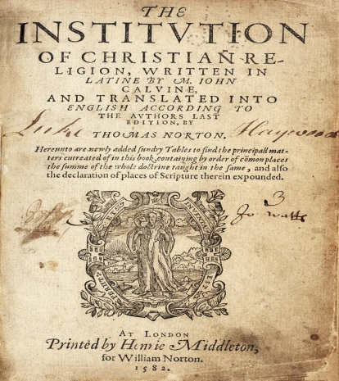
To enflame our love.
To winnow our wishes.
To prepare our gratitude.
To provoke our meditation.
To increase our delight.
To confirm His providence.

Slide 37
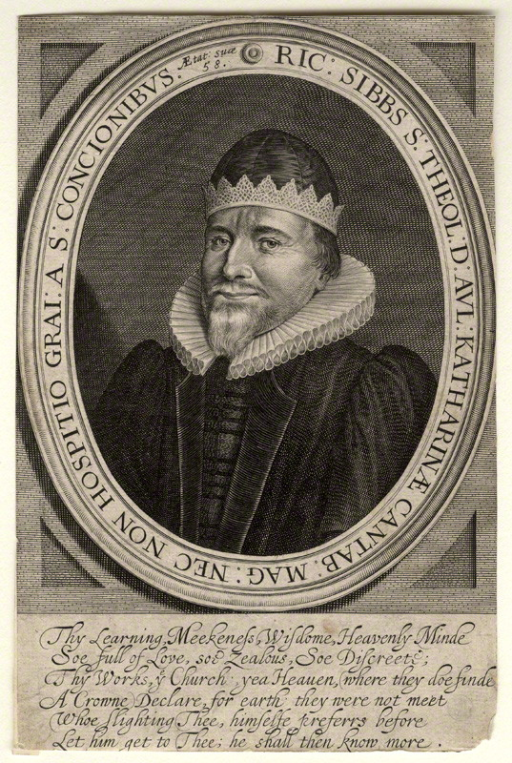
Richard Sibbes (1577-1635)
Richard Sibbes (Sibbs, Sibs)
by John Payne line engraving, circa 1635 7 3/8 in. x 4 7/8 in. (188 mm x 124 mm) paper size National Portrait Gallery D10733

Slide 38
Sibbes says that a great many Christians are full of complaints and discouragements about prayer.

Slide 39
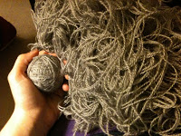
. . . I’ve prayed a long time
. . . I’m worse and worse
. . . I’m not heard
. . . I might as well quit praying
The Knot of Prayer

Slide 40
The Knot of Prayer Loosed

Slide 41
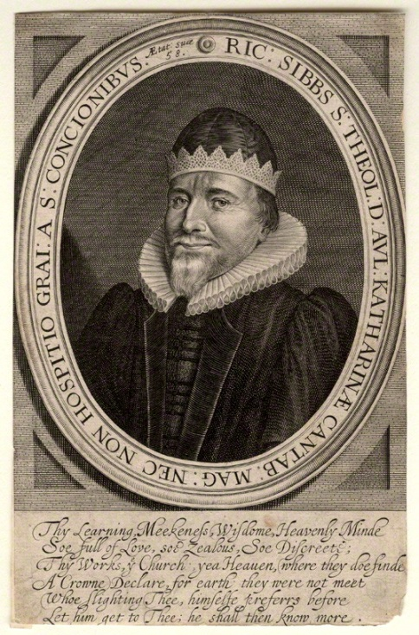
Conditions on our part
(2)Limitations on God’s part

Slide 42
Conditions on our part
Fourthly: The thing prayed for
must be lawful.

Slide 43
Conditions on our part
Fourthly: The thing prayed for
must be lawful.
Seventhly: Things must be asked
and desired in the right order.

Slide 44
Conditions on our part
(2) Limitations on God’s part
--The quality of the thing
--The timing for the thing
--The means of obtaining the
thing

Slide 45
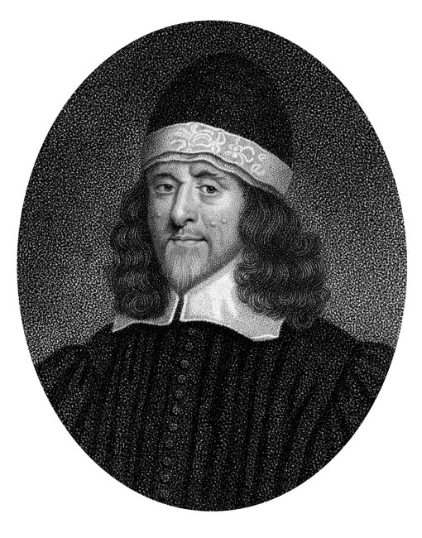
Thomas Goodwin (1600-1679)

Slide 46
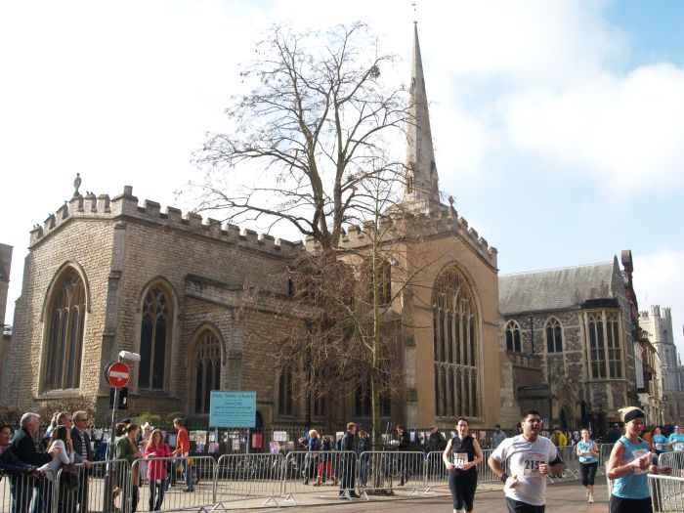

Slide 47
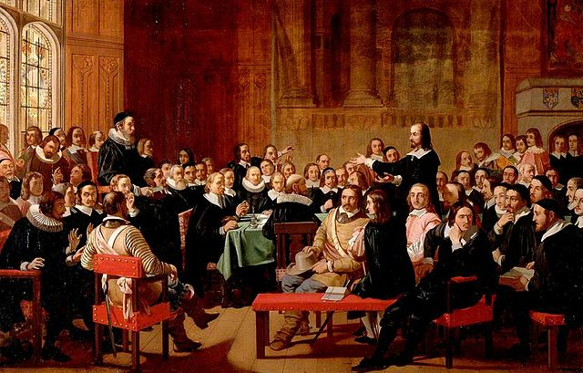

Slide 48
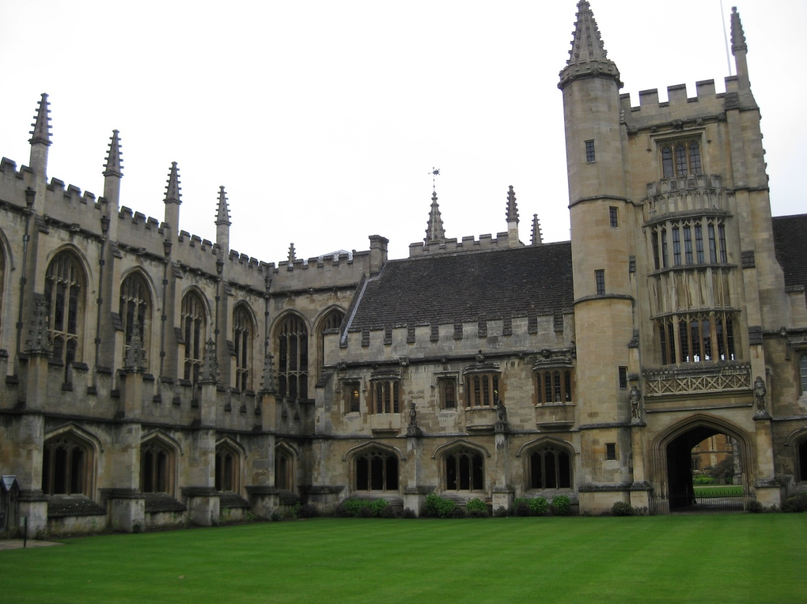

Slide 49
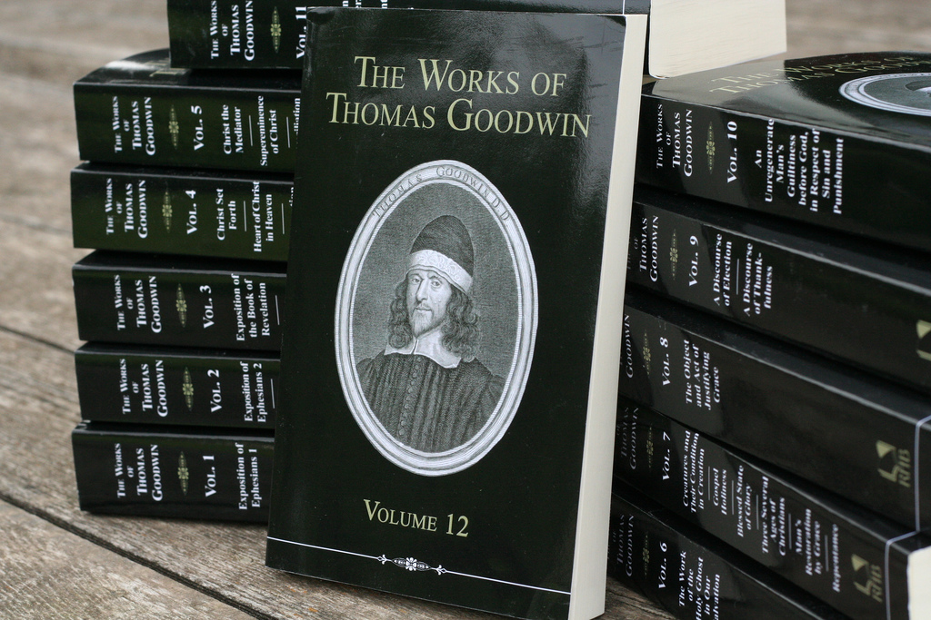

Slide 50
“The greatest pulpit exegete of Paul that has ever lived.”
--J. I. Packer

Slide 51
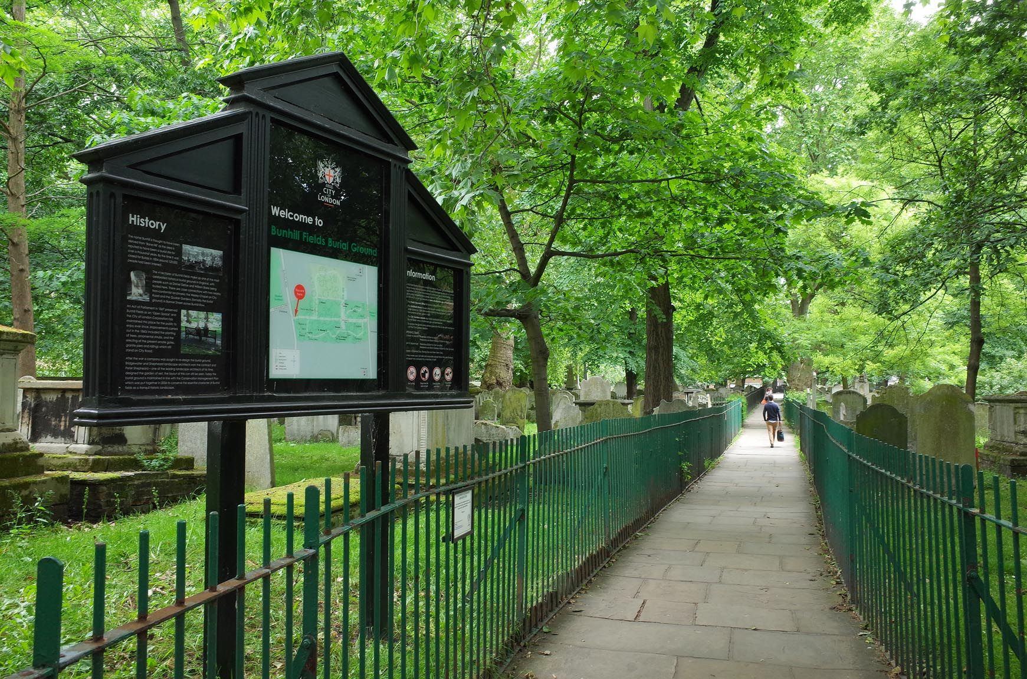

Slide 52
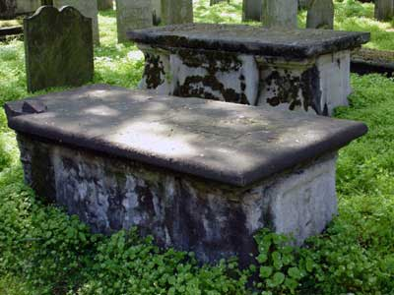

Slide 53
I am going to the three Persons, with whom I have had communion: they have taken me; I did not take them. . .

Slide 54
I could not have imagined I should ever have had such a measure of faith in this hour. . . Christ cannot love me better than he doth;

Slide 55
I think I cannot love Christ better than I do. I am swallowed up in God.

Slide 56
God is faithful, by whom ye were called unto the fellowship of his Son, Jesus Christ, our Lord.
--I Corinthians 1:9

Slide 57
Have communion with Him as His friend.

Slide 58
A stranger will visit one whom he hath. . . business with.

Slide 59
Friendship is most maintained and kept up by visits; and these, the more free and the less occasioned by urgent business, or solemnity, or custom they are, the more friendly they are.

Slide 60
Exodus 33:11

Slide 61
You see the Scripture lodgeth this in the notion of friendship; therefore attempt, if thou hast not yet tried, this way of seeking God.

Slide 62
And take my counsel, when the Spirit at some by-time moves thee, and it is merely a motion of his, go and stand in the presence-chamber; that is, put thyself on duty with this aim and design mentioned, and see if he hold not out his golden scepter to thee.

Slide 63
Have communion with Him as His friend.
When you come into his presence, be telling him how well thou lovest him.

Slide 64
Labor to abound in expressions of that kind.

Slide 65
What affections or expressions thou hast to bestow on friend or wife, God will have them from thee to himself.

Slide 66
If thy spirit be narrow, and shut up to such a way, yet thou wilt and mayest be able to vent that love thou bearest him in blunt and downright expressions: “Lord,” said Peter, “Thou knowest I love thee,” if ever I loved anything.

Slide 67
Have communion with Him as His friend.
When you come into his presence, be telling him how well thou lovest him.

