Slide 1
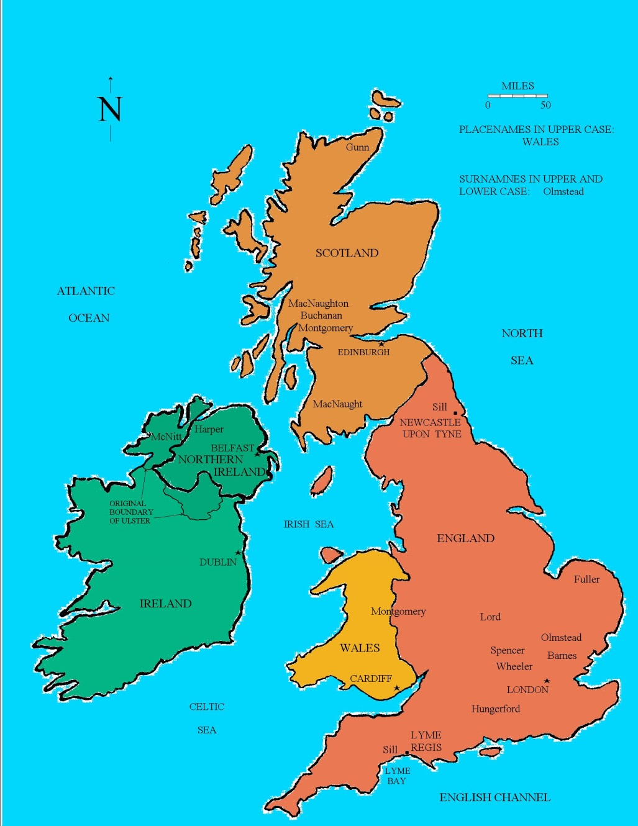

Slide 2
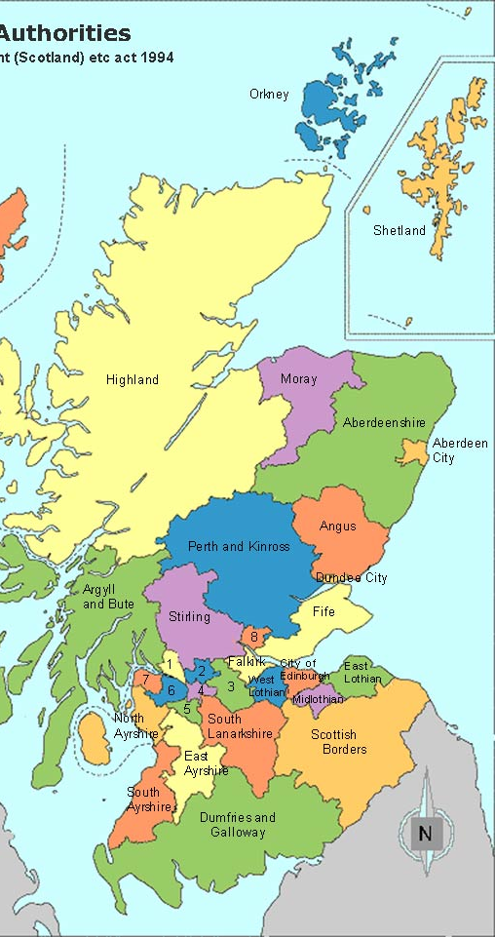

Slide 3
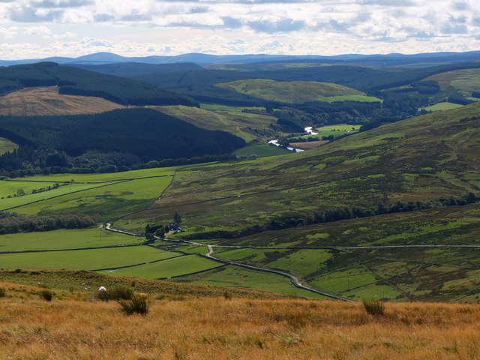

Slide 4
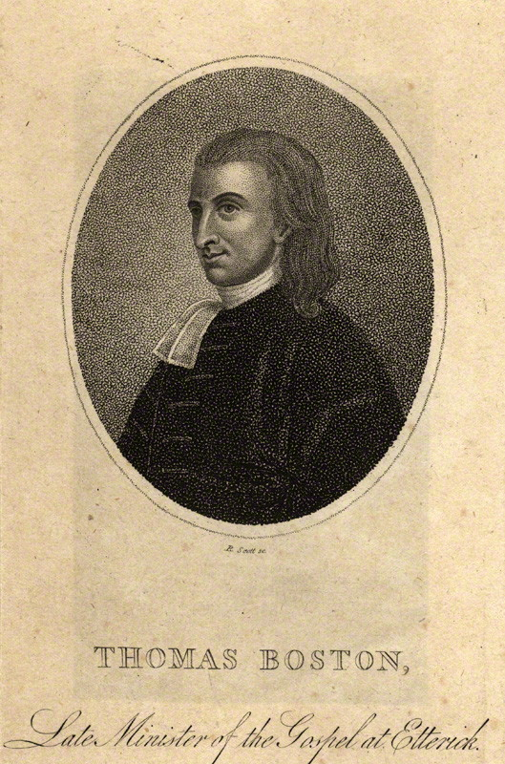

Slide 5
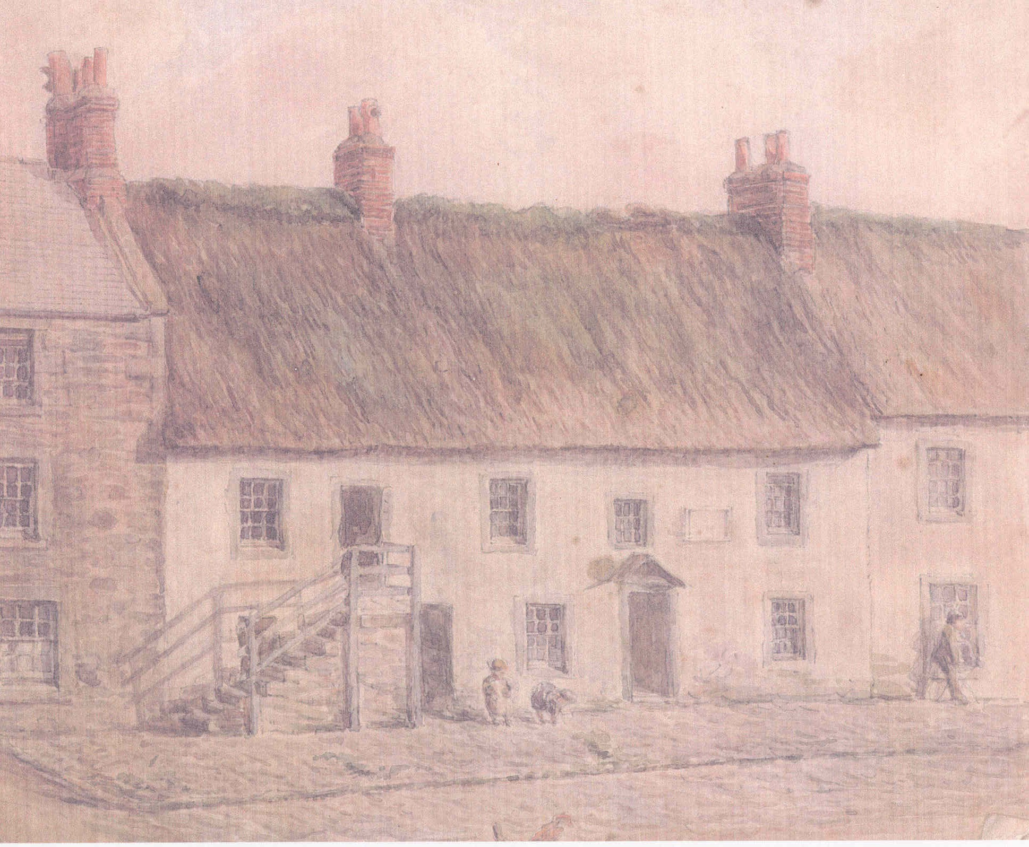
--Born in Duns (1676)
House in which he was born in 1676. Burnt down in 1891.

Slide 6
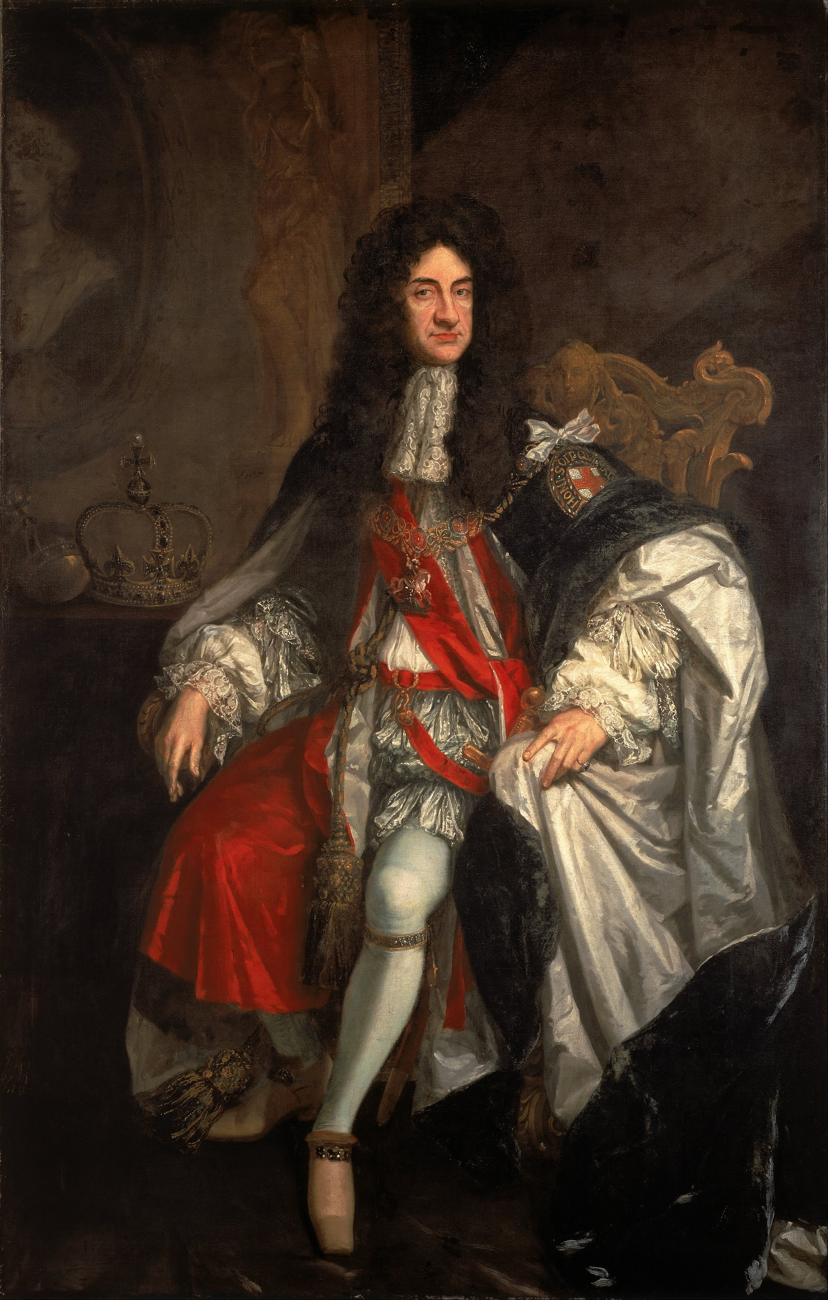

Slide 7
--Born in Duns (1676)
--Companion for his father in prison
House in which he was born in 1676. Burnt down in 1891.

Slide 8
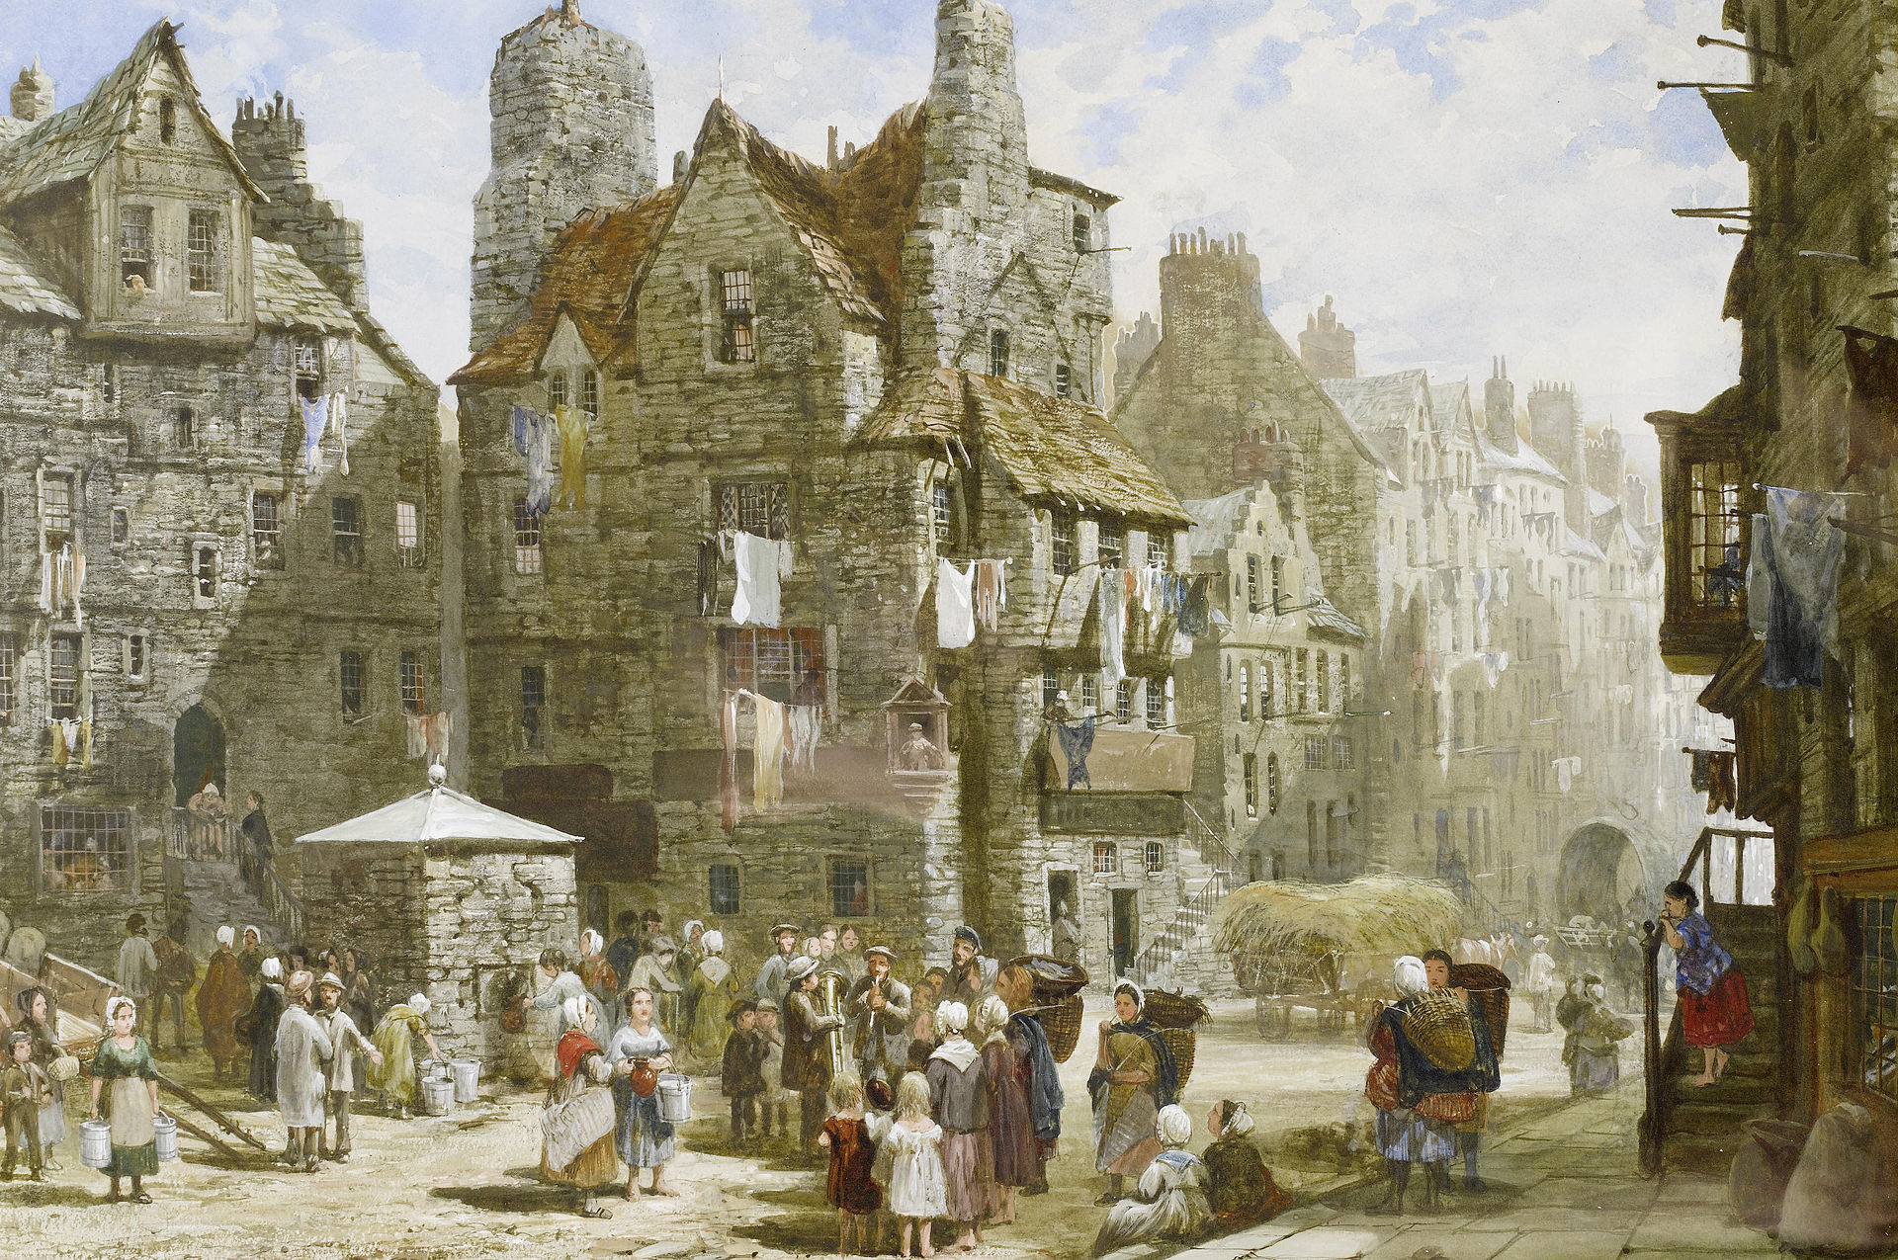
Age of 15 (1691) went to Edinburgh for University. John Knox house on Royal Mile

Slide 9
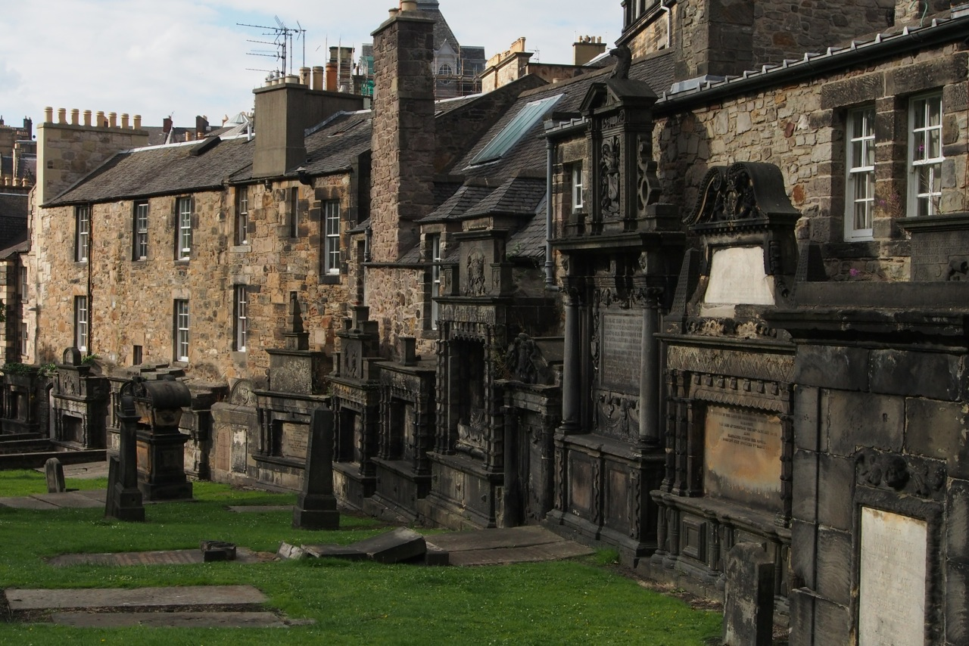

Slide 10
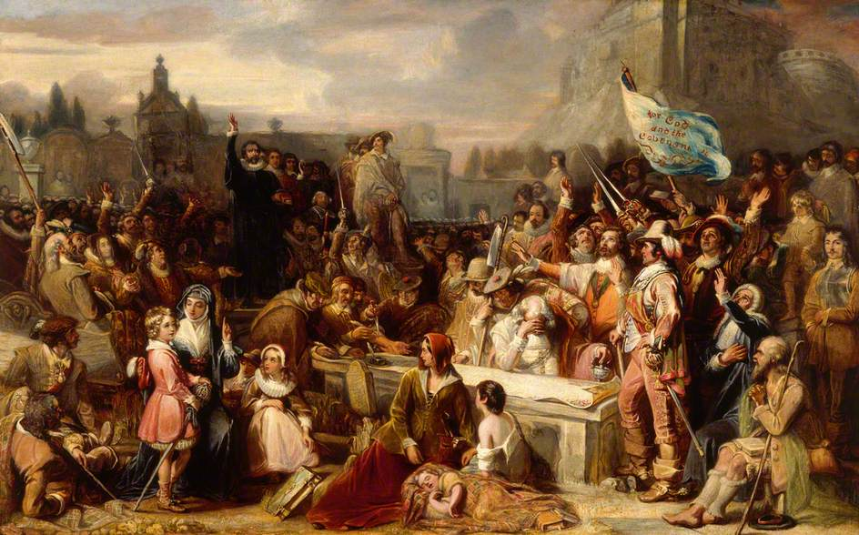
Signing of National Covenant, 1638.

Slide 11
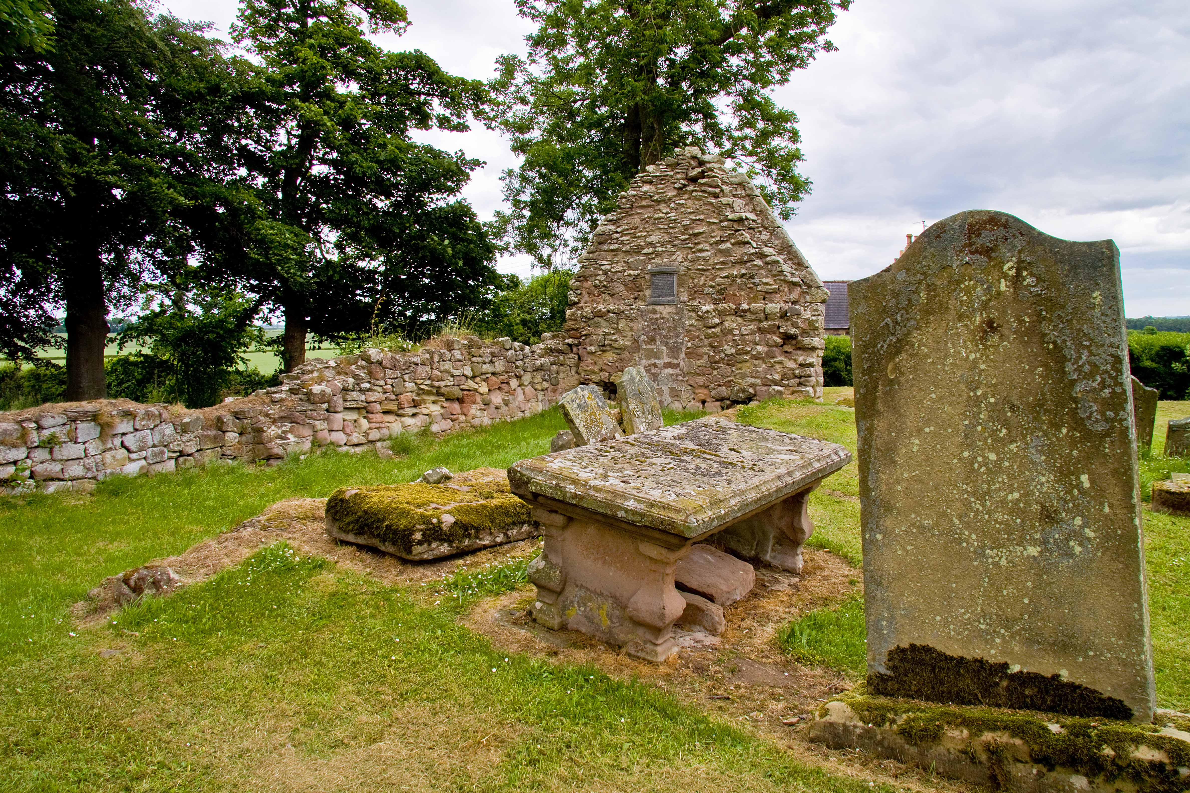
1699 became pastor in Simprin. Married Katheryn Brown. Here until 1707. They would have ten children, six of which would die in infancy or childhood.

Slide 12
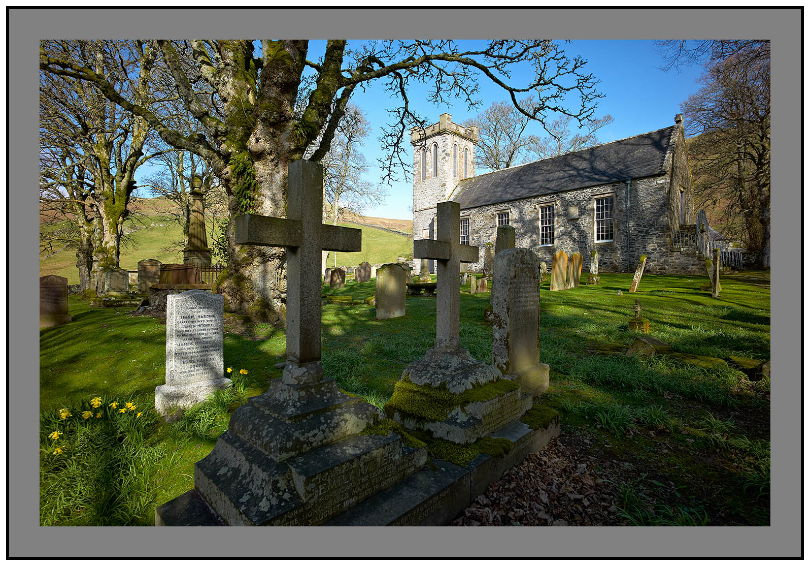
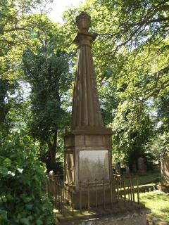
Went to Ettrick in 1707. Here for 24 years.

Slide 13
John Anderson . . . told me of a time when there was not a Bible in the church, except the minister’s, his father’s and another.

Slide 14
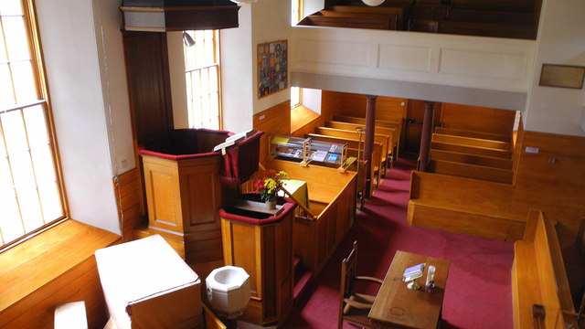
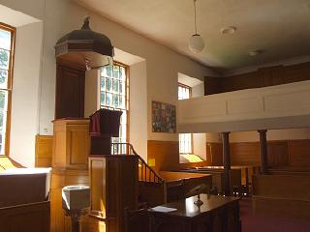
The pulpit is a classic Scottish 'double decker' with the precentor's box, below the minister's pulpit, with sounding board.

Slide 15
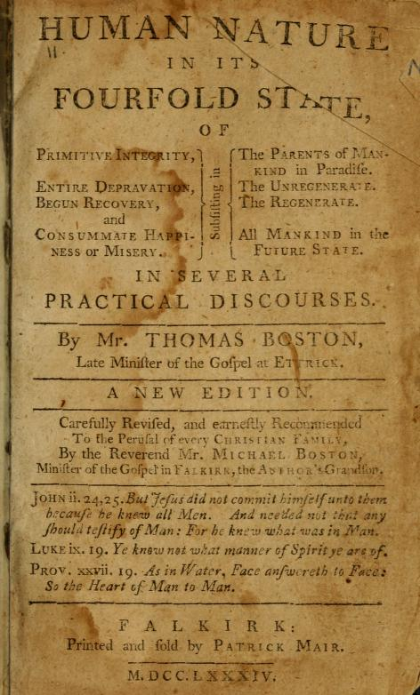
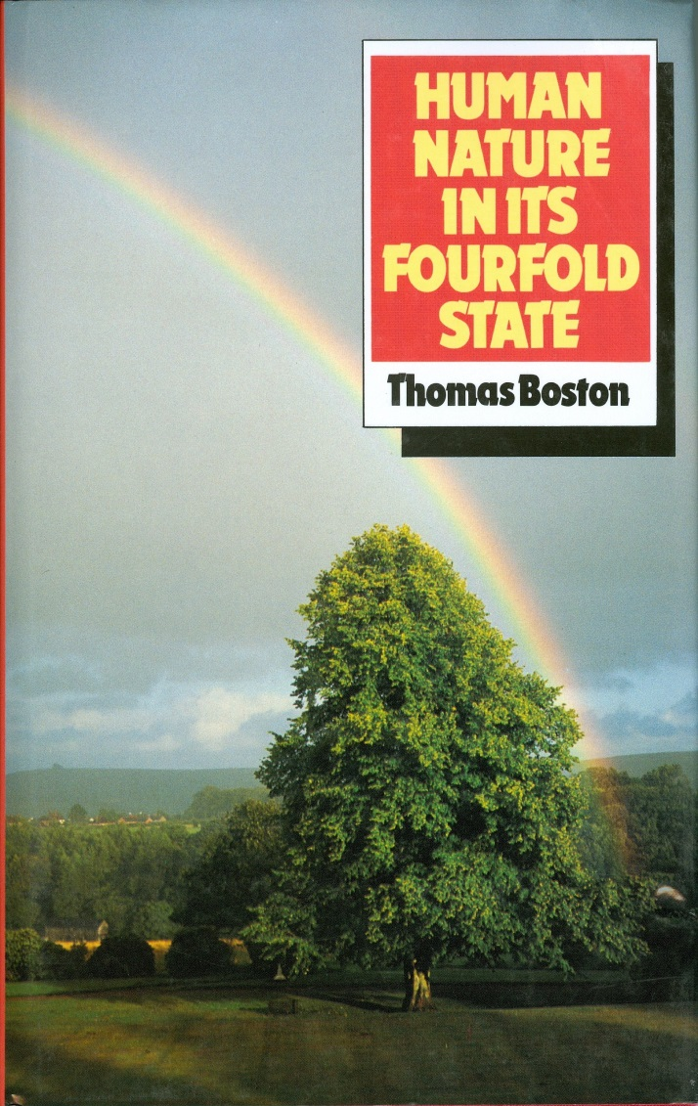
Published in 1720. Innocence, nature, grace, eternity. Over 100 editions in
18th century. Never been out of print to this day. Most Scottish homes had.

Slide 16
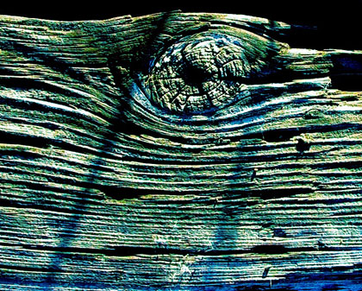

Published in 1737, after he died.

Slide 17
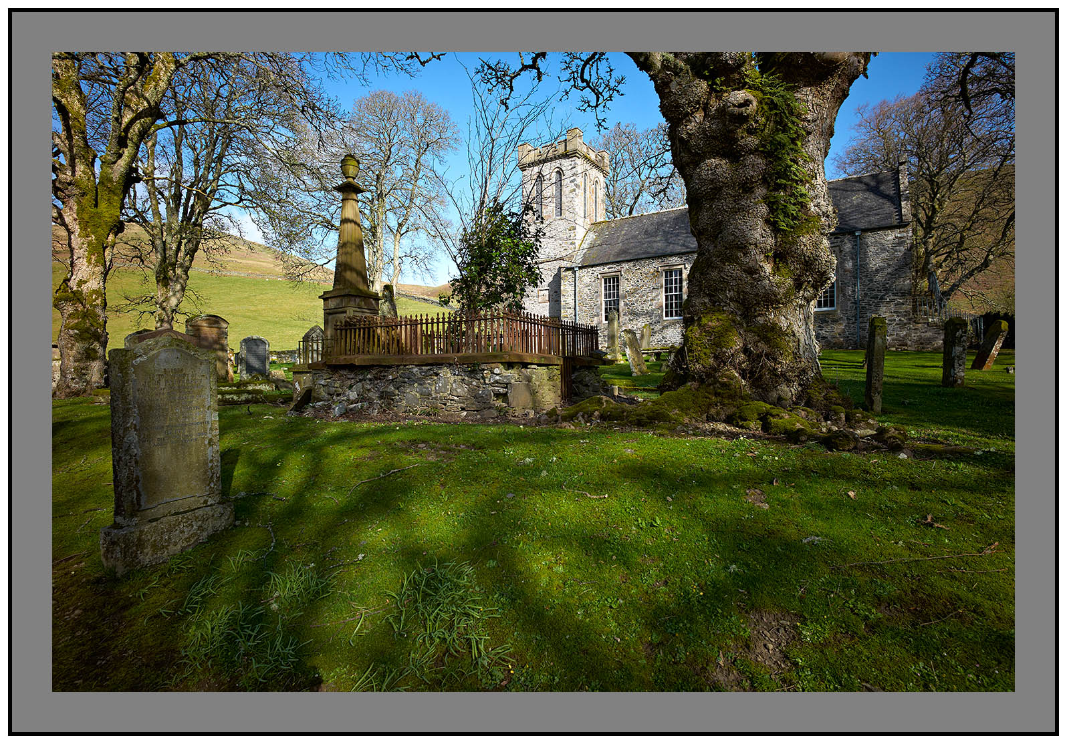
1710 there were 57 communicants. 1731, last time, there were 777.

Slide 18
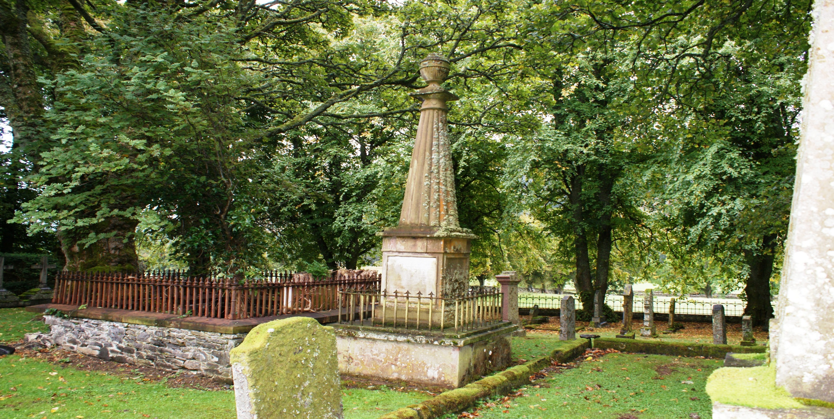

Slide 19
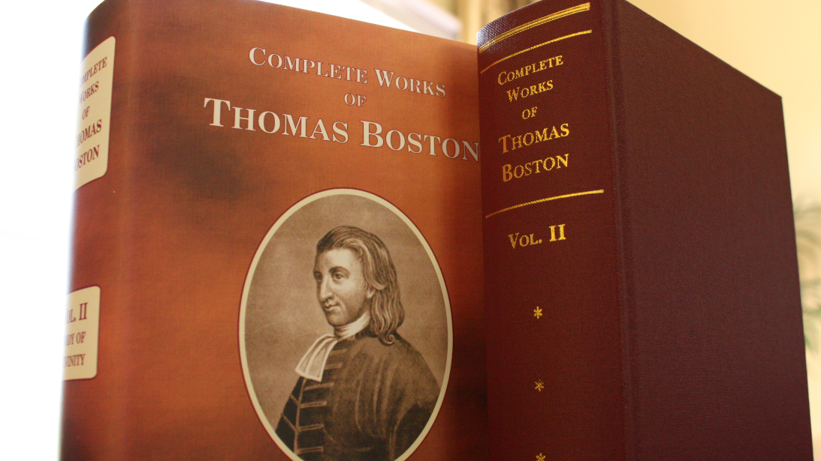

Slide 20

Prayer is an offering up of our desires unto God,

Slide 21
Prayer is an offering up of our desires unto God, for things agreeable to His will,

Slide 22
Prayer is an offering up of our desires unto God, for things agreeable to His will, in the name of Christ,

Slide 23
Prayer is an offering up of our desires unto God, for things agreeable to His will, in the name of Christ, with confession of our sins,

Slide 24
Prayer is an offering up of our desires unto God, for things agreeable to His will, in the name of Christ, with confession of our sins, and thankful acknowledgment of His mercies.

Slide 25
. . . in the name of Christ. . .

Slide 26

It is not a bare mentioning his name. . . and concluding our prayers therewith.

Slide 27
We must begin, carry on, and conclude our prayers in the name of Christ.

Slide 28
Whatsoever ye do in word or deed, do all in the name of the Lord Jesus, giving thanks to God and the Father by him.
--Colossians 3:17

Slide 29
The virtue is not in the words, but in the faith wherewith they are used.

Slide 30
Beginning in His name:

Slide 31
Beginning in His name:
We must go to God at
Christ’s command, and by order from him.

Slide 32
--God wants us to live from hand to mouth.

Slide 33
--God wants us to live from hand to mouth.
. . . and so to honour him by hanging daily about his hand for their supply from time to time. In heaven they shall be set down at the fountain; but now the law of the house is, “Ask, and ye shall receive” (Mtt. 7:7).

Slide 34
--God wants us to live from hand to mouth.
--Christ sends us to God by prayer for the
supply of all our wants.

Slide 35
--God wants us to live from hand to mouth.
--Christ sends us to God by prayer for the
supply of all our wants.
This he does by his word, commanding them to go, and by his Spirit inclining them to go. For thus the whole Trinity is glorified by praying believers.

Slide 36
--God wants us to live from hand to mouth.
--Christ sends us to God by prayer for the
supply of all our wants.
--Our prayers are under the sense of this
command of God in Christ.

Slide 37
--Our prayers are under the sense of this
command of God in Christ.
--We may pray without any sense of
being commanded (serving ourselves)

Slide 38
--Our prayers are under the sense of this
command of God in Christ.
--We may pray without any sense of
being commanded (serving ourselves)
--We may pray out of slavish fear.

Slide 39
--Our prayers are under the sense of this
command of God in Christ.
--We may pray without any sense of
being commanded (serving ourselves)
--We may pray out of slavish fear.
--We should pray out of son-like service.

Slide 40
--God wants us to live from hand to mouth.
--Christ sends us to God by prayer for the
supply of all our wants.
--Our prayers are under the sense of this
command of God in Christ.
--Let us therefore come boldly unto the throne
of grace. . .

Slide 41
The virtue is not in the words, but in the faith wherewith they are used.

Slide 42
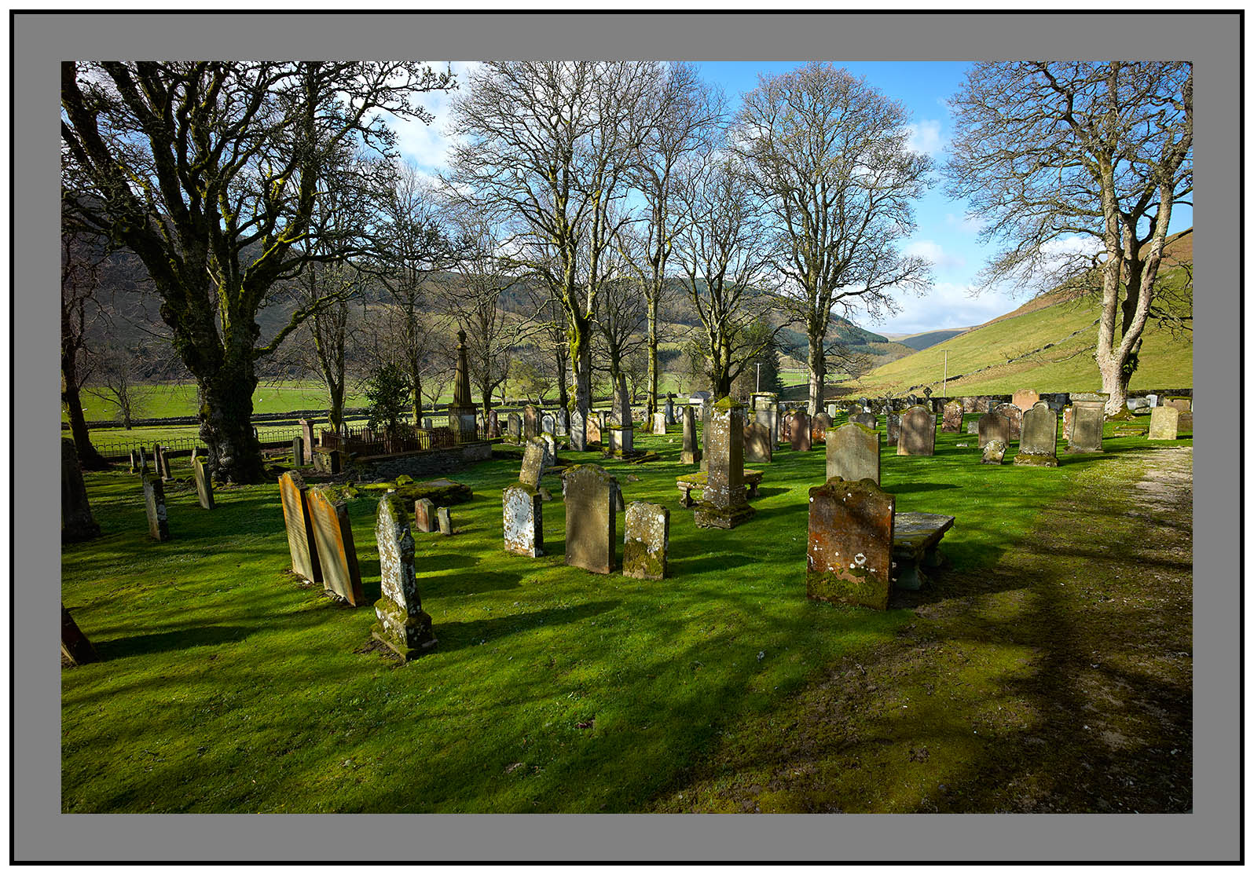

Slide 43
As a testimony of esteem for the Revd. THOMAS BOSTON, Senior whose private character was highly respectable, whose public labours were blessed to many and whose valuable writings have contributed much to promote the advancement of vital Christianity. This monument by permission of his relatives is erected by a religious and grateful public AD 1806. He was born in Dunse March 17th. 1676, ordained to the Pastoral Charge of Simprim Sept 21st. 1699, removed from thence to Ettrick May 1st. 1707 and died May 20th. 1732 aged 56 years leaving a widow and four children"

