Slide 1
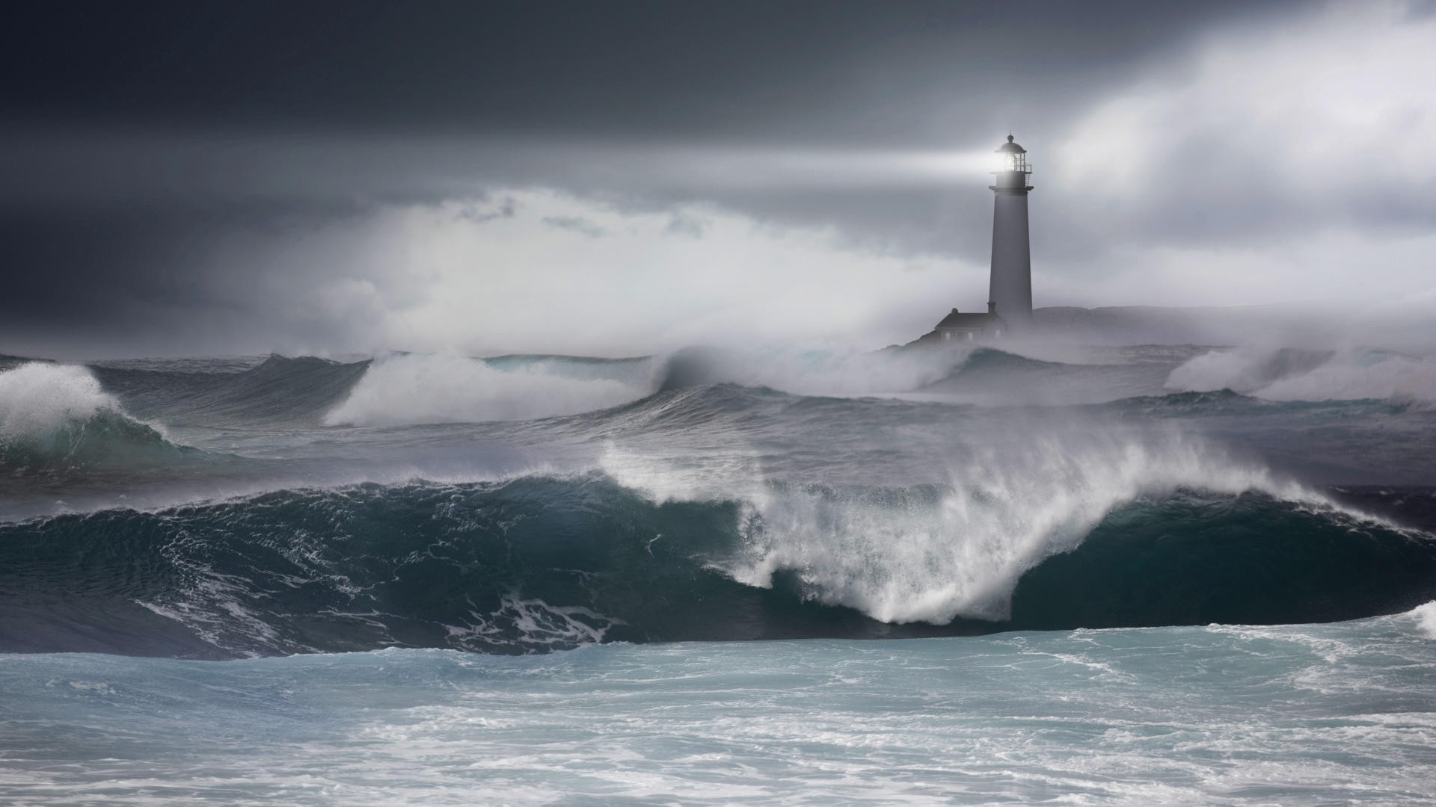
The wicked are like the tossing sea, for it cannot be quiet, and its
waters toss up refuse and mud. “There is no peace”, says my God, “for the wicked.”
--Isaiah 57:20-21

Slide 2
. . . the household of God, which is
the church of the living God. . .
--I Timothy 4:15

Slide 3
. . . the household of God, which is
the church of the living God. . .
--I Timothy 4:15

Slide 4
. . . the household of God, which is
the church of the living God, the pillar and support of the truth.
--I Timothy 4:15

Slide 5
Adopt God’s worldview unreservedly.

Slide 6
Adopt God’s worldview unreservedly.
Root your position on marriage immovably
  in Genesis 1-2.

Slide 7
Adopt God’s worldview unreservedly.
Root your position on marriage immovably
  in Genesis 1-2.
Accept God’s Law about homosexuality unquestioningly.

Slide 8
Adopt God’s worldview unreservedly.
Root your position on marriage immovably
  in Genesis 1-2.
Accept God’s Law about homosexuality unquestioningly.
Remember God’s judgments fearfully.

Slide 9
Adopt God’s worldview unreservedly.
Root your position on marriage immovably
  in Genesis 1-2.
Accept God’s Law about homosexuality unquestioningly.
Remember God’s judgments fearfully.
Repent of judging hypocritically.

Slide 10
Evangelize all people hopefully.

Slide 11
Evangelize all people hopefully.
Suffer patiently.

Slide 12
Evangelize all people hopefully.
Suffer patiently.
Correct other professing Christians gently.

Slide 13
Evangelize all people hopefully.
Suffer patiently.
Correct other professing Christians gently.
Embrace your pilgrim status fully.

Slide 14
Evangelize all people hopefully.
Suffer patiently.
Correct other professing Christians gently.
Embrace your pilgrim status fully.
Know confidently that the Lord will rescue the godly.

Slide 15


Slide 16


Slide 17
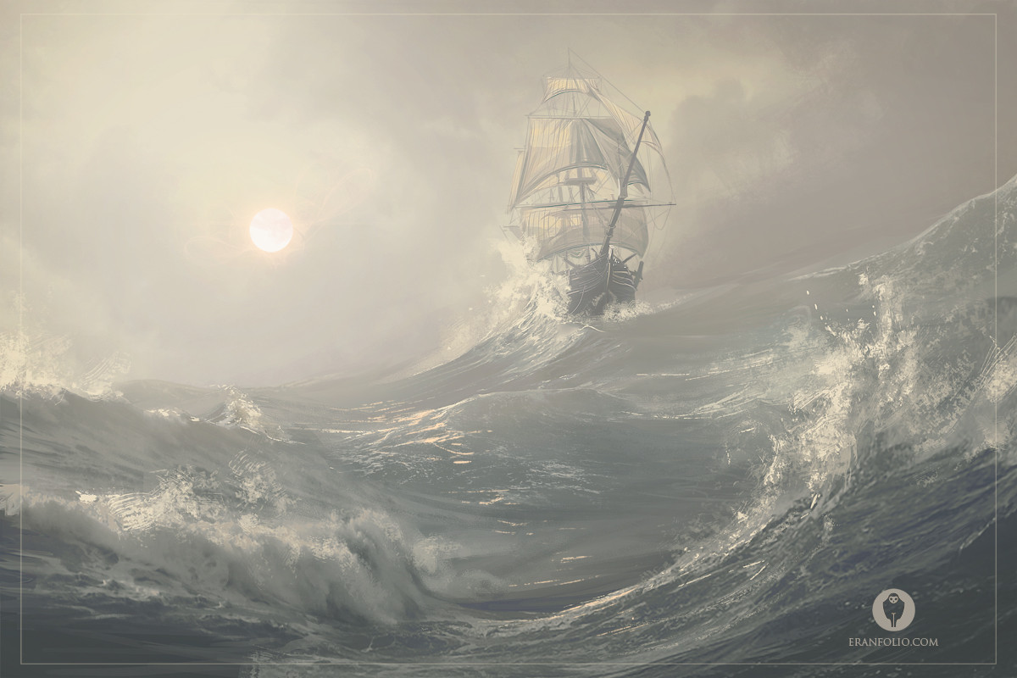

Slide 18
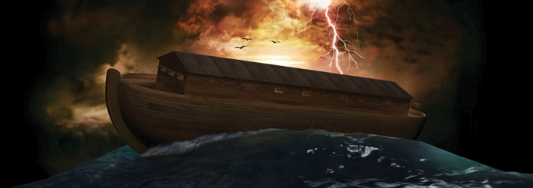

Slide 19
An Arke for all God’s Noahs in a Gloomy, Stormy Day
--Thomas Brooks (1662)

Slide 20
It was an excellent saying. . . “Such goods are worth getting and owning, as will not sink or wash away if a shipwreck happen.”

Slide 21
“The Lord is my portion,” saith my soul; “therefore will I hope in him.”
--Lamentations 3:24

Slide 22
“Well,” saith the prophet, “though I am in a sea of sorrow, and in a gulf of misery, yet my heart tells me that the Lord is my portion; my mind tells me that the Lord is my portion; my spirit tells me that the Lord is my portion; and my understanding tells me that the Lord is my portion; and therefore I will bear up bravely in the face of all calamities and miseries.”

Slide 23
The Lord is the peculiar portion
of His people.

Slide 24
Luther was wont to say that there lay a great deal of divinity couched up in pronouns, as “mine,” “thine,” “his.”

Slide 25
In the Psalter. . .
“Our God”

Slide 26
In the Psalter. . .
“Our God” 31 times

Slide 27
In the Psalter. . .
“Our God” 31 times
“My God”

Slide 28
In the Psalter. . .
“Our God” 31 times
“My God” 56 times

Slide 29
The Lord is the peculiar portion
of His people.

Slide 30
There is never a. . .

Slide 31
The Lord is the peculiar portion
of His people.
2. The Lord is a universal portion.

Slide 32
There is in God an immense fullness, an ocean of goodness, and an overplus of all that graciousness, sweetness, and kindness that is to be found in all other things or creatures.

Slide 33
As Noah had a copy of every kind of creature in that famous library of the ark, out of which all were reprinted to the world, so he that hath God for his portion hath the original copy of all blessings, out of which all may easily be renewed.

Slide 34
He is a portion that includes all other portions. God hath himself the good, the sweet, the profit, the pleasure, the delight, the comfort, etc., of all other portions.

Slide 35
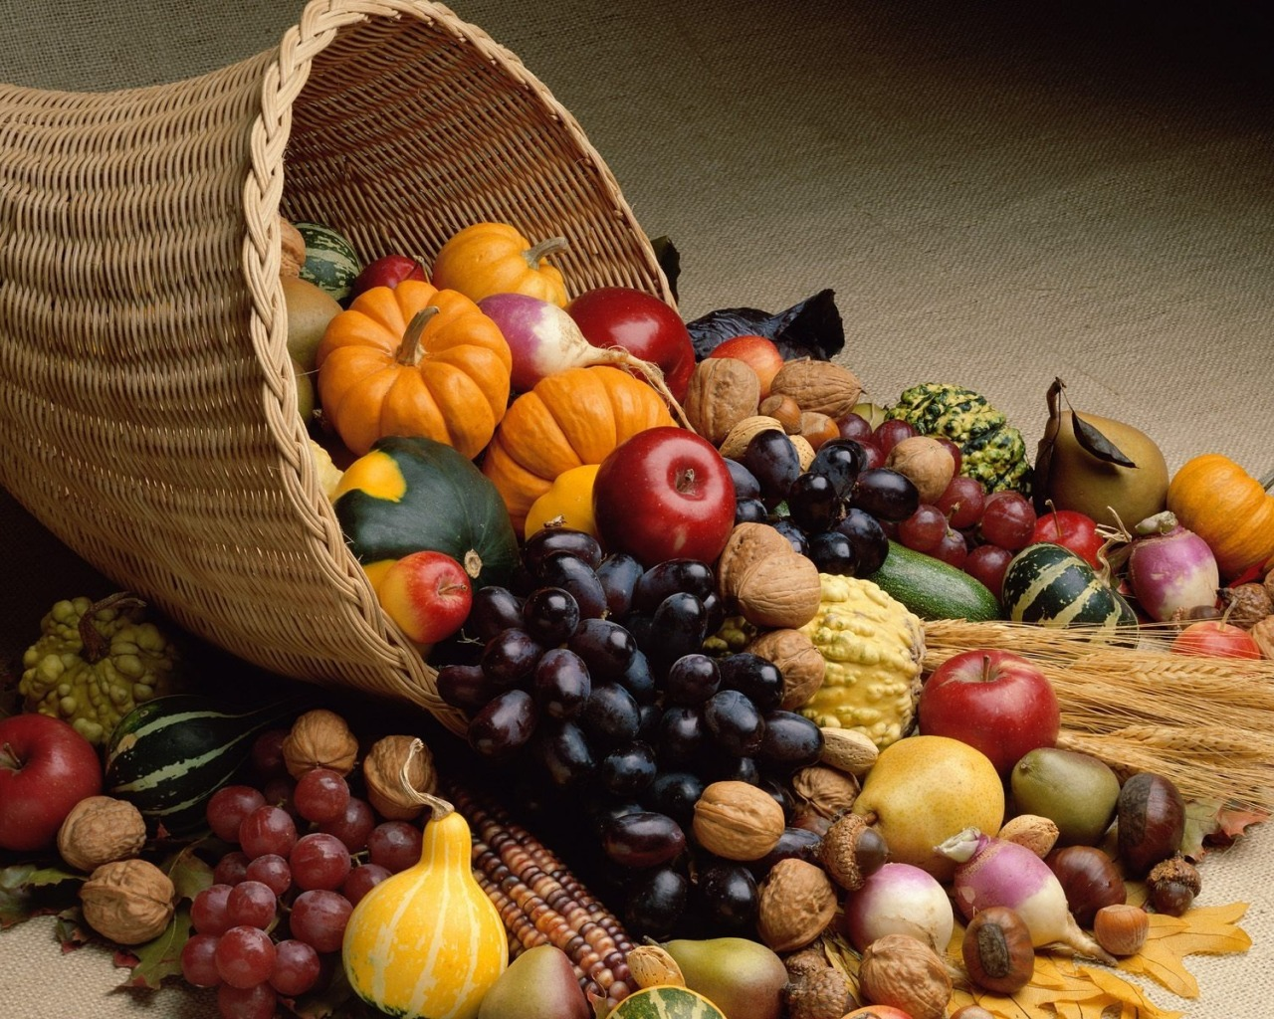

Slide 36
“The Lord is my portion,” saith my soul; “therefore will I hope in him.”
--Lamentations 3:24

Slide 37
