Slide 1
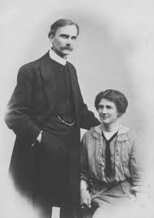
W. Graham Scroggie (1877-1958)
Florence (wife of 40 years)

Slide 2
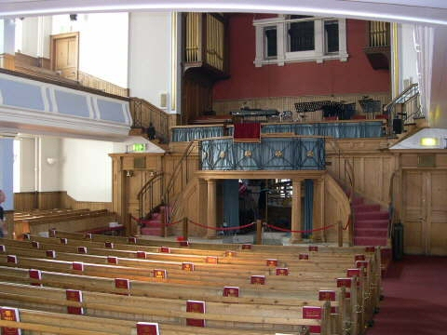
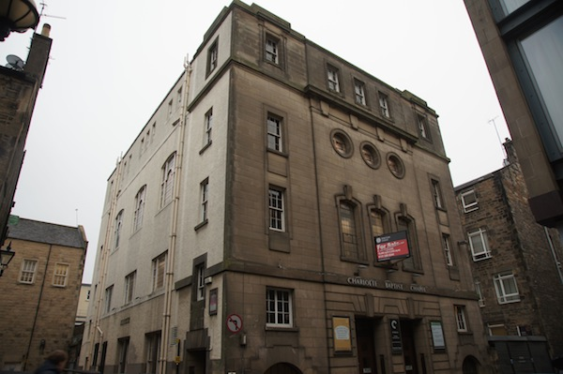
Charlotte Baptist Chapel, Edinburgh (1916-1933)

Slide 3
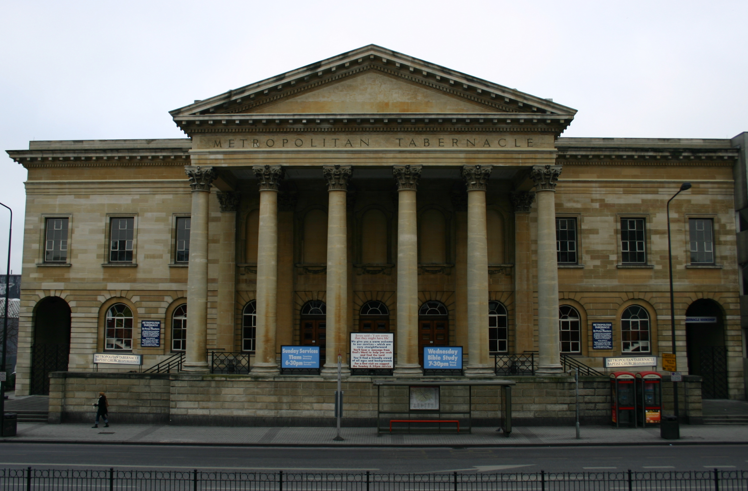
1938-1944

Slide 4
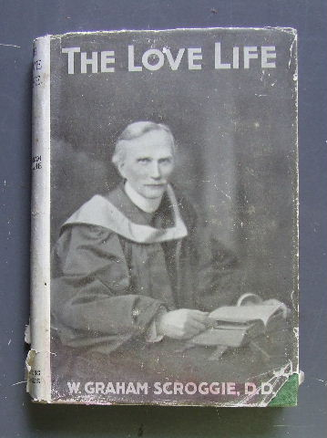
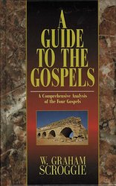
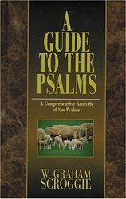
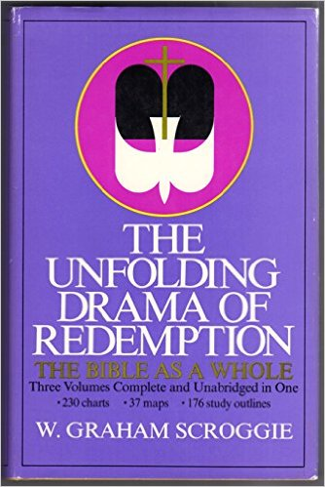
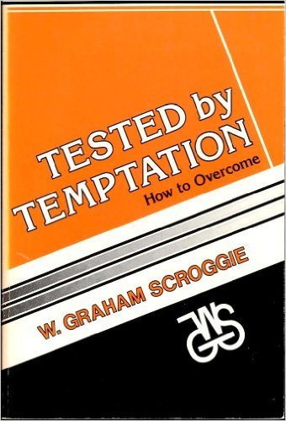
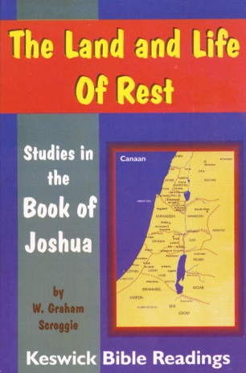

Slide 5


Slide 6
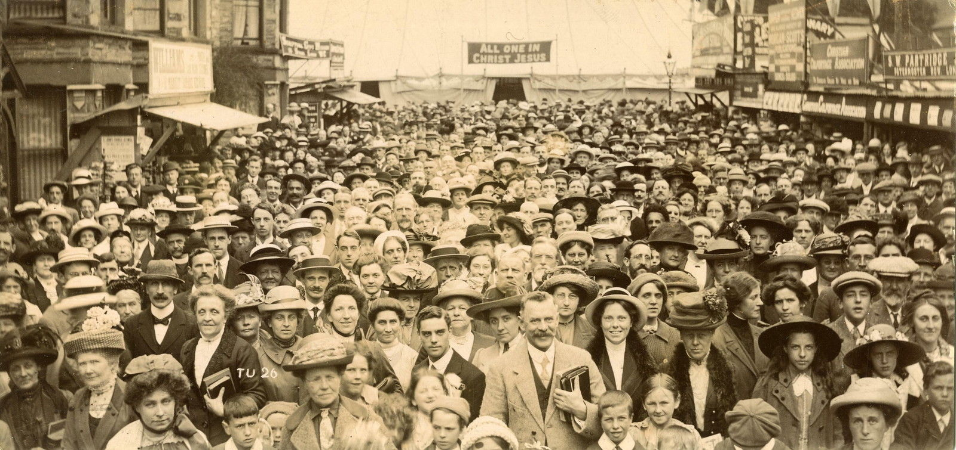
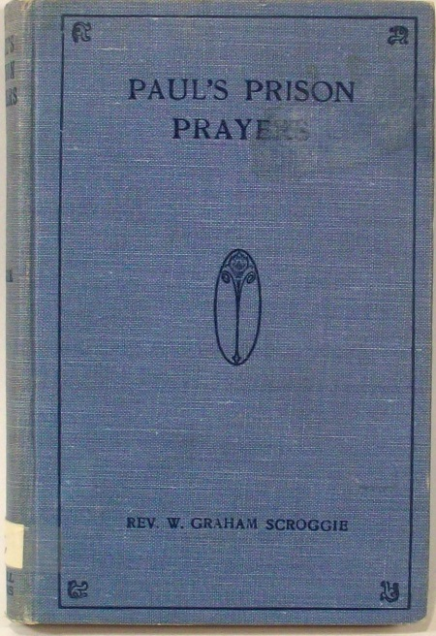
Keswick Convention, 1920s

Slide 7
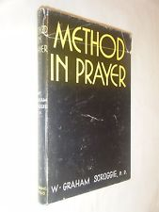
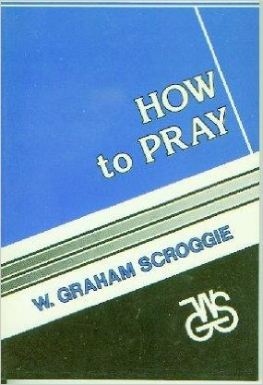

Slide 8
One of the greatest mistakes that a Christian can make, is to imagine that increased social or spiritual activity can be any compensation for the lack of secret communion with God.

Slide 9
Too long have prayer and Bible study been divorced, and with sad results. What God has joined together, we should never have put asunder.

Slide 10
Adoration
Confession
Petition (faith’s claim)
Intercession (the soul’s ministry at the throne of grace on behalf of others)
Thanksgiving

Slide 11
The Ordinance of Praise
  Praise is ordained of God
  In everything give thanks, for this is the will of God in Christ Jesus concerning you.
  --I Thess. 5:18

Slide 12
The Ordinance of Praise
  Praise is ordained of God
  Give unto the Lord the glory due unto His Name.
  Whoso offereth praise glorifieth Me.
  --Psalm 29:2; 50:23

Slide 13
How sadly we have
forgotten that praise is an obligation as well as a privilege,

Slide 14
How sadly we have
forgotten that praise is an obligation as well as a privilege, and that, therefore there is always occasion for praise. That which God has ordained, He has made possible, not sometimes only, but always; not to some people only, but to all.

Slide 15
David laid hold of this truth and so was able to say-- “ I will bless the Lord at ______ ____________.” His praise shall ___________ be in my mouth.”

Slide 16
The Ordinance of Praise
  Praise is ordained of God.
  Praise was organized in Israel.

Slide 17
            The necessity for method in everything is recognized by all business-like people today. But, as a rule, the Christian is most unbusiness-like in the discharge of his spiritual responsibilities.

Slide 18
Christian life and service are not going to lose anything of their spirituality by being a great deal more systematic. The soul must be disciplined and cultivated, and these things must not be left to accident or adventure.

Slide 19
The Ordinance of Praise
  Praise is ordained of God.
  Praise was organized in Israel.
  Praise was ordered in song.

Slide 20
Old Testament Songs of Praise
Song of Moses (Exodus 15)
Song of Deborah (Judges 5)
Song of Hannah (I Samuel 2)

Slide 21
Old Testament Songs of Praise Song of Moses (Exodus 15)
The song is sung to the Lord, of the Lord, and for the Lord, and the study of it is quite a liberal education in the art of praise.

Slide 22
Old Testament Songs of Praise Song of Moses (Exodus 15)
Song of Deborah (Judges 5)
One of its values is in the way it teaches us to praise God in great detail; to record His dealings with us minutely. . .

Slide 23
Old Testament Songs of Praise Song of Moses (Exodus 15)
Song of Deborah (Judges 5)
Song of Hannah (I Samuel 2)
Celebrates the Divine goodness in personal experience, as the former songs celebrated that goodness in national experience.

Slide 24
Praise is not a note, but a chord; not a mere sound, but a harmony; and chief among the notes which make it are. . .

Slide 25
          The Ordinance of Praise
          The Occasion of Praise
  Redemption
  Satisfaction
  Victory

Slide 26
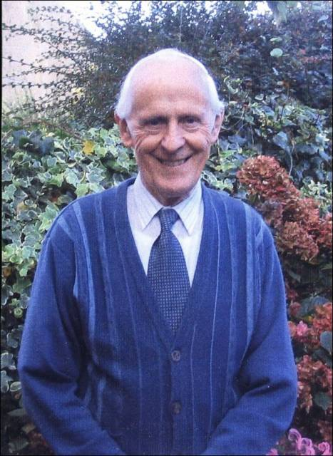
As studying a picture does not make a man a painter, and as listening to music does not make a man a musician, so reading prayers and about prayer does not give a man power with God.

Slide 27
It came to pass, as the trumpeters and singers were as one to make one sound to be heard in praising and thanking the Lord; and when they lifted up their voice with the trumpets and cymbals and instruments of music, and praised the Lord, saying: “For He is good; for His mercy endureth forever;” . . .

Slide 28
. . . that then the House was filled with a cloud, even the House of the Lord.
--II Chronicles 5:13

