Slide 1


Slide 2
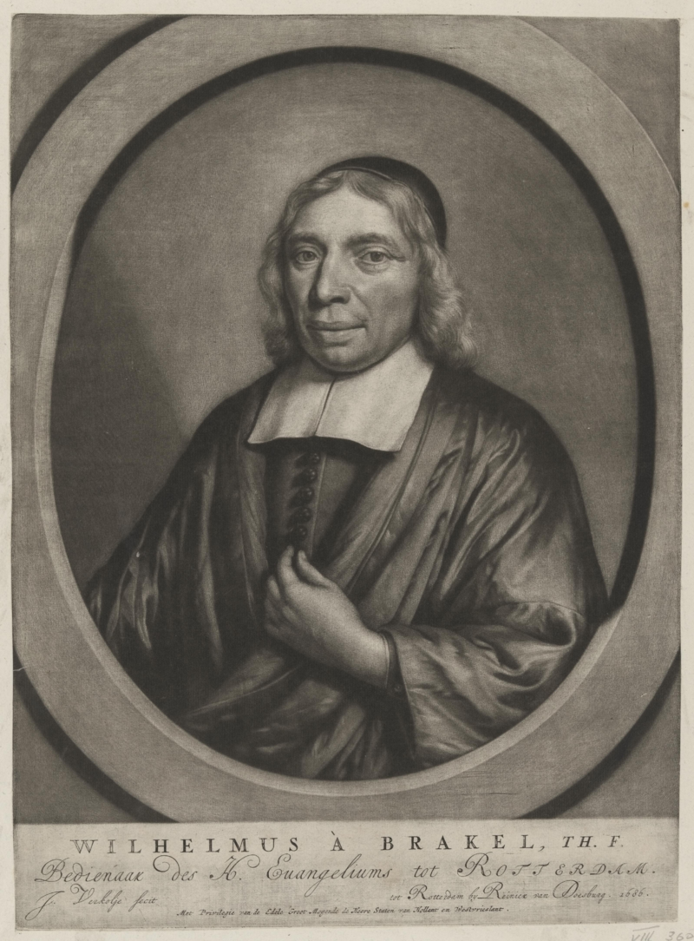

Slide 3
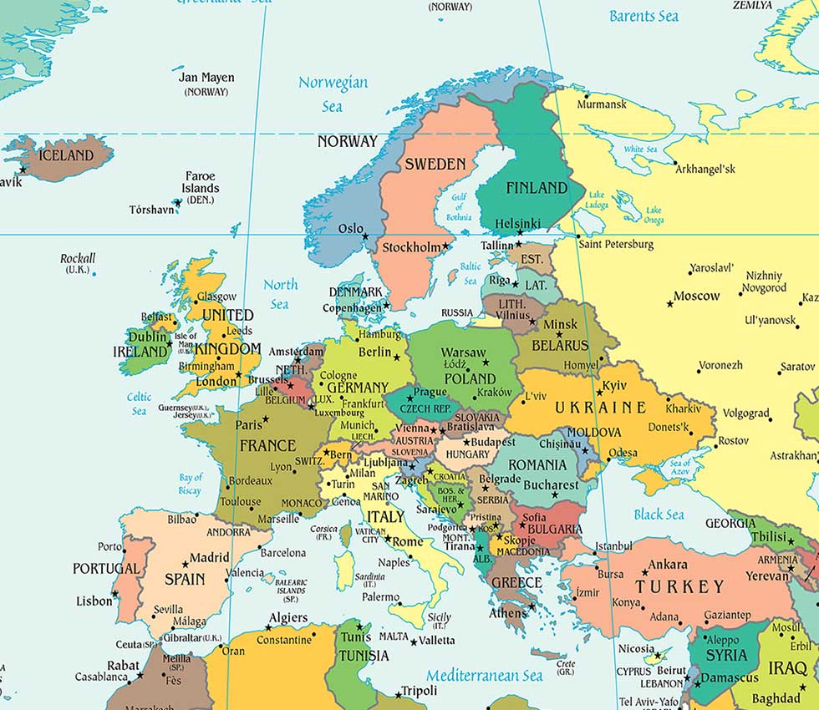

Slide 5
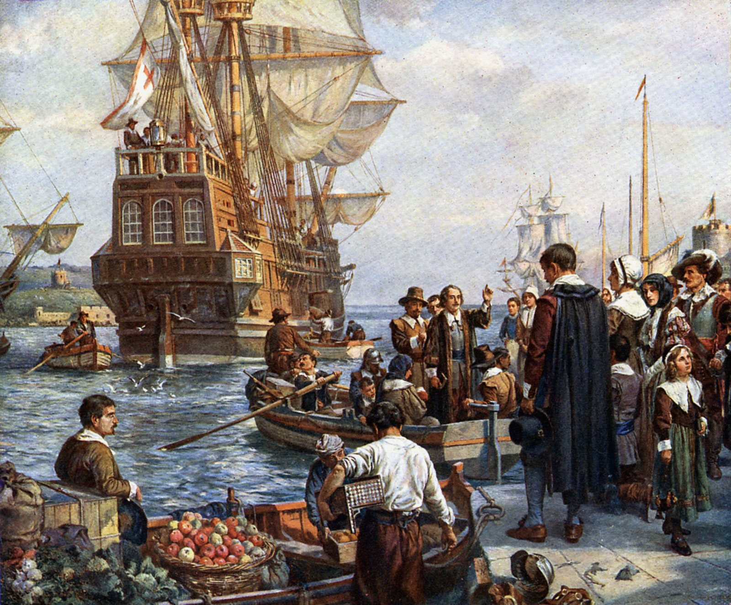

Slide 6
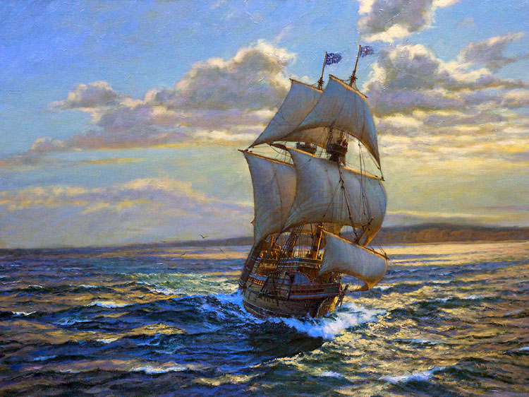

Slide 7
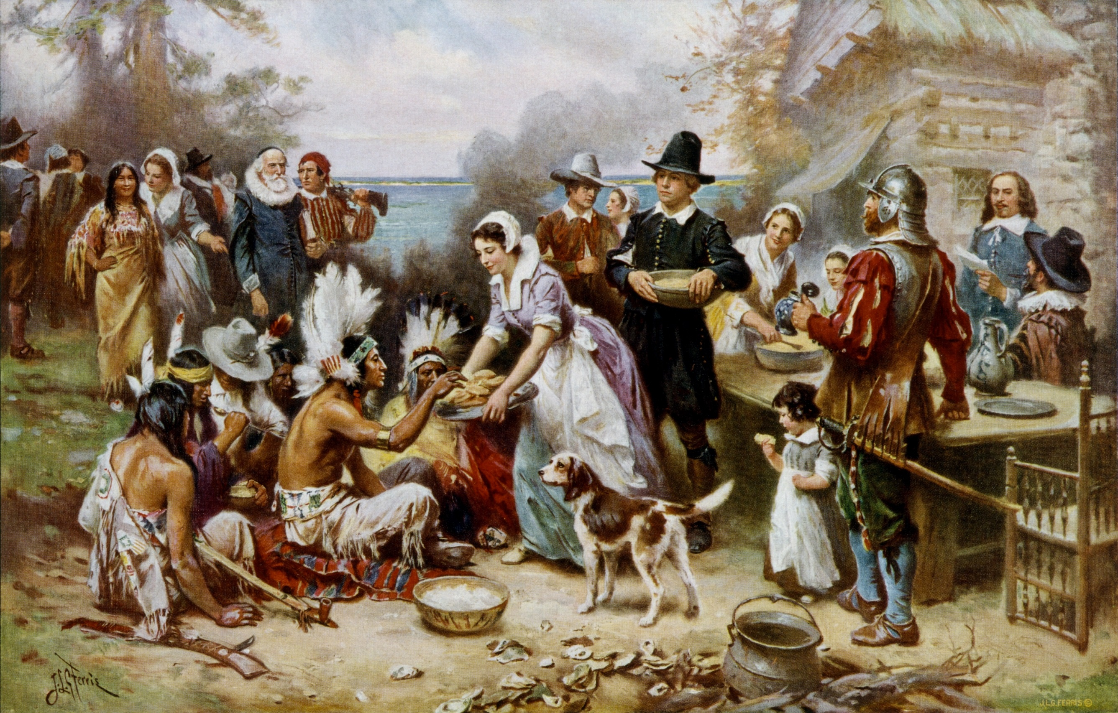

Slide 8
Wilhelmus à Brakel (1635-1711)

Slide 9
Wilhelmus à Brakel (1635-1711)
≈ Godly childhood

Slide 10
Wilhelmus à Brakel (1635-1711)
≈ Godly childhood
Praying mother
Child, how much you will have to answer for if you do not fear God!

Slide 11
Wilhelmus à Brakel (1635-1711)
≈ Godly childhood
Praying mother
Praying father

Slide 12
Wilhelmus à Brakel (1635-1711)
≈ Godly childhood
Praying mother
Praying father
Prayer a minister’s
first task

Slide 13
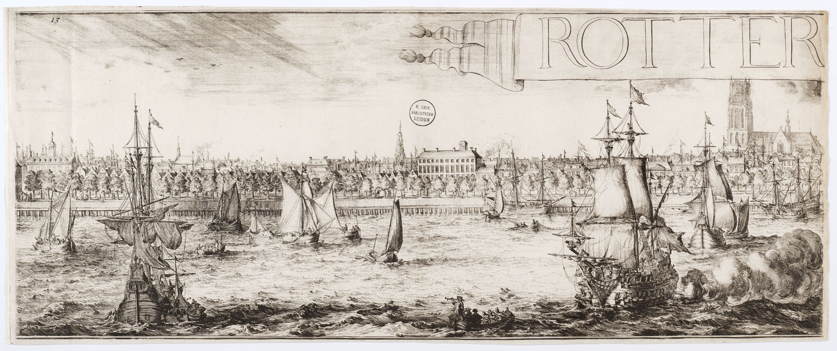

Slide 14
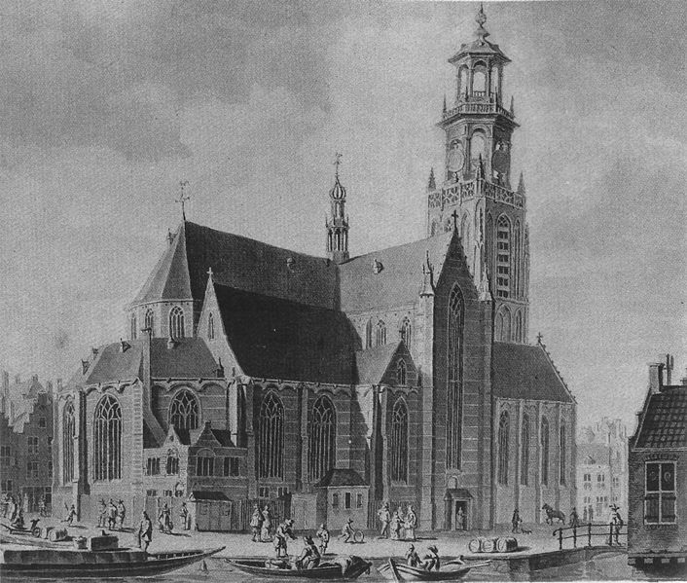

Slide 15
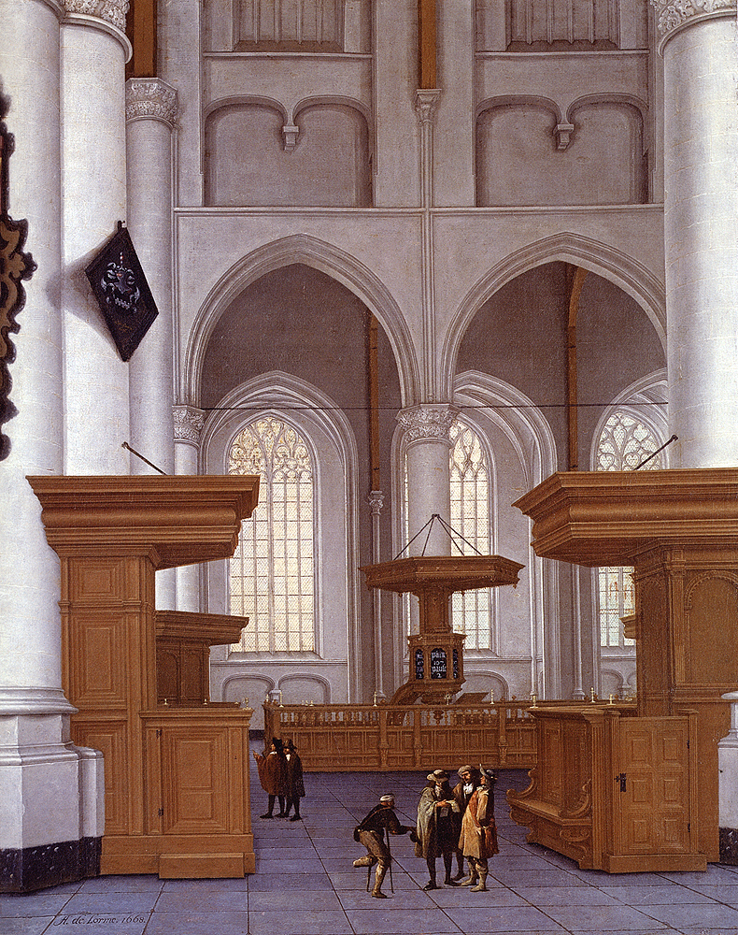
Anthonie de Lorme (circa 1610–1673)
Description | English: Interior Of The Laurenskerk, Rotterdam, View To The South
Date | 1668

Slide 16
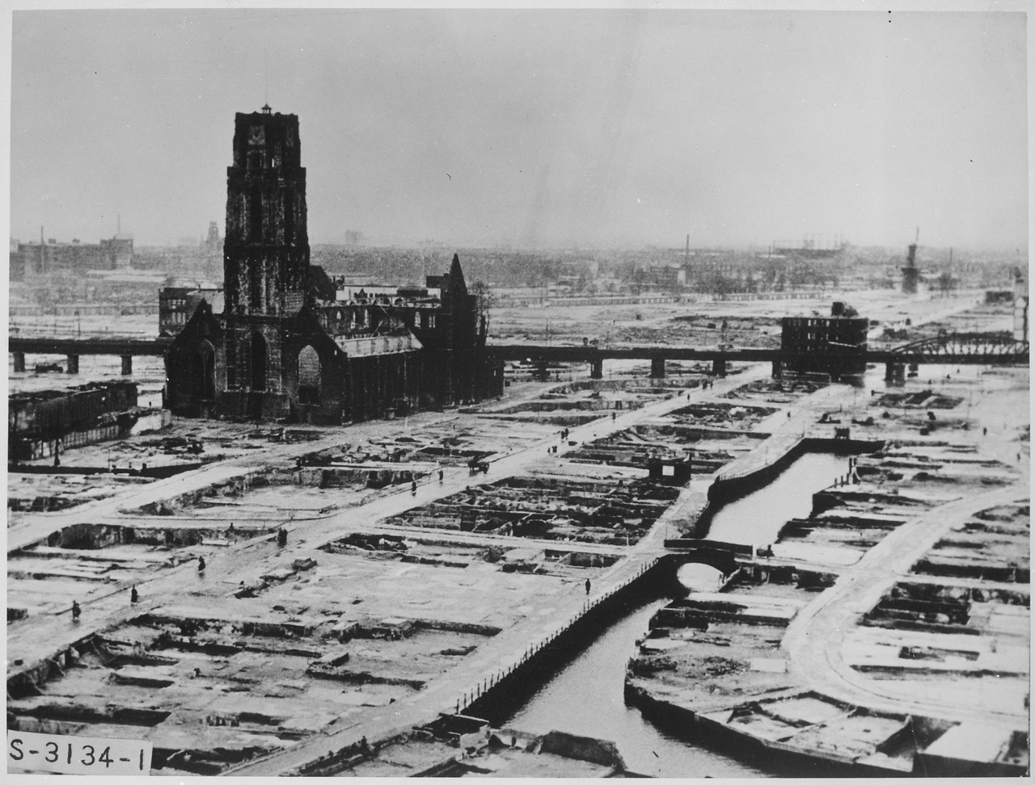
The Grote of St. Lawrence Church, often referred to simply as Laurence Church, a Gothic church in Rotterdam . She is the only vestige of the medieval Rotterdam's city center . After bombing by Germans in WWII.

Slide 17
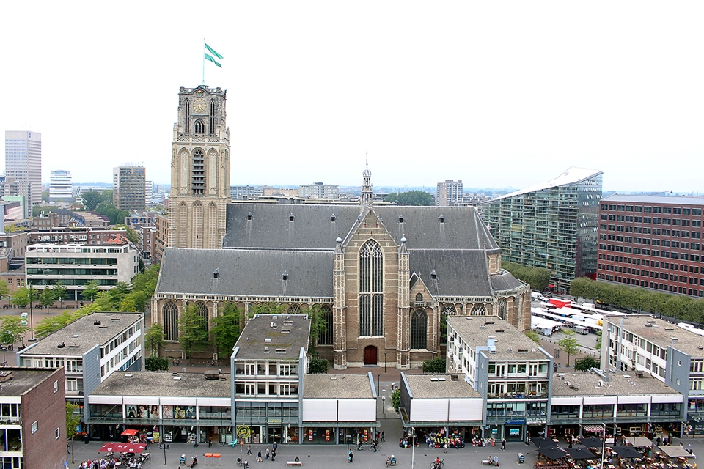

Slide 18
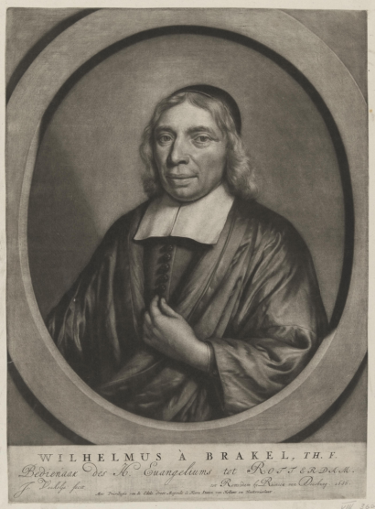
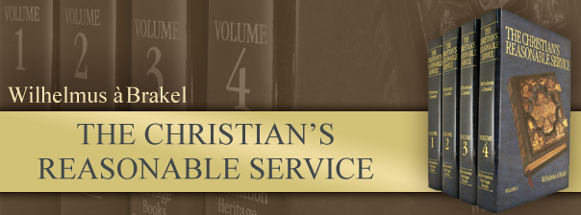

Slide 19
The acknowledgment of all God’s perfections, and the exercise of all virtues toward God coalesce in prayer. . .

Slide 20
Consequently, the exercise of religion is comprehensively expressed as praying and calling upon God . . . (Gen. 4:26).

Slide 21
Prayer is the expression of holy desires to God in the name of Christ. . .

Slide 22
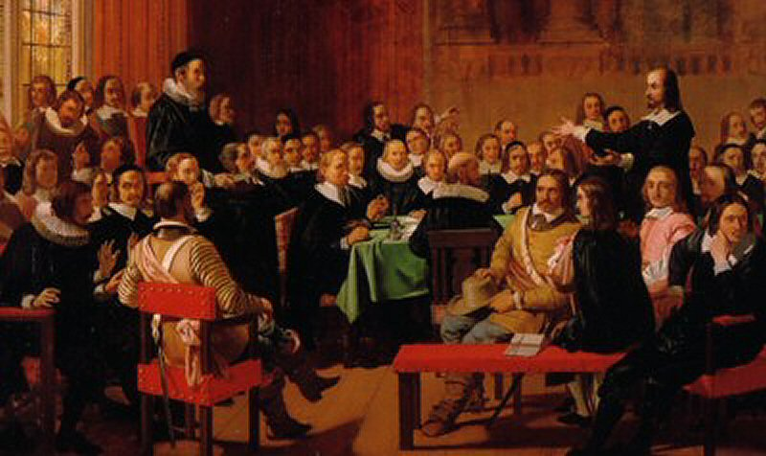
Prayer is the offering up of our desires unto God for things agreeable to His will, in the name of Christ, with confession of our sins, and thankful acknowledgement of His mercies.

Slide 23
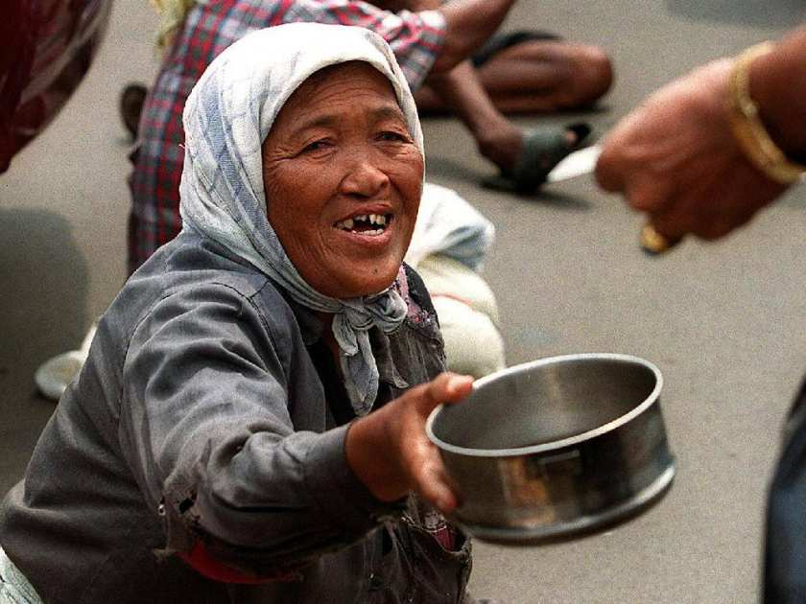

Slide 24
Man is but an empty vessel who must obtain his fulfillment from elsewhere. . .

Slide 25
Man is but an empty vessel who must obtain his fulfillment from elsewhere. . . To that end the Lord has given man the ability to desire and to give expression to his desires.

Slide 26
3 Objects of Attention:

Slide 27
3 Objects of Attention:
One: Upon himself

Slide 28
3 Objects of Attention:
One: Upon himself
His impotence

Slide 29
3 Objects of Attention:
One: Upon himself
His impotence
He perishes from hunger. . . He also knows that no creature can give him this. . .

Slide 30
3 Objects of Attention:
One: Upon himself
His impotence
He perishes from hunger. . . He also knows that no creature can give him this and he also does not desire to receive it from a creature.

Slide 31
3 Objects of Attention:
One: Upon himself
His impotence
His unworthiness

Slide 32
3 Objects of Attention:
One: Upon himself
His impotence
His unworthiness
His prayer is so sinful and so deficient that by it he cannot move God to help him.

Slide 33
3 Objects of Attention:
One: Upon himself
Two: Upon God

Slide 34
3 Objects of Attention:
One: Upon himself
Two: Upon God
Holding the Lord before Him as being majestic, omniscient, glorious, immanent, holy—as well as gracious in Christ, merciful, and omnipotent.

Slide 35
3 Objects of Attention:
One: Upon himself
Two: Upon God
Three: Upon what he desires.

Slide 36
3 Objects of Attention:
One: Upon himself
Two: Upon God
Three: Upon what he desires.
Prayer is the expression of holy desires to God. . .

Slide 37
We desire temporal and spiritual matters in a spiritual sense if it is lawful to desire these things. . .

Slide 38
We desire temporal and spiritual matters in a spiritual sense if it is lawful to desire these things and we desire them in order to be able to better serve God joyfully and zealously. . . So that in them we may observe, acknowledge, and praise God’s grace, goodness, help, and power, finding delight in doing so.

Slide 39
We desire temporal and spiritual matters in a spiritual sense if it is lawful to desire these things and we desire them in order to be able to better serve God joyfully and zealously. . . So that in them we may observe, acknowledge, and praise God’s grace, goodness, help, and power, finding delight in doing so.

Slide 40
We desire temporal and spiritual matters in a spiritual sense if it is lawful to desire these things and we desire them in order to be able to better serve God joyfully and zealously. . . So that in them we may observe, acknowledge, and praise God’s grace, goodness, help, and power, finding delight in doing so.

Slide 41
We desire temporal and spiritual matters in a spiritual sense if it is lawful to desire these things and we desire them in order to be able to better serve God joyfully and zealously. . . So that in them we may observe, acknowledge, and praise God’s grace, goodness, help, and power, finding delight in doing so.

Slide 42
We desire temporal and spiritual matters in a spiritual sense if it is lawful to desire these things and we desire them in order to be able to better serve God joyfully and zealously. . . So that in them we may observe, acknowledge, and praise God’s grace, goodness, help, and power, finding delight in doing so.

Slide 43
Following his childhood, Wilhelmus attended the Latin school in Leeuwarden. At that time his father pastored in the village of Beers, southwest of Leeuwarden. Distance made it impossible to travel back and forth each day. Wilhelmus would come home on Saturday and return to school on Monday. His father would accompany him for a distance. As long as possible he would watch his son in the distance while quietly beseeching the Lord to protect him. This concern and dependency upon God made such a deep impression upon Wilhelmus that he would frequently be in prayer himself as he continued his walk to Leeuwarden."

