Slide 1
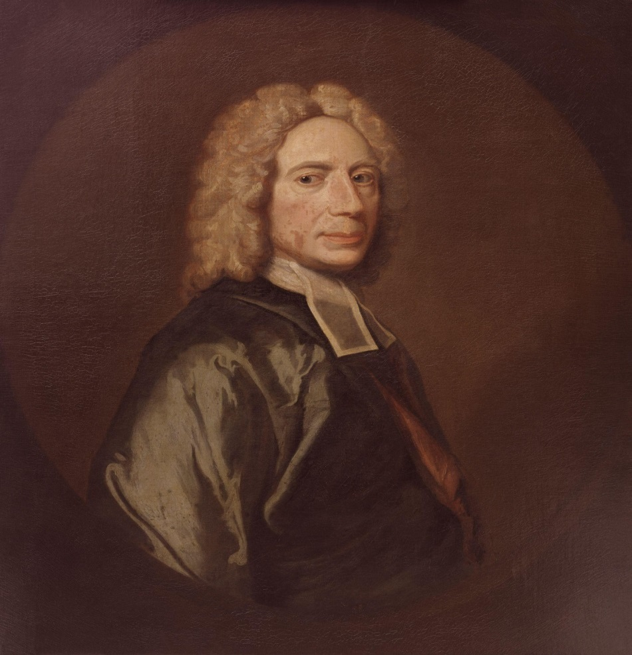
Isaac Watts (1674-1748)

Slide 2
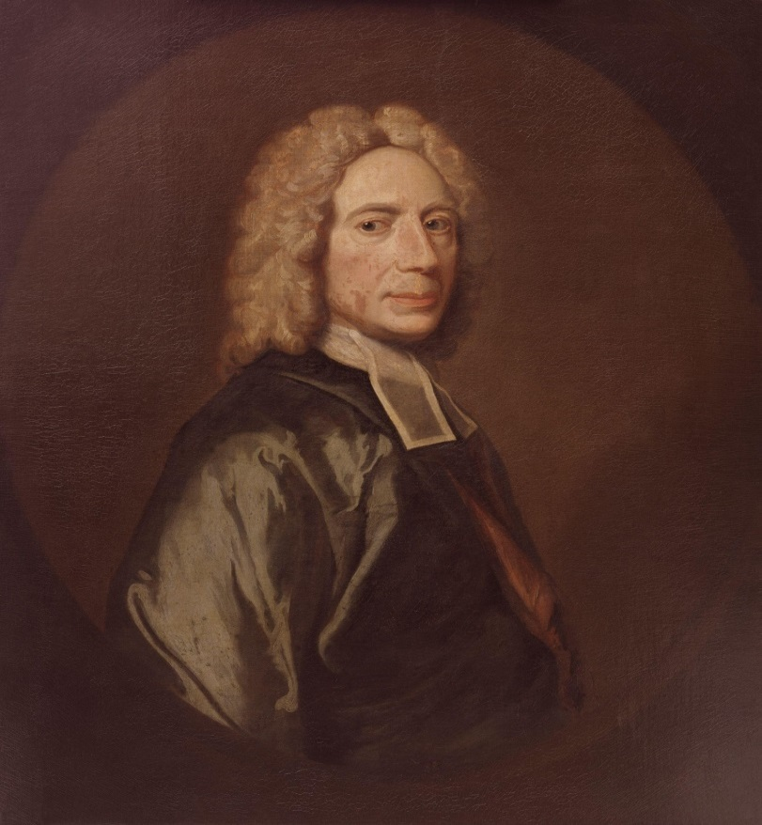


Slide 3

Persuasive Arguments to Learn to Pray
1. The Purpose & Dignity

Slide 4

1. The Purpose & Dignity
There is such a thing as correspondence with heaven, and prayer is a great part of it while we dwell on earth.

Slide 5
When a holy soul comes before God, he has much more to say than merely to beg. He tells his God what a sense he has of the divine attributes, and what high esteem he pays to his majesty, his wisdom, his power, and his mercy.

Slide 6
He talks with him about the works of creation and stands wrapped up in wonder.
He talks about the grace and mystery of redemption and is yet more filled with admiration and joy.

Slide 7
He talks of all the affairs of nature, grace and glory; he speaks of his works of providence, of love and vengeance, in this and the future world.

Slide 8
Infinite and glorious are the subjects of this holy communion between God and his saints. Shall we content ourselves with sighs and groans and a few short wishes, and deprive our souls of so rich, so divine, so manifold a pleasure, for want of knowing how to express such meditations and speak this blessed language?

Slide 9
1. The Purpose & Dignity

Slide 10
1. The Purpose & Dignity
2. Our Profession to be
Christians

Slide 11
1. The Purpose & Dignity
2. Our Profession to be
Christians
Some measure of the gift of prayer is of great necessity and universal use to all who are called by the name.

Slide 12
No faculty in the whole Christian life is called into such frequent exercise as this. And it is most unfitting to be always at a loss to perform the work which daily necessity requires and daily duty demands.

Slide 13
Will a person who cannot read profess to be a scholar. Shall any man that cannot preach claim to be a minister? It is but a poor pretense we make to Christianity if we are not able, at least in secret, to supply ourselves with a few meditations or expressions to continue a little in this work of prayer.

Slide 14
1. The Purpose & Dignity
2. Our Profession to be
Christians
3. The Enjoyment

Slide 15
1. The Purpose & Dignity
2. Our Profession to be
Christians
3. The Enjoyment
There is delight and very great advantage of this gift to our own souls and to the souls of all that join in prayer with us.

Slide 16
How sweet a refreshment have you found under inward burdens of mind or outward afflictions, when in broken language you have told them to your minister and he has spread them before God in such words as have expressed your whole souls and your sorrows?

Slide 17
And you have experienced a sweet serenity and calmness of spirits; you have risen from your knees no more sad-faced.

Slide 18
Have you not wished for the same gift yourselves, that you might be able upon all occasions to address the throne of grace and pour out all your hearts in this manner before your God?

Slide 19
1. The Purpose & Dignity
2. Our Profession to be
Christians
3. The Enjoyment
4. The Honor of God

Slide 20
1. The Purpose & Dignity
2. Our Profession to be
Christians
3. The Enjoyment
4. The Honor of God
God esteems himself dishonored when we do not pay him the best worship we are capable of.

Slide 21
Sinful sloth and indifference in religion have tempted some men to believe that God is not an interested and exact inquirer into outward things. And if they can persuade themselves their intentions are right, they imagine that for the substance and form of their sacrifice , anything will serve.

Slide 22
And as though he were not a God of order, they address him often in confusion. Because the heart is the chief thing in divine worship, like some foolish Israelite, they are unconcerned what beast they offer him, so long as it has a heart.

Slide 23
The reputation of religion in the world depends much on the honorable discharge of the duty of prayer. There is an inward beauty in divine worship that consists in the devout temper of the worshippers and the living exercise of holy devotion; but God only, who sees the heart, is witness to this.

Slide 24
There is also an outward beauty that arises from a decent and acceptable performance of all the parts of it that comes within the notice of our fellow creatures, that those that observe us may be forced to acknowledge the excellency of religion in our practice of it.

Slide 25
1. The Purpose & Dignity
2. Our Profession to be
Christians
3. The Enjoyment
4. The Honor of God
5. The Ease Of Learning

Slide 26
I call it easy in comparison of the long toil and difficulty that men go through in order to acquire a common knowledge in arts, sciences or trades in this world.

Slide 27
1. The Purpose & Dignity
2. Our Profession to be
Christians
3. The Enjoyment
4. The Honor of God
5. The Ease Of Learning
6. The Consequences of
Neglect

Slide 28
You will inevitably fall into one of these three evils. . .
You will drag on heavily in prayer
all your days.

Slide 29
You will inevitably fall into one of these three evils. . .
You will drag on heavily in prayer
all your days
You will give yourself up to a form
and rest in it.

Slide 30
You will inevitably fall into one of these three evils. . .
You will drag on heavily in prayer
all your days
You will give yourself up to a form
and rest in it.
You will be very inconstant in
prayer, and at last, neglect it
entirely.

Slide 31

