Slide 1
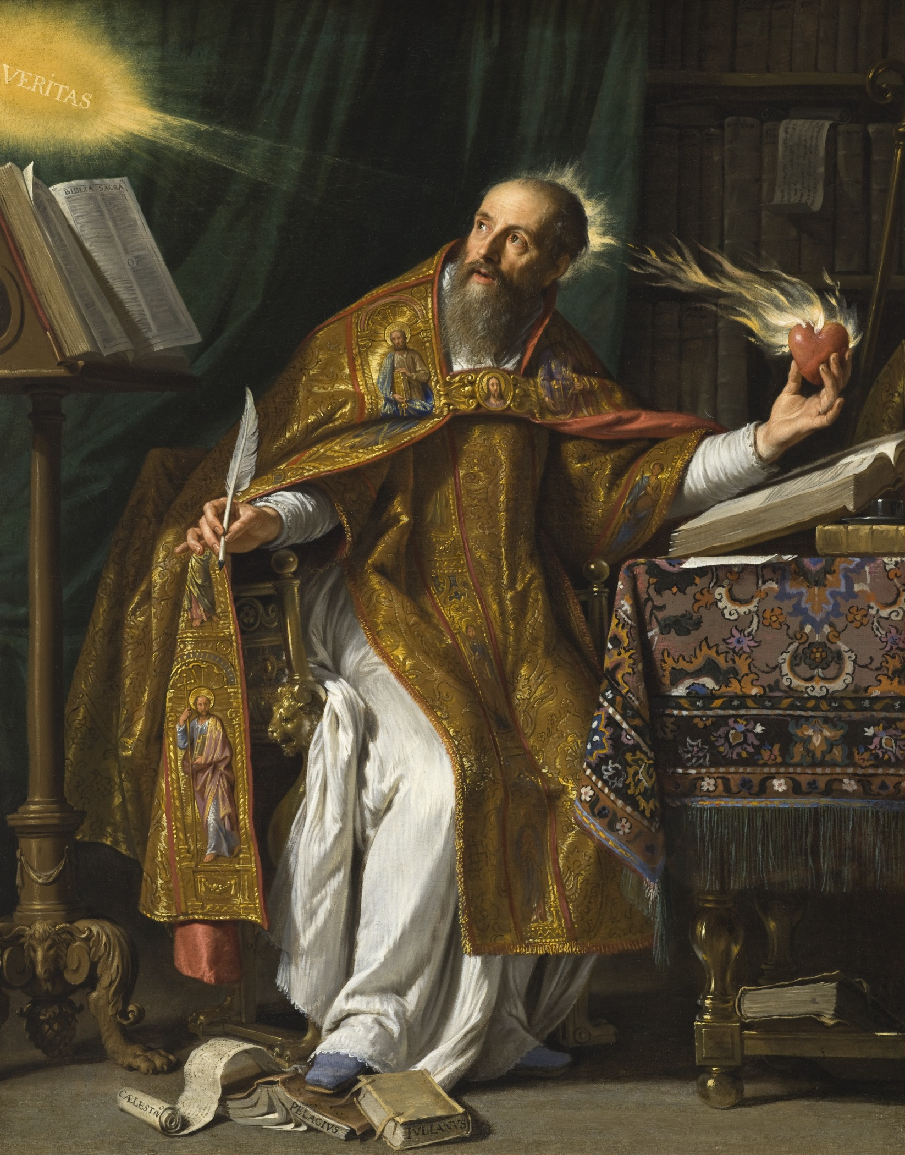

Slide 2
Augustine (354-430)

Slide 3
Father a pagan, who introduces him
to a licentious lifestyle while he is
in his early teens.

Slide 4
Father a pagan, who introduces him
to a licentious lifestyle while he is
in his early teens.
Mother, Monica, is a devout
Christian in her thirties at this time.

Slide 5
Father a pagan, who introduces him
to a licentious lifestyle while he is
in his early teens.
Mother, Monica, is a devout
Christian in her thirties at this time.
Both parents determined to see him
succeed in schooling.

Slide 6
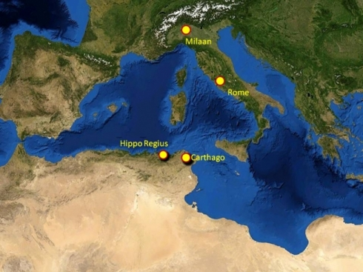

Slide 7
Schooled at Carthage, where he begins
living with a woman and fathers a
son.

Slide 8
Schooled at Carthage, where he begins
living with a woman and fathers a
son.
Returns home to teach rhetoric.

Slide 9
Schooled at Carthage, where he begins
living with a woman and fathers a
son.
Returns home to teach rhetoric.
Leaves home for Rome, then Milan,
where he sits under the preaching of
Ambrose. Augustine is 30.

Slide 10
Monica prays for him, with fasting
and crying, often in the local
Christian chapel.
Monica is comforted by a Christian
friend, who assures her that, “A son
of so many prayers cannot be lost.”

Slide 11
Let us behave properly as in the day, not in carousing and drunkenness, not in sexual promiscuity and sensuality, not in strife and jealously. But put on the Lord Jesus Christ, and make no provision for the flesh in regard to its lusts. --Romans 13:13-14

Slide 12
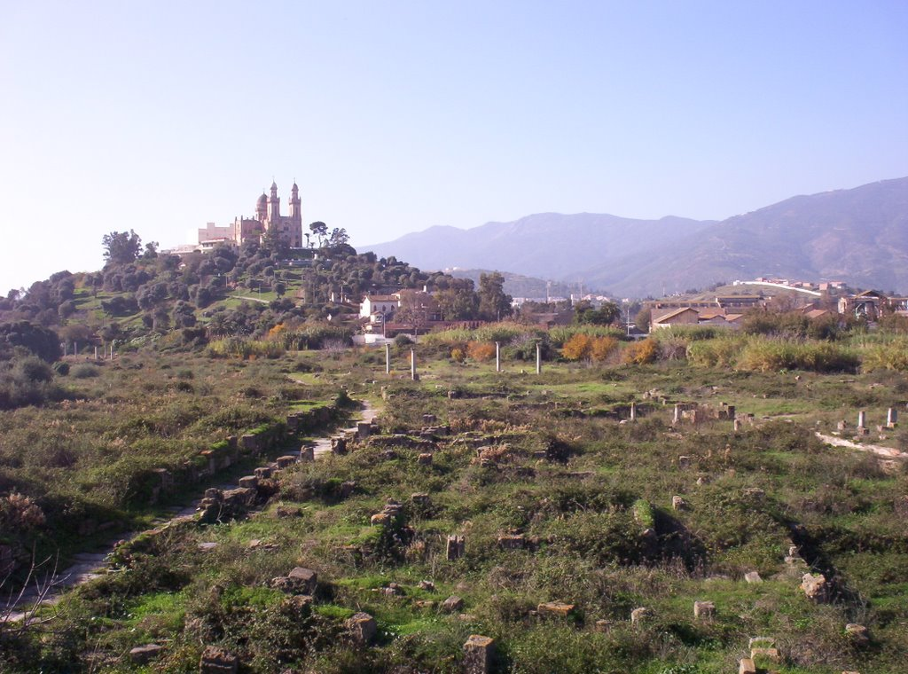

Slide 13
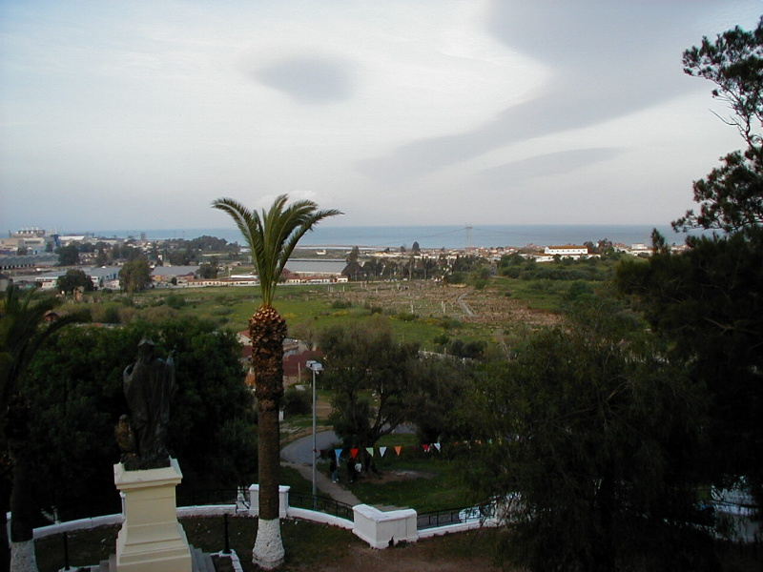

Slide 14
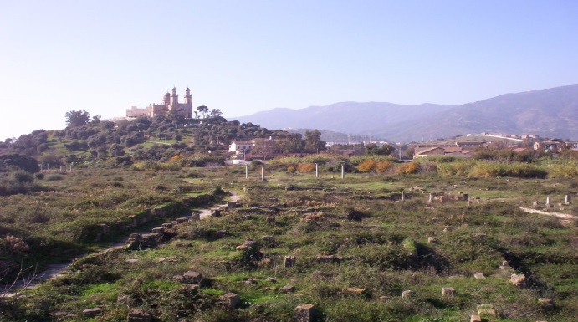
Ordained in Hippo 5 years later.
Established a monastery, which served as a
theological seminary and retreat.
Wrote some 230 books, containing over
5,000,000 words.

Slide 15
William Cunningham wrote, Augustine has had the peculiar honour assigned to him, by the great Head of the church, of having been the first to develop, in a systematic order, and in their right connection with each other, the great doctrines taught in the

Slide 16
word of God concerning man’s lost and ruined condition by nature; the gracious agency of God in the conversion and sanctification of sinners; and the true cause or source of all the effects thus produced.

Slide 17
No inconsiderable portion of the piety that existed in the church from the time when he flourished till the Reformation—a period of above one thousand years—was instrumentally connected, more or less directly, with his influence and writings
--Historical Theology, I, 331

Slide 18
685 of his sermons are extant.

Slide 19
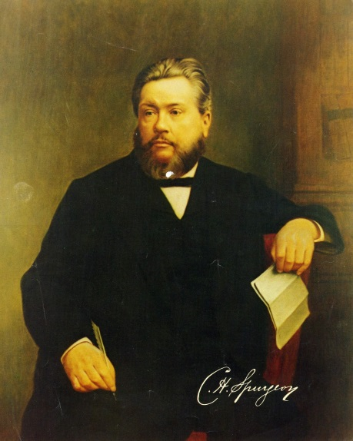
What knowledge he displayed
concerning all the great
preachers of every age! He
seemed to have made himself
familiar with the biographies
of every man of note who had occupied the French and Swiss, the Greek and Latin and the German, as well as the English, Scottish, and Welsh pulpits.

Slide 20
“Augustine,” he said, “was the
quarry from which nearly all of
them had dug.”
--W. Williams, Personal
Reminiscences of Charles Haddon Spurgeon, 34

Slide 21
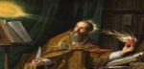
Augustine
Prayer is. . .
. . . an affectionate turning of the mind toward God.

Slide 22
Augustine
Prayer is. . .
. . . an affectionate turning of the mind toward God.
. . . the breath of the soul.

Slide 23
Augustine
The Lord our God wants us to petition him,
not in order to inform him. . . but in order that by our prayer we might exercise that desire by which we are prepared to receive what he wants to bestow upon us.

Slide 24
Augustine
His gifts are magnificent, but we are
small, and our ability to receive is constrained. . . in proportion to our simplicity of faith, firmness of hope, and ardor of desire,

Slide 25
Augustine
we will be able to be more open to receive what is immensely great, which neither eye has seen, nor ear has heard; and what has not entered into the heart of man. The heart of man must ascend to it.

Slide 26
Augustine
Carry everything out interiorly. Even though
you seek some high place, a holy place, make of yourself an earthly temple of God. “For the temple of God is holy, and you are that temple.” Do you want to pray in a temple? Pray within yourself.

Slide 27
Augustine
Be first a temple of God,

Slide 28
Augustine
Be first a temple of God, because he hears him who prays in his temple.

Slide 29
Letter CXXX
(A.D. 412)
To Proba, a devoted handmaid of God, bishop Augustin, a servant of Christ and of Christ’s servants sends greeting in the name of the Lord of Lords.
Augustine

Slide 30
Letter CXXX
(A.D. 412)
What Manner of Person You Should Be
Augustine

Slide 31
Letter CXXX
(A.D. 412)
What Manner of Person You Should Be
Now she who is a widow indeed and who has been left alone, has fixed her hope on God and continues in entreaties and prayers night and day. --I Timothy 5:5
Augustine

Slide 32
Letter CXXX
(A.D. 412)
It becomes you, out of love to this true life to account yourself “desolate “ in this world, however great the prosperity of your lot may be.
Augustine

Slide 33
Augustine
A widow is “desolate” indeed, even though she has sons and grandchildren, and conducts her household piously, entreating all dear to her to put their hope in God: and in the midst of all this, she says in her prayer,

Slide 34
“My soul thirsteth for Thee, my flesh longeth in a dry and thirsty land, where
no water is;” and this dying life is nothing else than such a land, however numerous our mortal comforts, however pleasant our companions in the pilgrimage, and however great the
Augustine

Slide 35
abundance of our
possessions. You know how uncertain all these things are; and even if they were not uncertain, what would they be in comparison with the happiness which is promised in the life to come!
Augustine

Slide 36
In the darkness, then, of this world, in which we are pilgrims absent from the Lord as long as “we walk by faith and not by sight,” the Christian soul ought to feel itself desolate, and continue in prayer.
Augustine

Slide 37
Letter CXXX
(A.D. 412)
What Manner of Person You Should Be
What You Ought To Pray For
Augustine

Slide 38
Letter CXXX
(A.D. 412)
What Manner of Person You Should Be
What You Ought To Pray For
You were disturbed by the words, “We know not what we should pray for as we ought.”
Augustine

Slide 39
Letter CXXX
(A.D. 412)
A short solution to your difficulty may be given thus,
Augustine

Slide 40
Letter CXXX
(A.D. 412)
“Pray for a happy life.”
Augustine

Slide 41
He. . .is truly happy who has all that he wishes to have, and wishes nothing which he ought not to wish. . . Men do nothing wrong in desiring for themselves and for their kindred the sufficient portion of necessary things of which the apostle speaks when he says,
Augustine

Slide 42
“Godliness with contentment is great gain; for we brought nothing into this world, and it is certain we can carry nothing out: and having food and raiment, let us be content” (I Tim. 6:6-8).
Augustine

Slide 43
For these things, therefore, it becomes us to pray: if we have them, that we may keep them; if we have them not, that we may get them.
Augustine

Slide 44
Letter CXXX
(A.D. 412)
What Manner of Person You Should Be
What You Ought To Pray For
Augustine

Slide 45
Letter CXXX
(A.D. 412)
What Manner of Person You Should Be
What You Ought To Pray For
--A happy life
--The Lord’s Prayer
Augustine

Slide 46
Letter CXXX
(A.D. 412)
What Manner of Person You Should Be
What You Ought To Pray For
--A happy life
--The Lord’s Prayer
--What about tribulations?
Augustine

Slide 47
These things are written to prevent anyone from thinking too highly of himself if he has received an answer when he was urgently asking anything, which it would be more advantageous for him not to receive,
Augustine

Slide 48
or to prevent him from being cast down and despairing of the divine compassion towards himself if he be not heard, when, perchance, he is asking something by the obtaining of which he might be more grievously afflicted, or might be by the corrupting influences of
Augustine

Slide 49
prosperity wholly destroyed. . . Accordingly, if anything is ordered in a way contrary to our prayer, we ought, patiently bearing the disappointment, and in everything giving thanks to God, to entertain no doubt whatever that it was right that the will of God and not our will should be done.
Augustine

Slide 50
Letter CXXX
(A.D. 412)
What Manner of Person You Should Be
What You Ought To Pray For
--A happy life
--The Lord’s Prayer
--What about tribulations?
--The “one thing”
Augustine

Slide 51
The thing referred to is the true and only happy life, in which, immortal and incorruptible in body and spirit, we may contemplate the joy of the Lord forever. All other things are desired, and are without impropriety prayed for, with a view to this one thing.
Augustine

Slide 52
For in it is the fountain of life, which we must now thirst for in prayer. . . trusting under the shadow of His wings before whom are all our desires, that we may be abundantly satisfied with the fatness of His house, and made to drink of the river of His pleasures.
Augustine

Slide 53
Augustine
Augustine calls this earthly life, the time we
have for prayer, while in our eternal home we will only have time to praise God.

