Slide 2
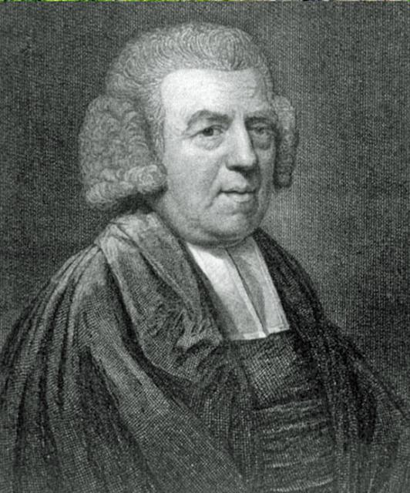
John
Newton
k
January 1, 1765

Slide 3
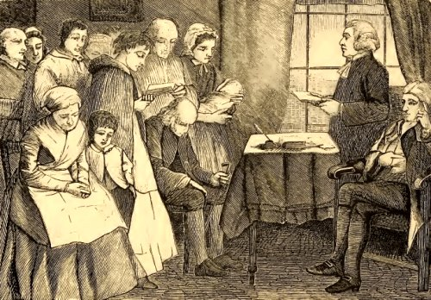
May 31, 1775

Slide 4
“It may be observed that the most absurd rumours were in circulation in consequence to the establishment of the prayer meeting.”

Slide 5
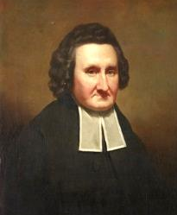
John
Erskine
k
1721-1803

Slide 6
Memorial
(1744)

Slide 7
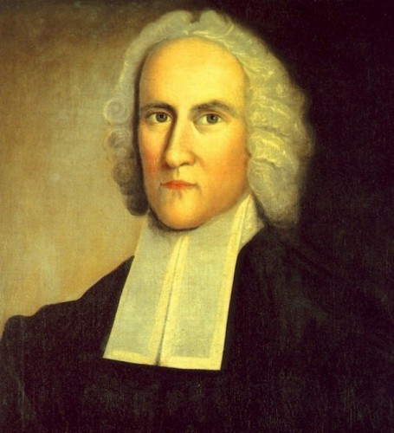
Jonathan
Edwards
k
1703-1758

Slide 8
Jonathan Edwards, 1747
A Humble Attempt to Promote Explicit Agreement
and Visible Union of All God’s People in
Extraordinary Prayer for the Revival of Religion and
the Advancement of Christ’s Kingdom on earth,
Pursuant to Scripture Promises and Prophecies
Concerning the Last Time.

Slide 9
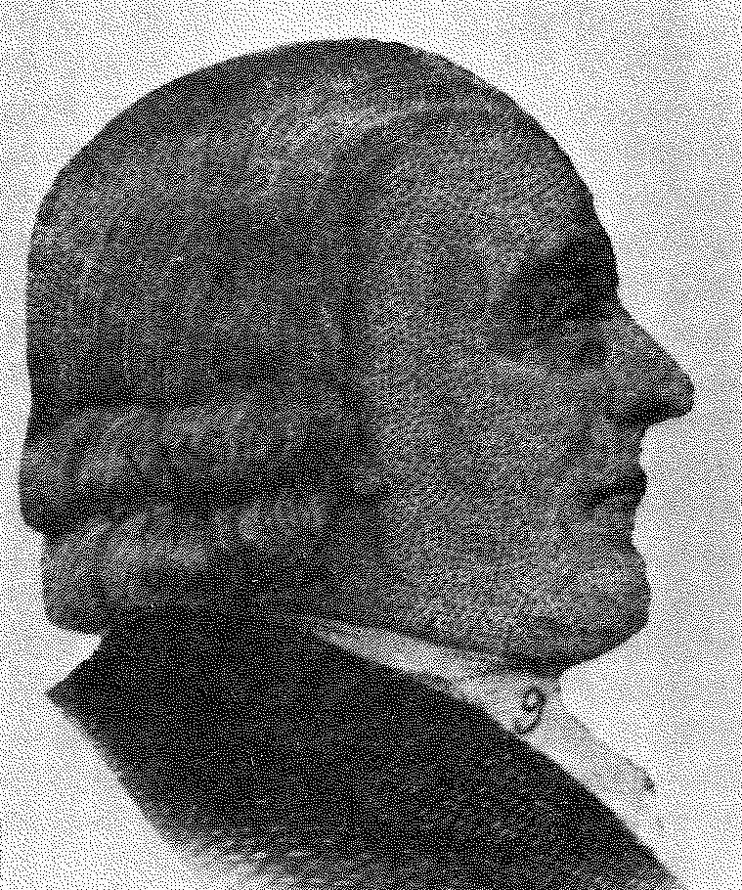
John
Sutcliffe
k
1752

Slide 10
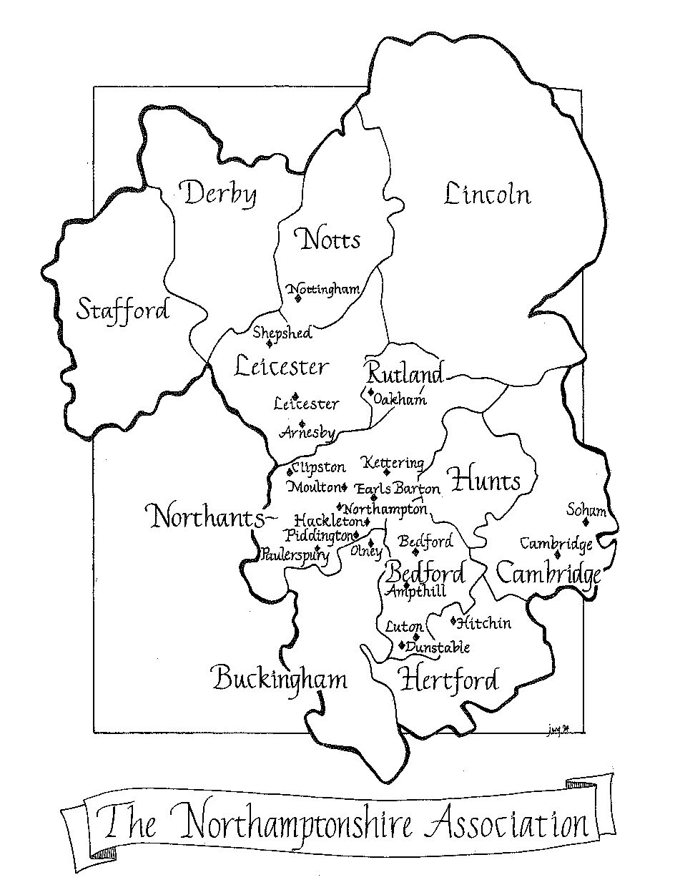

Slide 11
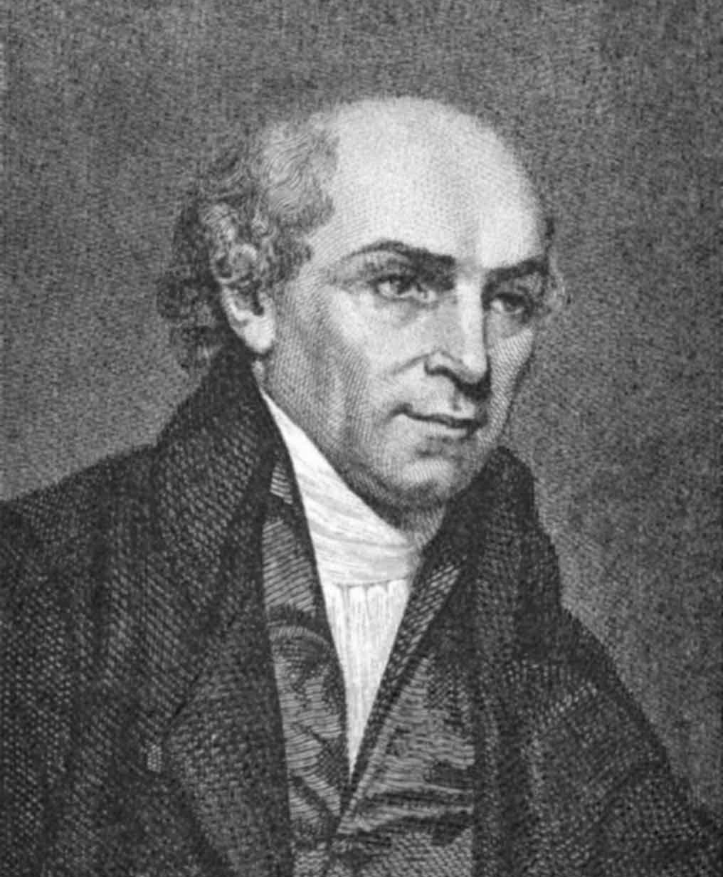
William
Carey
k
1761-1834

Slide 12
William Carey, 1792
An Enquiry into the Obligations of Christians to Use
Means for the Conversions of the Heathens in Which
the Religious State of the Different Nations of the
World, the Success of Former Undertakings, and the
Practicability of Future Undertakings are Considered

Slide 13
“The revivification of prayer was due almost entirely to the breath of the Holy Spirit in the Evangelical Revival which issued in missionary enterprise of astonishing proportions.”
Horton Davies

Slide 14
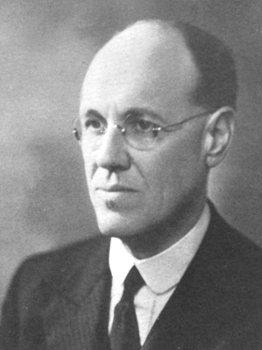
James
Outram
Fraser
k
1886-1938

Slide 15
“To know the real Fraser one needed to hear him in prayer. Prayer was the very breath of life to him, and in prayer he seemed to slip from time into eternity.”
Roxie Dymond, (Fraser’s wife)

Slide 16
“If our Master returned today to find millions of people unevangelized, and looked, as of course He would look to us for an explanation, I cannot imagine what explanation we should have to give.”

Slide 17
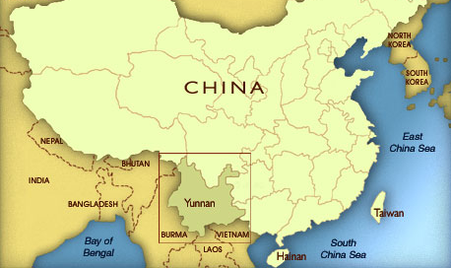

Slide 18
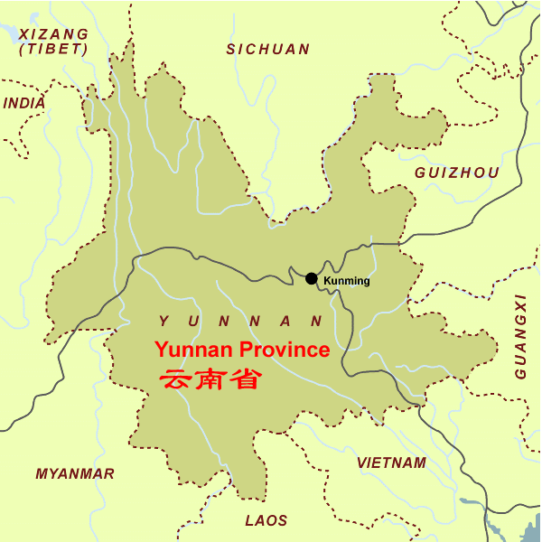

Slide 19
January 1, 1916
“Must watch against getting up too late these intensely cold mornings. The indwelling Christ is my successful weapon against all sin these days—praise Him!”

Slide 20
January 2, 1916
“An earnest desire to save souls is on me, but prayer is rather unstable. I must regain my equilibrium in the prayer life. . . .”

Slide 21
January 16, 1916
“Not a single person at service in the morning . . . . The walls of Jericho fell down ‘by faith.’ Of all the instances of faith in Hebrews 11, this corresponds most clearly to my case. But not faith only was necessary; the wall fell down after it had been compassed about for seven days.

Slide 22
January 16, 1916
Seven days’ patience was required, and diligent compassing of the city every day – which seems to typify the situation by regular, systematic prayer. Here then we see God’s way of success in our work, whatever it may be – a trinity of prayer, faith, and patience.”

Slide 23
February 4, 1916
“Thoroughly depressed about the state of work at Tantsah. Feel much inclined to ‘let Ephraim alone,’ but I am torn . . . . My prayer is not so much, ‘Lord lead me somewhere else,’ as ‘Lord, give me a solid church here at Tantsah.’”

Slide 24
February 5, 1916
“I am not taking the black, despondent view I took yesterday. The opposition will not be overcome by reasoning or by pleading, but (chiefly) by steady, persistent prayer. The men need not be dealt with (it is a heart breaking job, trying to deal with a Lisu possessed by a spirit of fear) but the powers of darkness need to be fought.

Slide 25
February 5, 1916
I am now setting my face like a flint: if the work seems to fail, then pray: if services, etc., fall flat, then pray still more; if months slip by with little or no result, then pray still and more and get others to help you.”

Slide 26
August 27, 1916
“The Cross is going to hurt – let it hurt! I am going to work hard and pray hard too, by God’s grace.”

Slide 27
“I am feeling more and more that it is, after all, just the prayers of God’s people that call down blessing upon the work, whether they are directly engaged in it or not. Paul may plant and Apollos water, but it is God who gives the increase; and this increase can be brought down from heaven by believing prayer, whether offered in China or in England. . .

Slide 28
. . . We are, as it were, God's agents—used by Him to do His work, not ours. We do our part, and then can only look to Him, with others, for His blessing. If this is so, then Christians at home can do as much for foreign missions as those actually on the field. I believe it will only be known on the Last Day how much has been accomplished in missionary work by the prayers of earnest believers at home. . . .

Slide 29
. . . And this, surely, is the heart of the problem . . . . Solid, lasting missionary work is done on our knees. What I covet more than anything else is earnest, believing prayer, and I write to ask you to continue in prayer for me and the work here.”

Slide 30
“I am not asking you just to give ‘help’ in prayer as a sort of sideline, but I am trying to roll the main responsibility of this prayer warfare on you. I want you to take the BURDEN of these people on your shoulders. I want you to wrestle with God for them. I do not want so much to be a regimental commander in this matter as an intelligence officer. I shall feel more and more that a big responsibility rests upon me to keep you well informed.”

Slide 31
Prayer Procedure
1.
Seek Prayer in Concert (Agreement & Together)

Slide 32
“I will not, by God’s grace, let anything deter me from going straight ahead in the path to which He leads, but I shall feel greatly strengthened if I know of a definite company of pray-ers holding me up.”

Slide 33
Prayer Procedure
2.
Pray for Success
of Preaching

Slide 34
“The work for which I am asking prayer is preaching and teaching the Word of God, pure and simple. I have no confidence in anything but the Gospel of Calvary to uplift these needy people.”

Slide 35
Prayer Procedure
3.
Pray with Understanding
of Needs in Definite
Focused Prayer

Slide 36
Prayer Procedure
4.
Pray earnestly

Slide 37
“And is there not sufficient reason for such earnestness? We have our Peninnah’s as sure as ever Hannah had and as God’s saints have had all down the ages. David’s eyes ran down with rivers of water, because the ungodly observed not God’s law (Psalm 119:136). Jeremiah wept with bitter lamentation, because of the destruction of the holy city. . . .

Slide 38
. . . Nehemiah fasted, mourned, and wept when heard the fresh calamities which had befallen Jerusalem. Our Lord wept over it, because of its hardness of heart. The Apostle Paul had ‘great sorrow and unceasing pain’ in his heart on account of his brethren according to the flesh (Romans 9:2).”

