Slide 1
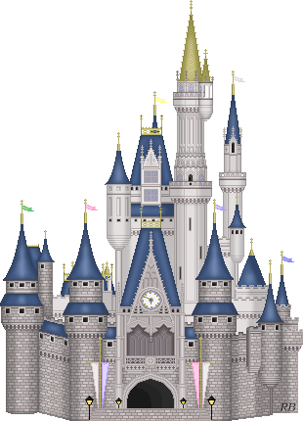
The Holy War

Slide 2
Week 6
Imprisonment of Understanding and Conscience
to Mansoul barricades Ear-gate against Emmanuel

Slide 3
Goals
To gain a greater understanding of the spiritual warfare in which we are engaged.
To develop a greater awareness of the methods employed by Satan.
To deepen our appreciation for the grace of God in saving sinners.
To learn more about ourselves through empathizing with Mansoul (Mansoul = me)

Slide 4
Synopsis
Unable to make any further progress against the town, the Captains petition Shaddai who sends Emmanuel with reinforcements. Yet Emmanuel Himself is rejected by Mansoul.

Slide 5
Key Questions
What primary Bible passages come to your mind as you read this assignment?
To what degree does the story accurately depict Bible teaching?

Slide 6
Conditions
We want to:
Retain our old leadership
Retain all aspects of our present rebellion without penalty
Retain our former practices engaged in under Diabolus
Have veto power over any new authority
Basically:
“We will surrender to you if we can do it without surrendering.”

Slide 7
First Move
What does Diabolus do first in today’s section?
He imprisons Lord Understanding and Mr. Conscience

Slide 8
Strategy
The town continues to resist
The captains decide to trumpet further appeals to the town. Why did they continue with this strategy?
There was a possibility of response
The town seemed “more inclinable than heretofore”
They desired to do nothing that would harden the hearts of the townsmen unnecessarily

Slide 9
Trumpeter’s Message
The captains send the trumpeter with a message
In response, Diabolus makes a speech to the town
What does he say about Shaddai?
The greatness of God is to be shunned rather than enjoyed.
If the thought of a distant Shaddai is distasteful, what must it be like in His presence?
The subjects of Shaddai are all “enslaved”, “unhappy”, and “trampled.”
What does he say about himself?
“I, your prince, am familiar with you, and you may play with me as you would with a grasshopper.”
This implies that the townsmen have more control and less to fear in their relationship with Diabolus than with Shaddai.

Slide 10
Response
What was the result of this speech by Diabolus?
The townsmen “did again harden their hearts yet more”
“The thoughts of his greatness did quite quash them”
“The thoughts of his holiness sunk them in despair”
They sent back word that:
They were “resolved to stick to their king”
“It was . . . vain to give them any further summons”
“They had rather die upon the place than yield”
Do we have any Scripture that speaks against this response by the townspeople?

Slide 11
Hebrews 4:12-16 (NASB)
Therefore, since we have a great high priest who has passed through the heavens, Jesus the Son of God, let us hold fast our confession.
For we do not have a high priest who cannot sympathize with our weaknesses, but One who has been tempted in all things as we are, yet without sin.
Therefore let us draw near with confidence to the throne of grace, so that we may receive mercy and find grace to help in time of need.

Slide 12
Petition
With the hardening once again of the town the captains resolve to:
Continue peppering the town with stones to hinder it from growing in its wickedness
Petition Shaddai for reinforcements to help finish the work the soldiers had begun
The petition was delivered to Emmanuel. What was His reaction?
“He took it and read it”
“He mended, and also in some things added to the petition himself”
“He carried it in to the King . . . [and] with obeisance delivered it”
“He put on authority, and spake to it himself”
What aspect of Christ’s ministry does this reflect?

Slide 13
Romans 8:34 Who is the one who condemns? Christ Jesus is He who died, yes, rather who was raised, who is at the right hand of God, who also intercedes for us.
Hebrews 7:24-25 but Jesus, on the other hand, because He continues forever, holds His priesthood permanently. Therefore He is able also to save forever those who draw near to God through Him, since He always lives to make intercession for them.
Hebrews 9:24 For Christ is not entered into the holy places made with hands, which are the figures of the true; but into heaven itself, now to appear in the presence of God for us:
I John 2:1b And if any man sin, we have an advocate with the Father, Jesus Christ the righteous

Slide 14
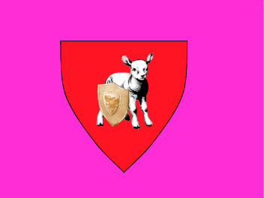
The 5 Additional Captains
Captain | Color | Scutcheon | Standard Bearer | Significance | Place
Credence | Red |  | Mr. Promise |  | First
Good-Hope | Blue |  | Mr. Expectation |  | Middle
Charity | Green |  | Mr. Pitiful |  | Middle
Innocent | White |  | Mr. Harmless |  | Middle
Patience | Black |  | Mr. Suffer-Long |  | Last
Belief in God’s promises
Assurance in belief
Role of love in faith
Simplicity of the Gospel
Shaddai’s patience and call to steadfast following

Slide 15
Reinforcements
The reinforcements:
Lifted the soldiers’ morale
Made a total of nine regiments now
Surrounded not only the gates, but now the entire city

Slide 16
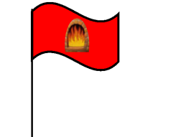
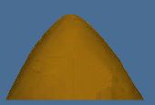
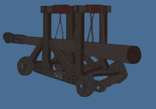
Reinforcements
Grace and mercy
Judgment
Mount Gracious
Mount Justice
(4 slings)
(4 slings)
The execution of judgment
Plain-Truth Hill
No-Sin Banks
Mount Hearken
(5 battering rams)
Once surrounded, the townsmen were forced:
“To shift, and shift, and again to shift their thoughts”
Yet not to “thoughts more stout”
But rather to “thoughts more faint”
Why did Emmanuel display Captain Innocent’s flag for 2 days?
To communicate that opportunity for repentance still existed
So that if they resisted still, they might be more justly condemned
The townsmen completely ignored this flag
After two days, Immanuel hung Captain Justice’s red flag bearing a fiery furnace.
They ignored this flag as well
At their continued defiance, He raised the black flag of Defiance.
This was the flag of Captain Boanerges, which pictured three burning thunderbolts.
It conveyed to them His imminent purposes.
They ignored this third flag also
To what does Emmanuel attribute the fact that the townsmen ignored the flags?
They do not understand the “rites and ceremonies of the wars”
Rather than a “secret defiance of us and abhorrence of their own lives”
Thus he sends a message to them to explain His meaning and see what they would choose.

Slide 17
Diabolus and Emmanuel
Despite recognizing who Emmanuel is and conceding His authority, Diabolus claims that the town is rightfully his:
By right of conquest
By the townsmen’s willing submission
Emmanuel confronts Diabolus
For using deceit in his conquest of Mansoul
For defacing the image of Shaddai in Mansoul
For setting Mansoul against its own deliverance
Emmanuel then shows that Mansoul truly belongs to Him
By right of inheritance
By donation from His Father
By right of purchase
Because He left none of Mansoul’s debts unpaid
Because He is under His Father’s orders to reclaim the town

Slide 18
Emmanuel to the town:
“Poor Mansoul! What shall I do unto thee?”
“Shall I save thee?”
“Shall I destroy thee?”
“Hearken to my word . . . I am merciful”
“Shut me not out of thy gates”
About Diabolus:
I could, would I now put forth my might, cause that forthwith he should leave you and depart; but I have it in my heart so to deal with him, as that the justice of the war that I shall make upon him may be seen and acknowledged by all. He hath taken Mansoul by fraud, and keeps it by violence and deceit, and I will make him bare and naked in the eyes of all observers.
All my words are true. I am mighty to save, and will deliver my Mansoul out of his hand.

Slide 19
Response
The townsmen respond
By barricading Ear-gate
By setting guards at the gate
By forbidding that any should go out to Emmanuel or come in from Him.

Slide 20
Application

Slide 21
The Holy War

